Slide 1
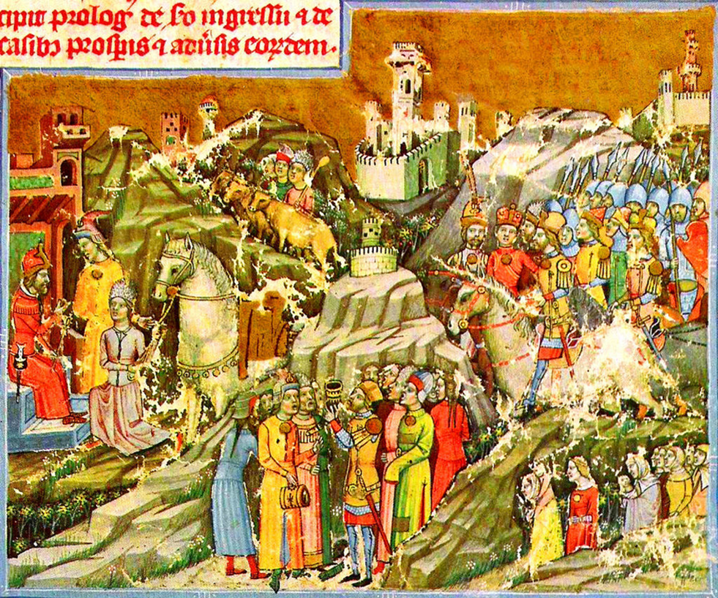
The Legend of the White Horse
A HUNGARIAN MYTH

Slide 2
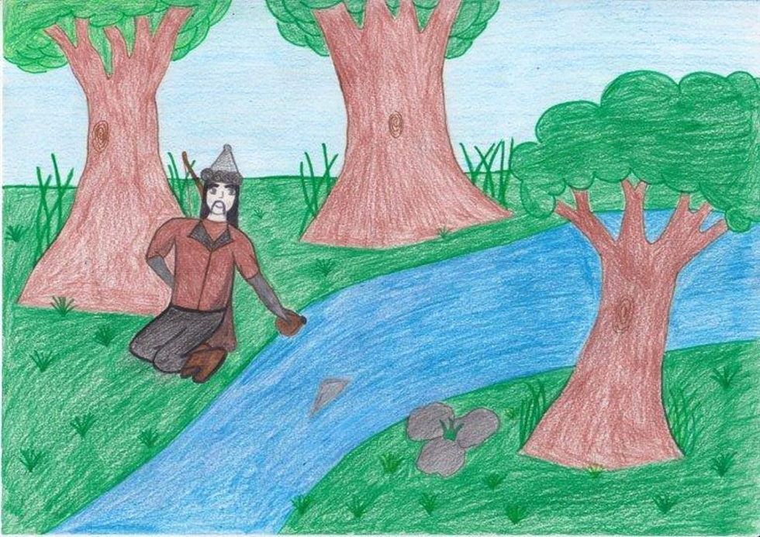
Árpád, the head of the Hungarian tribes, sent an ambassador spy called Kusid, the son of Künd, to the interior of the Carpathian Basin. When Kusid reached the middle of Hungary and reached the Danube region, he found the place delightful, the land all around good and fertile, and its streams and meadows splendid.
He loved it very much. Then he went to the Moravian king of the area, named Svatopluk, who governed after Attila. He greeted him in the name of his people and told him the reason why he came. Hearing this, Svatopluk rejoiced greatly because he thought they were settlers who would come to cultivate the land.

Slide 3
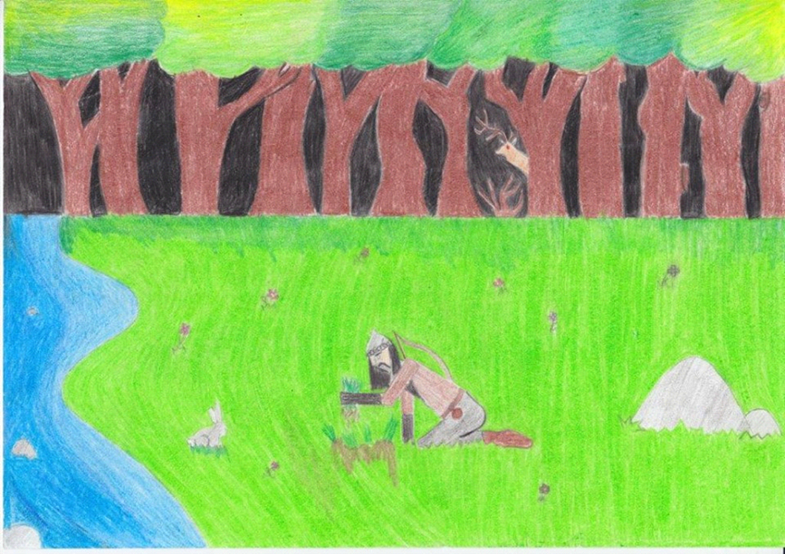
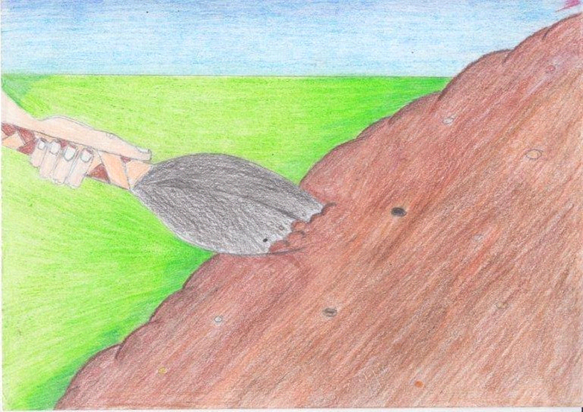
For this reason, he joyfully sent the ambassador back. Filling his flask with water from the Danube, loading his goatskin with meadow grass, and taking a sample of the black sandy soil, Kusid returned to his people.
Tasting them with their tongues, they saw that the soil was very good, the water sweet, and that such grasses grew in the pastures as the ambassador had told them.

Slide 4
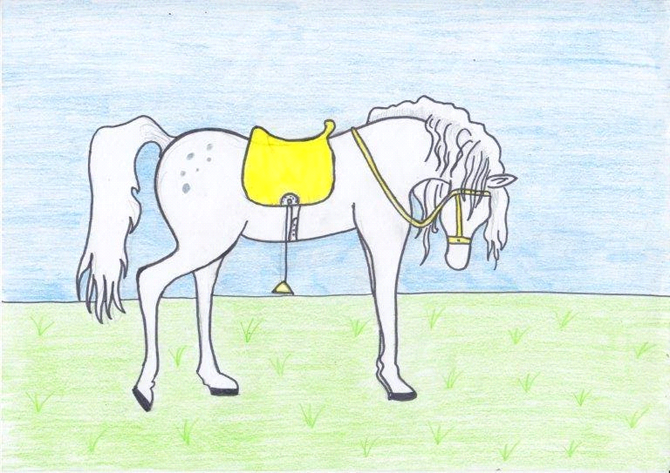
Surrounded by his people, Árpád filled his drinking horn with the water from the Danube, and, in front of all the Hungarians, he asked for the grace of Almighty God on the horn, that the Lord grant them that land forever…
They sent Kusid back to the king with a beautiful white horse with golden saddle and golden bridle as a payment for his land. Seeing these, Svatopluk said to Kusid, take as much water and soil as you wish.

Slide 5
And so the ambassador returned to his people. At this, Árpád and the seven chiefs invaded Pannonia, not as immigrants but as the lawful owners of the land in perpetuity. Then they sent another ambassador to the king, sending him off with this message: ‘Árpád and his men tell you not to remain any longer in any way on the land they have purchased, for they bought your land with a horse, your grass with a bridle, and your water with a saddle’.
When the message was delivered to the king, he spoke as follows: ‘Beat that horse to death with a club, throw the bridle into the meadow, and cast the saddle into the waters of the Danube!‘ At this, the ambassador said:
‘What loss would this bring to our lord? If you beat the horse to death, you provide food for his dogs; if you throw the golden bridle into the grass, his men will find it at harvest time; if you cast the golden saddle into the Danube, his fishermen will pull it to the bank and take it home! Whoever owns the land, the grass, and the water, he owns everything!’

Slide 6
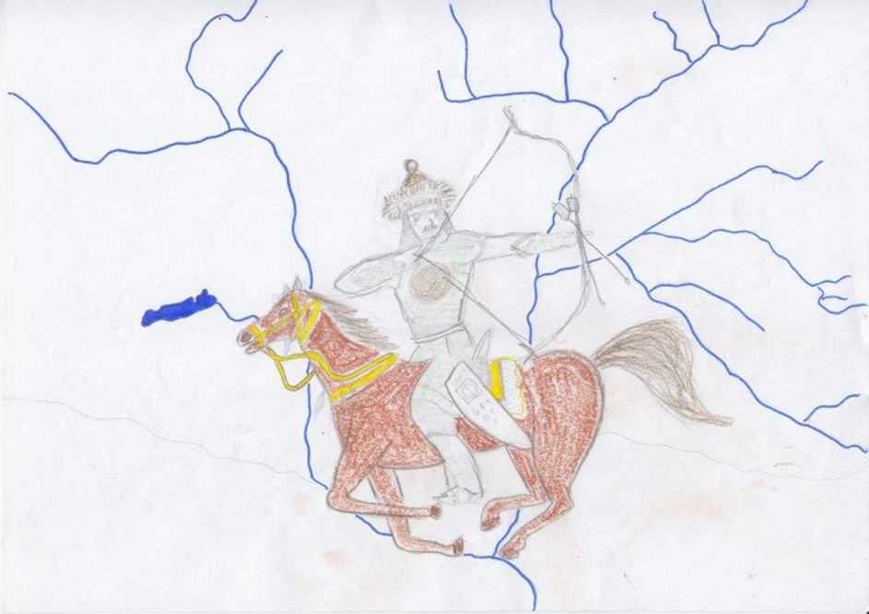
Hearing this and fearing the Hungarians, the king quickly gathered an army and called upon his friends for help.
In the meantime, the Hungarians arrived beside the Danube and at dawn they arose on a lovely field to do battle.
But God’s support was with the Hungarians whose sight made Svatopluk flee. The Hungarians pursued him to the Danube, and there in his fright he cast himself into the water where he drowned.

Slide 7
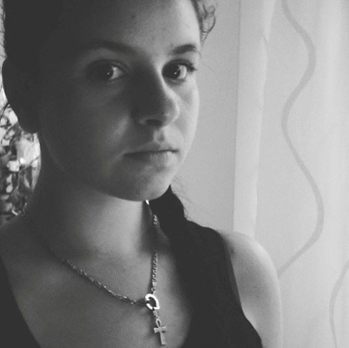
Nóra Kotnyek 10/B
Drawer
Kinga Tóth 10/B
Drawer
Zsanett Szitai 12/B
Editor
Edited by Viktória Vas
Mentor: Katalin, Sándorné Peleskei

Slide 8
Source:
Hungarian Illumintaed Chronicle
By Anonymus - Csanády (vitalap · szerkesztései) (A feltöltő saját munkája), Közkincs, https://commons.wikimedia.org/w/index.php?curid=1971102
Disclaimer:
"The European Commission support for the production of this publication does not constitute an endorsement of the contents which reflects the views only of the authors, and the Commission cannot be held responsible for any use which may be made of the information contained therein.„
Erasmus+ BookPals@schools.eu

