Slide 1
“Greek and Cypriot modern literature, based on the ancient greek myth of the adventure of Odysseus.”
The task was presented in Poland during the second mobility.
Students:
Michaelia Andreou
Styliana Andreou
Elena Rouvi
Teachers:
Sotiria Papamargariti
Marina Zervou

Slide 2
The myth of Odysseus in modern Greek literature

Slide 3
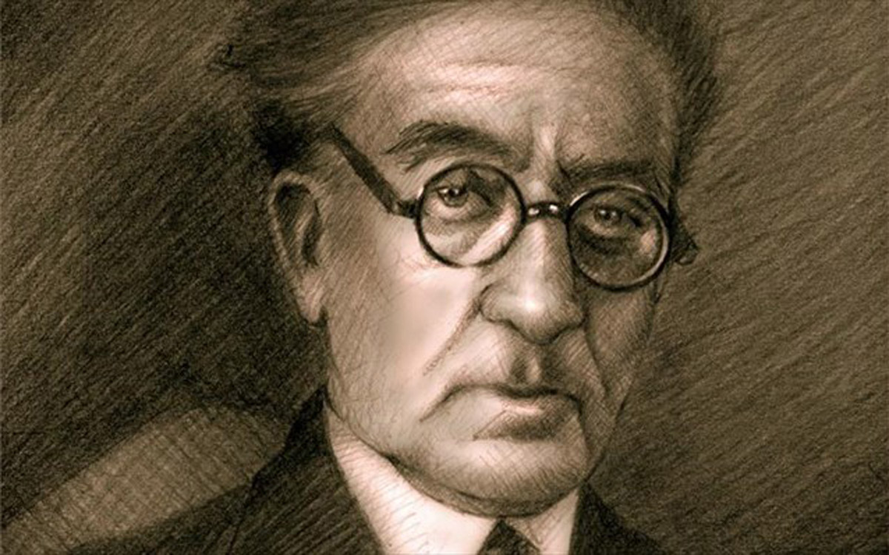
C. P. Cavafy (1863-1933)

Slide 4
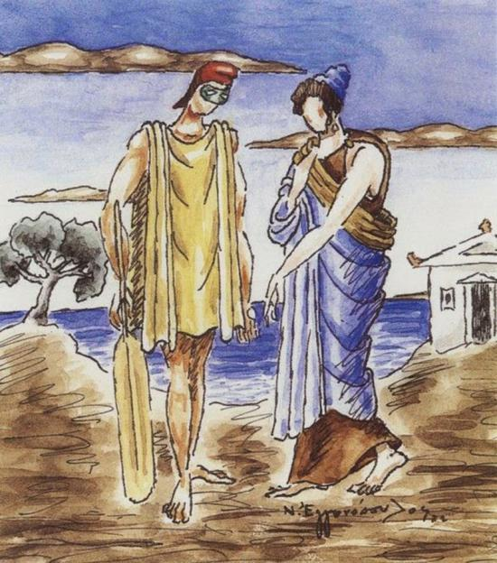
Second Odyssey
A great second Odyssey, Greater even than the first perhaps, But alas, without Homer, without hexameters. Small was his ancestral home, Small was his ancestral city, And the whole of his Ithaca was small.

Slide 5
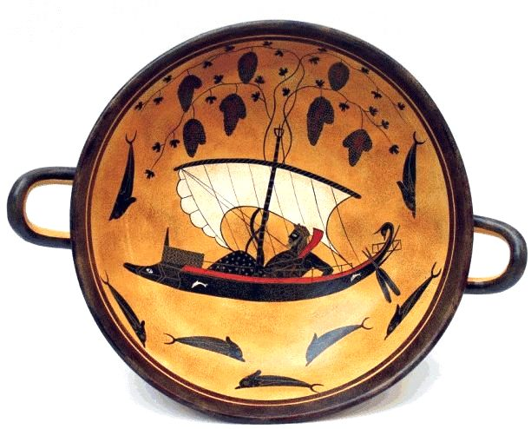
The affection of Telemachus, the loyalty Of Penelope, his father’s aging years, His old friends, the love Of his devoted subjects, The peace and repose of his home Bored him. And so he left.

Slide 6
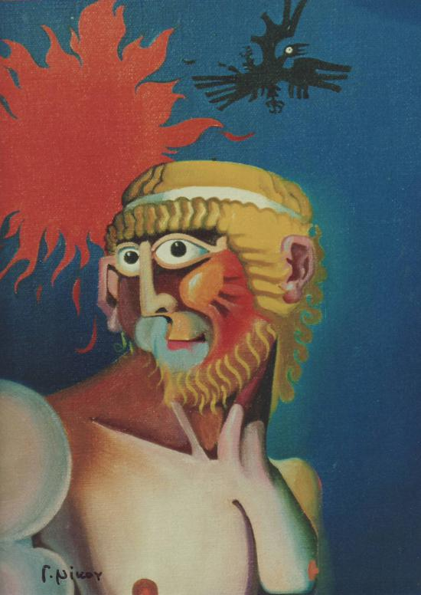
As the shores of Ithaca gradually Faded away behind him And he sailed swiftly westward Toward Iberia and the Pillars of Hercules, Far from every Achaean sea, He felt he was alive once more, Freed from the oppressive bonds Of familiar, domestic things. And his adventurous heart rejoiced Coldly, devoid of love.

Slide 7
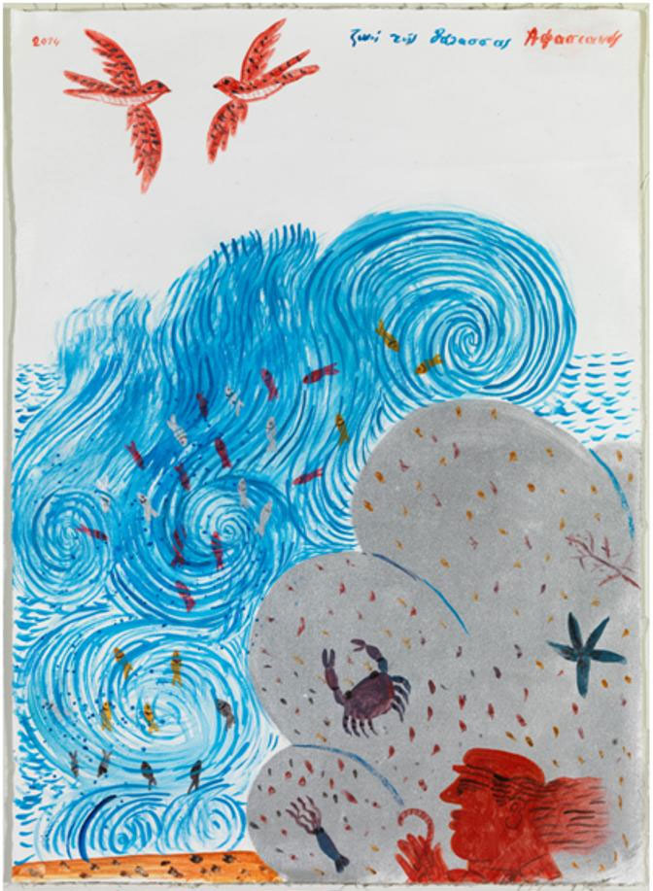
Ithaka
As you set out for Ithaka hope the voyage is a long one, full of adventure, full of discovery. Laistrygonians and Cyclops, angry Poseidon—don’t be afraid of them: […]
Laistrygonians and Cyclops, wild Poseidon—you won’t encounter them unless you bring them along inside your soul, unless your soul sets them up in front of you.

Slide 8
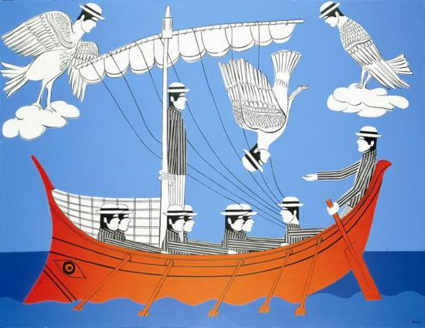
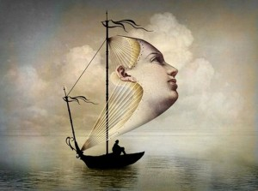
Ithaka gave you the marvelous journey. Without her you would not have set out. She has nothing left to give you now. And if you find her poor, Ithaka won’t have fooled you. Wise as you will have become, so full of experience, you will have understood by then what these Ithakas mean.

Slide 9
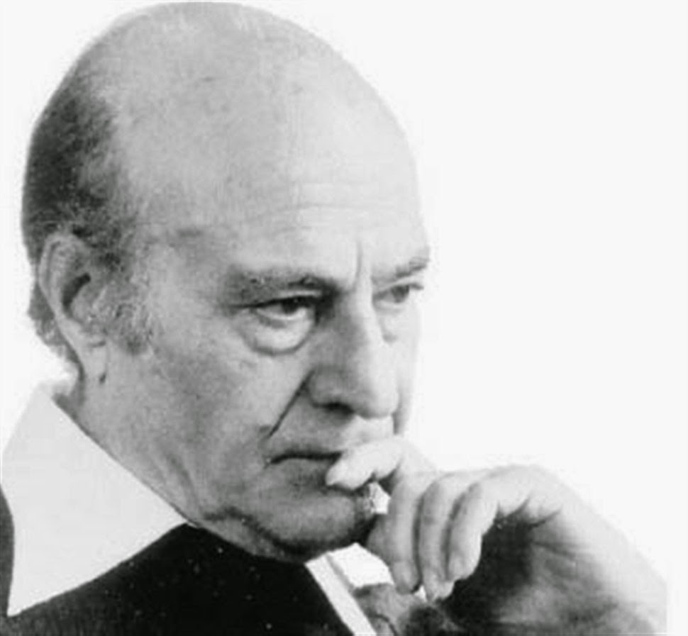
Odysseas Elytis
(1911-1996)

Slide 10
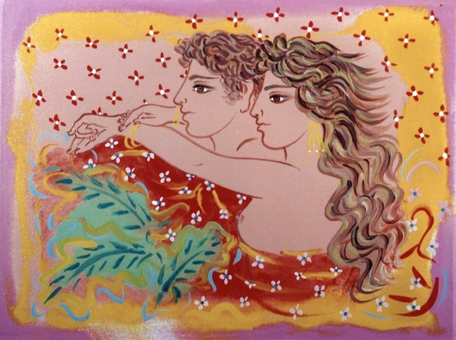
Aegean Sea
Love Archipelago And the bow of the foams And the dreams of seagulls In the tallest mast the sailor flaps A song

Slide 11
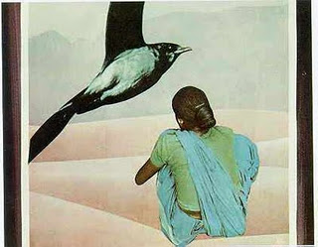
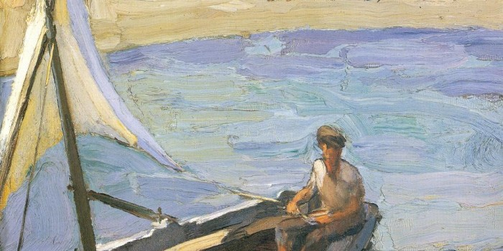
Love The song And the horizons of journey And nostalgia’ s echoes On the wet rock a woman is waiting A boat

Slide 12
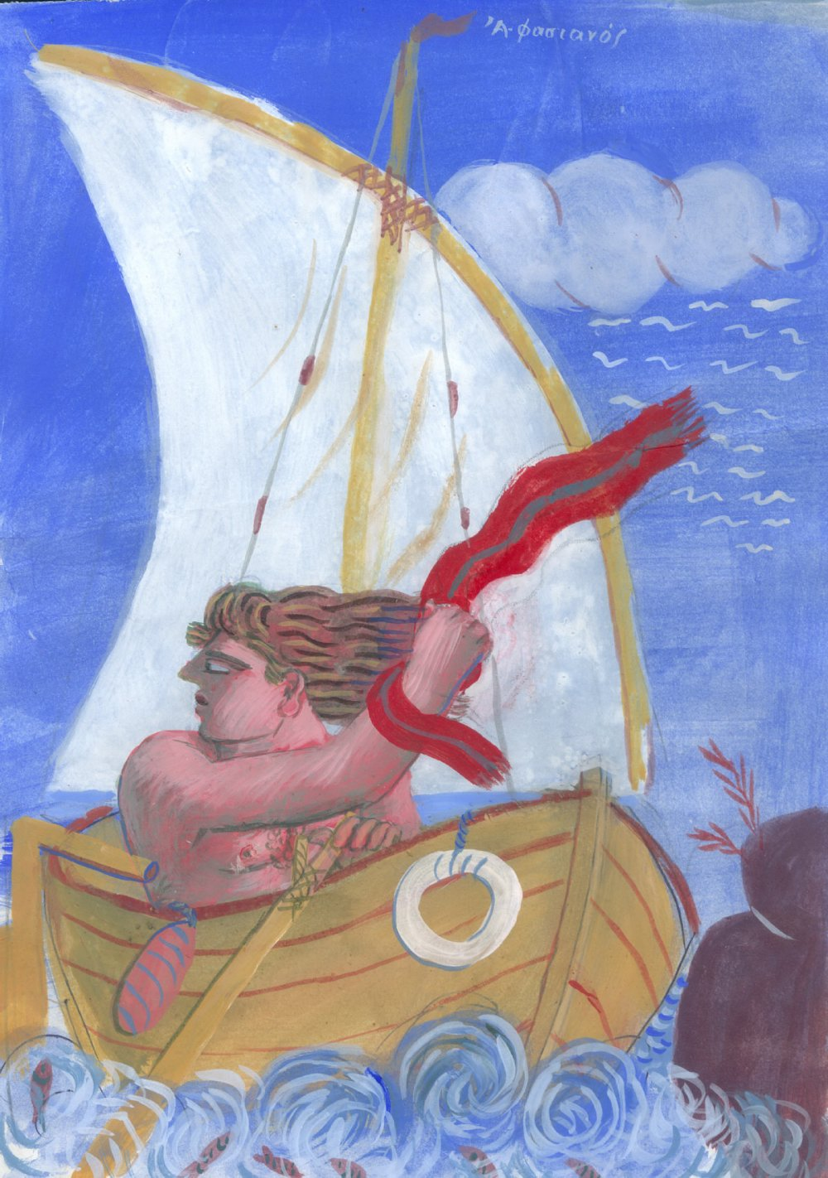
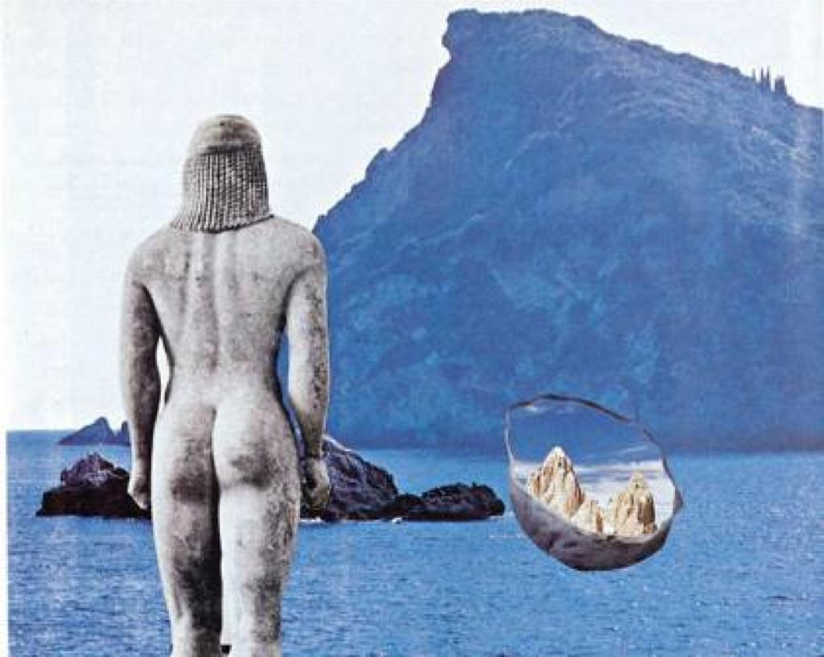
Love The boat And the carelessness of the wind And the sail of hope In the most light wave the island welcomes
The return

Slide 13
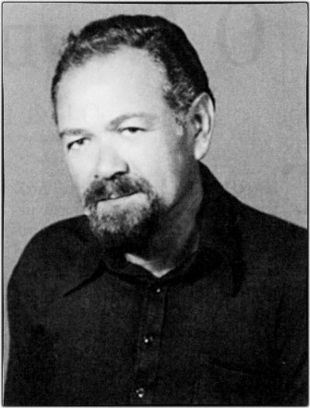
Pantelis Michanikos
(1926-1979)

Slide 14
In the cave of Cyclop
Odysseus was tied under the ram’ s belly. (It is not, of course, a poetic image).

Slide 15
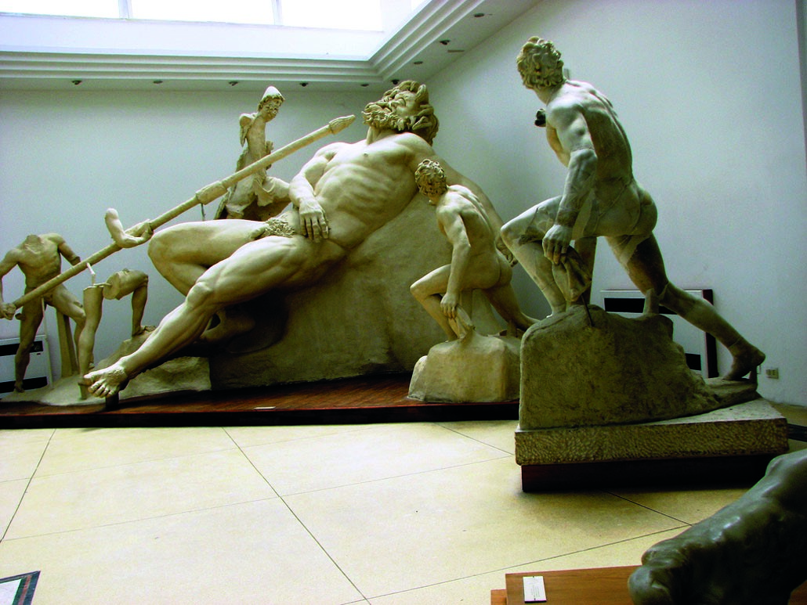

Slide 16
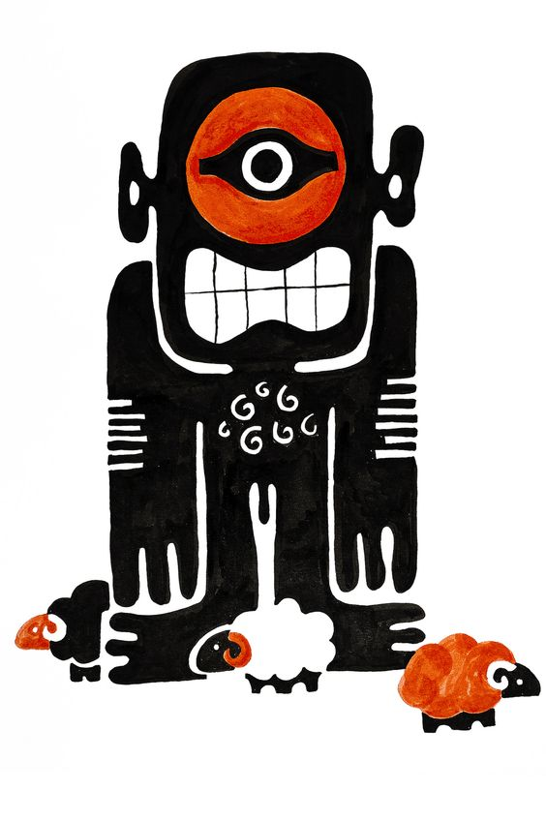
We are in the cave and death stands at the door. The heartbeat will pass underneath the palpable of Polyphemus.

Slide 17
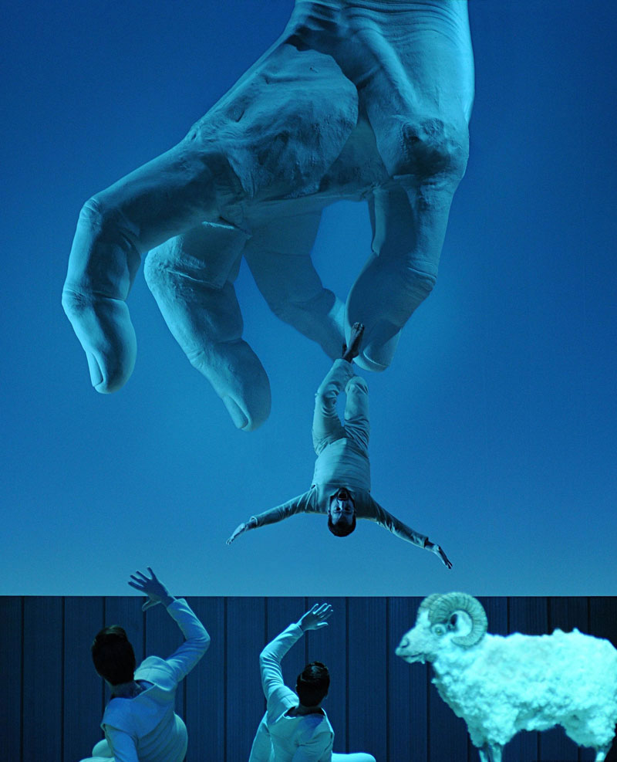
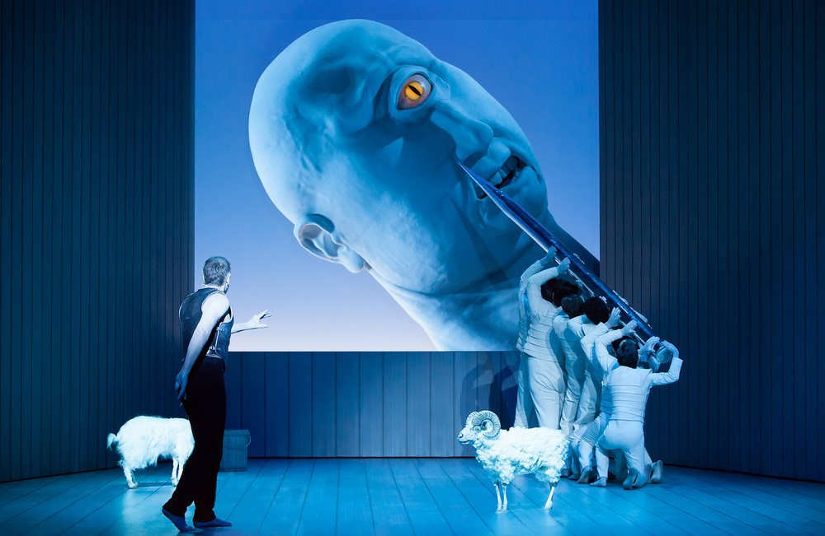

Slide 18
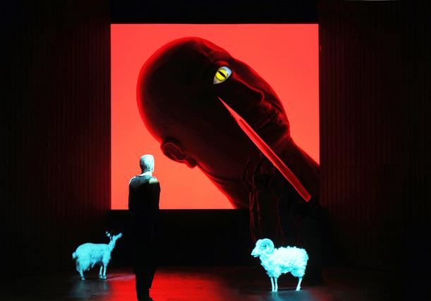
“My ram, I will make golden horns for you to copulate with brilliance the ewes of Polyphemus. But now stretched your rugged body and get me out of the death’s door. Completely blind Polyphemus does not see light and the sun is shining out of the cave. There I will kiss you on the forehead and caress your groin.”

Slide 19
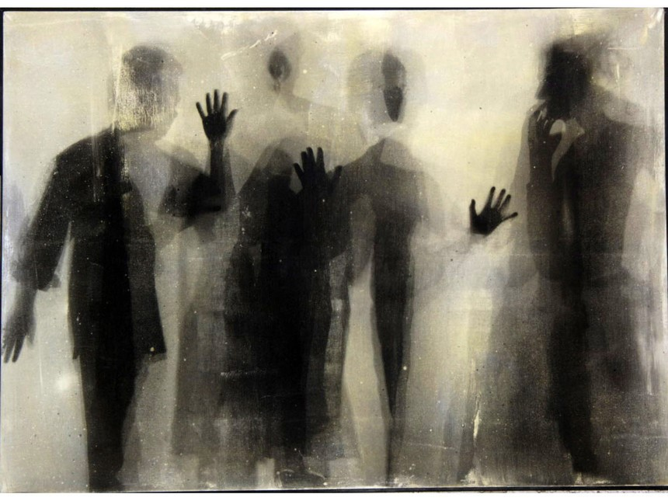
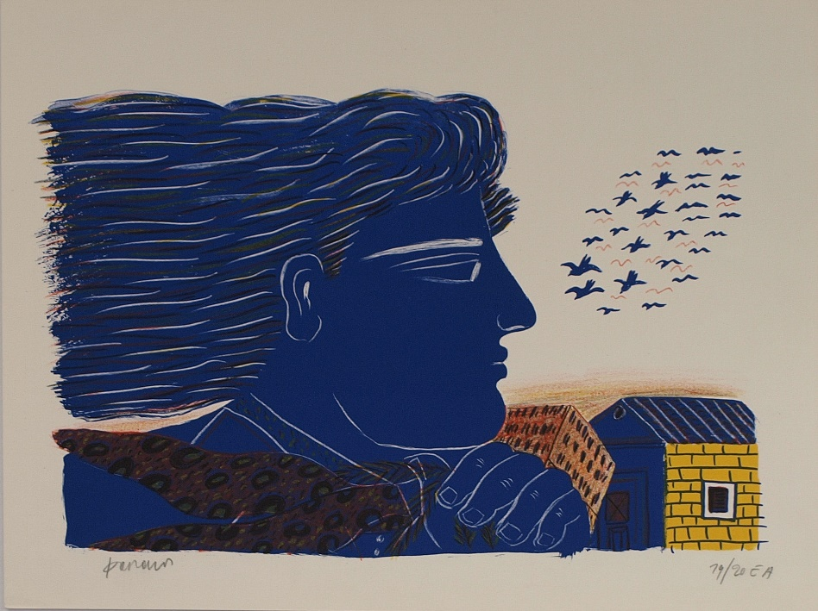
He said, and giving a strong tweak on ram’s rear Odysseus dared
towards life or death.

Slide 20
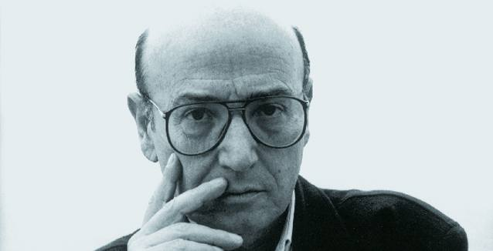
Theodoros Angelopoulos
Filmmaker
(1935-1912)

Slide 22
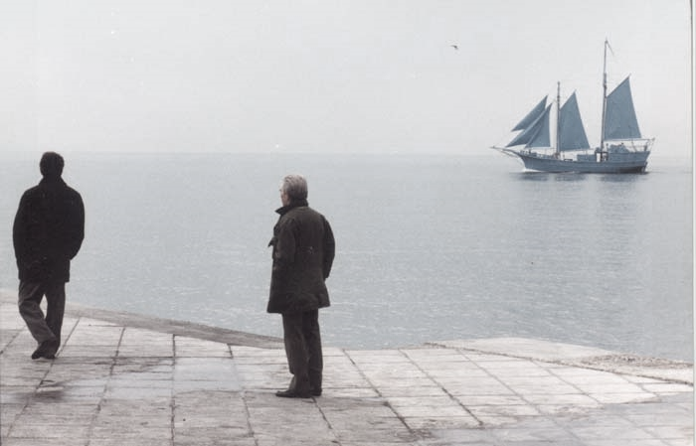
A successful Greek filmmaker is returning home and sets out on an epic journey across the battered Balkans in search of three lost reels of film by the Manaki brothers, the pioneering photographers who introduced movies into the Balkans at the beginning of the century. The search for the reels of film works as a metaphor for a search for the common history of the Balkan countries. It is also a reflection on the impossibility of finding new fora of communication.
Odysseus returns in the twentieth century to find a nation that mocks its classical past, thrives on repressive state policies and dictatorship, and corrupt and dynastic measures. Angelopoulos makes nostalgic journeys into the past and weaves his exiled travelling heros never fully make it back to their Ithaca. The film ends in Sarajevo, where he finds both the lost reels and his true love (Maia Morgensten), who is executed by a death squad. The director laments both the lost love and the impossibility of building a new solidarity in the Balkans.

Slide 23
