Slide 1
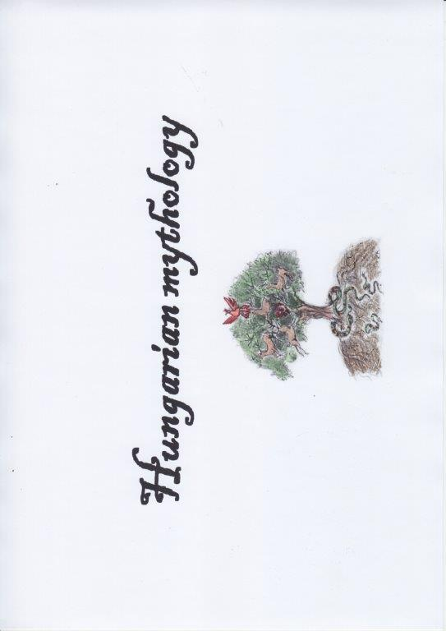

Slide 2
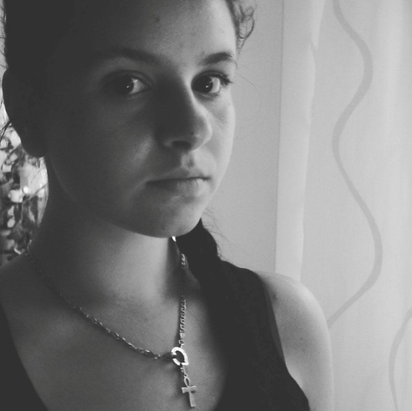
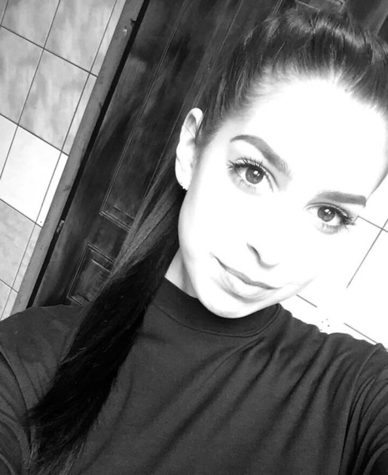
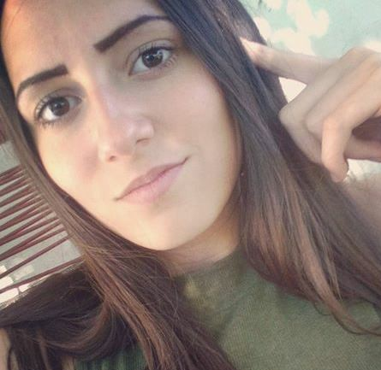
Edited by
Anett Manhertz 12/B
Drawn by Kinga Tóth 10/B
Drawn by Nóra Kotnyek 10/B
The presentation was made by Viktória Vas
Mentor: Katalin, Sándorné Peleskei

Slide 3
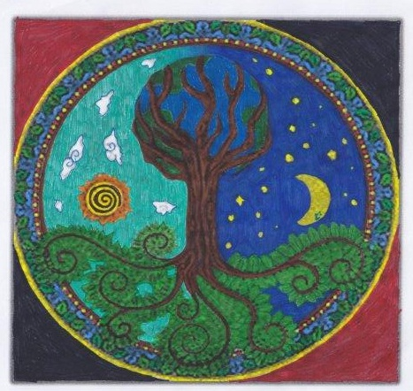
In Hungarian myth, the world is divided into three spheres:
the first is the Upper World, the home of the gods;
the second is the Middle World or world we know,
and finally the underworld.
In the centre of the world stands a tall tree: the World Tree / Tree of Life. Its foliage is the Upper World, and the Turul bird dwells on top of it. The Middle World is located at its trunk and the underworld is around its roots. In some stories, the tree has fruit: the golden apples.

Slide 4
Upper World
The gods and the good souls live in the Upper World. Gods have the same rank. Isten ( Hungarian for "God") created the world with the help of Ördög ("the devil" representing Evil).
Middle World
The Middle World is shared among humans and many mythological creatures; There are ghosts of the forests and waters, who are ordered to scare humans.
Underworld
The Underworld is the place of bad souls (this includes evil spirits and the souls of dead people who were cruel and evil in their lives) and the home of Ördög, creator of everything bad for humans: for example, annoying animals such as fleas, lice, and flies.

Slide 5
Dear Golden Father and Dear Golden Mother
Main gods, it was forbidden to make images about them
The most important figure of them is Isten. He controls the world, shapes the fate of humans, observes the Middle World from the sky, and sometimes gives warning by lightning.

Slide 6
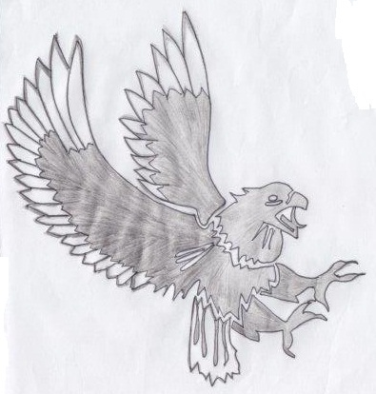
Turul (animal)
The great bird resembling to a falcon that was sent forth by Isten to guide the creation and destiny of the Magyar people. The first kings after St. Stephen I. were the hereditary of Turul ("Turul nemzetség")

Slide 7
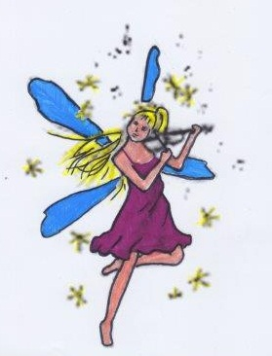
Tündér (fairy
Favourite creatures are the tündérek (fairies) who are beautiful young virgins or female creatures (often depicted either as personified purity and innocence or as playful and foxy). They aid humans and sometimes grant them three wishes.

Slide 8
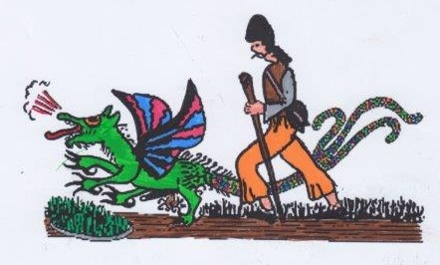
Garabonciás (person)
A male figure who learned magic, unlike the táltos, who had the ability by birth. He is able to create storms and ride dragons.

Slide 9
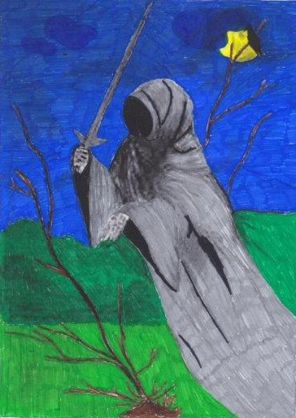
Lidérc (creature)
A unique supernatural being of Hungarian folklore. It is the Hungarian demon. It has three known varieties, which often borrow traits from one another.

Slide 10
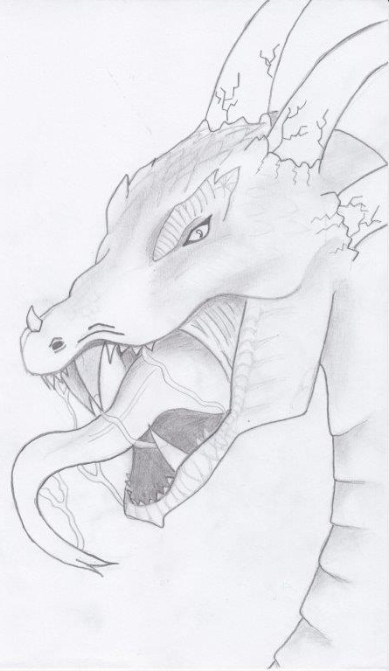
Sárkány (dragon)
Appearing in almost all folk tales, the Hungarian sárkány is not similar to Chinese dragons or dragons from West Europe. According to their oldest, universal function, dragons originally symbolized the unity of the material and spiritual world. They usually had seven heads, sometimes three, 12 or 21 (relating to numbers in astrology). Dragons also symbolized human behaviour or character, i.e. when the hero was fighting with him, he was fighting to overcome his own bad behaviour, habit or characteristic.

Slide 11
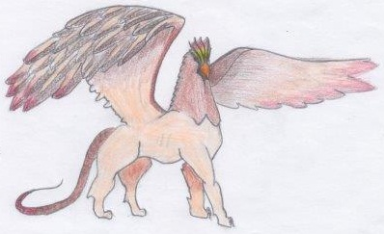
Griff (animal)
Also known as griffin in Western Europe, but without special features.
In Hungarian mythology, it is similar to Turul. Featuring in some fairy tales(like Fehérlófia - The son of the white horse), it is a cruel, greedy bird eating humans, but it's the only way to get back from Underworld to Middle World.

Slide 12
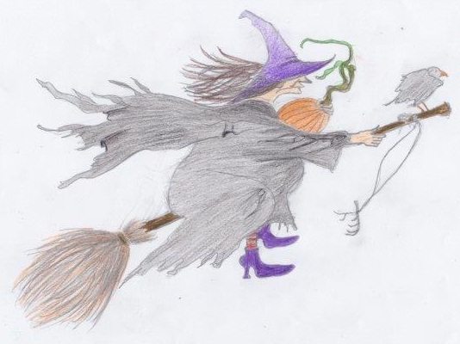
Boszorkány (witch)
A hostile, harm-doing, supernatural old lady, the witch. She had an ability to transform, fly and curse. The boszorkány corrupted the animals, for example, soured the milk of the cows. For humans, she brought an abrupt illness.
They "operated" in the night, or in the nightfall.

Slide 13
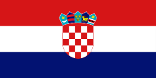
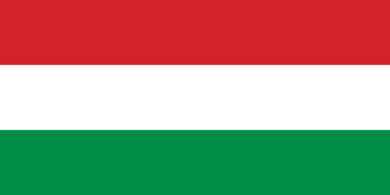
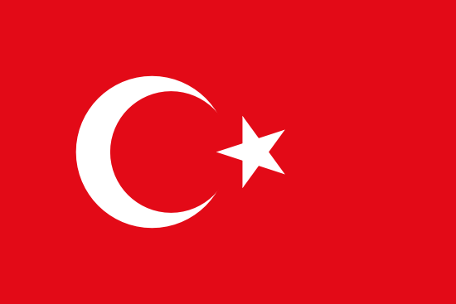
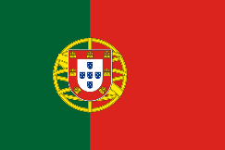
Source: Kandra Kabos: Magyar mytologia (Eger, 1897) – Hungarian Mythology
Disclaimer:
"The European Commission support for the production of this publication does not constitute an endorsement of the contents which reflects the views only of the authors, and the Commission cannot be held responsible for any use which may be made of the information contained therein.„
Erasmus+ BookPals@schools.eu

