Slide 1
BookPals@schools.eu
CROATIAN
LANGUAGE
WORKSHOP

Slide 2
CROATIAN LANGUAGE HRVATSKI JEZIK CROATIA HRVATSKA

Slide 3
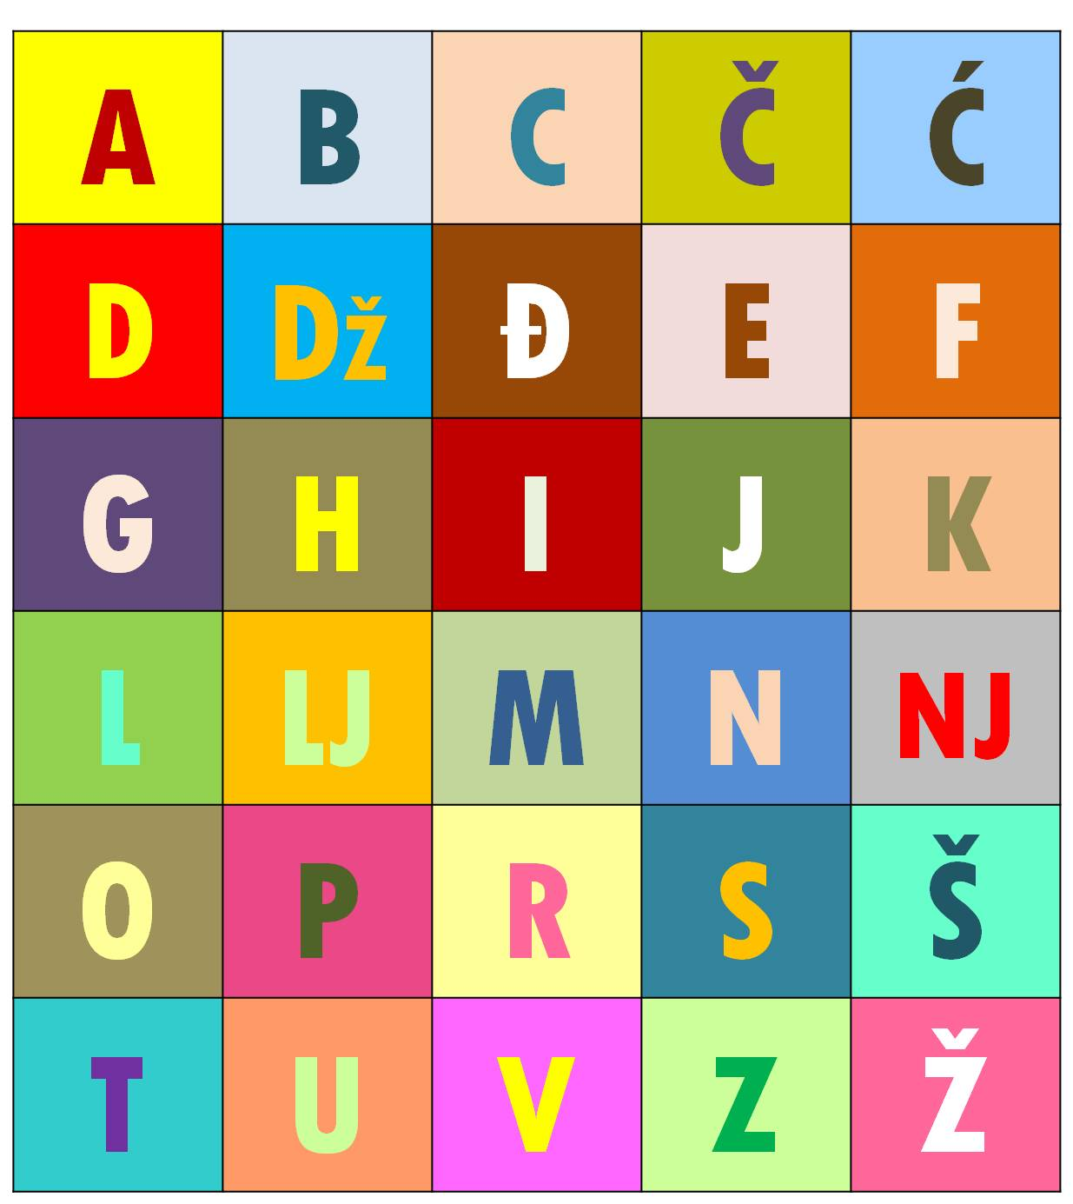
CROATIAN ALPHABET = HRVATSKA ABECEDA

Slide 4
TRY TO PRONOUNCE THESE SPECIFIC CROATIAN LETTERS:

Slide 5
❝If you talk to a man in a language he understands, that goes to his head. If you talk to him in his own language, that goes to his heart.❞ Nelson Mandela

Slide 6
DOBRODOŠLI!

Slide 7
HVALA!

Slide 8
VOLIM TE!

Slide 9
OBITELJ

Slide 10
MAJKA (MAMA)

Slide 11
OTAC (TATA)

Slide 12
JEZIK

Slide 13
KAVA

Slide 14
SRETAN ROĐENDAN!

Slide 15
WAIT! YOU ALREADY MAY KNOW SOME CROATIAN WORDS… LET’S SEE…

Slide 16
AUTOBUS (BUS)

Slide 17
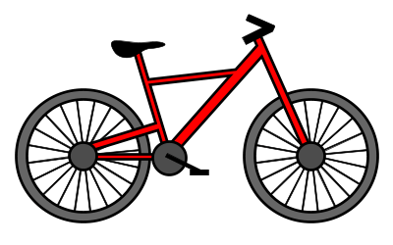
BICIKL (BICYCLE)

Slide 18
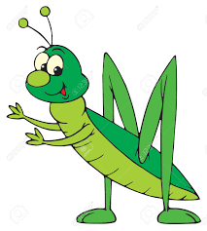
CVRČAK (CRICKET)

Slide 19
DIPLOMA (DIPLOMA)

Slide 20
EKONOMIJA (ECONOMICS)

Slide 21
FAKULTET (FACULTY)

Slide 22
GEOGRAFIJA (GEOGRAPHY)

Slide 23
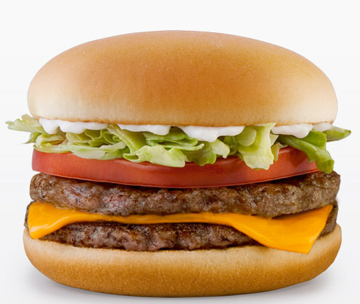
HAMBURGER (HAMBURGER)

Slide 24
INFORMACIJA (INFORMATION)

Slide 25
JAKNA (JACKET)

Slide 26
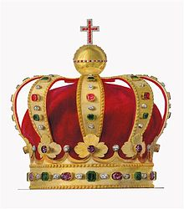
KRUNA (CROWN)

Slide 27
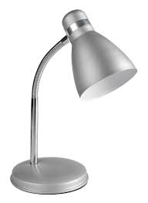
LAMPA (LAMP)

Slide 28
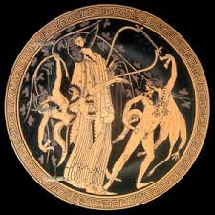
MITOLOGIJA (MYTHOLOGY)

Slide 29
NOS (NOSE)

Slide 30
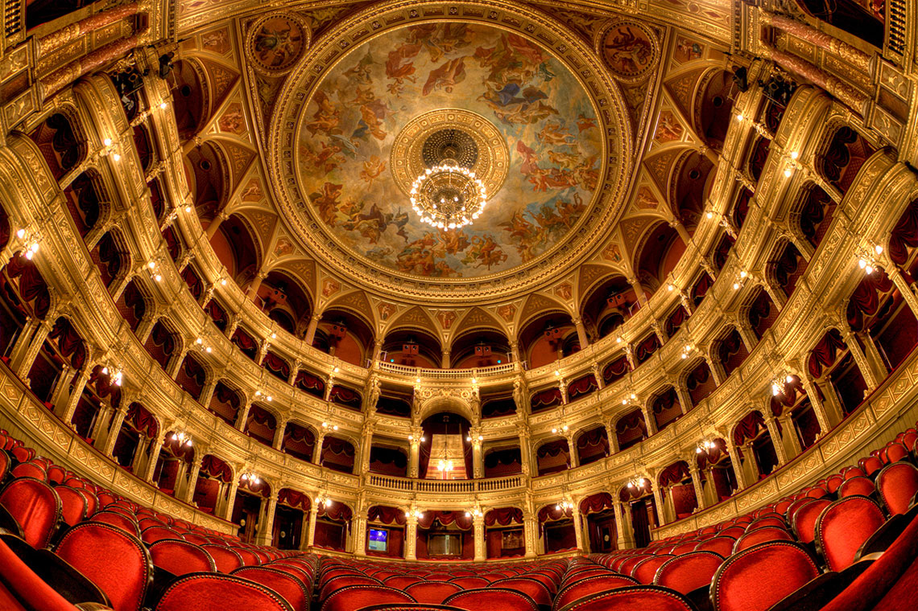
OPERA (OPERA)

Slide 31
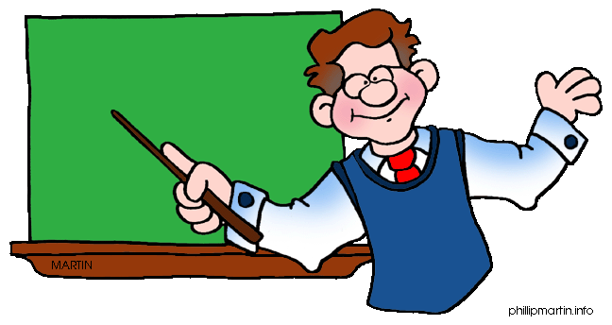
PROFESOR (PROFESSOR)

Slide 32
RIJEKA (RIVER)

Slide 33
SUNCE (SUN)

Slide 34
TELEVIZIJA (TELEVISION)

Slide 35
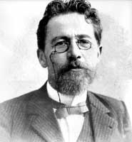
UJAK (UNCLE)

Slide 36
ZEBRA (ZEBRA)

Slide 37
SOME OF THE LONGEST CROATIAN WORDS ARE:
prijestolonasljednikovičičinima
najneindustrijaliziranija
otorinolaringologija
pluskvamperfekt

Slide 38
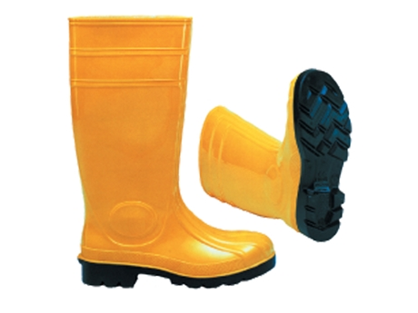
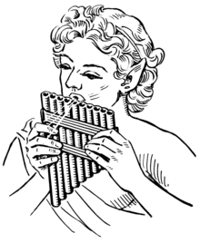
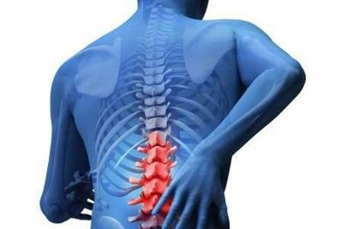
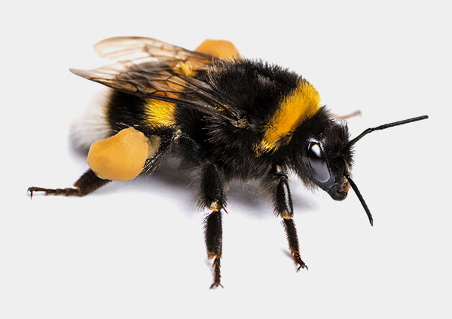
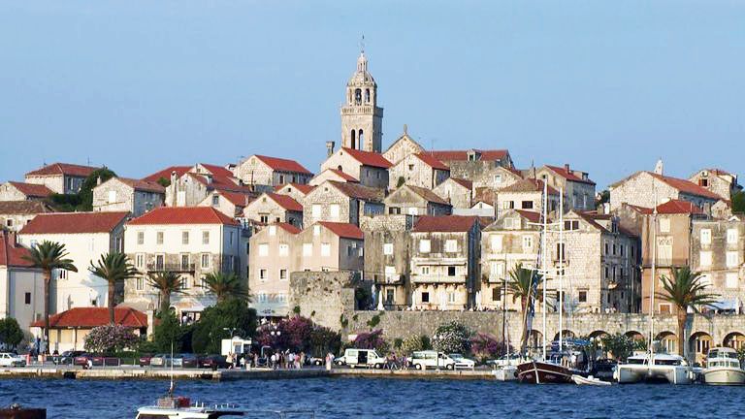
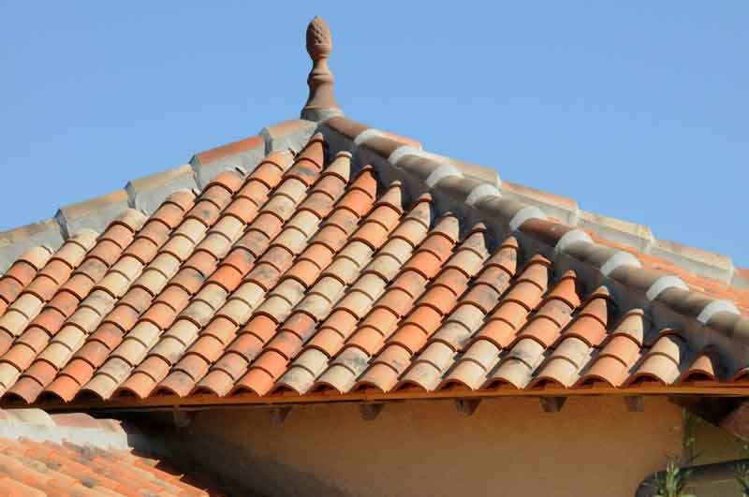
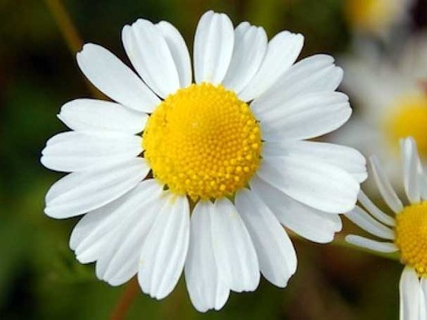
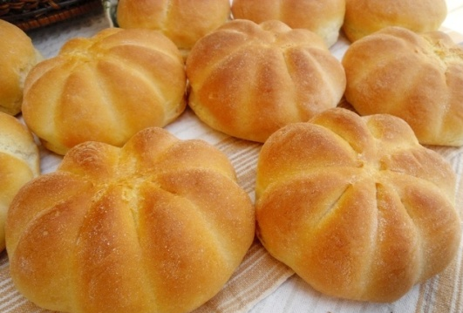
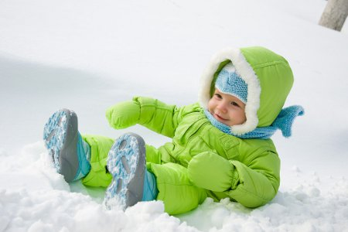
TRY TO SAY THESE CROATIAN WORDS !
čizme
kruščić
skafander
Korčula
crijep
kralježnica
cvijet
žlica
bumbar
frula

Slide 39
CROATIAN GREETINGS

Slide 40
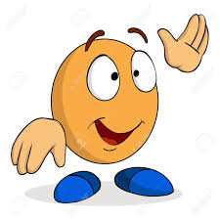
POZDRAV! ZDRAVO! HEJ! BOK/BOG!
eng: HI! HELLO!
gre: Χαίρετε!
tur: HEY! MERHABA! SELAM!
por: OLÁ!
pol: CZEŚĆ! WITAJ!
hun: HELLÓ! SZIA!

Slide 41
POZDRAV! ZBOGOM! DOVIĐENJA! VIDIMO SE!
eng: GOODBYE! SEE YOU!
gre: Αντιο Σας!
tur: GÜLE GÜLE! ELVEDA!
por: TCHAU!
pol: DO WIDZENIA! DO ZOBACZENIA!
hun: VISZONTLÁTÁSRA!

Slide 42
DOBRO JUTRO!
eng: GOOD MORNING!
gre: Καλημέρα!
tur: GÜNAYDIN!
por: BOM DIA!
pol: DZIEŃ DOBRY! DOBRE RANO!
hun: JÓ REGGELT!

Slide 43
DOBAR DAN!
eng: GOOD DAY / AFTERNOON!
gre: Καλημέρα!
tur: TÜNAYDIN!
por: BOA TARDE!
pol: DZIEŃ DOBRY!
hun: JÓ NAPOT!

Slide 44
DOBRA VEČER!
eng: GOOD EVENING!
gre: Καλό απόγευμα!
tur: IYI AKŞAMLAR!
por: BOA NOITE!
pol: DOBRY WIECZÓR!
hun: JÓ ESTÉT!

Slide 45
LAKU NOĆ!
eng: GOOD NIGHT!
gre: Καληνύχτα!
tur: IYI GECELER!
por: BOA NOITE!
pol: DOBRANOC!
hun: JÓ ÉJSZAKÁT!

