Slide 1
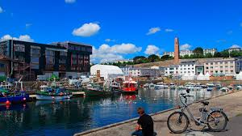
Présentation of Brest

Slide 2
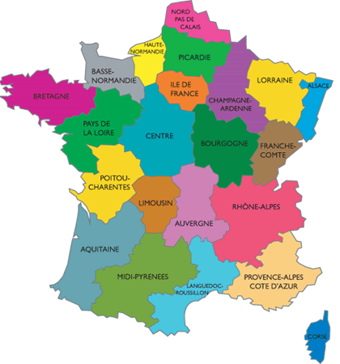
Geographic situation
North- west of the France

Slide 3
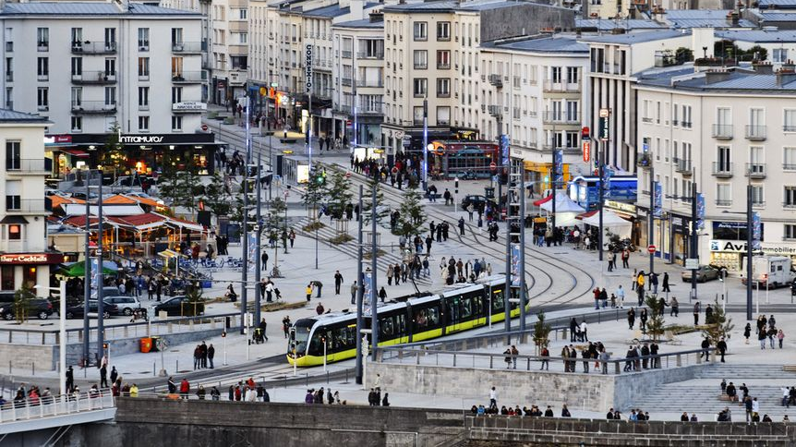
Population
In 2020 : 139 602 inhabitants

Slide 4
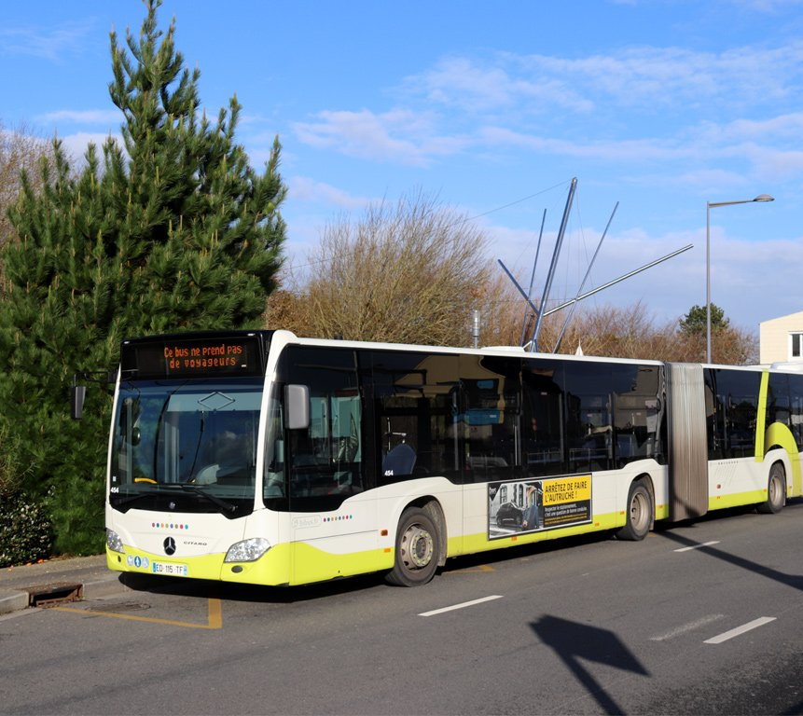
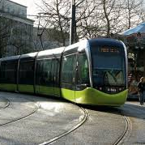
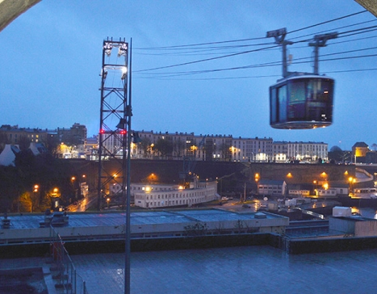
Public Transportation
Tramway
Bus
Cable car

Slide 5
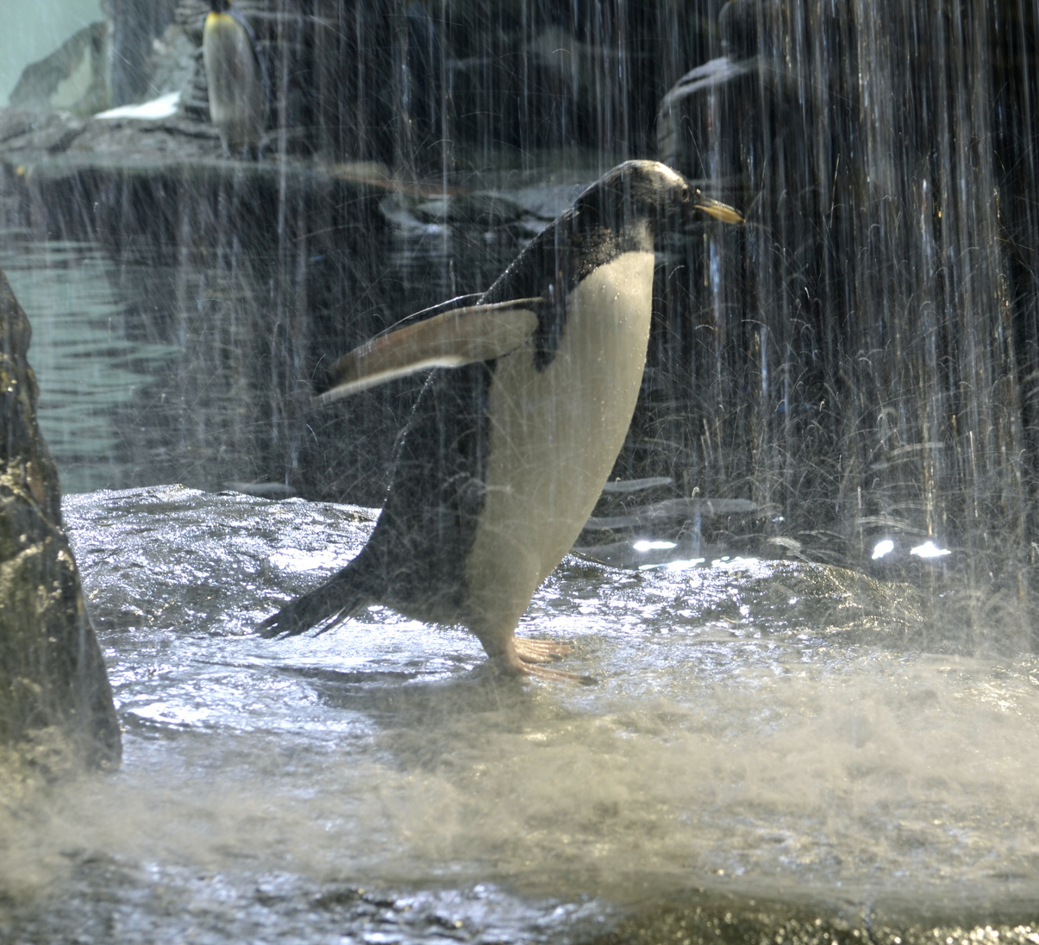
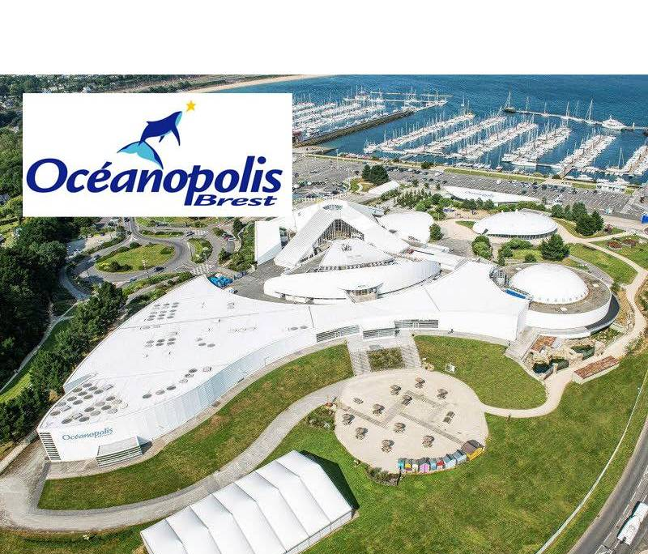
Oceanopolis
Giant aquarium

Slide 6
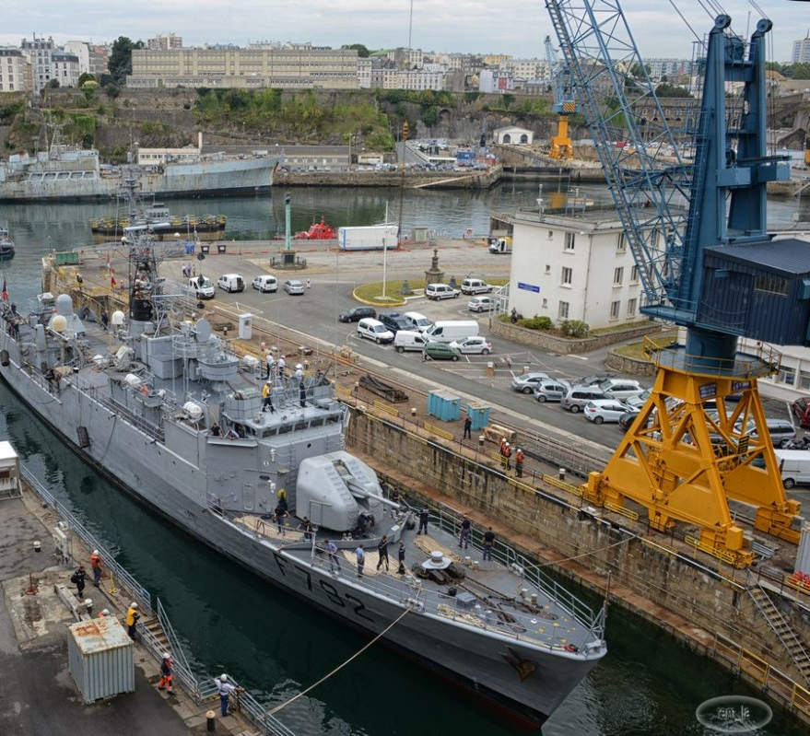
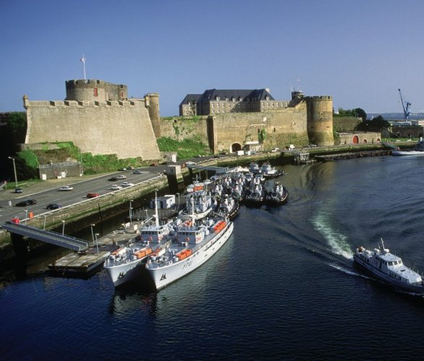
Brest Arsenal
Centre of scientific culture dedicated to the oceans

Slide 7
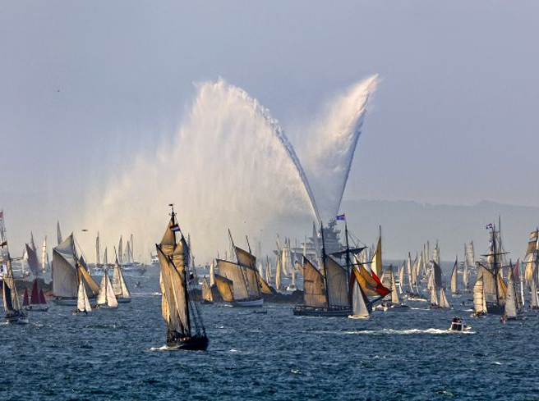
International Maritime Festivals

Slide 8
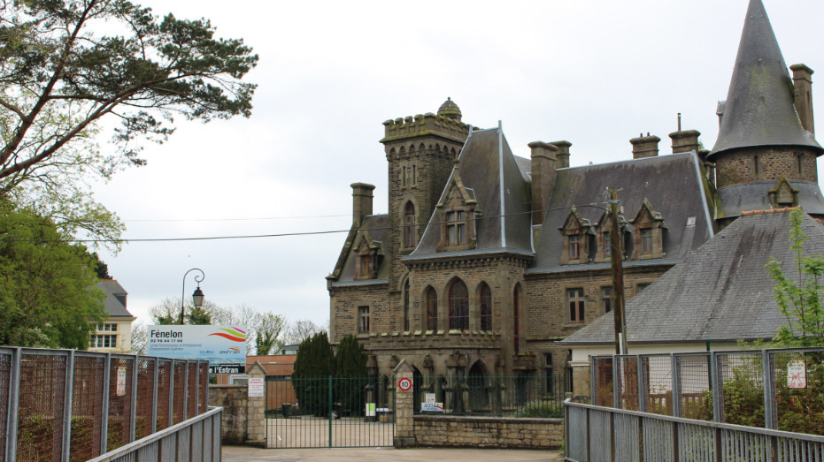
School of Fenelon
Students : 740

Slide 9
Differents type of formation
St2S: technical science of the health and the social
Tmd : Technical of the music and dance
Assp: Accompaniment, care and personal services

