Slide 1
TORO

Slide 2
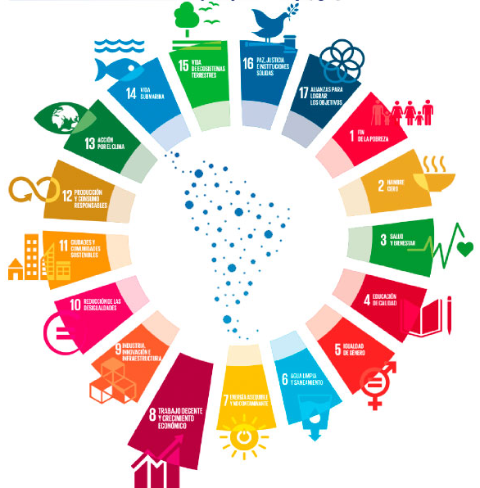
One of the most important objectives is education in sustainability.
Cardenal Pardo de Tavera students should behave as sustainable citizens

Slide 3
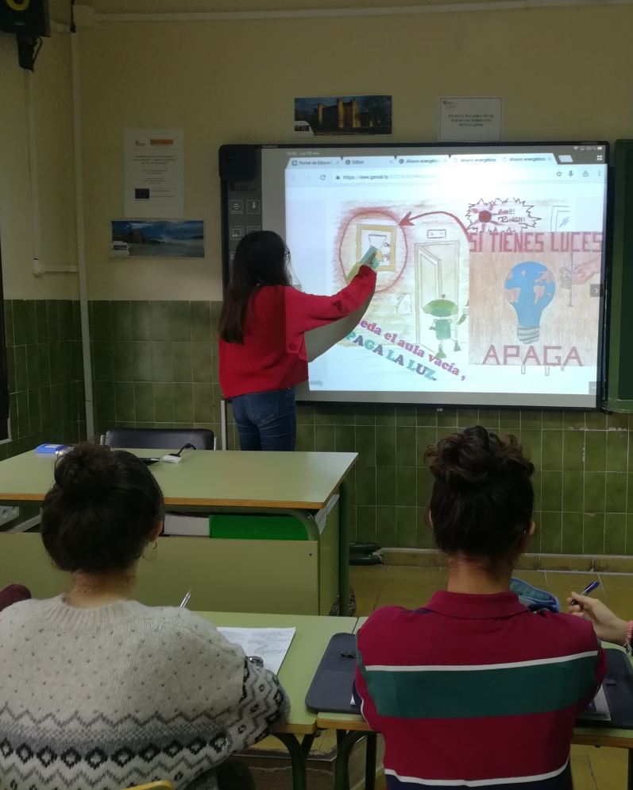
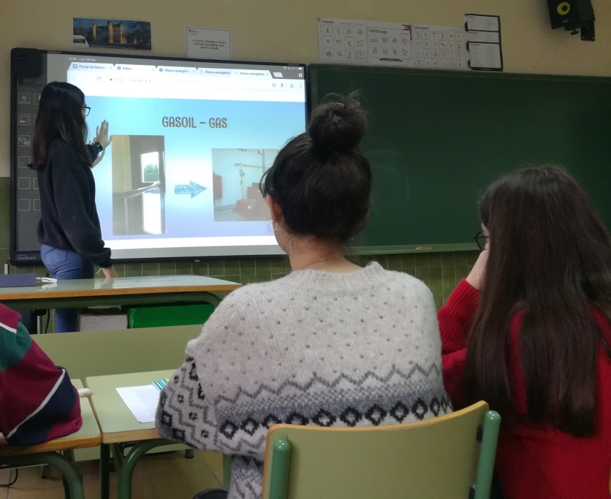
Energy saving plan
We started this saving plan 10 years ago
4th grade students make a concioussness-raising campaign about saving energy at the school to invite all the students to take care of the environment.
VIDEO

Slide 4
REVISION OF STUDENTS BEHAVIOUR
SOME STUDENTS IN EACH CLASS ARE RESPONSIBLE OF FOLLOWING ENERGETIC SAVING RULES.
OLDER STUDENTS SCORE THE BEHAVIOUR OF THE DIFFERENT GROUPS
https://docs.google.com/forms/d/e/1FAIpQLSdwTNjnc9M6OAWDl8x-zu9ItiMN6-8E_hzvs4Pi3E-ZOVRejA/viewform

Slide 5
RECYCLING PLAN
Around the high school, there are five pairs of bins distributed.
In addition, each educational level is reponsible for a pair of bins and a group of students take out the rubbish.
Even so, in each classroom there is a box where you can take paper to reuse and there is another box where you can throw away used paper to recycle.
Finally, once a week some of the responsible students empty the paper box into the classroom´s blue bin.

Slide 6
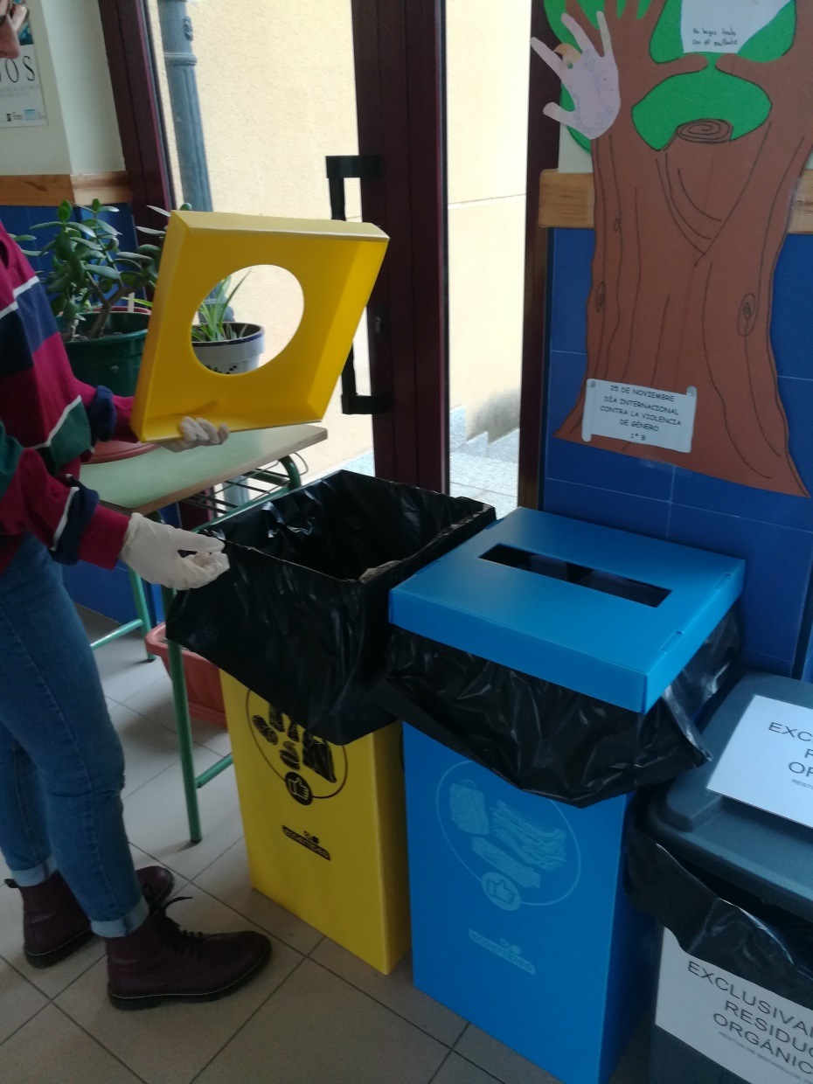
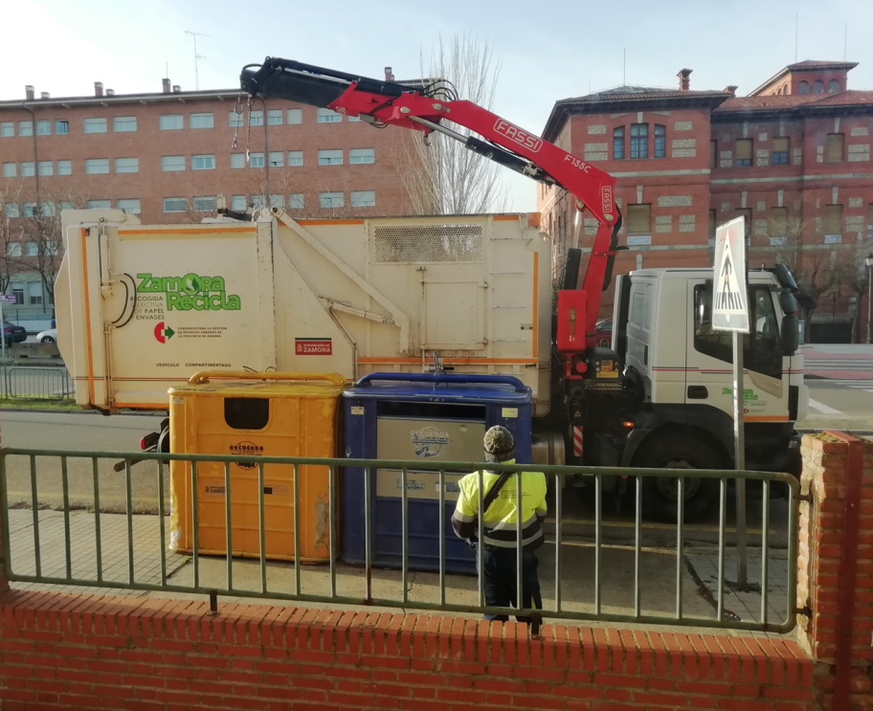
RECYCLING PLAN
The students of each level are also responsible for taking out the rubbish, and emptying both the blue and the yellow bin into the exterior trash can.

Slide 7
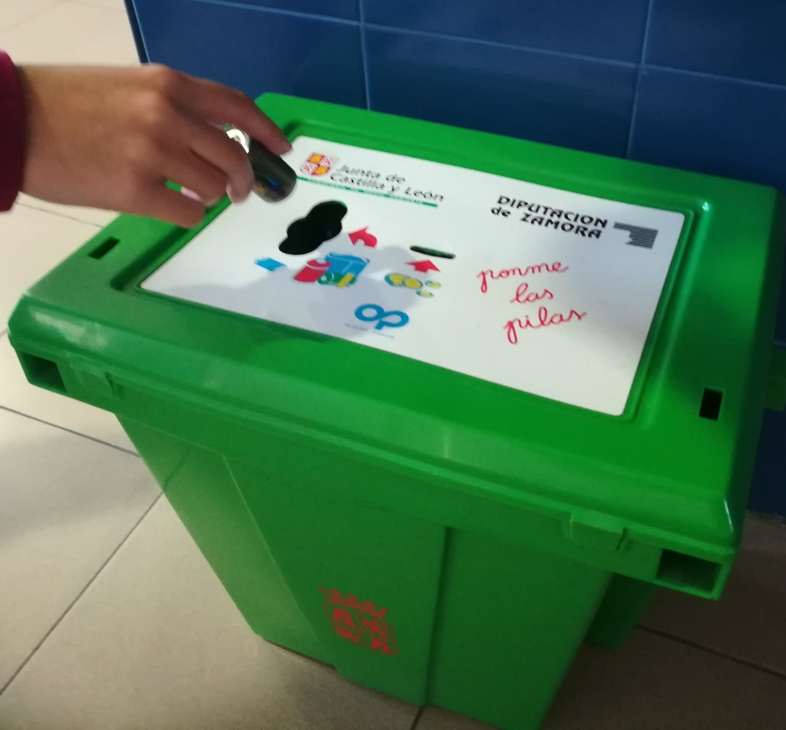
RECYCLING
Besides that, we have bins for used batteries and organic waste to compost. Also, we take part in campaigns about waste collection of electric and electronic waste.

Slide 8
SEPARATE YOUR RUBBISH TO RECYCLE BECAUSE THERE ARE A LOT OF ADVANTAGES
Results of a preliminary survey about habits in separation of rubbish:
95,6% of families think waste should be separated to recycle.
86% of families think recycling is easy.
53% of families throw used batteries in the specific bin.
56% of families separate plastic and glass to dispose of in yellow and green containers.
53% of families separate paper to dispose of in the blue bin.
36,5% of families use the organic waste to feed animals or to treat in a compost bin.

Slide 9
OBJECTIVES OF OUR WORK
Encourage as many families in the high school as possible who separate their waste, and encourage them to continue with this good habit.
Convince the ones who now don´t separate their waste at home to acquire that habit.

Slide 10
STEPS OF THE WORK
• History of recycling in Spain and the placing of the first recycling containers for the correct waste separation. • Analysis of the waste produced in Toro as useful data in our community. • Obtaining the experimental data: the measurement of the mass of the different types of waste that we generate during a week in the home of some students.
• Analysis of the experimental data that we have obtained to calculate the benefits that we contribute to the environment by separating our waste with extrapolation to the whole community. • The search for examples that raise awareness in the education community about the good impact they can make to the environment through the habit of separating waste, and to create signs to do an awareness raising campaign.

Slide 11
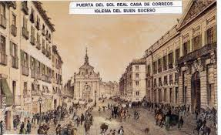
RECYCLING IN SPAIN
Although in the 18th century in Spain the first municipal cleaning services were established in Madrid, it would not be until a century later when people began to think that organic waste should be eliminated from cities, in order to avoid rodents, flies and diseases of the time.

Slide 12
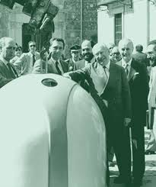
First recycling bins in Spain
In 1982, more than 30 years ago, the first glass containers were installed in our country, specifically in Madrid and Barcelona.

Slide 13
First blue and yellow bins
The first yellow and blue containers were installed in 1997, more than 20 years ago.
That same year, the Packaging and Waste Law was approved.
We have been learning for more than 20 years how we should separate our waste for recycling.

Slide 14
Recycling in Spain
Ecovidrio
1995
Management of glass recycling
Ecoembes
1996
Management of paper, plastic, tins and cans recycling
Anarpla
1996
Society of plastic recycling enterprises

Slide 15
Glass
During 2013 in Spain almost 700.000 tons of glass were collected from green containers.
In 2016, each Spaniard deposited an average of 16,2 kilograms of containers, about 62 per person, into green containers, according to data from Ecovidrio.
In total, 752.234 tons of glass container waste were recycled, a sum that would allow the Sagrada Familia to be covered five times.
In 2017, almost 820.000 tons of glass containers were collected and deposited in 218.146 containers distributed throughout Spain, which corresponds to 17,6 kg per inhabitant.

Slide 16
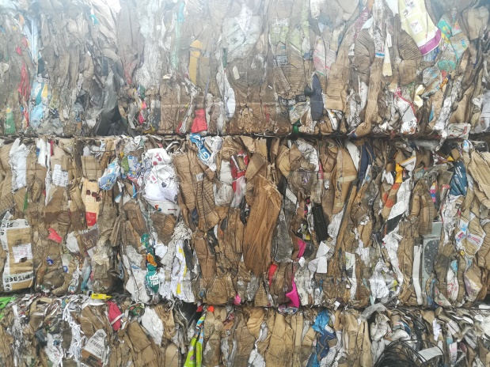
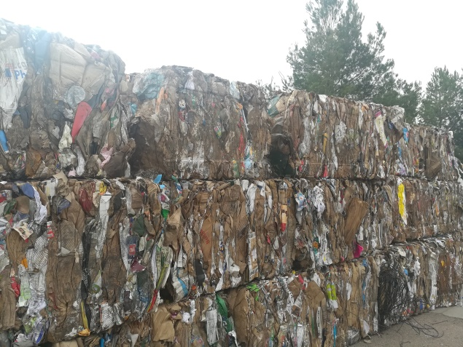
Paper
In 2014, the Spanish industry for the recovery and recycling of paper and cardboard waste transformed 4,4 million tons of this waste into recyclable raw materials.
The Spanish paper industry, the second largest recycler in Europe after Germany, recycled 5,2 million tons of paper in 2015, 2,5% more than the previous year.
In 2017, waste production increased by 2,9% compared to the previous year.
On the other hand, plastic waste was reduced by 21,5% compared to 2016.
81, 1% of cardboard and paper packaging and 69, 7% of plastic packaging were recycled, achieving an average recycling rate of 77, 1%.

Slide 17
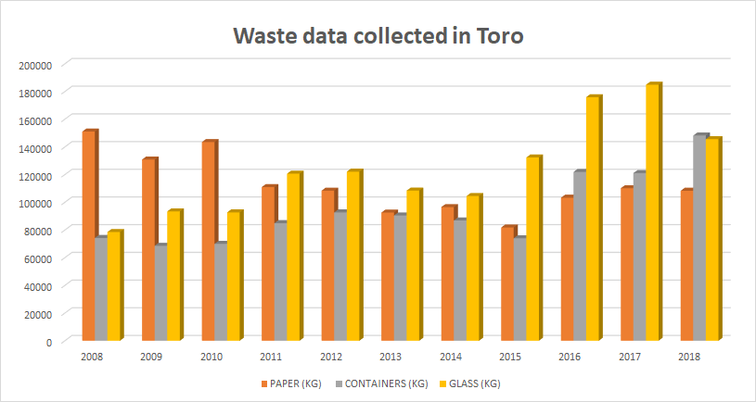
Recycling in Toro
About 184.910 kg of glass were collected in Toro using 51 containers. The average per inhabitant was 20, 6 kg.
This is the graph of waste collection in Toro from 2008 to 2018, provided by the Commité de Residuos de Zamora:

Slide 18
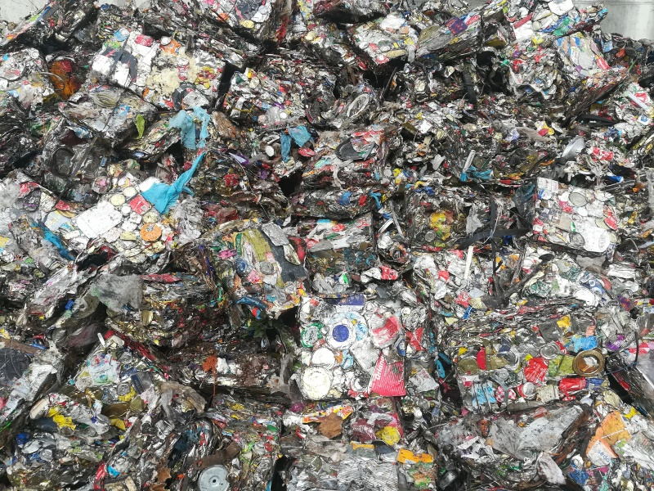
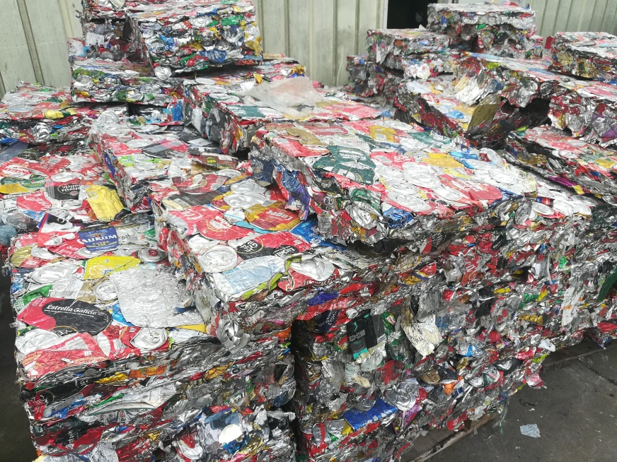
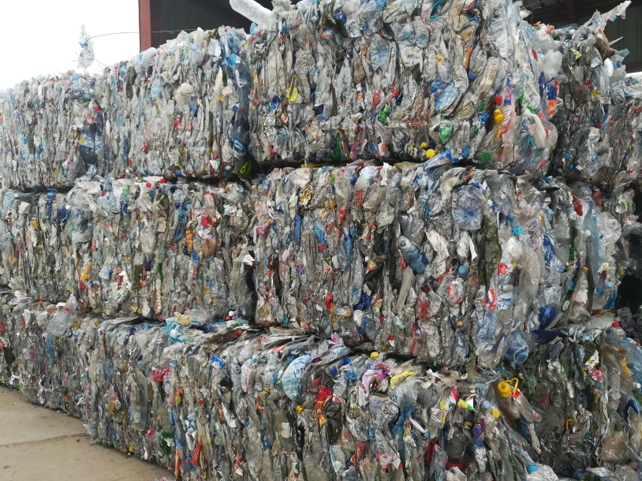
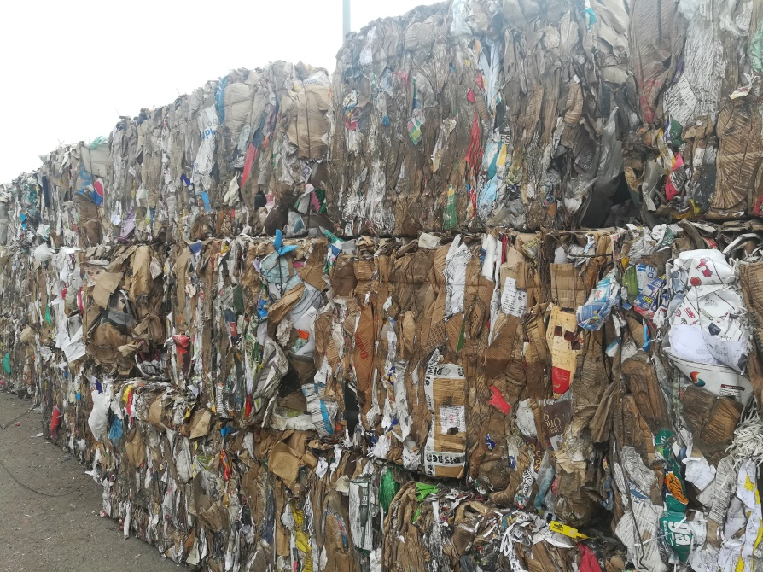
HOME WASTE THAT IS RECYCLED
STEEL
ALUMINIUM
PLASTIC
PAPER
GLASS

Slide 19
STEEL
The Greeks hardened their iron weapons by heat treatment in 1000 BC
From the 14th century, large smelting furnaces were built that allowed the steel to be manufactured.
Steel is a material that, depending on its composition, has different properties: resistance to corrosion, isolation, dashed, conductivity, deformation, etc. For this reason the steel industry points out the development level of a country.
Steel is easy to recycle and can be recycled indefinitely.

Slide 20
Advantages of recycling steel
1 ton of steel
1,5 ton of mineral
3.890 kg of _{CO2}
0,5 ton of coal
66,8 kWh
6.420 l of water

Slide 21
ALUMINUM
Although the aluminum was discovered in 1808, its extraction from bauxite wasn´t profitable until 1889.
Its main properties are the high endurance to corrosion and the low density. Moreover, it is a good electricity conductor and cheaper than other metals.
The aluminum is easily and indefinitely recyclable.

Slide 22
Advantages of recycling aluminium
1 ton of aluminium
1.162 kg of _{CO2}
14.630 kWh
91.200 l of water

Slide 23
PLASTICS
Plastic was used for the fist time in 17th century BC when the ancient Mesoamerican people used it to make natural rubber.
Its properties make it useful and long-lasting. Unfortunately, because of its durability, it rots very slowly in the rubbish tips, which is very dangerous for the environment.
The global production of plastic has increased rapidly over the last 50 years, especially during recent decades. The European countries which produce the most plastic are Germany, Italy, France and Spain.

Slide 24
Advantages of recycling plastic
1 ton of plastic
3333 l of petroleum
1500 kg of _{CO2}
1136,7 kWh
26800 l of water

Slide 25
PAPER
The first manufacturing process of paper was developed in 2nd century B.C.
Paper is a substance, usually in thin sheets, made of wood pulp, rags, or other fibrous material. They are wet and whitened. Later, they are dried, and finally, they harden.
Before inventing the paper, Chinese writers wrote on bamboo stalks or wooden planks using a rigid tip.
Recycling paper is getting more and more important. In short, paper can be recycled seven times at the most.

Slide 26
Advantages of recycling paper
1 ton of paper
5,48 trees
177 kg of CO₂
2.907,5 kWh
14.000 l of water
1.400 kg of residues

Slide 27
GLASS
Glass is a material which people started to use before 2000 B.C. to make necklaces and glass beads.
Glass is recyclable 100% ( one hundred per cent), that is to say, we can obtain one kilogramme of recycled glass for one kilogramme of glass.
Different types of glass are obtained when we add different materials to the basic raw material as the silica sand, limestone and sodium carbonate or sodium sulfate.

Slide 28
Advantages of recycling glass
1 ton of glass
2,66 ton of residues
167 kg of _{CO2}
1.000 kWh

Slide 29
EXPERIMENTAL WORK
49 families separate and weigh the waste produced in a week.
We have calculated the average waste produced by families at the school.

Slide 30
Average weekly rubbish produced by family
Weekly waste by family | Organic waste | Plastic and bricks | paper | glass | Total waste
Mass (kg) | 9,185 kg | 2,193 kg | 1,372 kg | 1,371 kg | 14,141 kg
Mass percentage | 65,0% | 15,5% | 9,7% | 9,7%

Slide 31
DATA ANALYSIS
Taking into consideration that 227 families make up our school, we have extrapolated data to all the families at the school.
We have calculated the waste production in a year by all the families.

Slide 32
Average annual rubbish production at IES Cardenal Pardo de Tavera
Annual waste | Organic waste | Plastics and bricks | steel | aluminium | Paper | glass
 | 108420 kg | 21778 kg | 1227 kg | 2880kg | 16195kg | 16183 kg

Slide 33
In a year we produce 1,23 ton of steel waste
1 ton of steel
1,5 ton of mineral
3.890 kg of _{CO2}
0,5 ton of coal
66,8 kWh
6.420 l of water
82 kWh
7.884 l of water
_{4.777 kg CO2}
614 kg of coal
1,84 ton of mineral

Slide 34
We produce in a year 2,88 ton of aluminum waste
1 ton of aluminium
1.162 kg of CO₂
14.630 kWh
91.200 l of water
42.134,4 kWh
262.656 l of water
_{3.346,6 kg CO2}

Slide 35
We produce in a year 15,88 tons of plastic waste
1 ton of plastic
3333 l of petroleum
1500 kg of _{CO2}
1136,7 kWh
26800 l of water
52.920 l of petroleum
18.046,25 kWh
425.048 l of water
_{23.814 kg CO2}

Slide 36
We produce in a year 16,195 ton of paper
1 ton of paper
5,48 trees
177 kg of _{CO2}
2907,5 kWh
14000 l of water
1400 kg of residues
88 trees
47.087 kWh
226.730 l of water
_{2.866,5 kg CO2}
22.673 kg of residues

Slide 37
We produce in a year 16,183 ton of glass waste
1 ton of glass
2,66 ton of residues
167 kg of _{CO2}
1.000 kWh
43 ton of residues
16.183 kWh
2.702,6 kg of CO₂

Slide 38
CONCIOUSNESS CAMPAIGN
We have converted these numerical data into examples that show the benefit if all the families of our institute separate our waste for recycling.
We have designed posters to be placed in different places in the institute in order to encourage people to recycle.
At the moment, the information is in the GREEN POINT.

Slide 39
Recycle
THE ENERGY WE SAVE WHEN OUR WASTE IS RECYCLED IS THE ONE NEEDED TO KEEP ALL THE LIGHTS OF OUR HOUSES ON FOR 1578 HOURS

Slide 40
DO YOU KNOW THAT A FAMILY SPENDS 27,2 kWh A DAY?​
A FAMILY THAT RECYCLES IS ANNUALLY SAVING THE ENERGY USED IN 20 DAYS ​

Slide 41
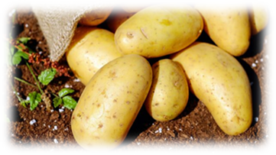
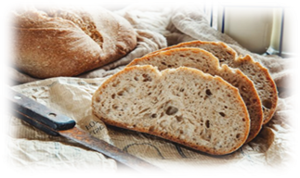
DO YOU KNOW THAT IF ALL THE FAMILIES OF THE HIGH SCHOOL RECYCLE WE AVOID THE PRODUCTION OF CO₂ 37.507 Kg of CO₂
IT IS EQUIVALENT TO 6,234 TRIPS BY CAR FROM TORO TO MADRID 230 km between Toro and Madrid
IT IS ALSO EQUIVALENT TO PRODUCING 176,250 KG OF POTATOES OR 44,396 KG OF BREAD

Slide 42
Water saving

Slide 43
Petroleum saving

Slide 44
SAVING TREES

Slide 45
GREEN POINT

