Slide 1
ReducING the use of plastics
How can we help to the world?

Slide 2
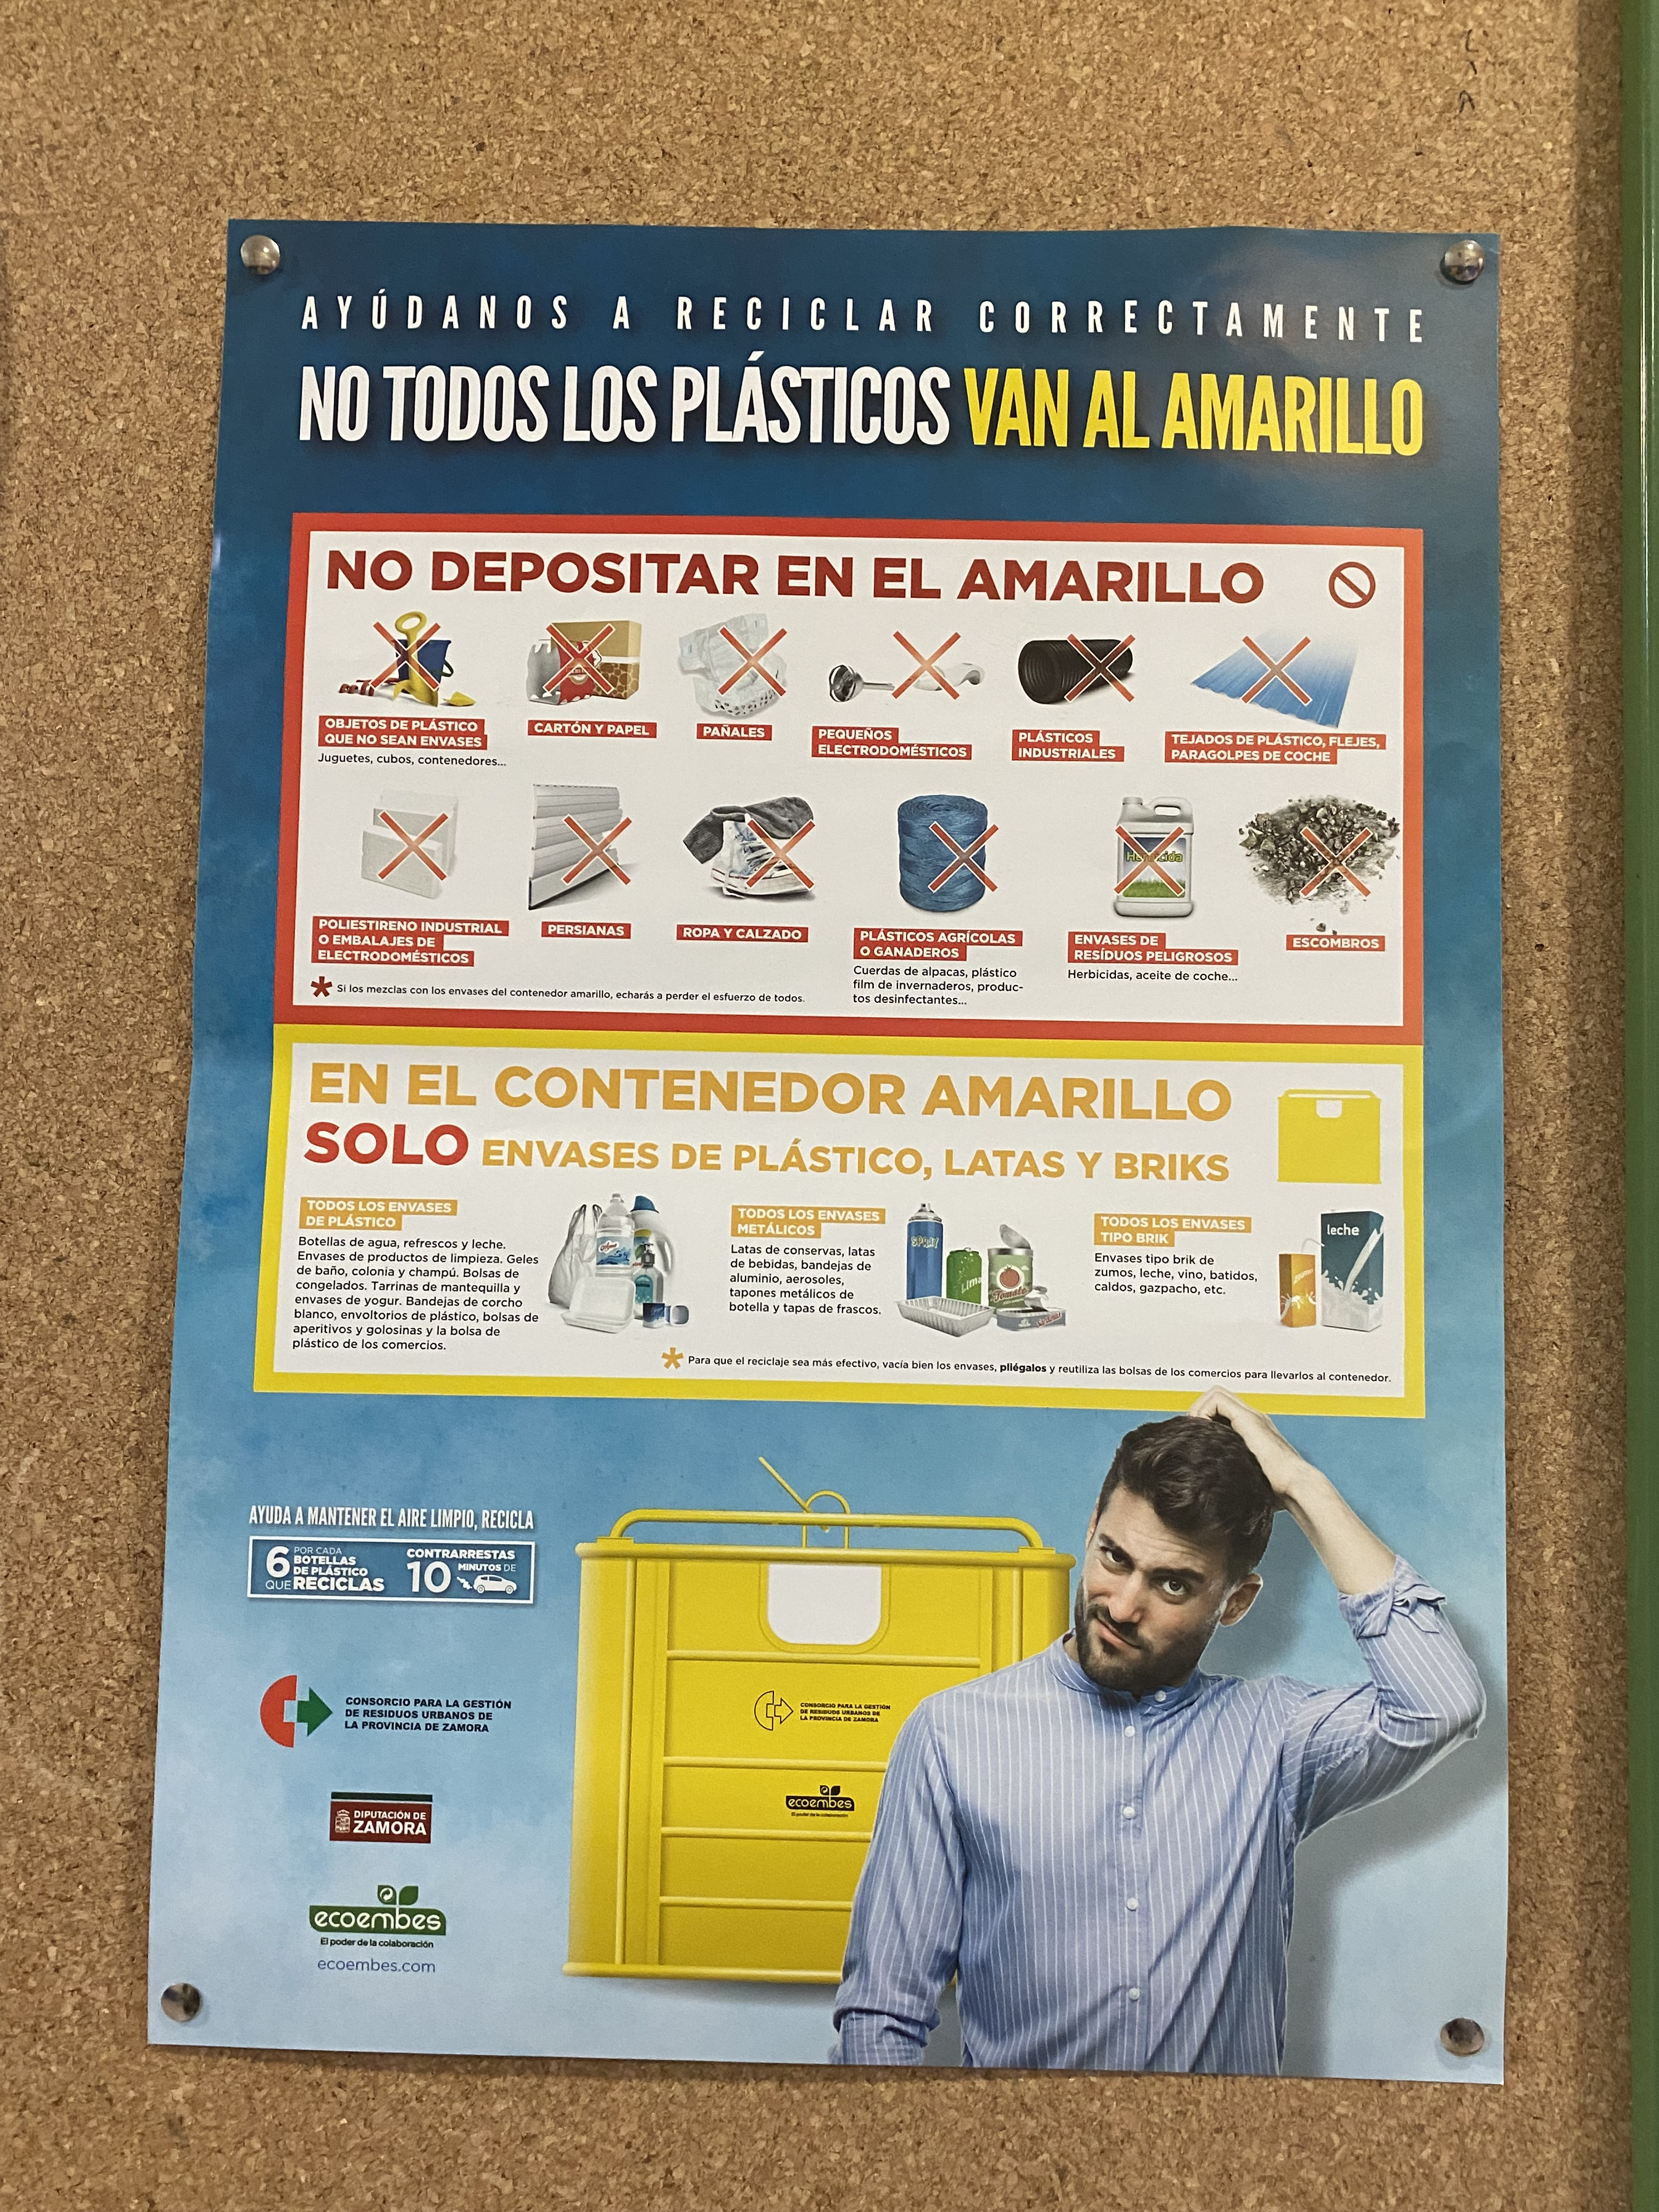
LAWS
1. The new waste law includes two new taxes and limits the use of single-use plastics
This law also includes:
-Tax on non-reusable plastic containers
-Reduce the volume of plastic
2. Law to reduce pollution with plastic -new and free delivery of single-use plastic straws throughout the national territory.
Failure to comply with the law will be sanctioned with a slight fine

Slide 3
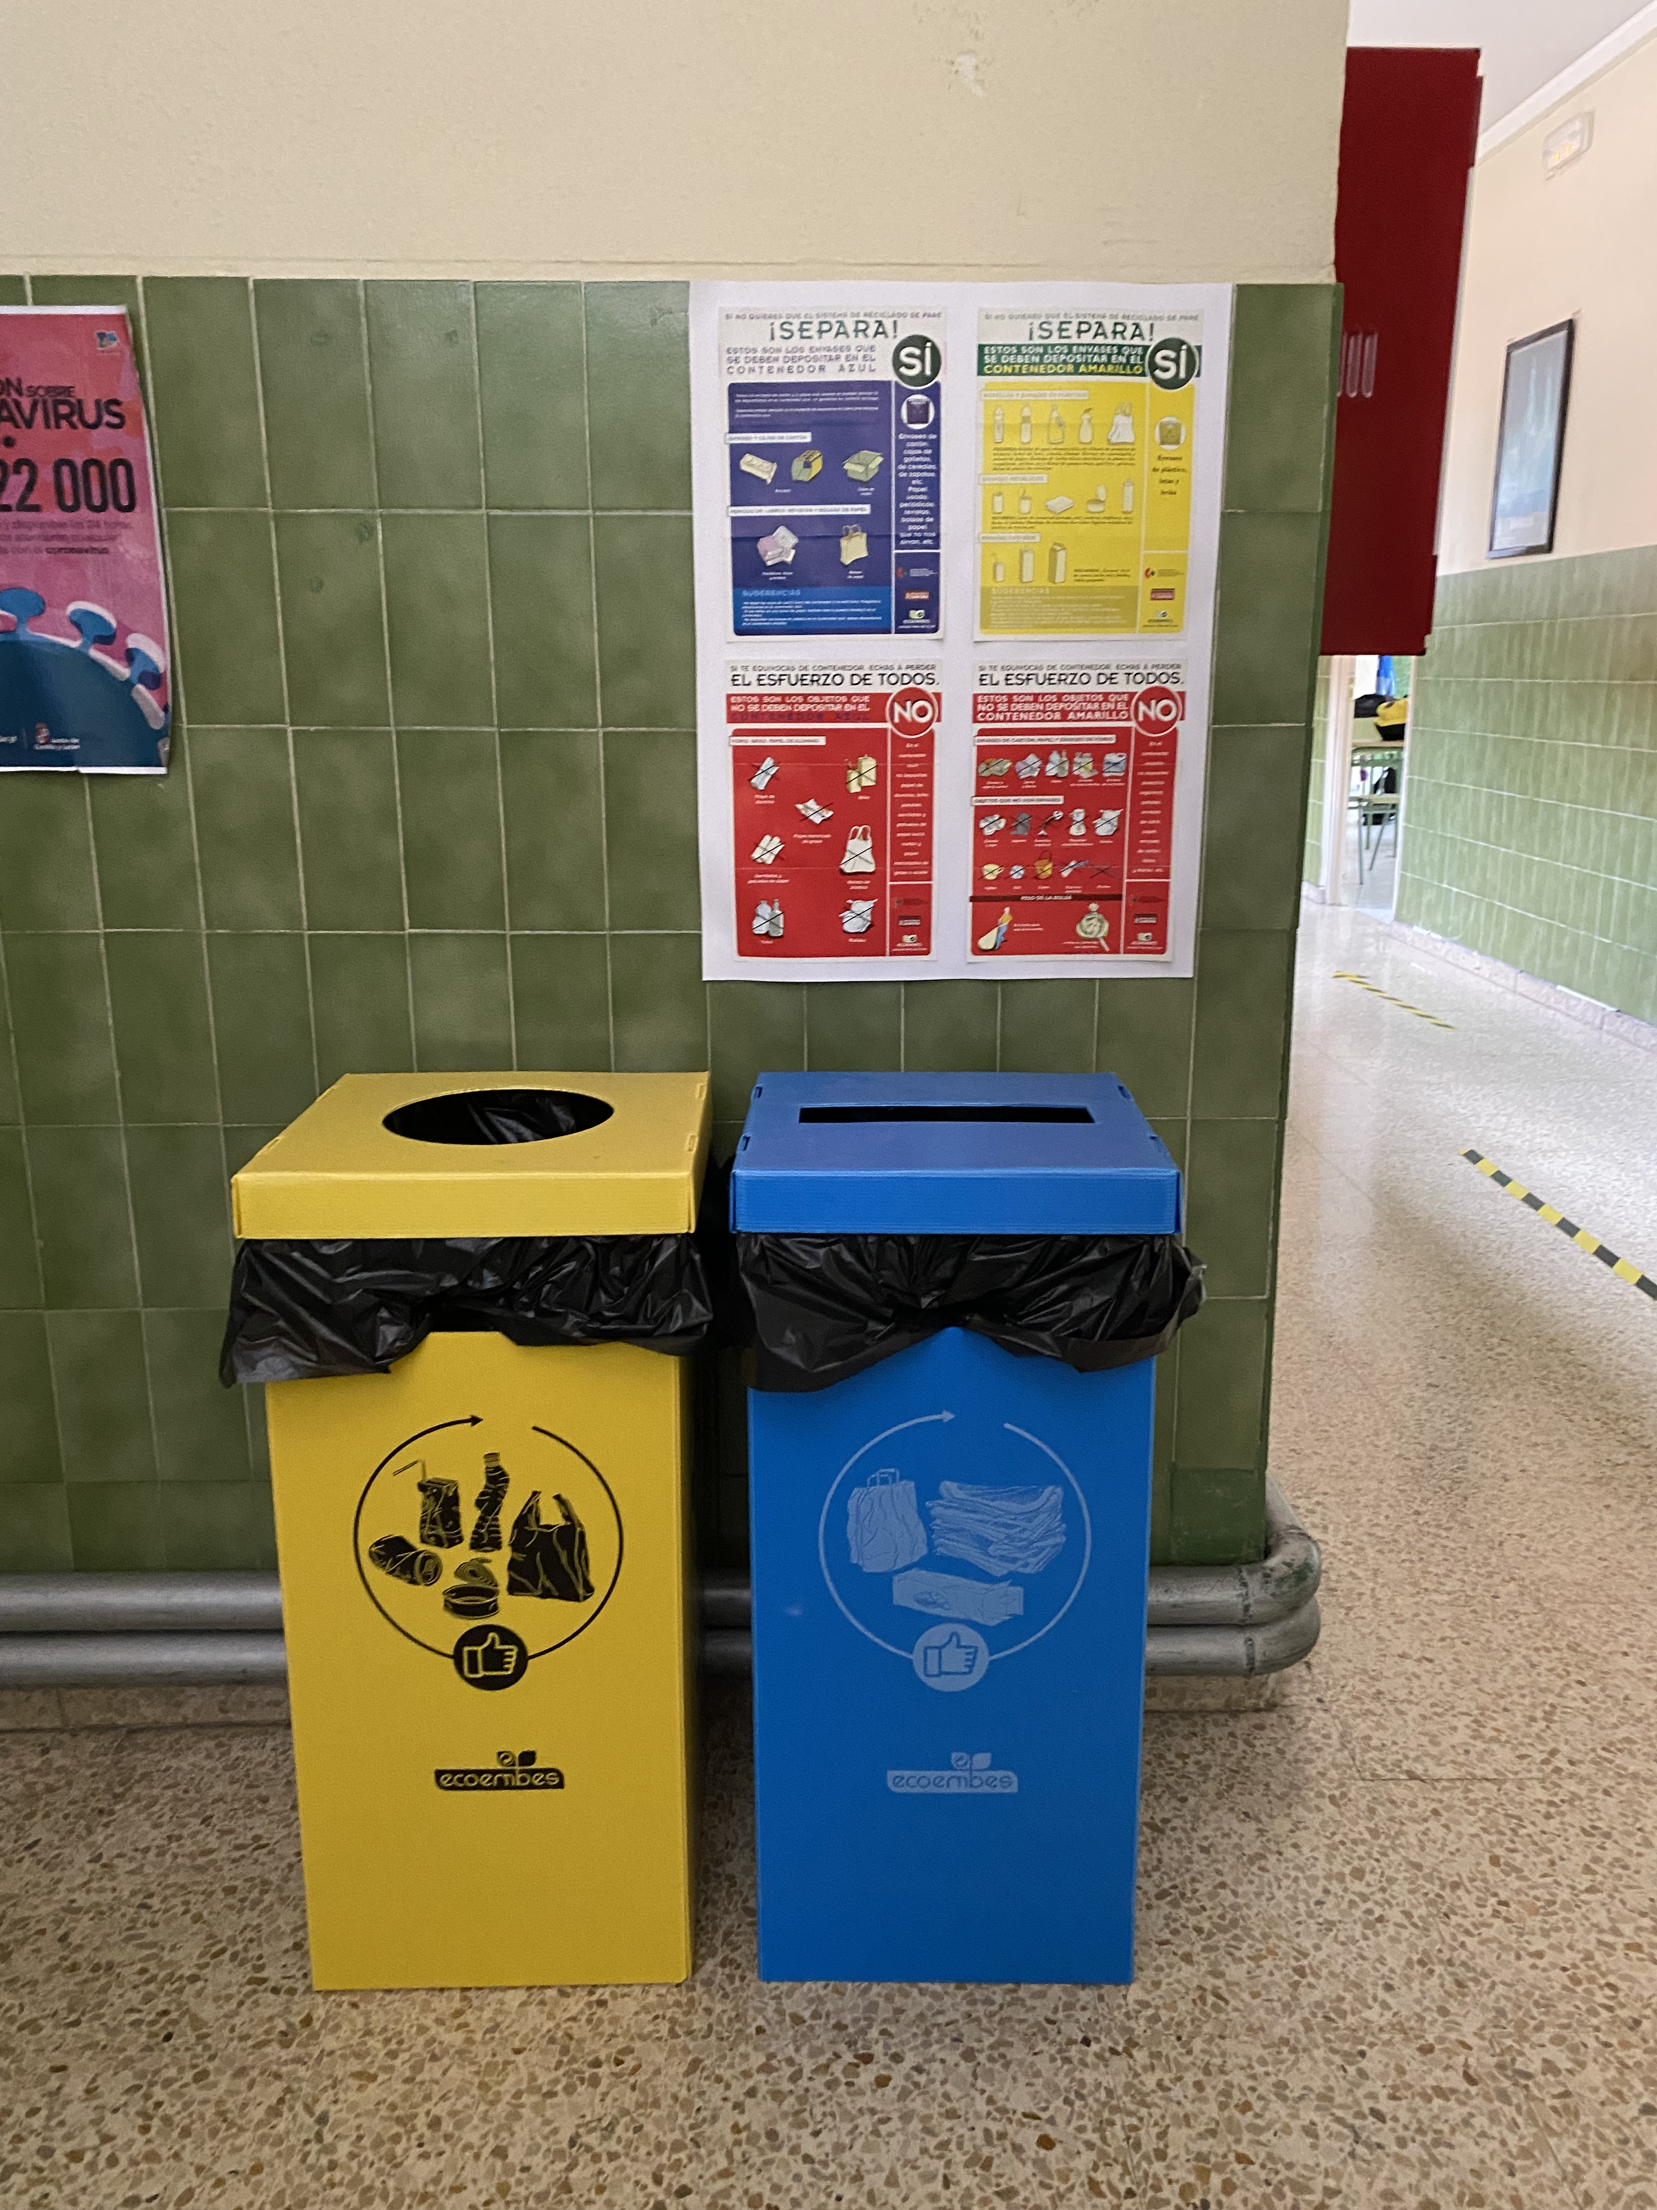
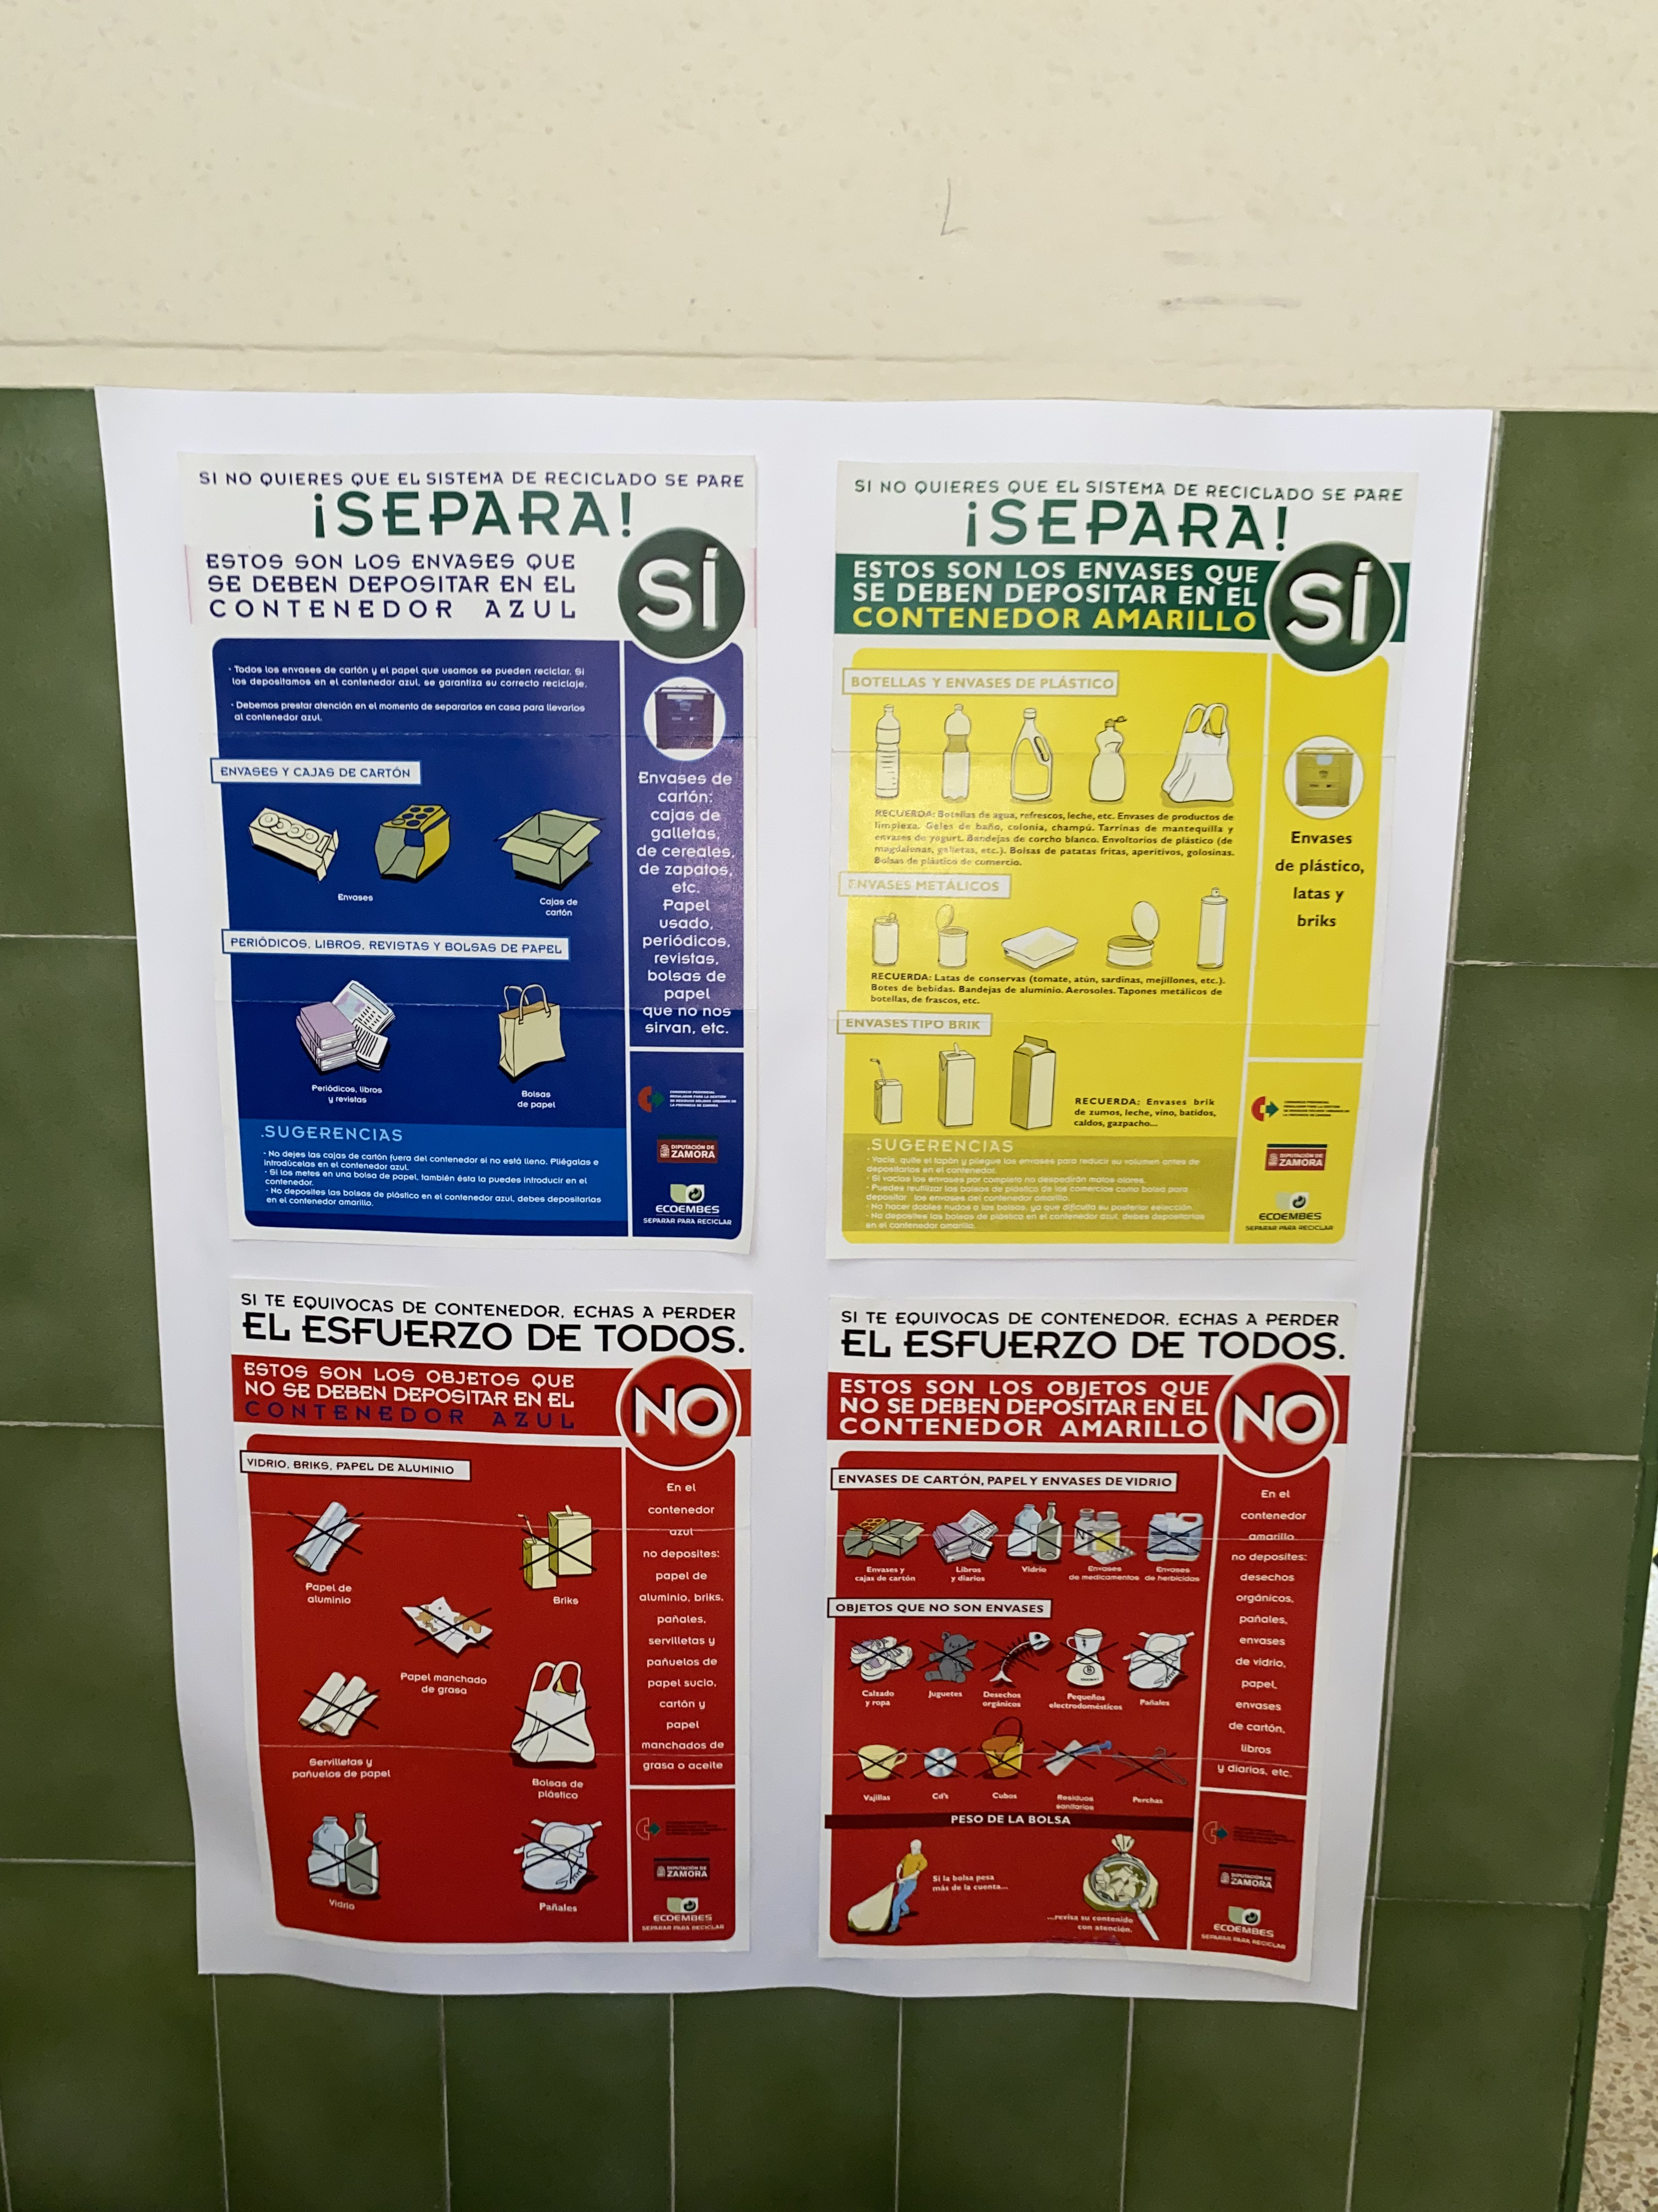
THE INICIATIVES LAUNCHED IN THE SCHOOL
Here in our high school, we use this method to recycle paper and of course plastic.
This type of bins are distributed throughout the school and the objective is to motivate students to recycle, not only at the high school but also at home.
In the yellow container we have to put waste, such as plastic containers, plastic bags, brick type containers ...
But, why do we have to recycle packaging?
Easy, recycling helps avoid the exploitation of natural resources. Recycling allows the original materials to be reused with a new use, without having to reuse natural resources to manufacture them.

Slide 4
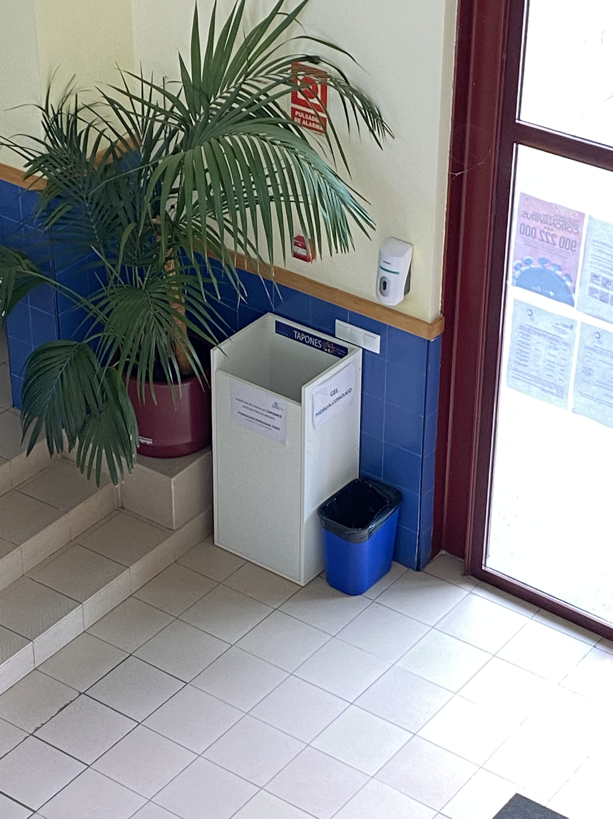
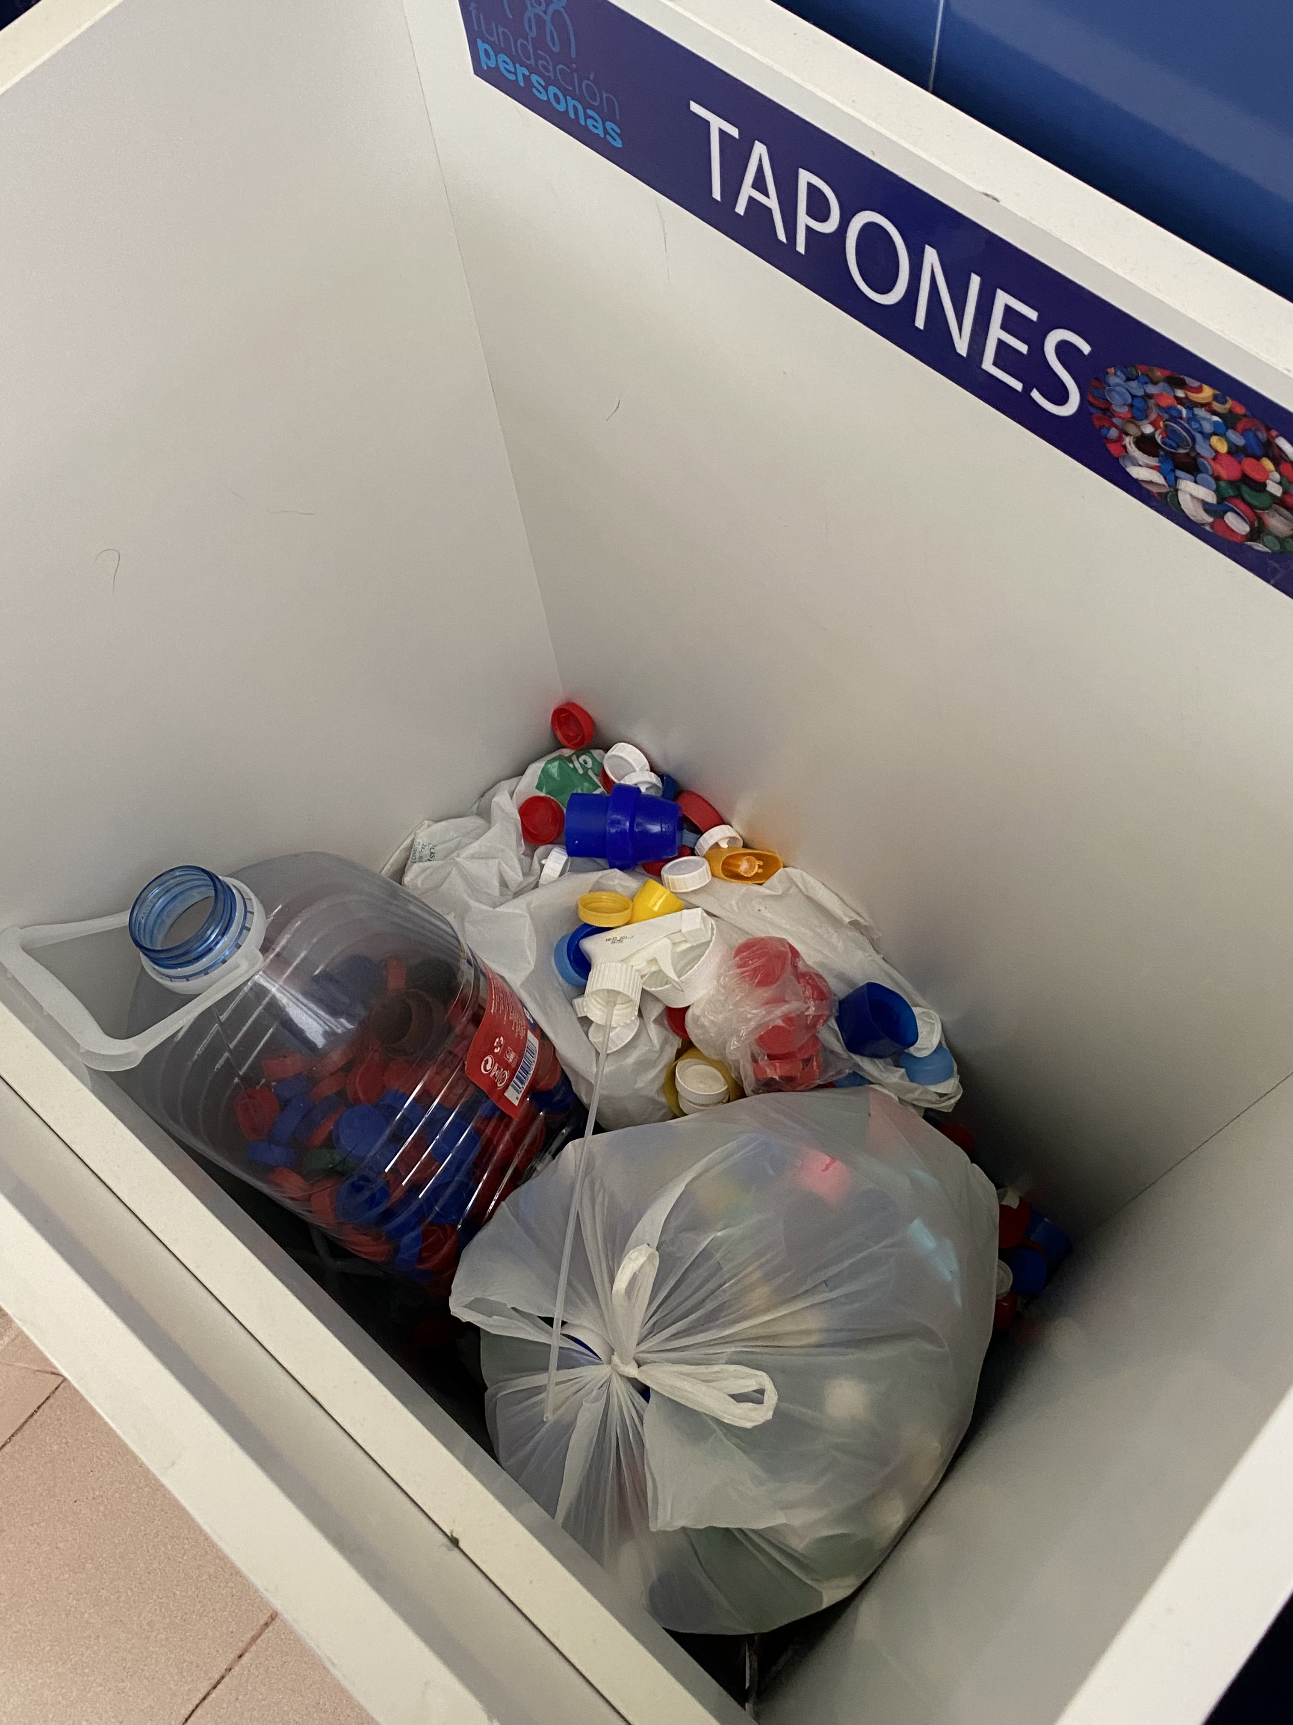
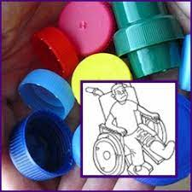
THE INICIATIVES LAUNCHED IN THE SCHOOL
At the high school, we collaborate with an association (we will talk about and explain about that association later) that consists of collecting caps to donate to different types of associations so, they can be used to buy wheelchairs for disabled children
The caps are in a wooden box in the hall of the high school,. It is easier for people to see them and to collaborate with the association and with the recycling of plastic.
With this recycling method, we recycle plastic and also help people who need help

Slide 5
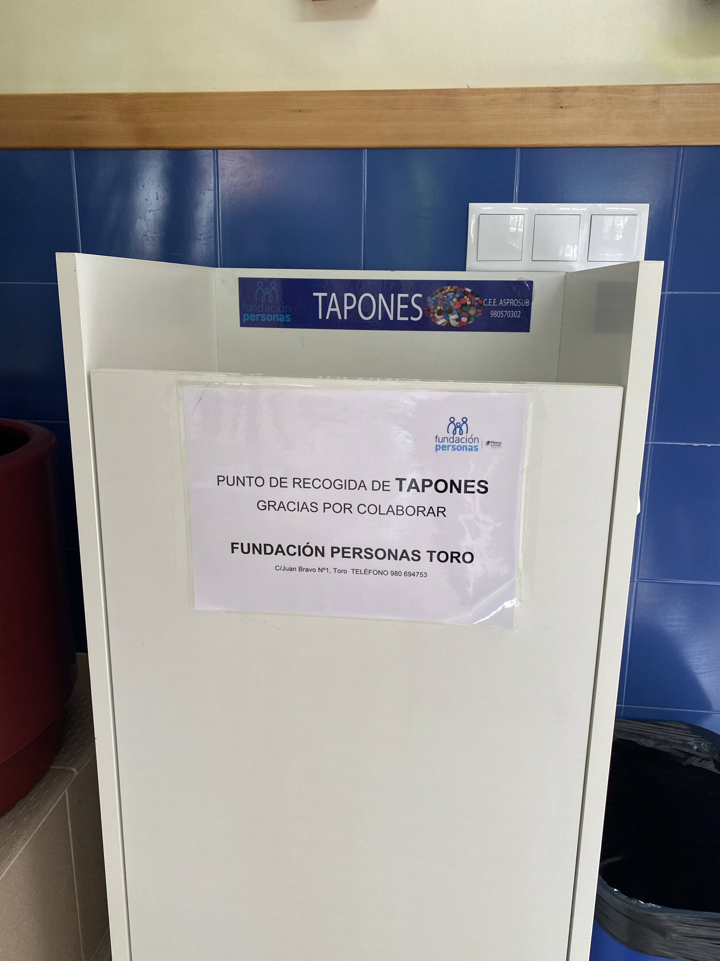
ASSOCIATIONS THAT WORK TO PROMOTE THE REDUCTION OS PLASTIC
It Is an association that attends to the needs, expectations and capacities of each person throughout their entire life
Its mission is to promote prevention, care and inclusion of people with intellectual disabilities. Provide services that improve their quality of life and that of their families.
They have three Special Employment Centers and some other centers distributed in:
Palencia, Valladolid, Segovia, Zamora and Guardo.

Slide 6
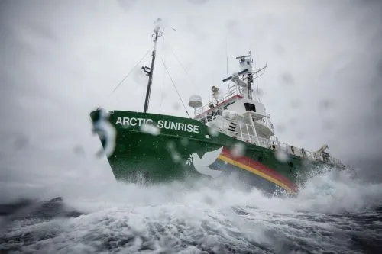
ASSOCIATIONS THAT WORK TO PROMOTE THE REDUCTION Of PLASTIC
It is an "international, economically and politically independent environmental and pacifist organization that does not accept donations or pressure from governments, political parties or companies.”
They work for
-Stop climate change.
-Protect biodiversity in all its forms.
-Prevent pollution and abuse of the oceans, land, air, and fresh water.
-Promote peace, world disarmament and non-violence.
THANKS FOR WATCHING AND LISTEN TO OUR PRESENTATION!!

