Slide 1
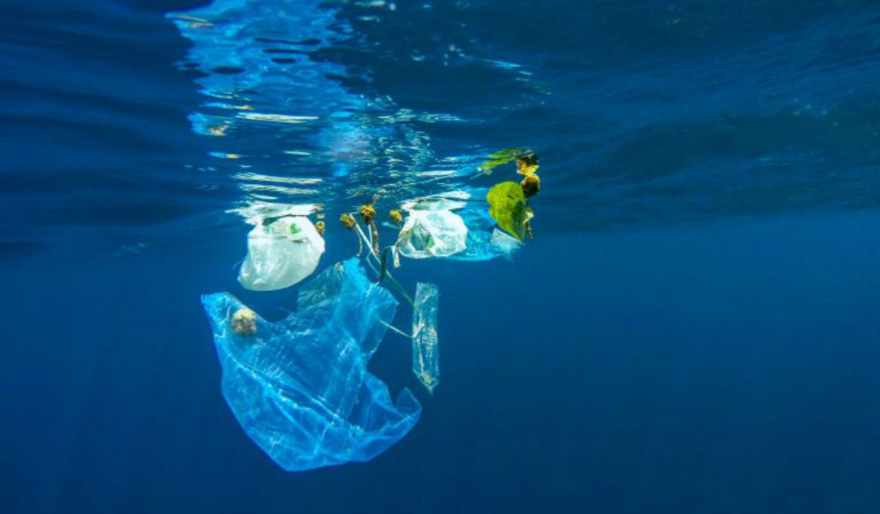
WHAT ABOUT PLASTIC ALONG THE COASTS OF SPAIN?

Slide 2
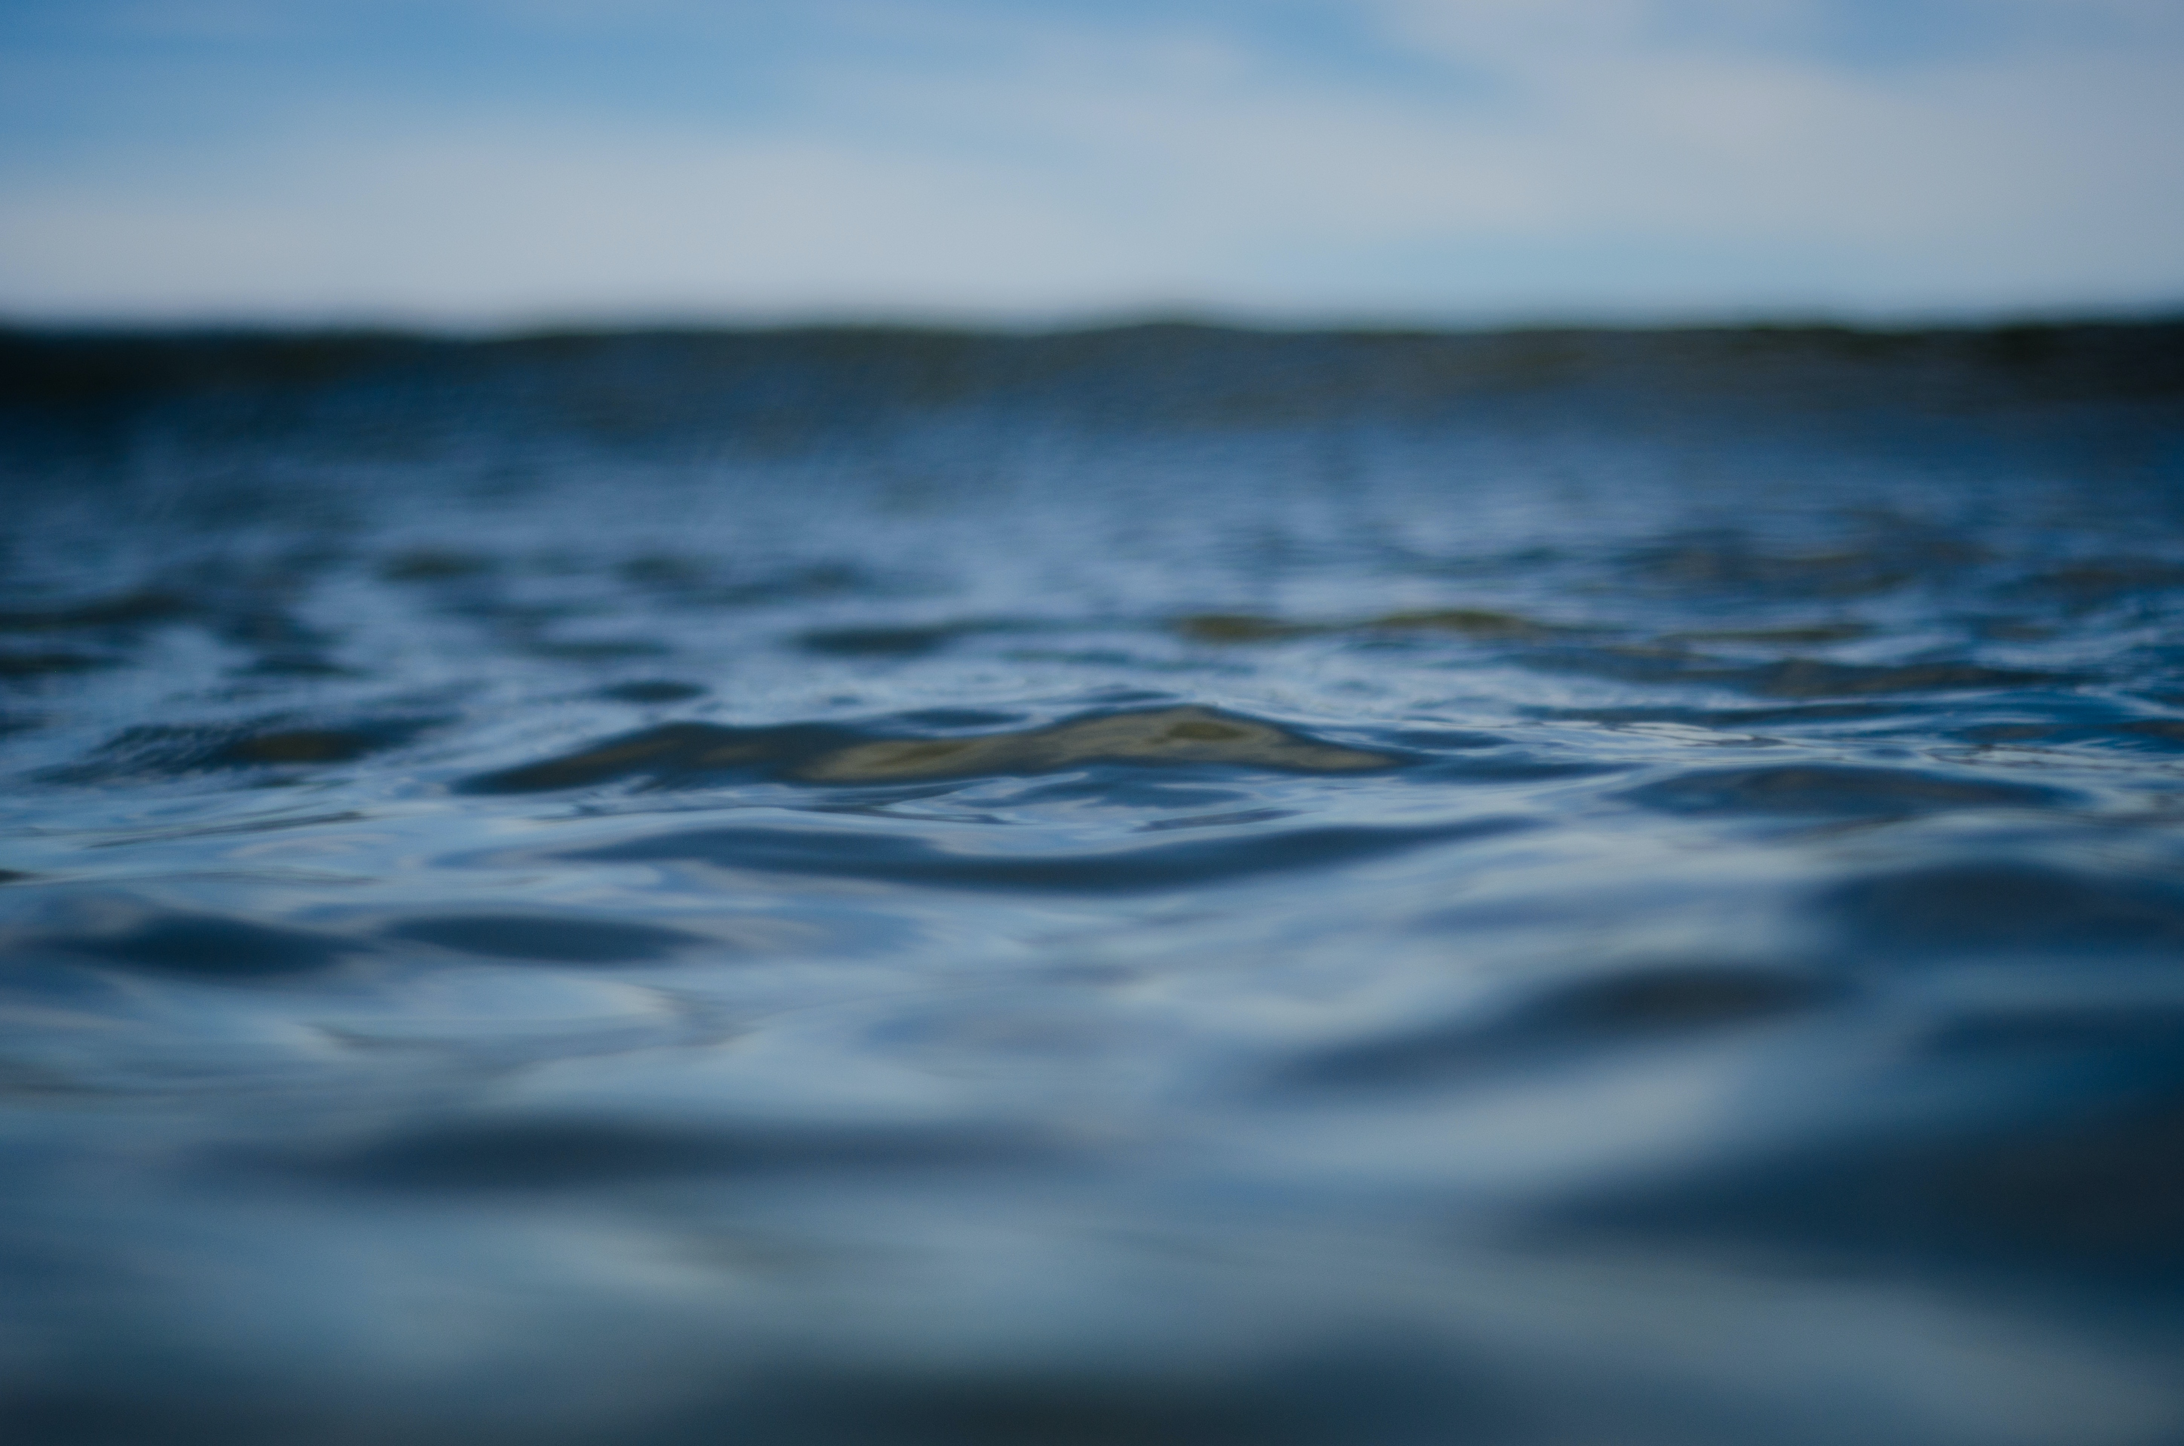
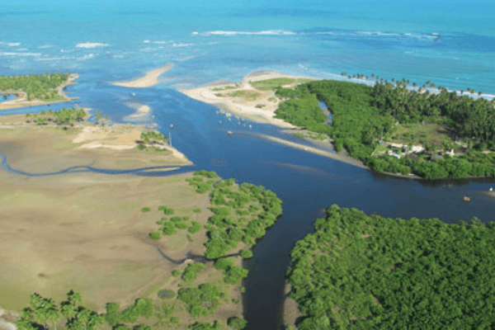
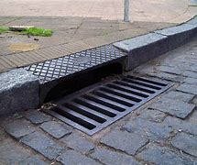
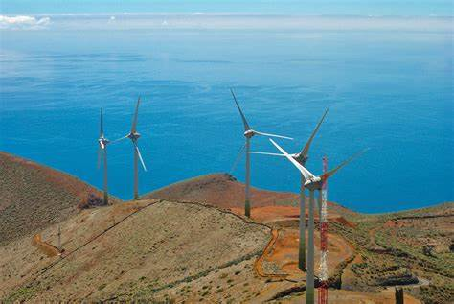
Where does it come from?
80% of the plastic that is discharged into the sea comes from land, that is, -- through rivers
- sewage systems
- dragged by wind or storms.

Slide 3
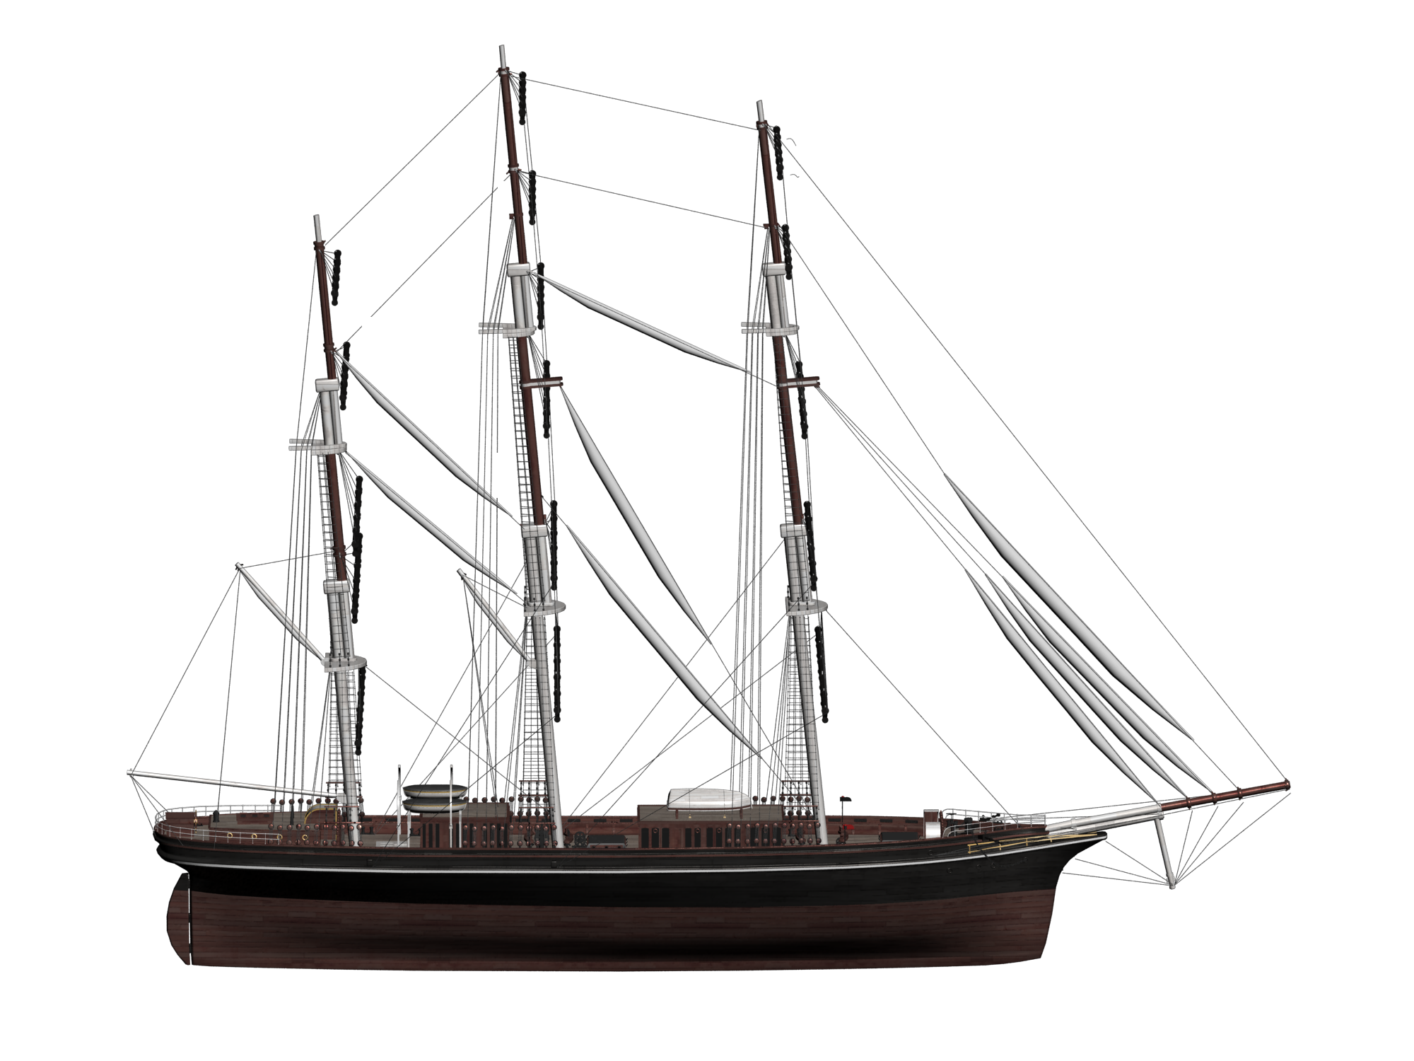
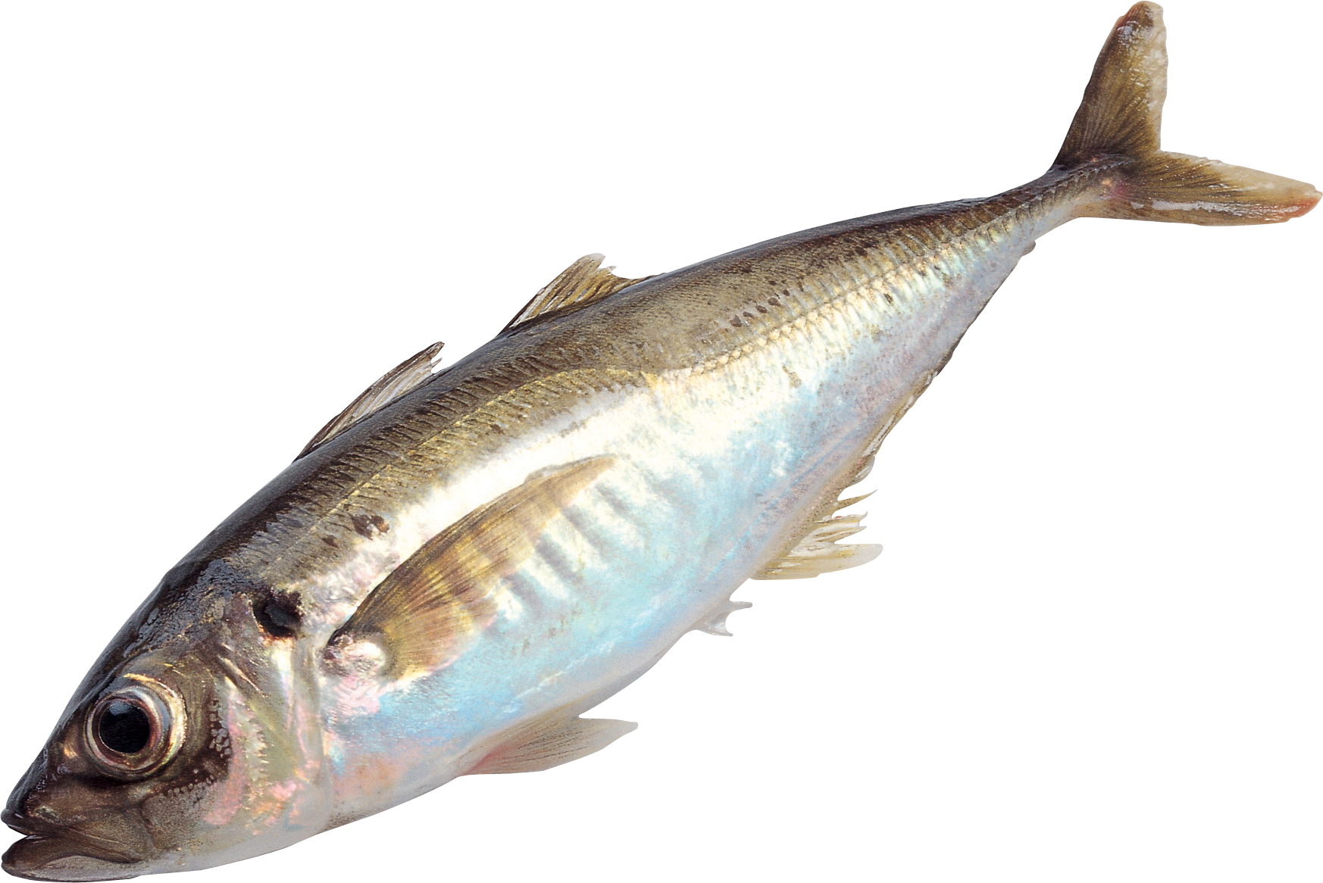
Where does it come from?
And the remaining 20% comes from offshore waste such as:
gasoline
fishing nets...

Slide 4
What is this waste like?

Slide 5
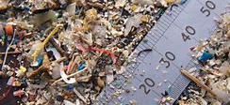
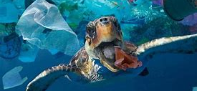
How is the situation today?
Spain is one of the countries with the most plastic on its coasts, it falls within the 10 countries that pours more plastic into the sea in the world.
One of the biggest problems of plastic are microplastics since marine species can ingest them and we can also ingest them as well as breathe

