Slide 1
International exchange project

Slide 2
Questionnaire

Slide 3
Exchange (general information)
Participating countries

Slide 4
Exchange (general information)
The main goals of the project are:
Digital learning
International collaboration

Slide 5
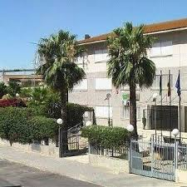
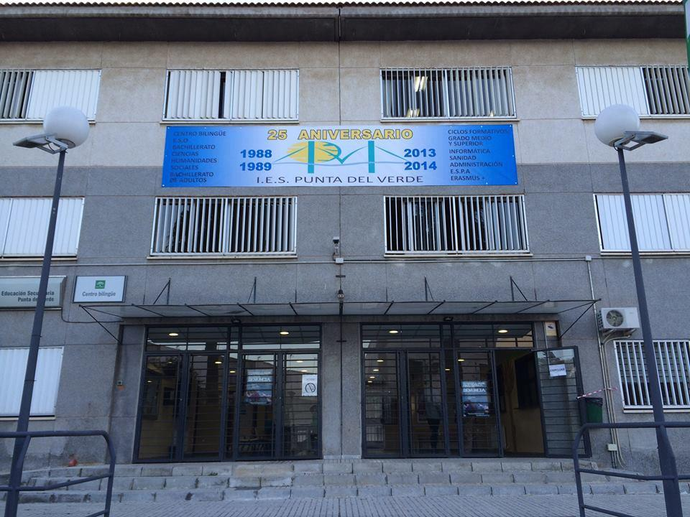
Exchange (Spain)
IES Punta del Verde
Experienced in Erasmus+ projects
Familiar with Farelcollege (Job-shadowing 18/19)
Host families

Slide 6
Twinspace
Login codes for teachers and students
Communication:
-Exchanging good practices
-Sharing products and experiences

Slide 7
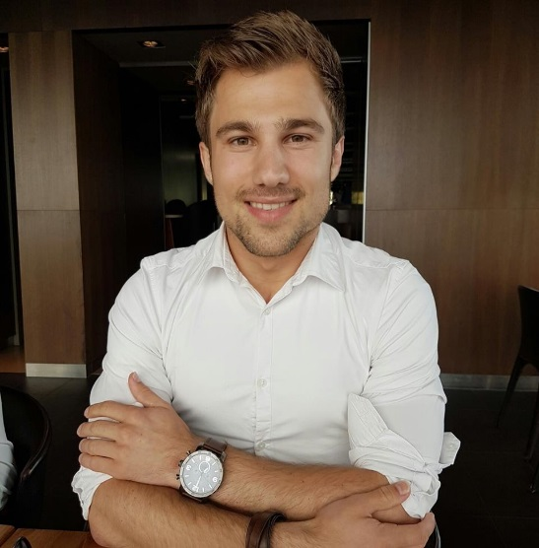
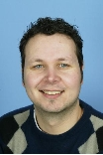
Practical information
Supervisors on the exchange to Spain
D.R.Giesbers +31657949545
S.I.J. van Wissen +31634184107

Slide 8
Practical information
What we need from you:
Information for booking a flight.
Allergies, diets, etc.
Contact information
Host family
Etc..?

Slide 9
Questions?

