Slide 1
International exchange project

Slide 2
Exchange (general information)
Participating countries

Slide 3
Exchange (general information)
The main goals of the project are:
Digital learning
International collaboration

Slide 4
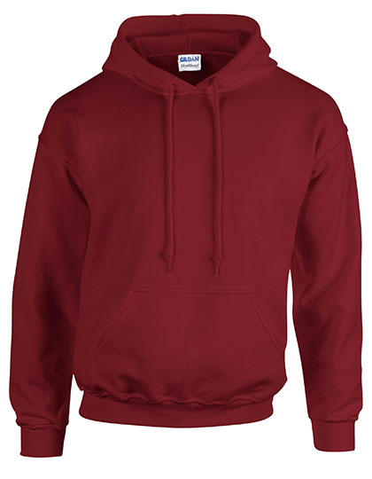
Logo competition
Digital or on paper
Prize for the best logo
Best logo will be used for the project.
Submit in postbox Dhr. Van Wissen (outside of his office).
Logo will be printed on exchange hoodies.

Slide 5
Questionnaire
General knowledge about project and international collaboration.
Receive codes from GIE in mail.
Both you and your parents need to answer the questionnaire.
TO DO: Fill in the questionnaire.

Slide 6
Info video about the Netherlands
Gives an idea of Dutch culture / habits.
Gives an image of the surroundings / landscape.
Gives an impression of the school.
TO DO: Create a clip

Slide 7
Twinspace
Login codes for teachers and students
Communication:
-Exchanging good practices
-Sharing products and experiences
-Personal profile
TO DO: Create a ‘digital postcard’

Slide 8
Practical information
Student mobility dates:
Spain = 25-11-19 to 29-11-19
Poland = 30-03-20 to 03-04-20
Italy = 05-10-20 to 09-10-20
Portugal = 22-02-21 to 26-02-21
NL = 08-03-21 to 12-03-21

Slide 9
What we need from you
Fill in the questionnaire
Update your Twinspace (digital postcard)
Create a logo for the project
Create a informative video about NL
Your size (for the hoodie)
Become a host family

Slide 10
Questions?

