Slide 1
Our trip to the Netherlands

Slide 2
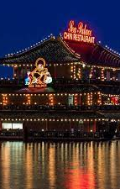
Arrival day
on our first day we visited the capital of the Netherlands, Amsterdam. Masto is beautiful and full of new architecture everywhere. We visited the red light district and took a boat trip on the rivers of the city. we saw restaurants and houses on the water. The next point was meeting our hosts, with whom we returned to their homes.

Slide 3
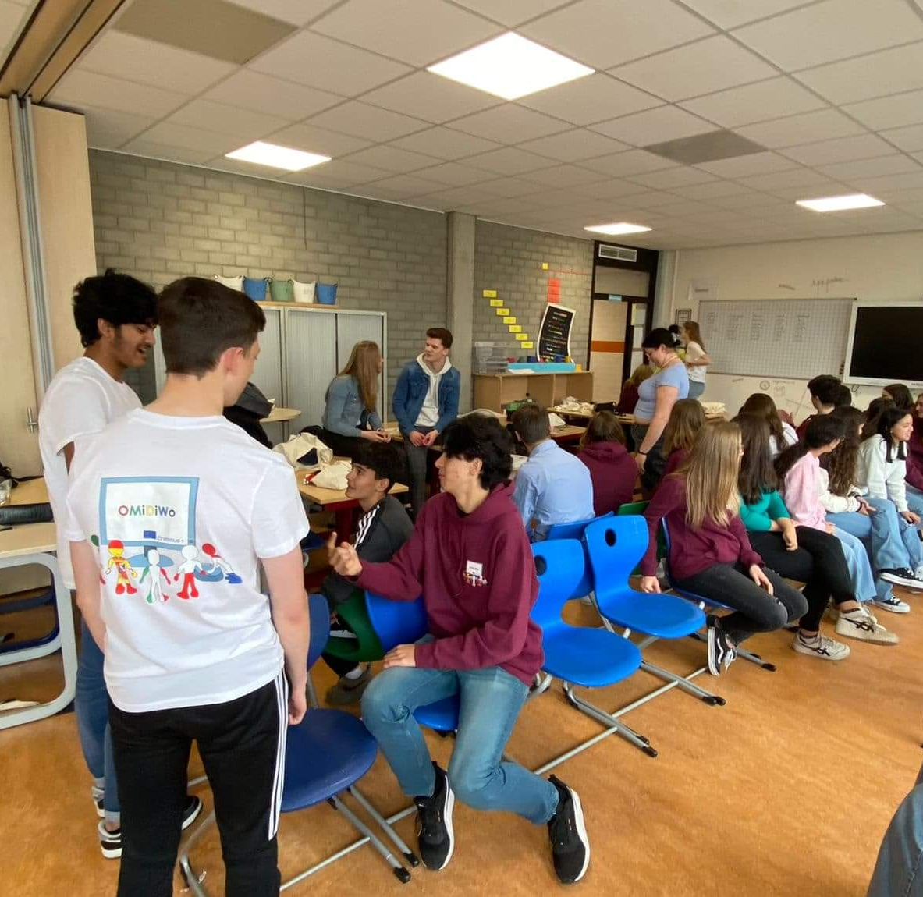
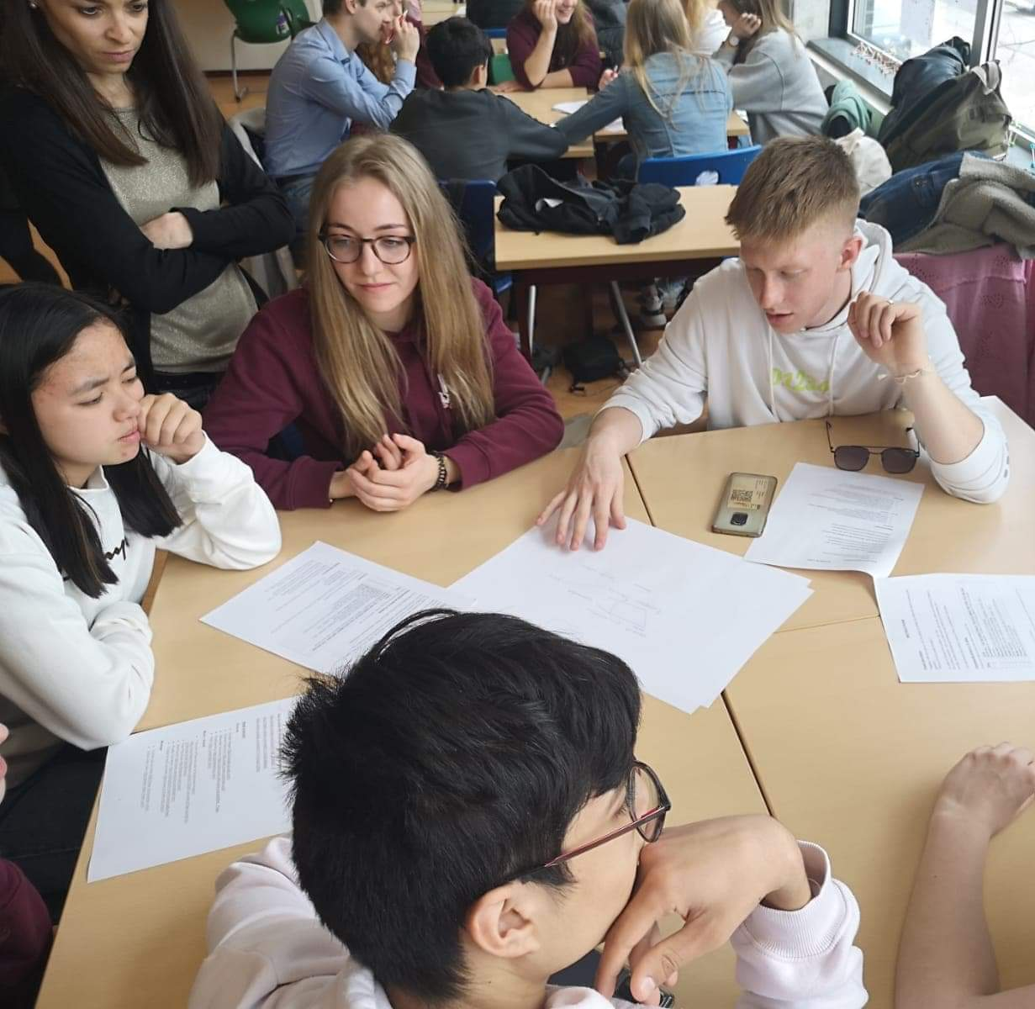
The second day
on the second day, we visited our hosts' school - Farel College - for the first time. Then there was a welcome where the project coordinator from the Netherlands told us what we were going to do during this trip. For the next few hours, we played all kinds of integration games with different people. While playing the dancing chairs, by cheating a bit, I managed to win the competition. On that day we were divided into groups in which we had to make a film about what European identity means to us.

Slide 4
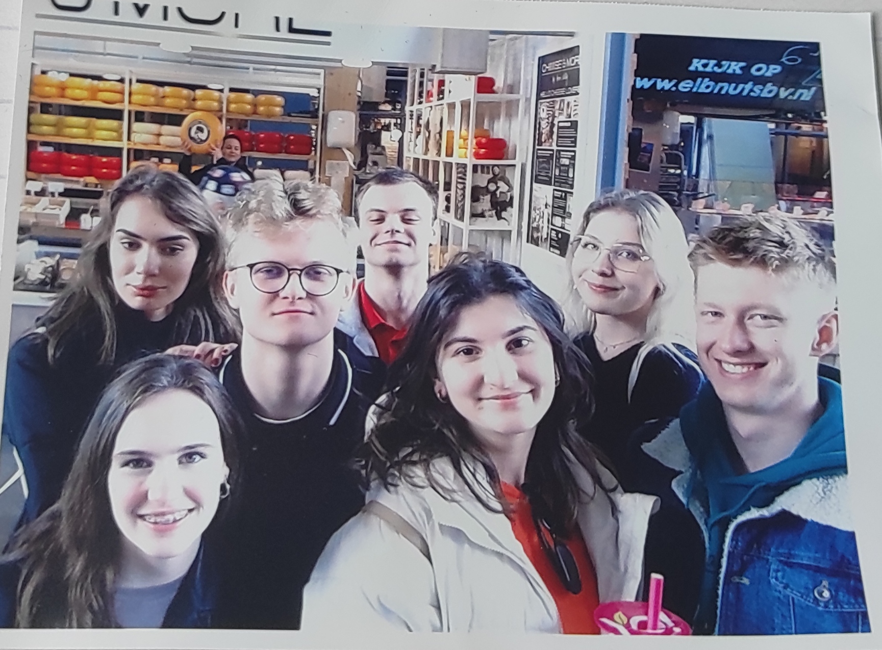
The third day
On the third day we went by water bus to Rotterdam. It is a large and modern city. We visited a very large faith called Euromast there. Then we rode our bikes to the harbor where we got to the boat restaurant which mainly serves pancakey. My plan was to break this restaurant's record, which is to eat more than 17 pancakes. after leaving the restaurant, we went to a large market in which we had free time, during which we took a photo of ourselves in our small group of friends.

Slide 5
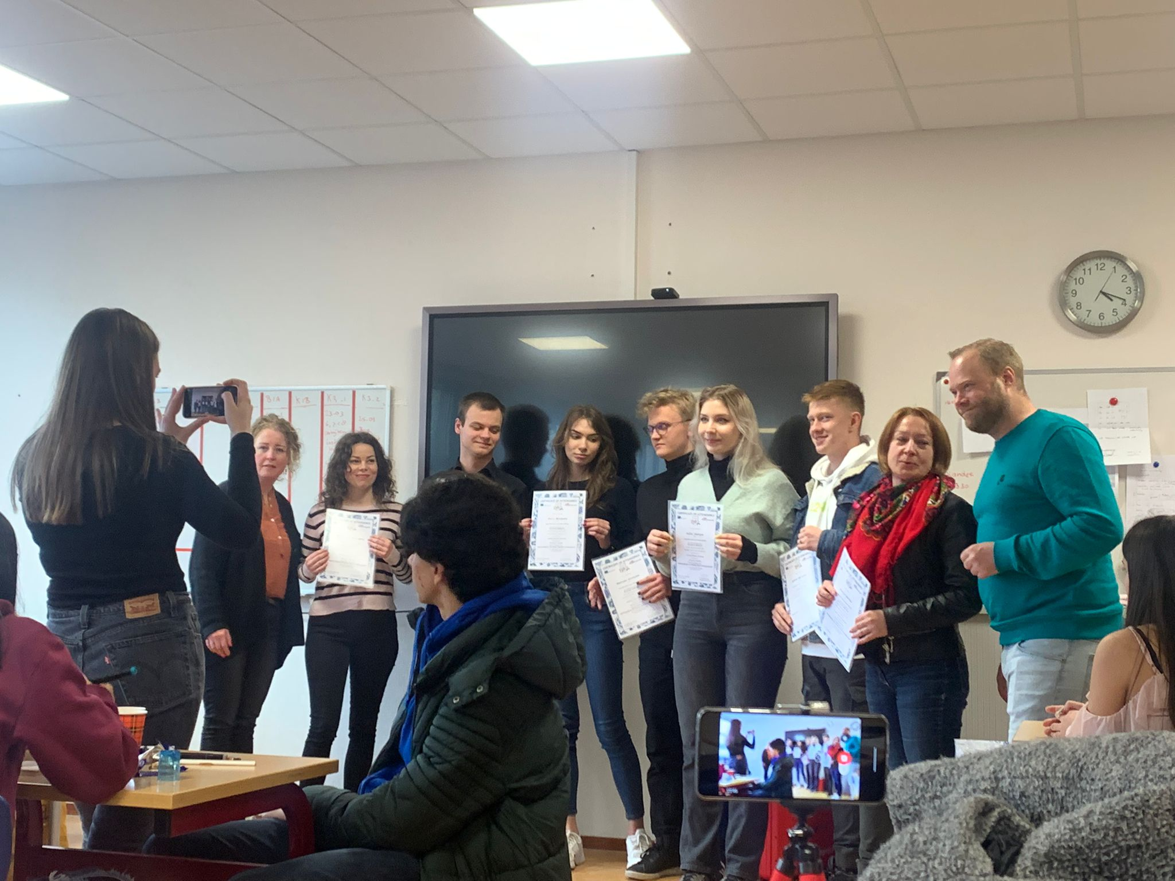
The fourth day
The fourth day of our stay focused on presenting our films with reference to the European identification we made in the groups. After this presentation, we received certificates of completion of the project. The last and best part of the trip was the evening on Thursday when we all went together to the pizzeria where we had a great time talking and pizza

Slide 6
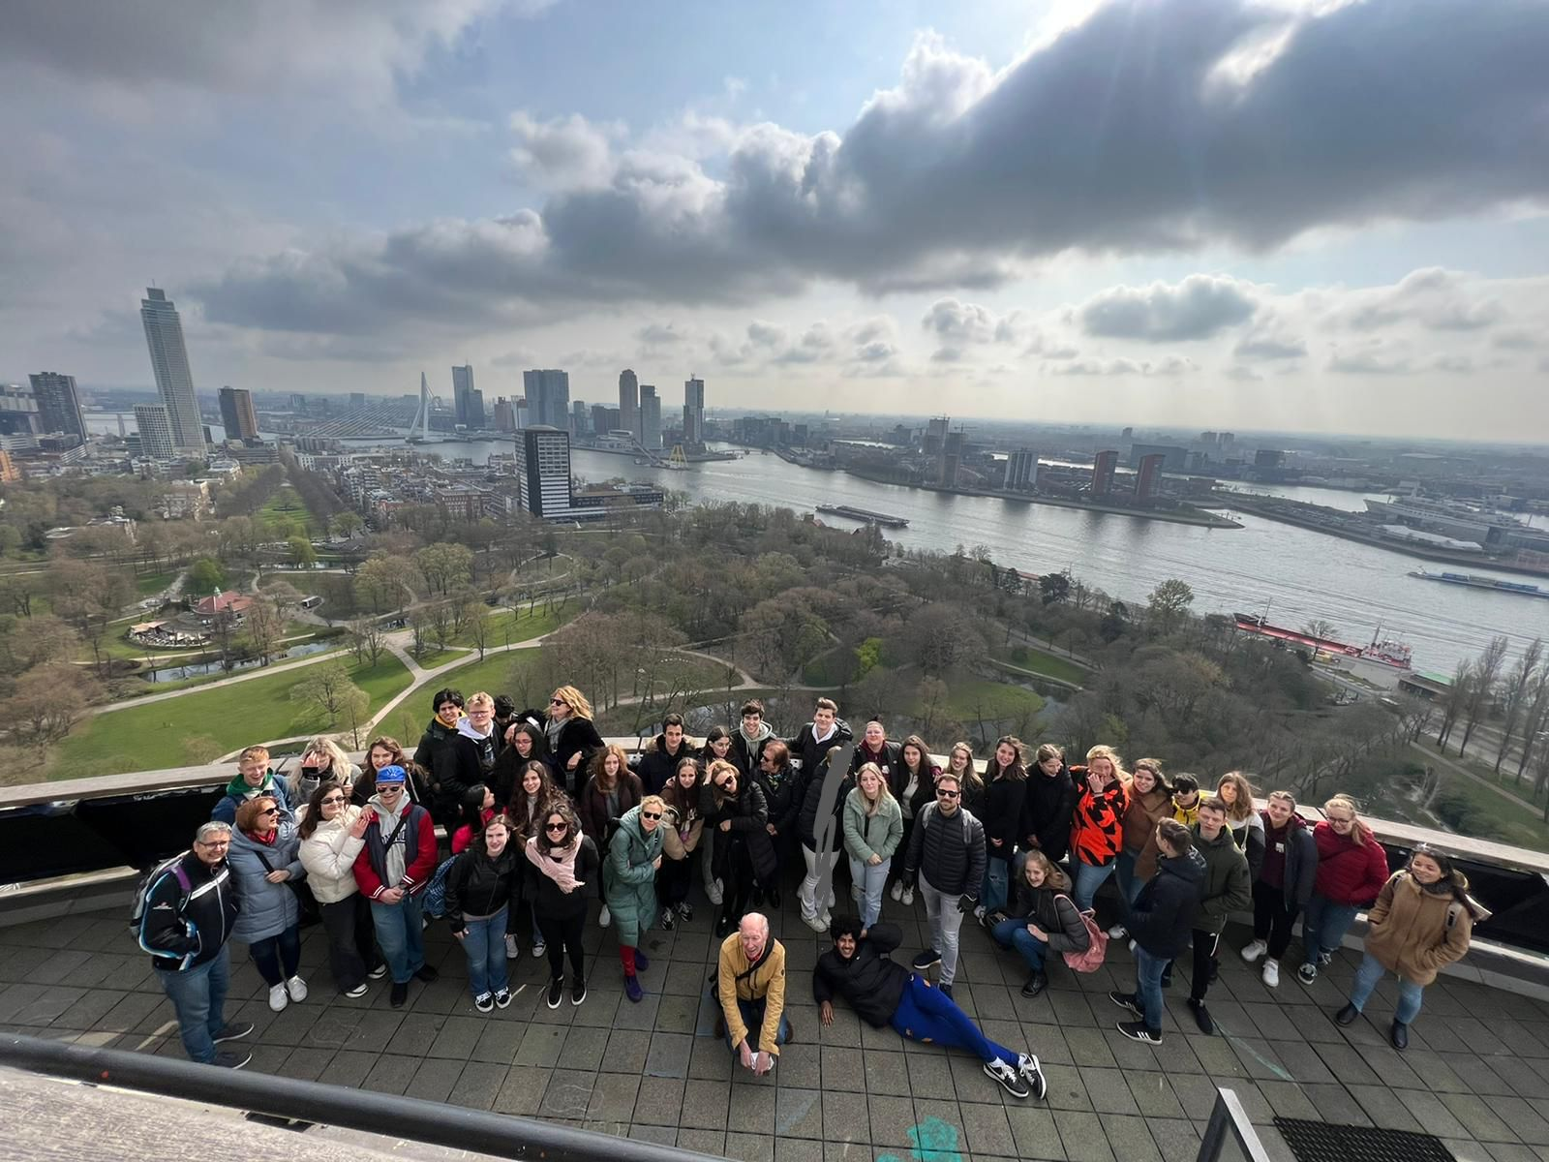
departure day
on the last day at 6.30 we said goodbye to our hosts and returned to the airport from where we returned home.
Goodbye holland we will be back ...

