Slide 1
Open Your Mind - Perils Of Digital Learning

Slide 3
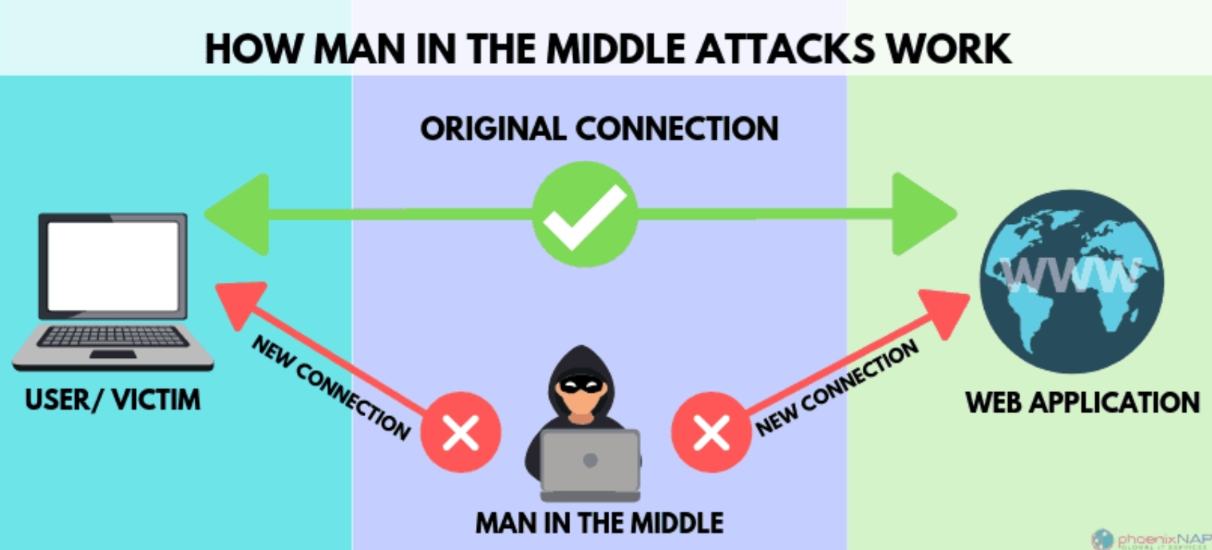

Slide 7
