Slide 1
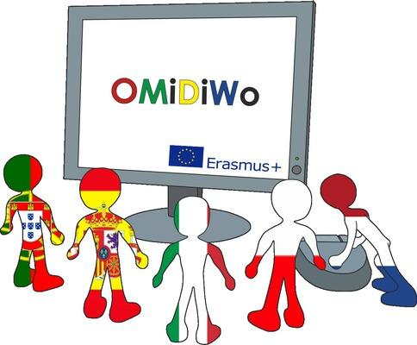
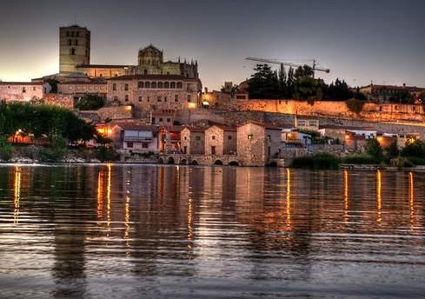
Impressions mobility C4 to Braganza by Spanish team

Slide 2
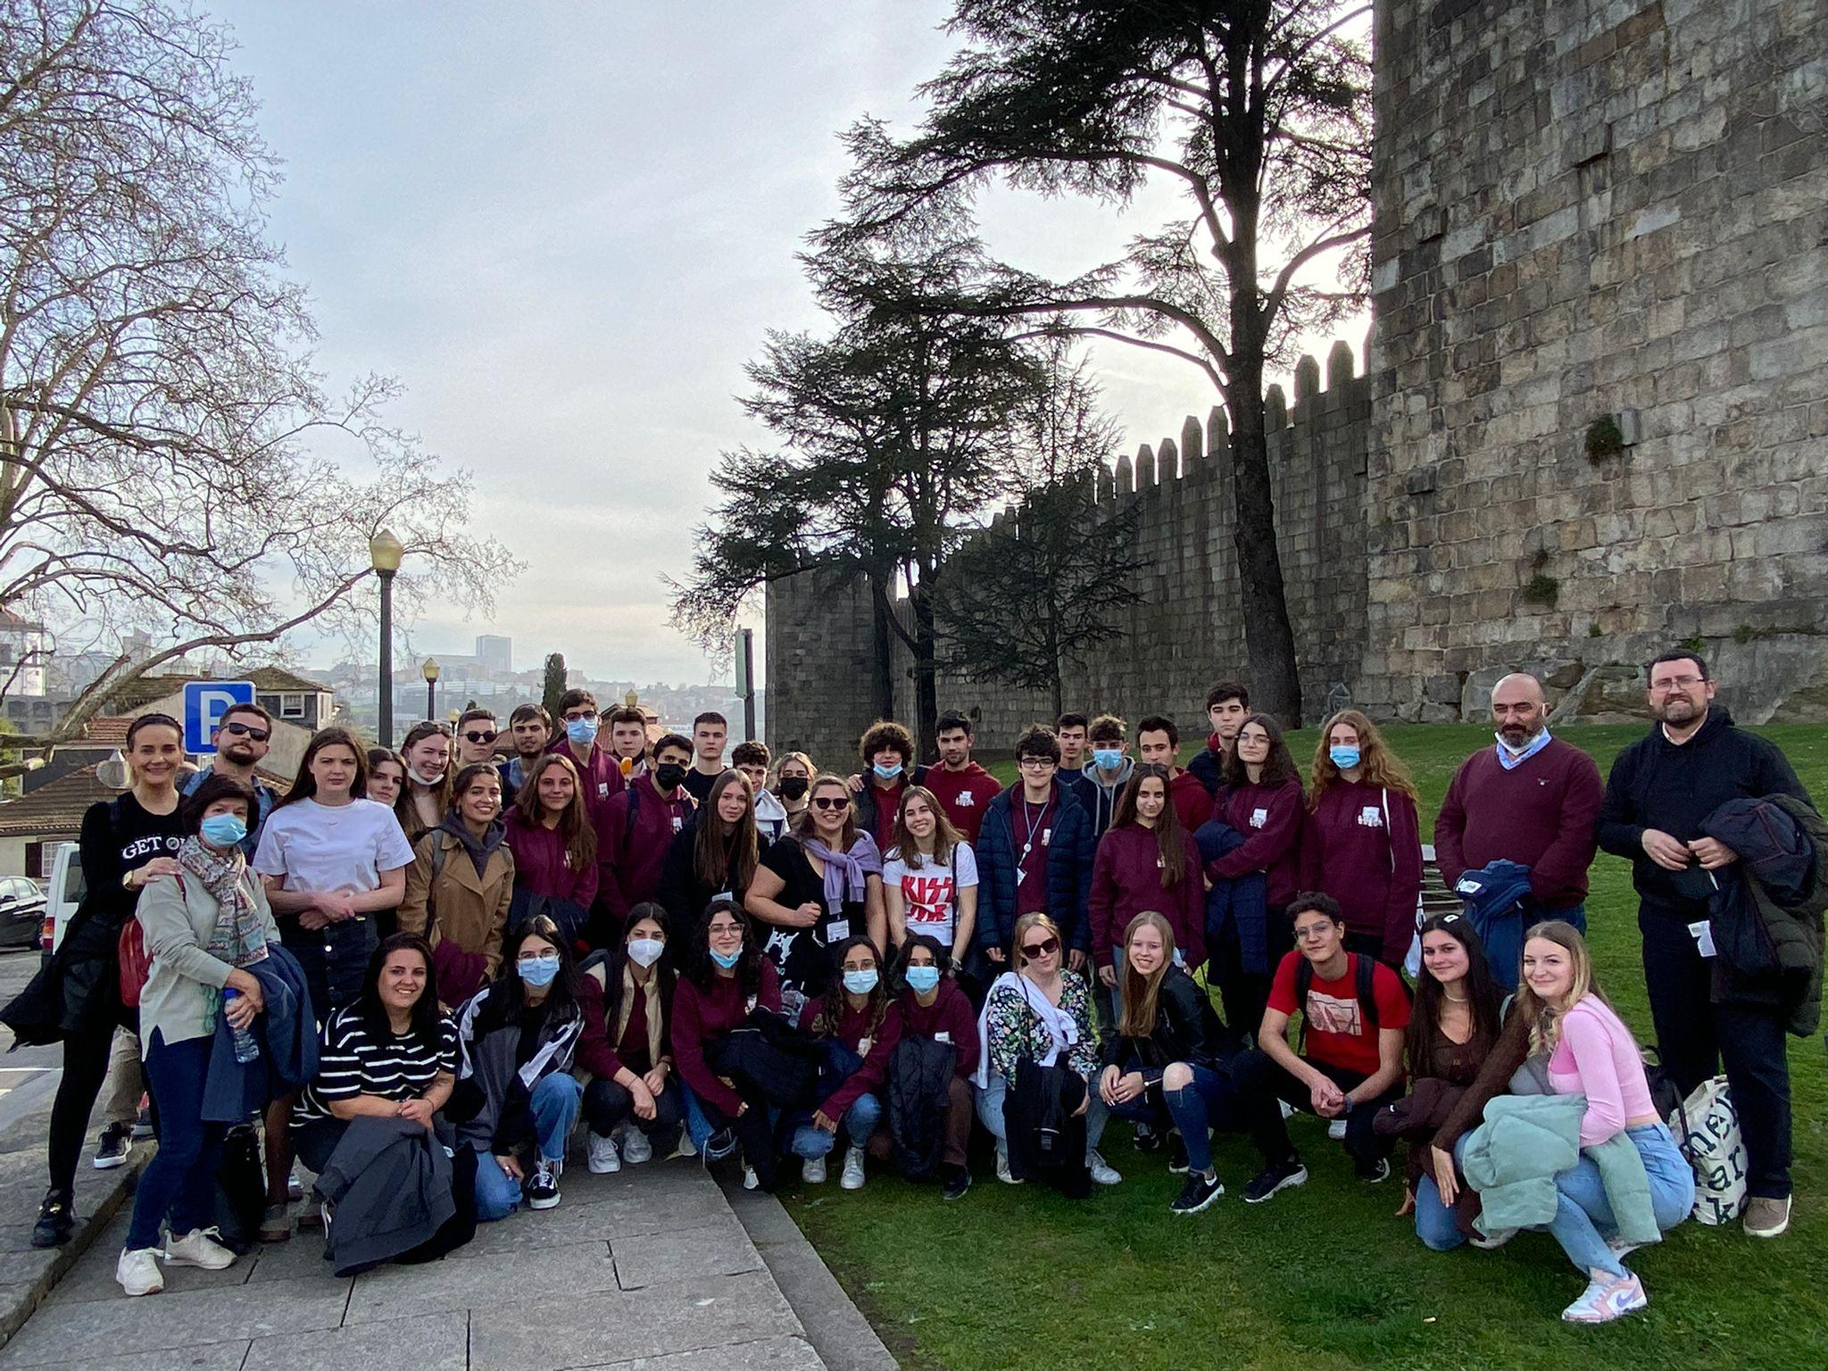
Mario Acedo
This experience was incredible, Braganza is a gorgeous town with magnificent views, my host family were incredible all of them were kind and pleasant, in this trip i had the chance to see the similarities and differences between the Spanish and the Portuguese, Braganza school was just magnificent, with a lot of useful facilities, thanks to this experience i could know more about other countries. Just Incredible.

Slide 3
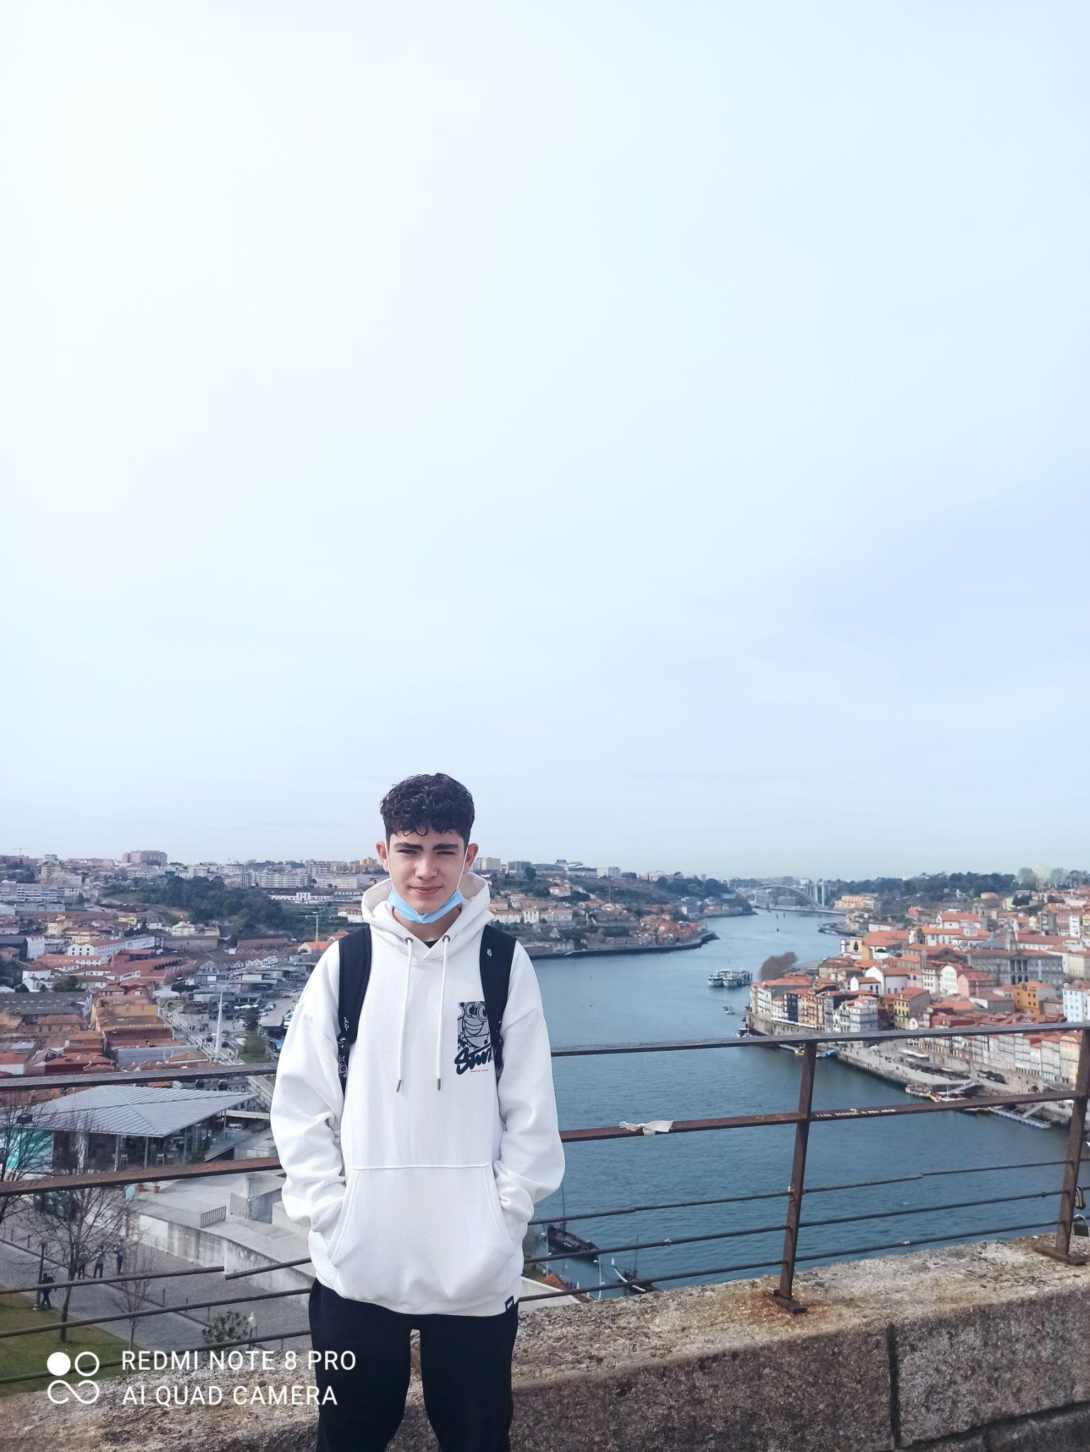
Alvaro Bayón
This experience was very enriching and it was an opportunity to make friends. My host family was very good to me and I got along very well with Pedro, the boy who welcomed me into his house. I was very surprised by how big your institute was, which was almost triple ours. I also really liked the excursion we did to Porto where we saw many monuments and it was a lot of fun. In conclusion, this experience was incredible.

Slide 4
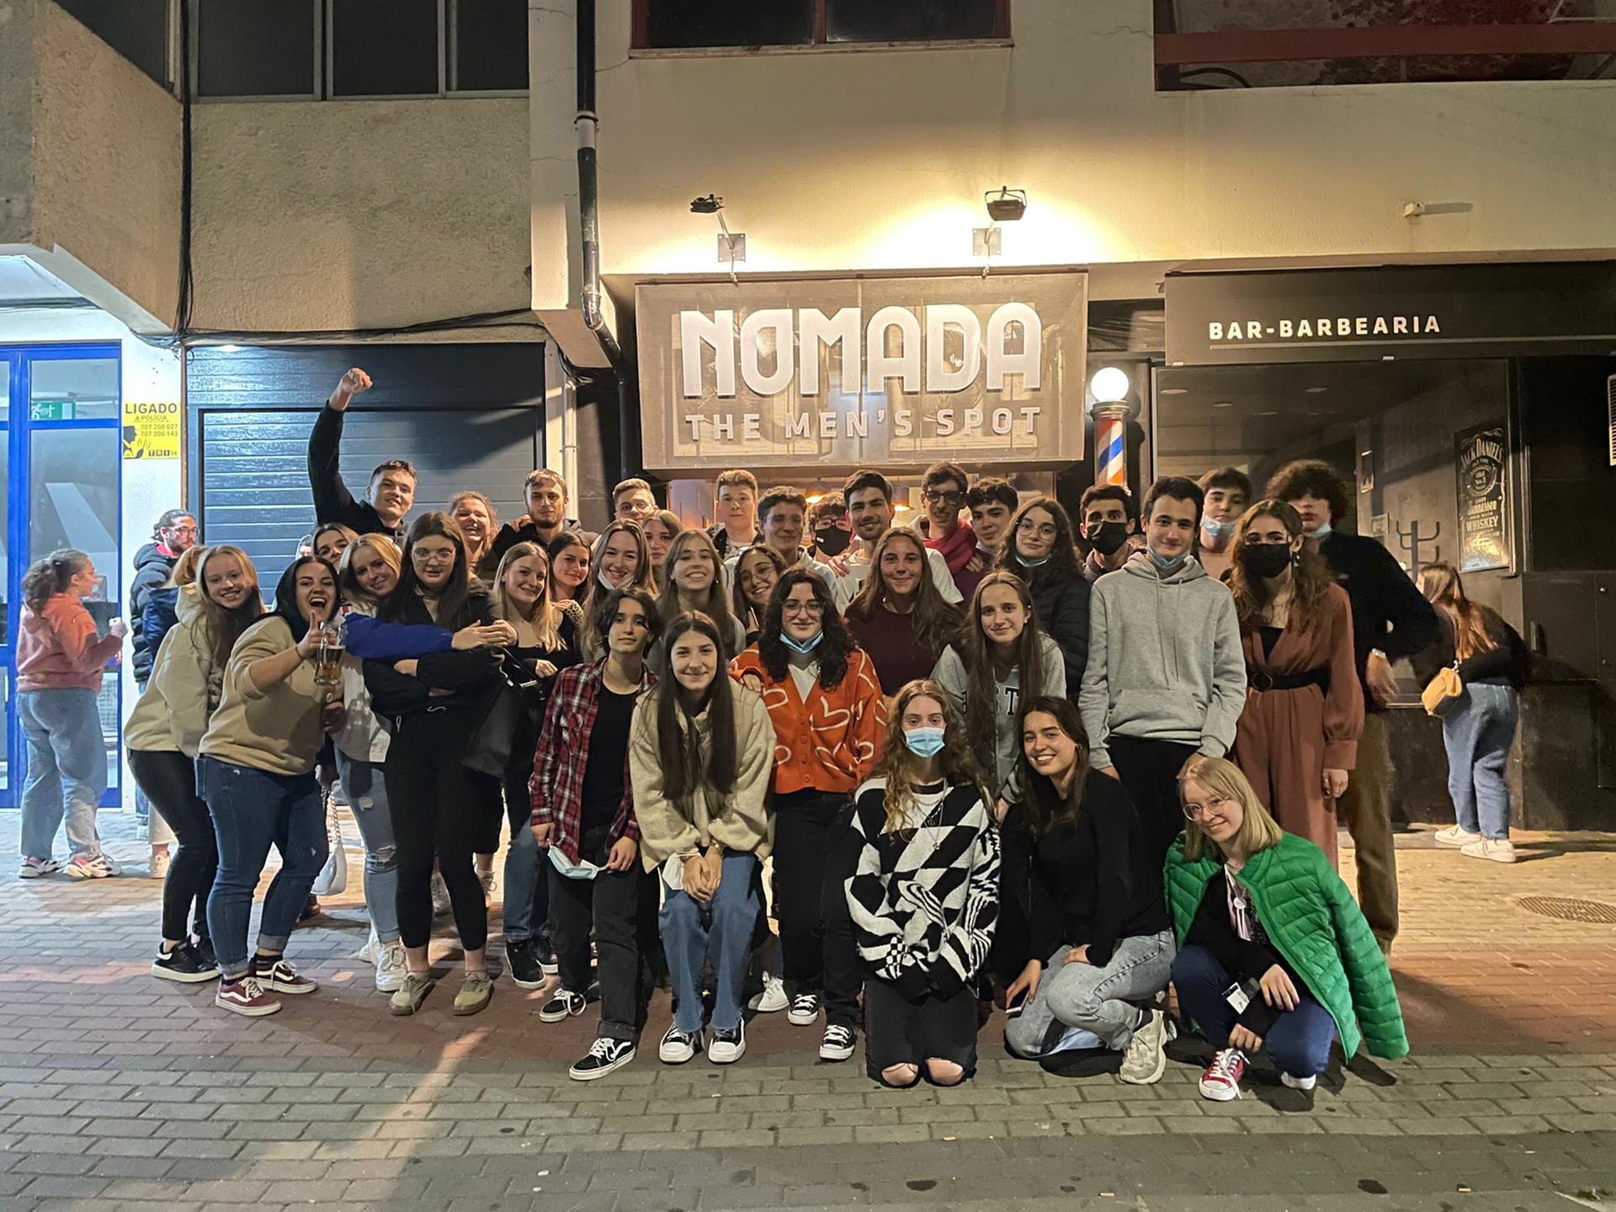
Luis Riobóo
My stay in bragança could not have been better.
Every day there were all kinds of entertaining
activities such as visiting the castle, doing a
kind of competition and more, moreover the town
is very beautiful and has very good lives.
The family I stayed with was very welcoming and
hospitable On this trip I was able to verify the
differences between Portugal and Spain, as well as the rest of the countries.

Slide 5
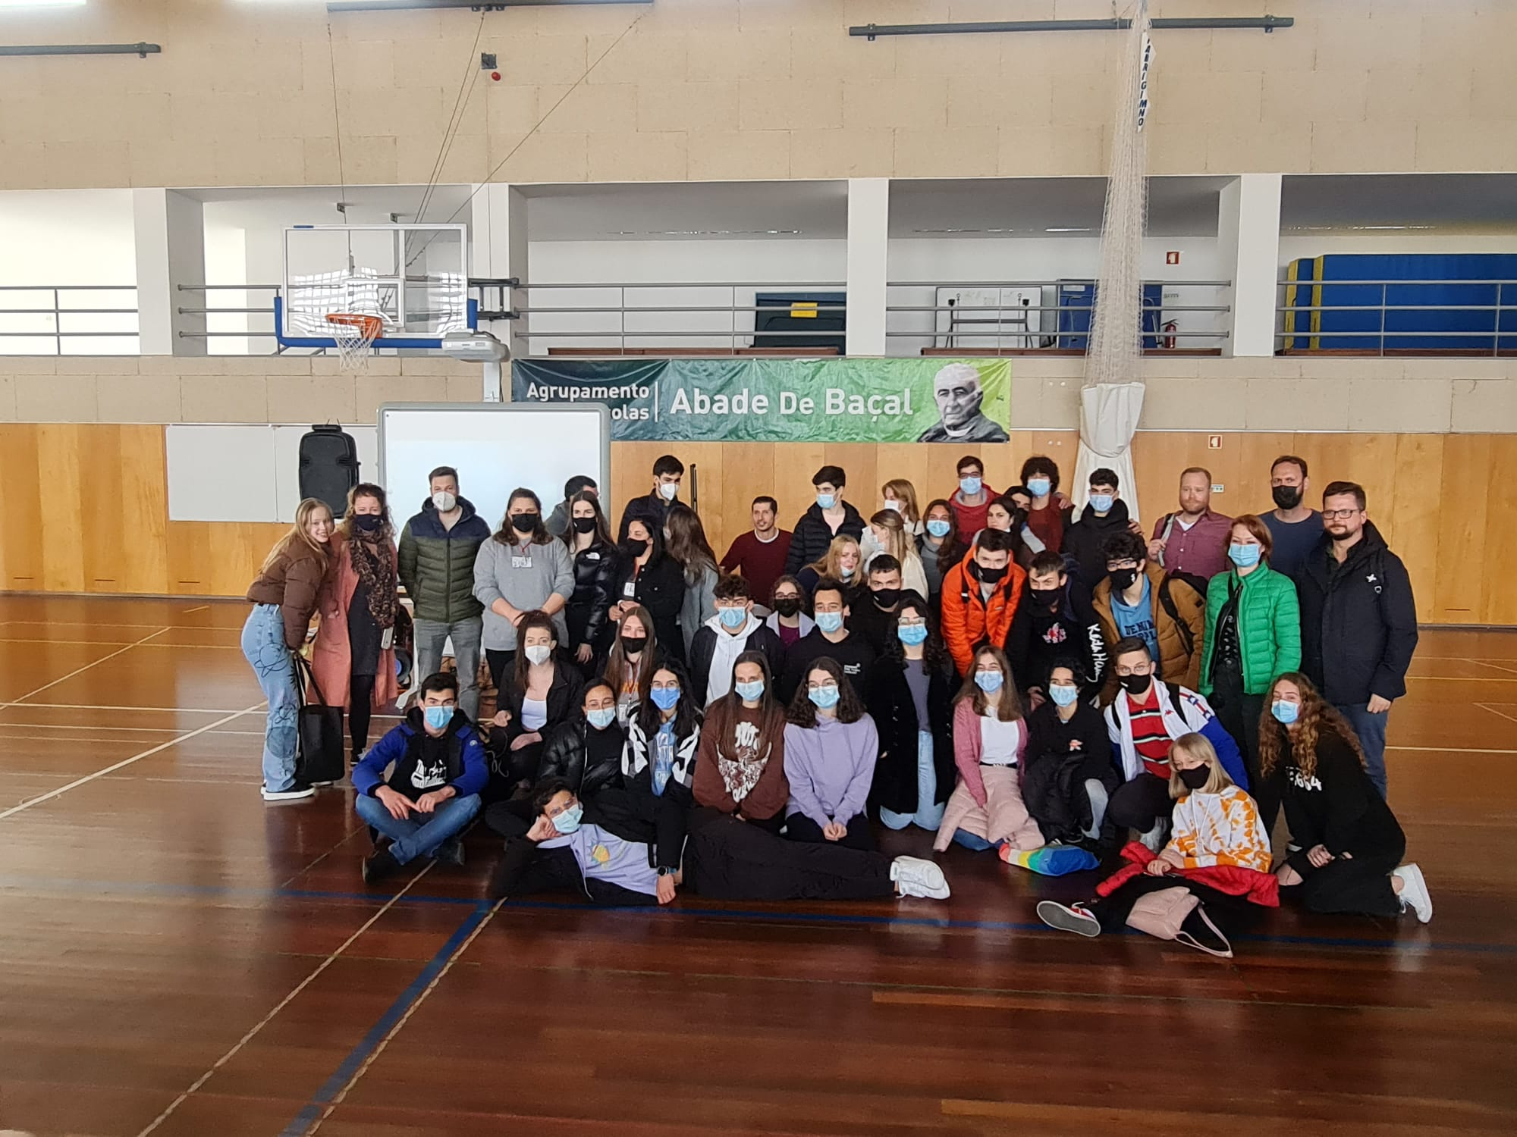
Soledad Conradi
My stay in Bragança was amazing. In my opinion this travel and experience was fantastic. It help to grow up by a person and a make a lot of friends in this travel that were amazing people. The activities were so entertaining all the time we have something to do and we never get bored. I would repeat the experience if I have the opportunity.

Slide 6
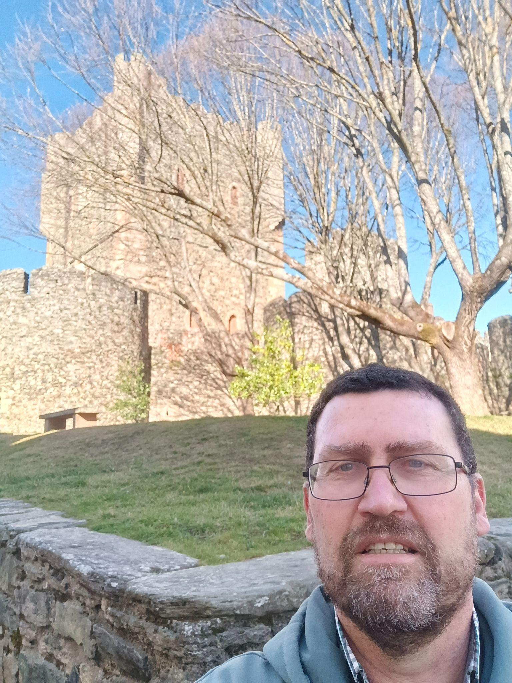
José Manuel de los Santos Castro
My experience in Braganza was really positive, It allowed me to discover new educational application’s programs , new school structures. Moreover cultural aspects of the city like Braganza’s Castle. And also, emotional aspects like the story of …..

