Slide 1
KA 229 Erasmus+ mobility the Netherlands 29-03-22 to 31-03-22
Digital project assignment

Slide 2
Project goal
In groups, create a videoclip which answers the question:
“What is the European identity?”

Slide 3
Project understanding
What is an “identity”?
Oxford dictionary (2022):
Identity (noun): “the fact of being who or what a person or thing is.”
https://answergarden.ch/2400523

Slide 4
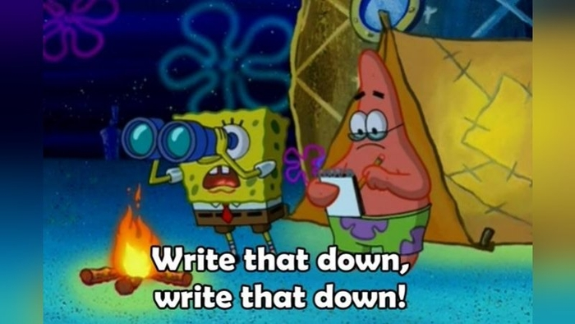
Project instructions
How to finish your assignment in 10 steps:
Read all the information provided.
Brainstorm the question: “What is the European identity?”
Determine which information is still needed.
Research the missing information (internet, interviews, surveys, etc.)
Gather ideas on how to present your findings.
Assign tasks (camera, speaker, script, sound, design, etc.)
Carry out tasks.
Merge everything into one videoclip (see Do’s and Don’ts overview).
Present the clip to the other groups.
Send the clip to your teacher(s).

Slide 5
Project outcome

Slide 6
Project information
European Identity and mobility programmes
https://www.youtube.com/watch?v=8lVUlN3gffY
European Identity & National Identity: Constructing a 'We'
https://www.youtube.com/watch?v=p9hhXLho_94
The History of the EU with David Mitchell
https://www.youtube.com/watch?v=GfN05WB_rYw

