Slide 1
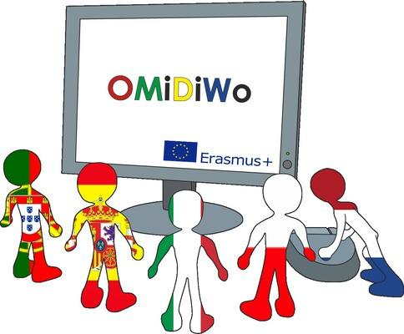
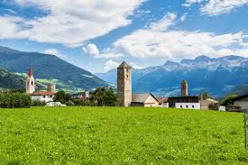
IMPRESSIONS OF SPANISH TEAM ABOUT THE MOBILITY TO MALS (C6/7)

Slide 2
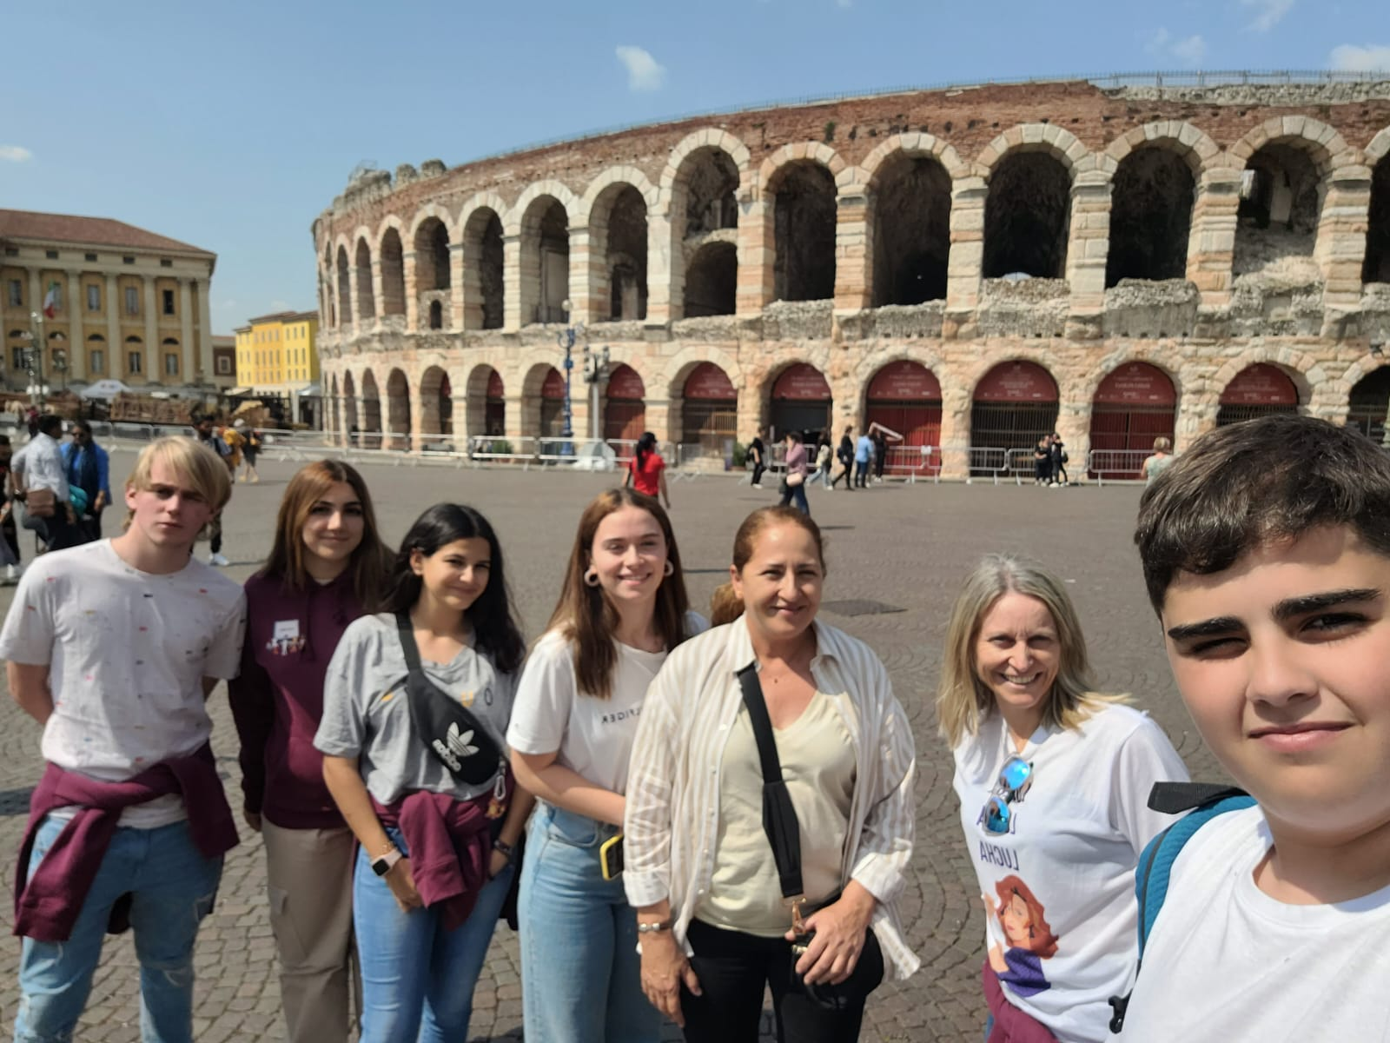
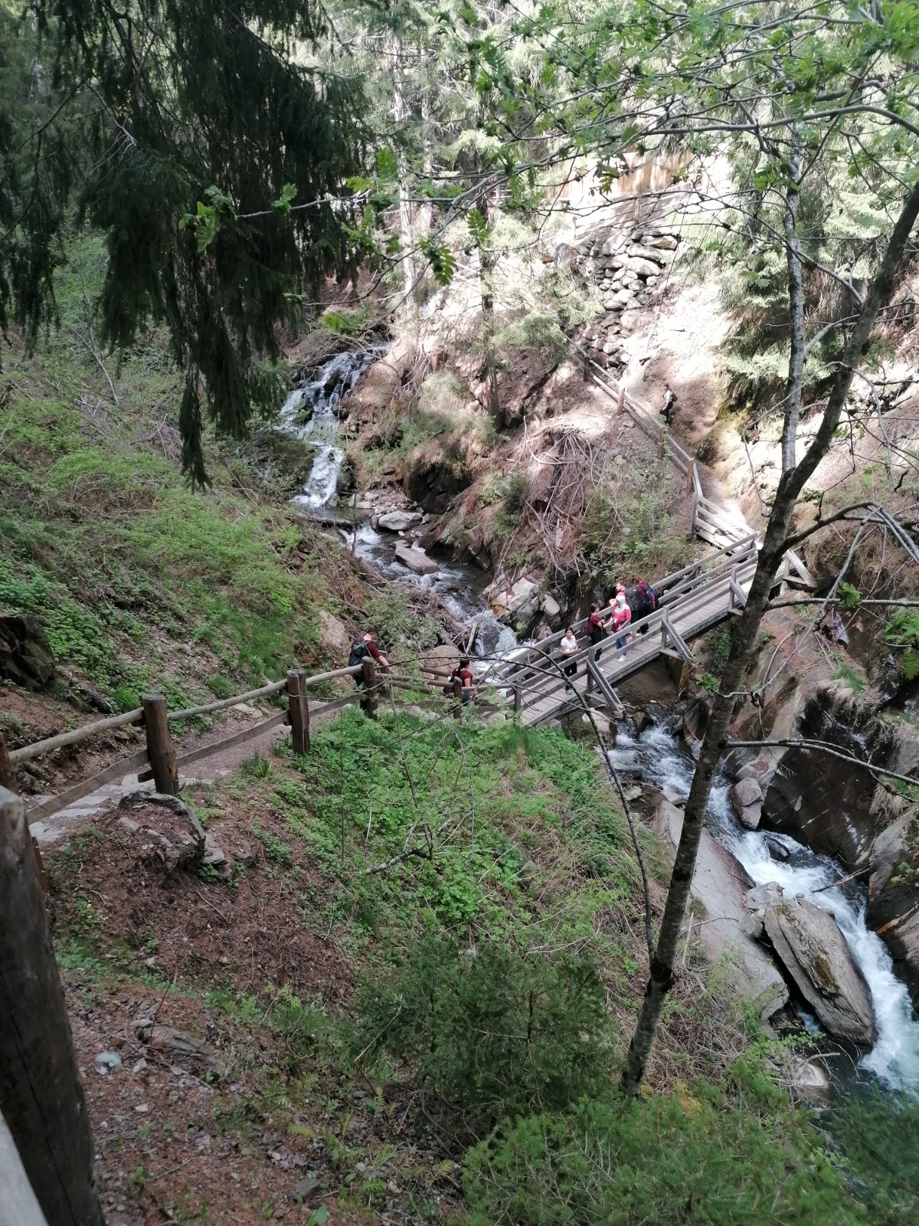
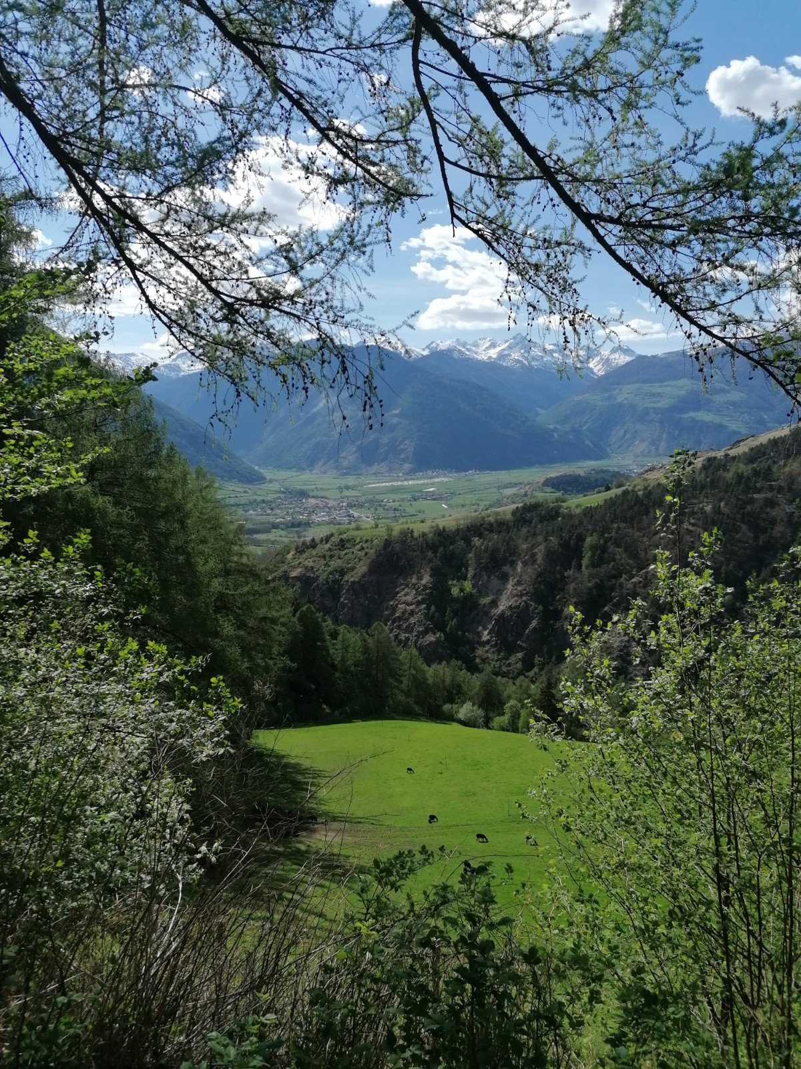
Miriam Benjumea
My stay in Mals was a great adventure. I loved getting to know other places in the world that I would never have imagined seeing. Being able to enjoy the landscape hiking with my friends was unforgettable.
But the best thing, was meeting new friends and my host family, they made me feel like one of them.
I would definitely do it again

Slide 3
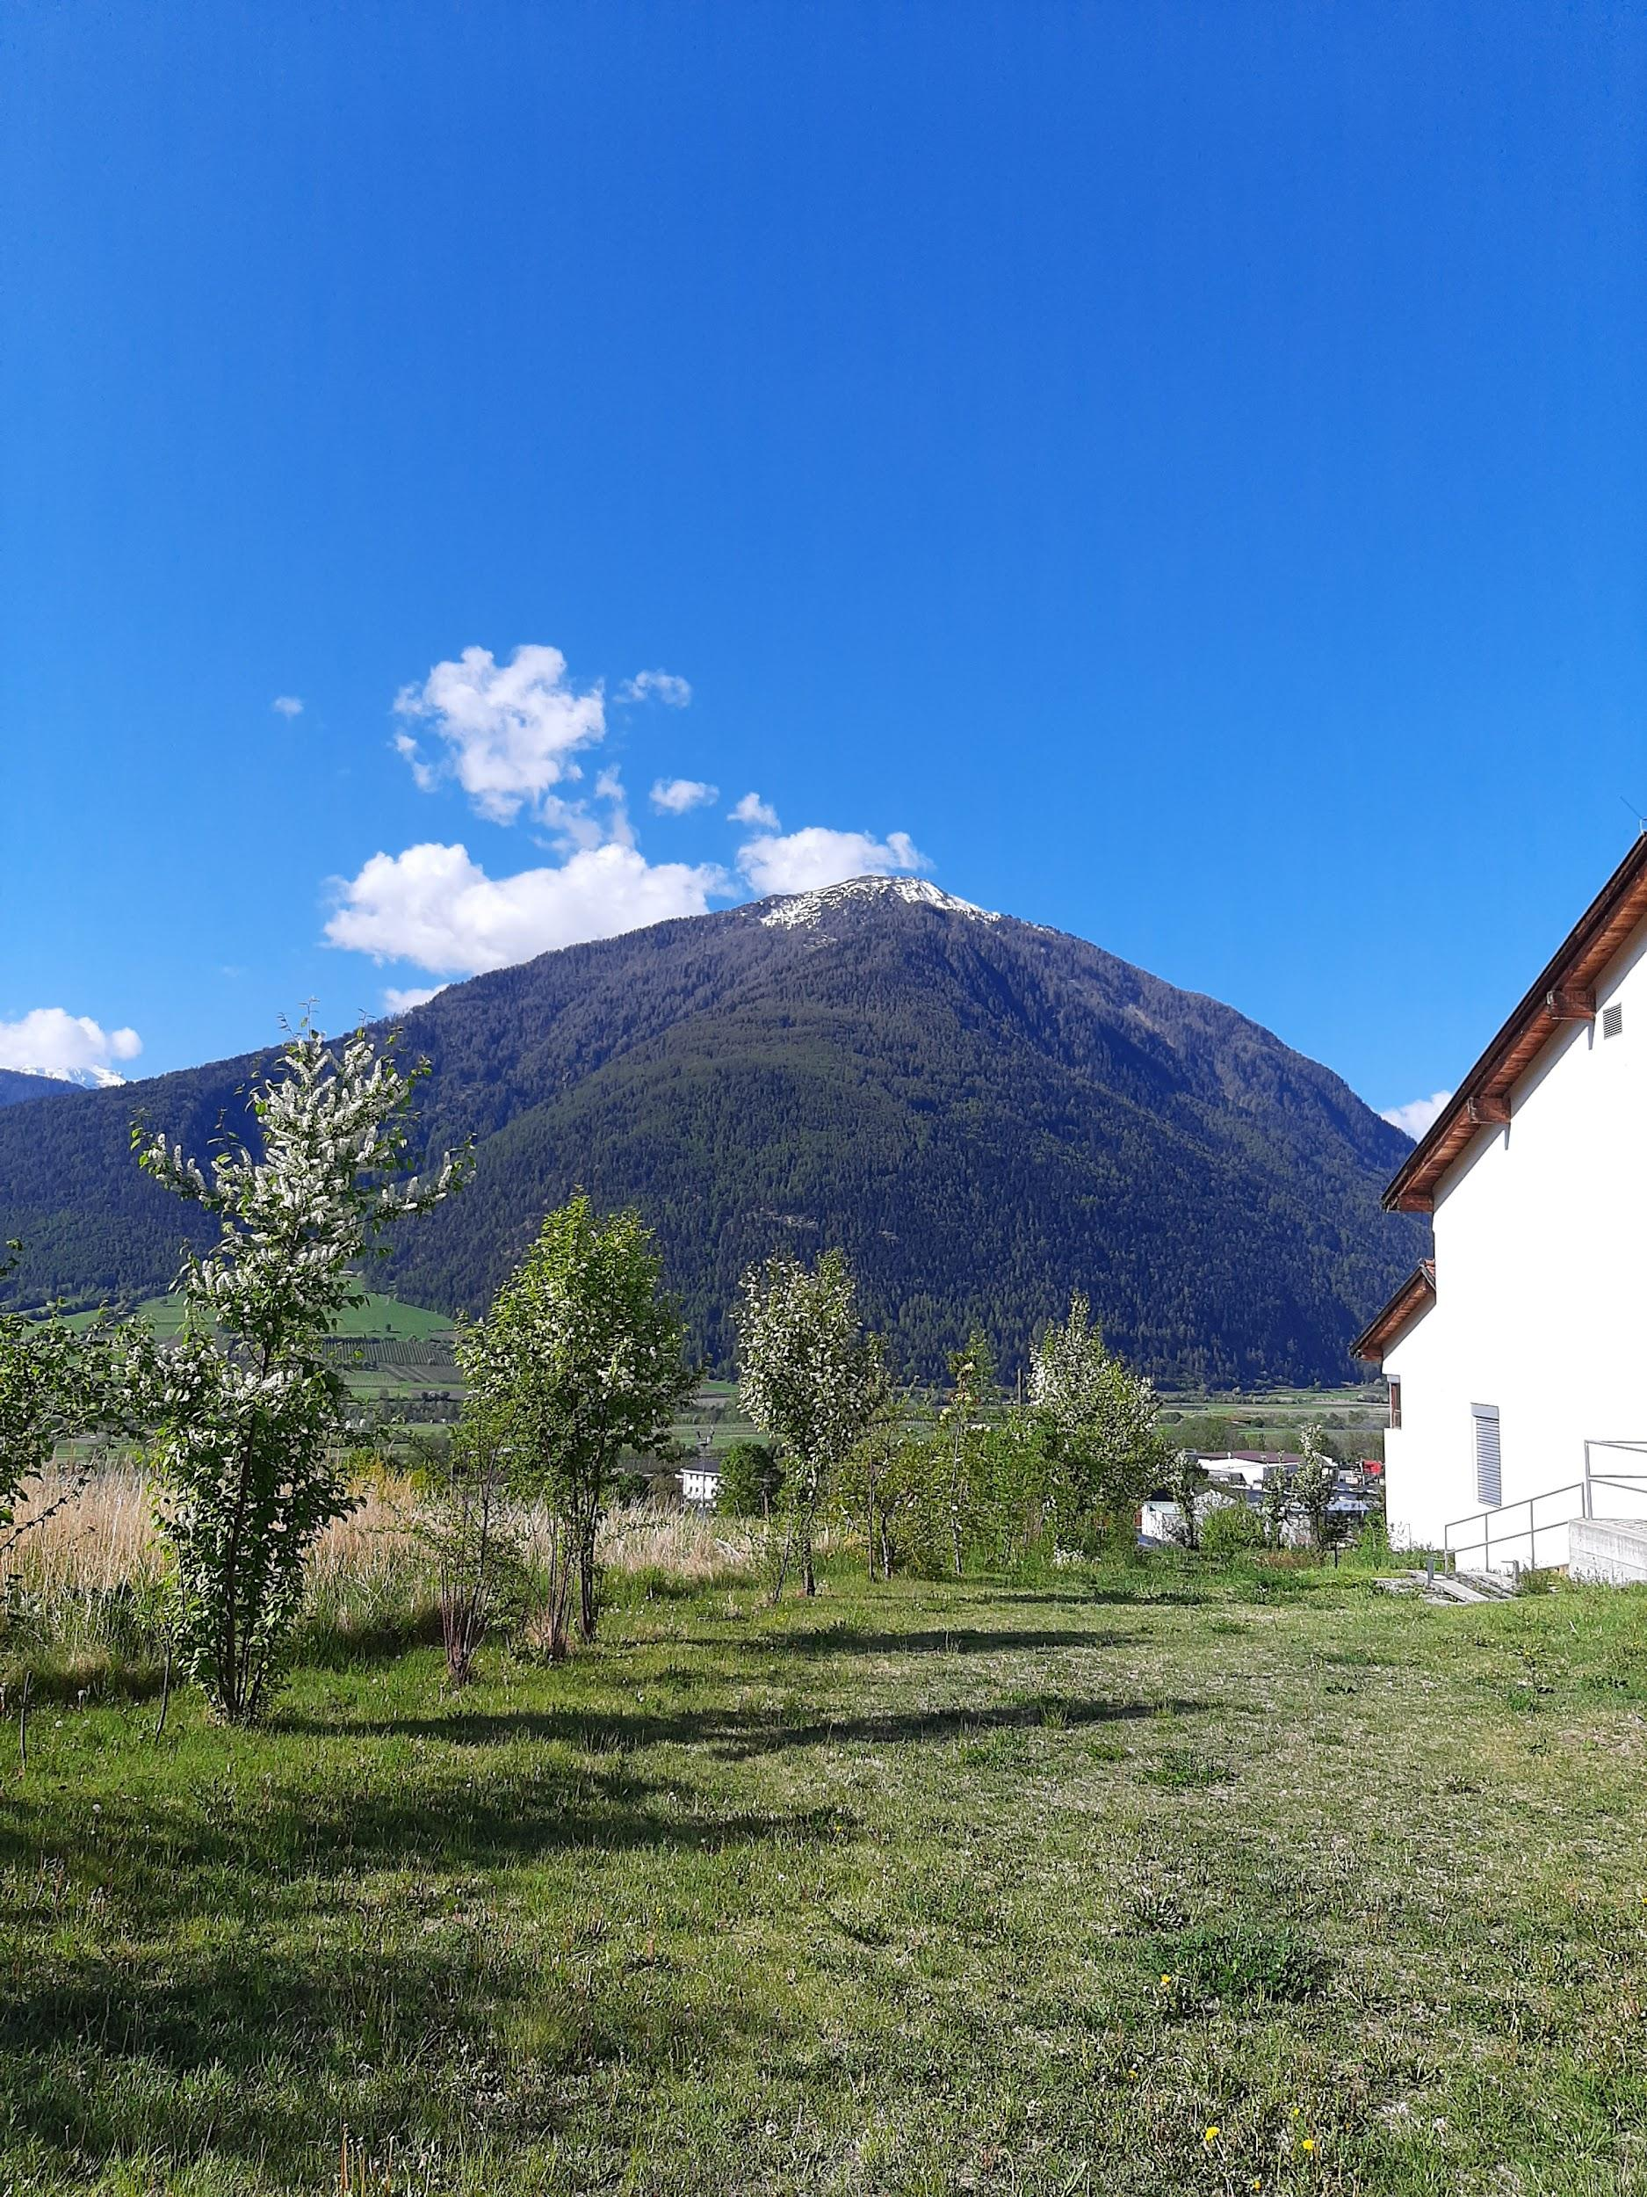
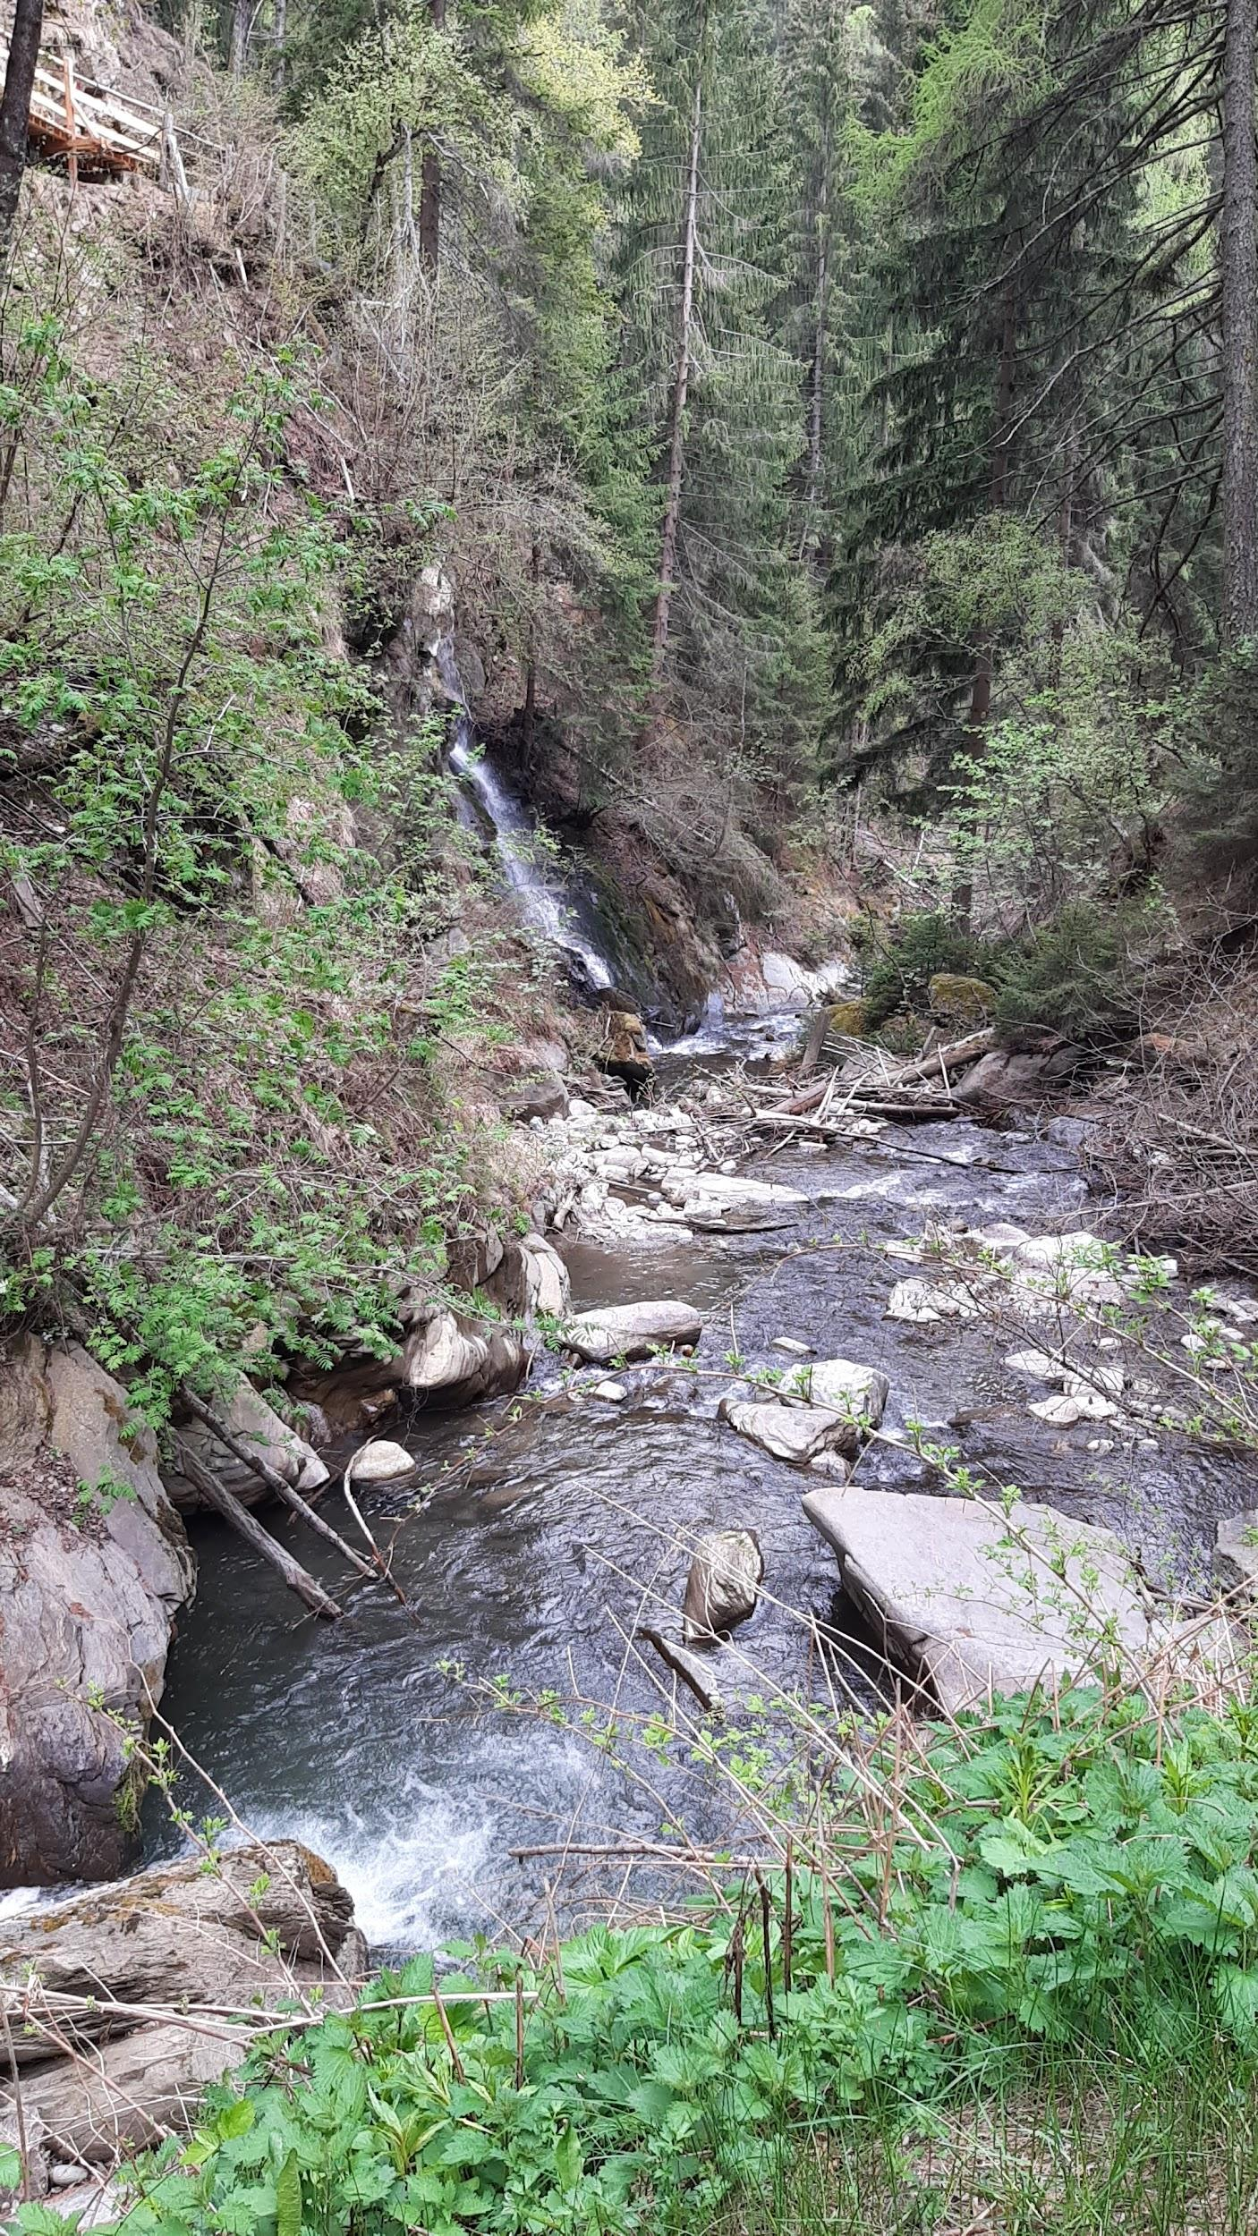
Carlos Jiménez
The time I have been in Mals has been very good. It has been a new experience.
I have had a good time and the family was very nice.
The activities carried out were fun.
I also liked the experience of being in a country that I had not been.
I would repeat the project.

Slide 4
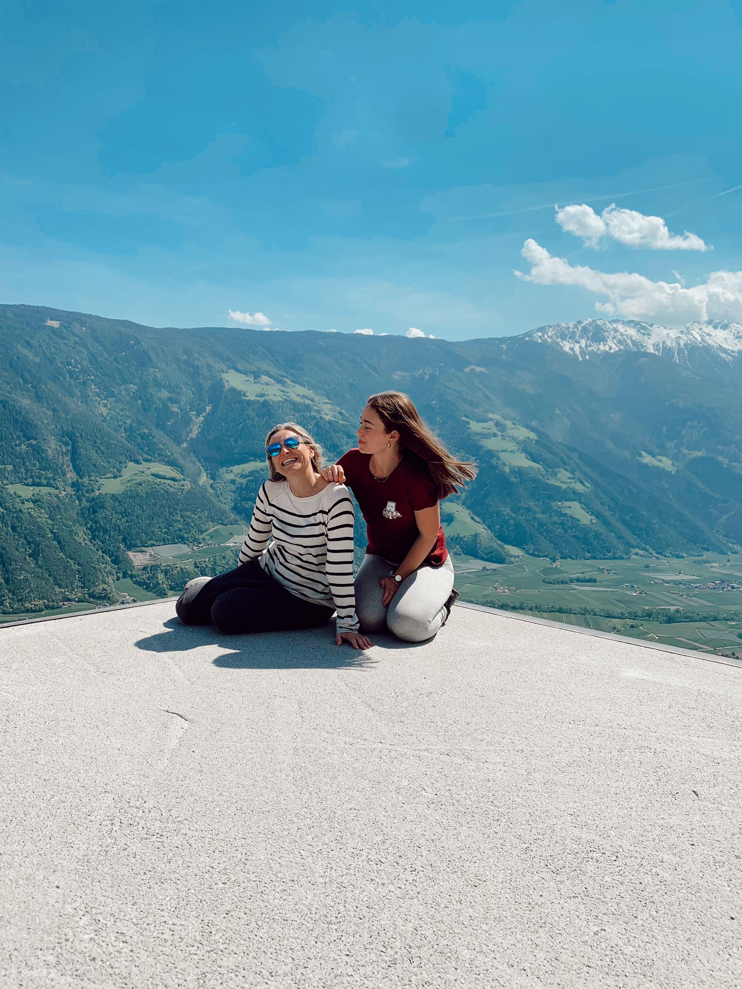
Manuela Márquez
My stay in Mals was perfect. I visited new places that I had never been to. I really love the people there, they were so nice to us.
My favourite day was the one we visited the waterfall, it was beautiful.
I am so happy about my host family because they were so nice to me.
I would like to repeat!

Slide 5
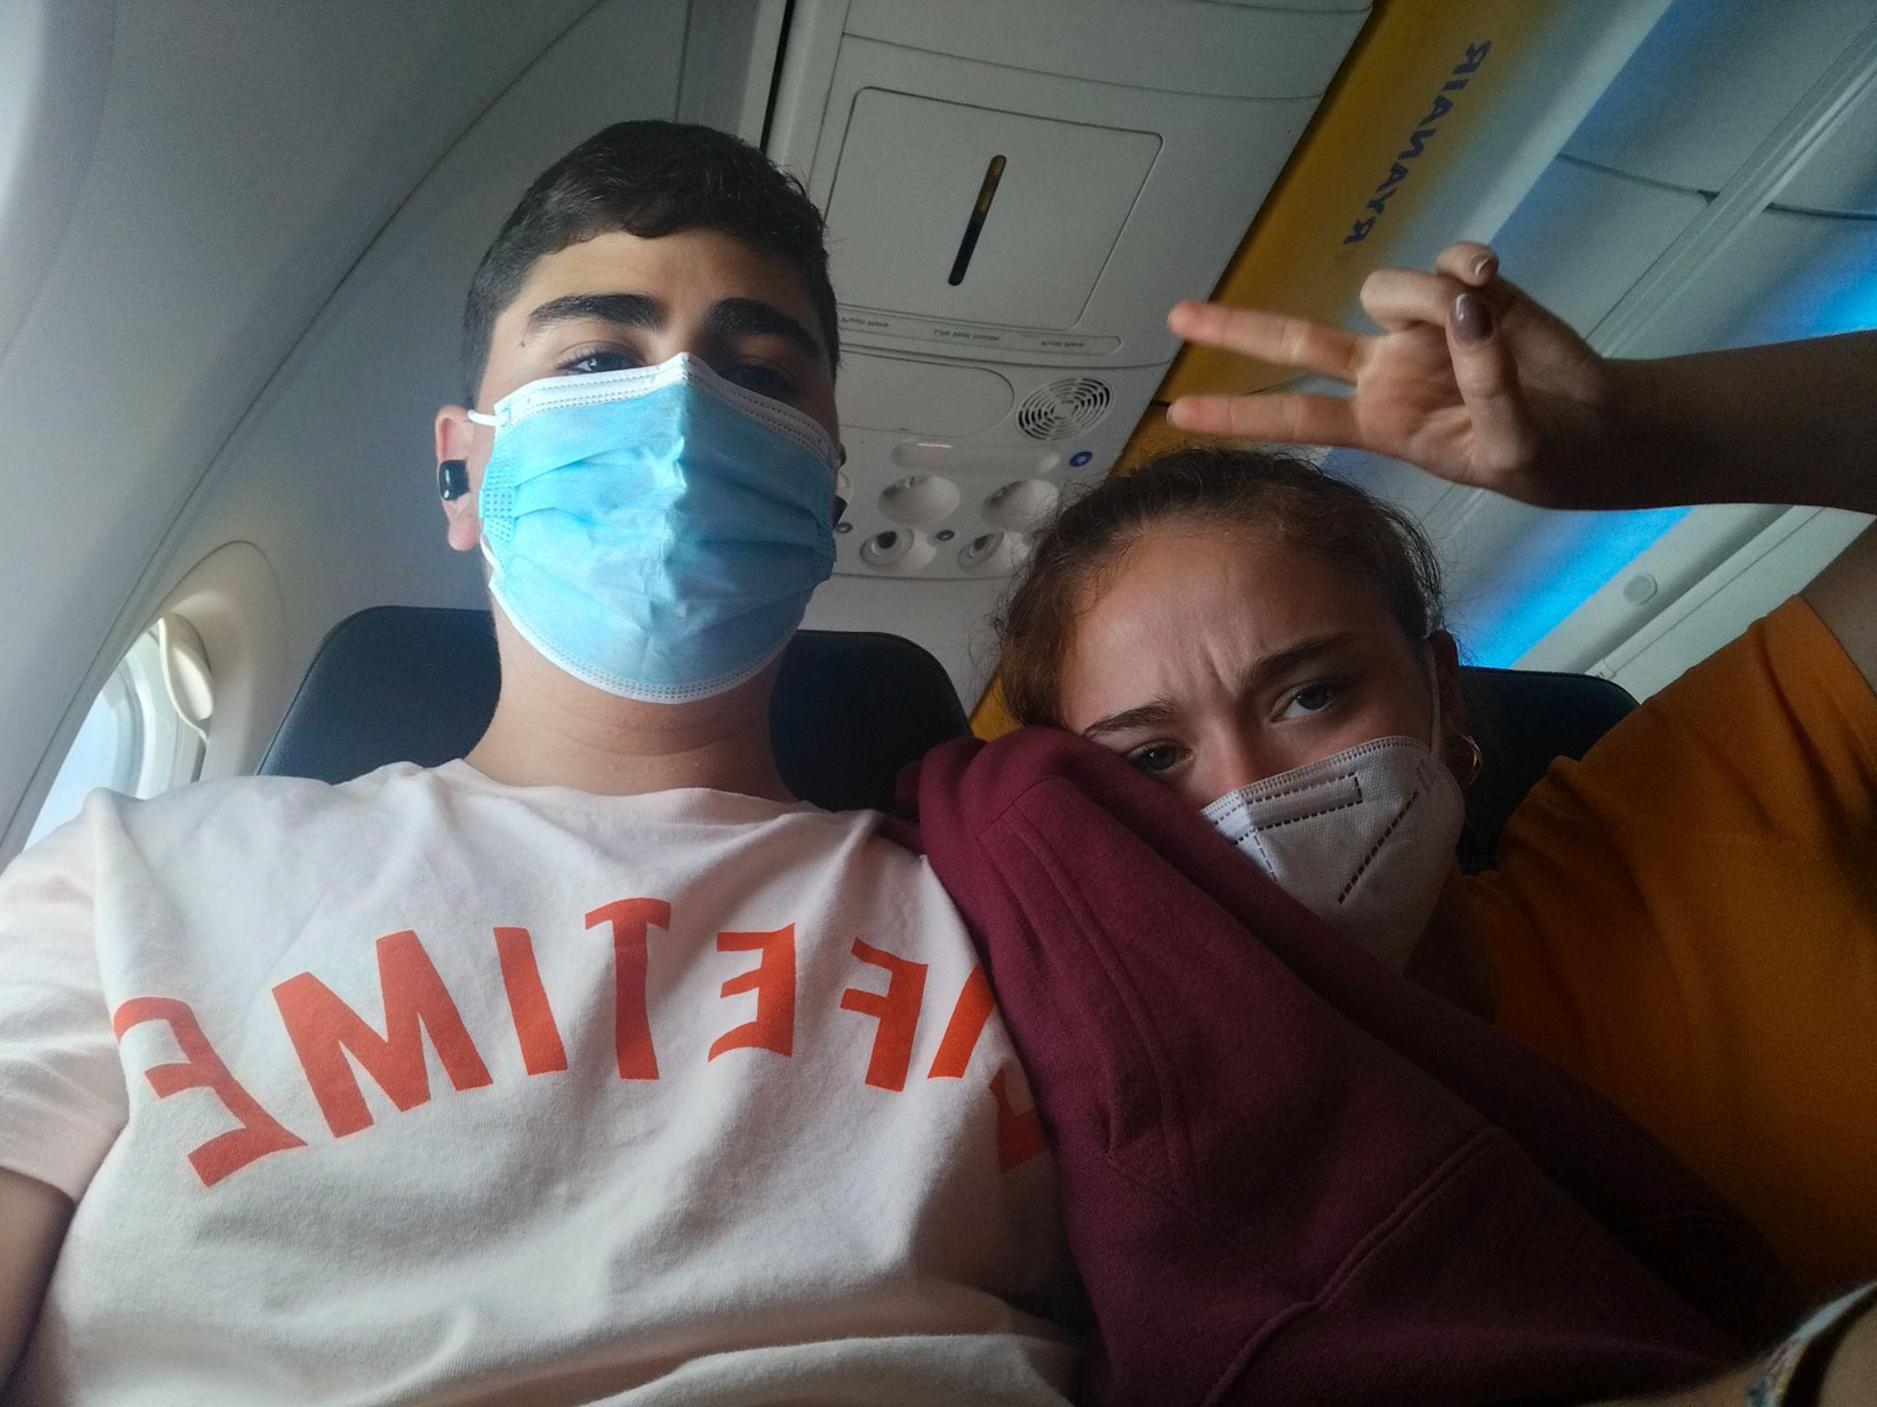
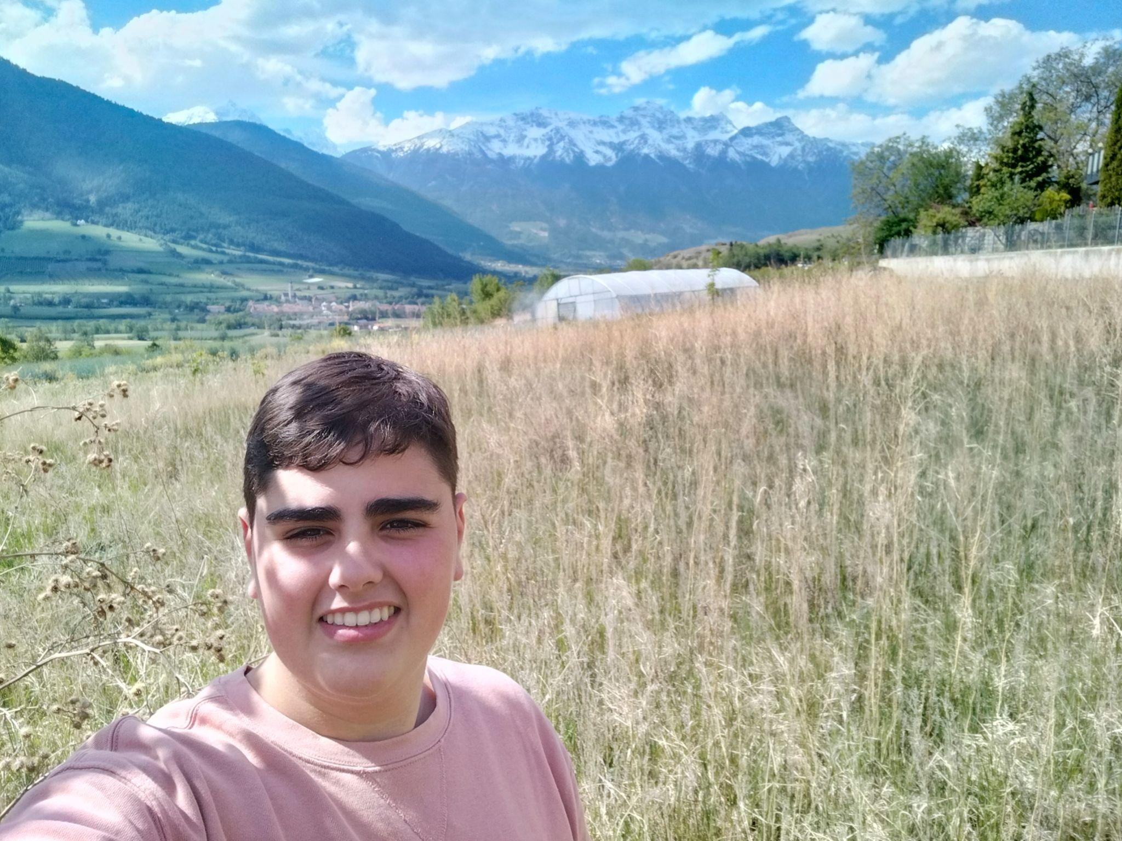
Rafael Llach
I had a great time on this trip, it was the second
time in my life that I took a plane in a lifetime and
it is a very good experience.
In Mals I have done very fun activities and I have
visited places that on my own I would never have
visited since I did not know or that they existed.
I have also met many new people and I have
made many friends, I would repeat it and
recommend it to everyone.

Slide 6
Lourdes Real
What a great experience our stay in Mals was. We were not only able to see our good partner friends again but also enjoy the interesting and fun activities that our hosts had prepared for us, all in the most picturesque setting ever. I always learn from the incredibly professional and fun team that make up this project. Thanks Marilyn and Peter for being such great hosts, thanks to all the teachers and students for all that you have given me and special thanks to my wonderful mentor, Pilar Candau, for giving me the opportunity to live this incredible Erasmus experience.

Slide 7
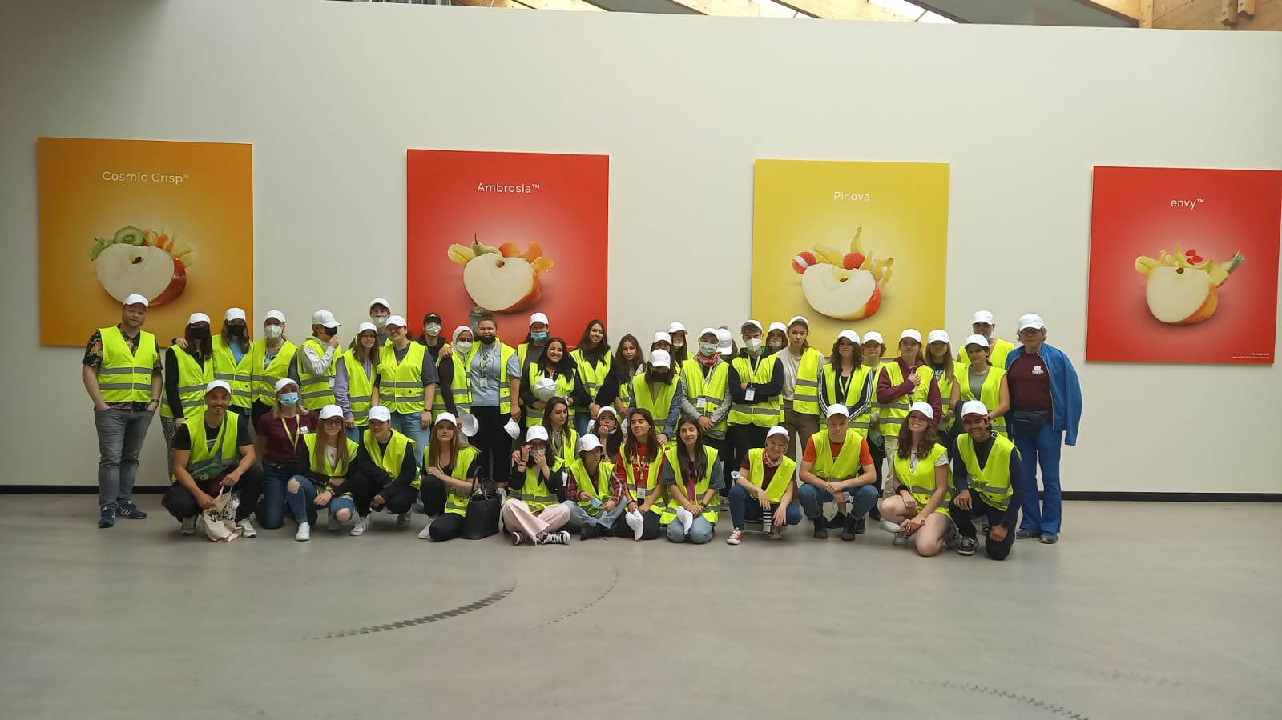
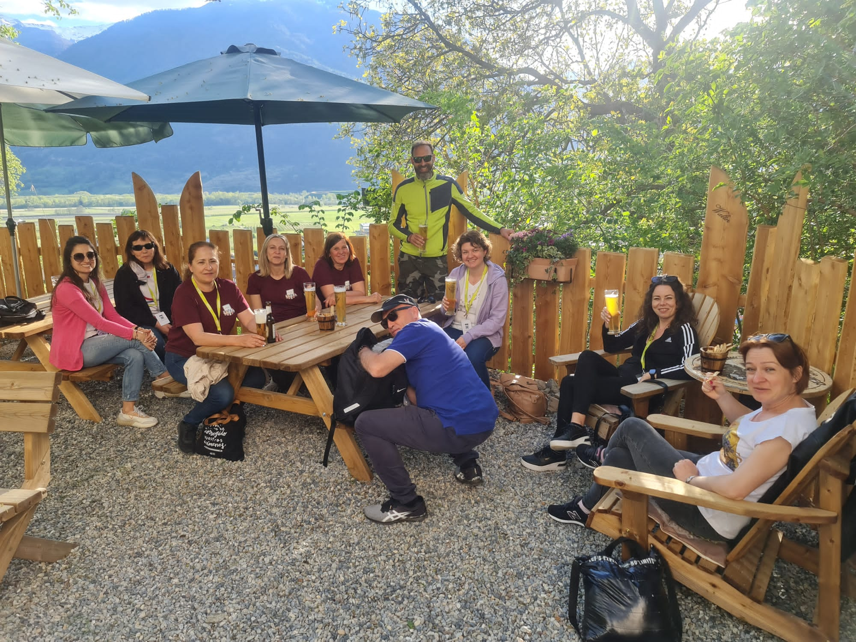

Slide 8
Pilar Romero Candau
Having the chance to travel is a unique opportunity but travelling to such a unique place as Mals is a dream come true. Even more if the company is so good. I was very lucky to travel with the best colleage, Lourdes, funny, hardworking and trustworthy,and with a wonderful group of students who made a wholehearted effort to do all the activities proposed by the coordinators of this project and travelled such long distances without any complain.
Peter and Marilyn did a fantastic job from beginning to end. Thanks to giving me the chance of knowing your country a little better . Thanks to your team , they were all great, specially Gloria and Mathias.

Slide 9
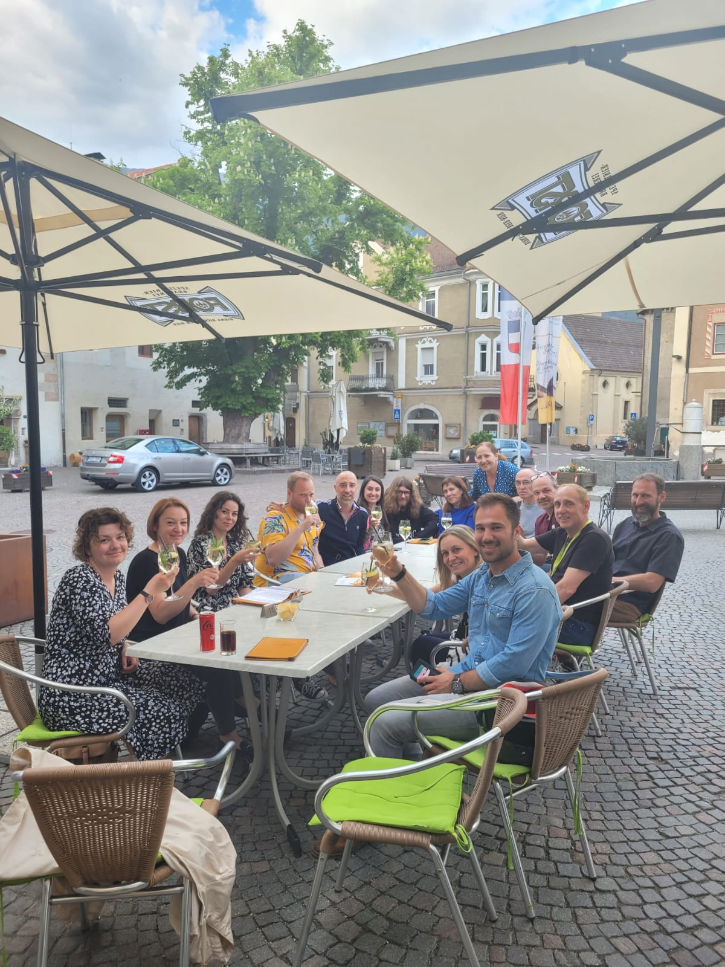
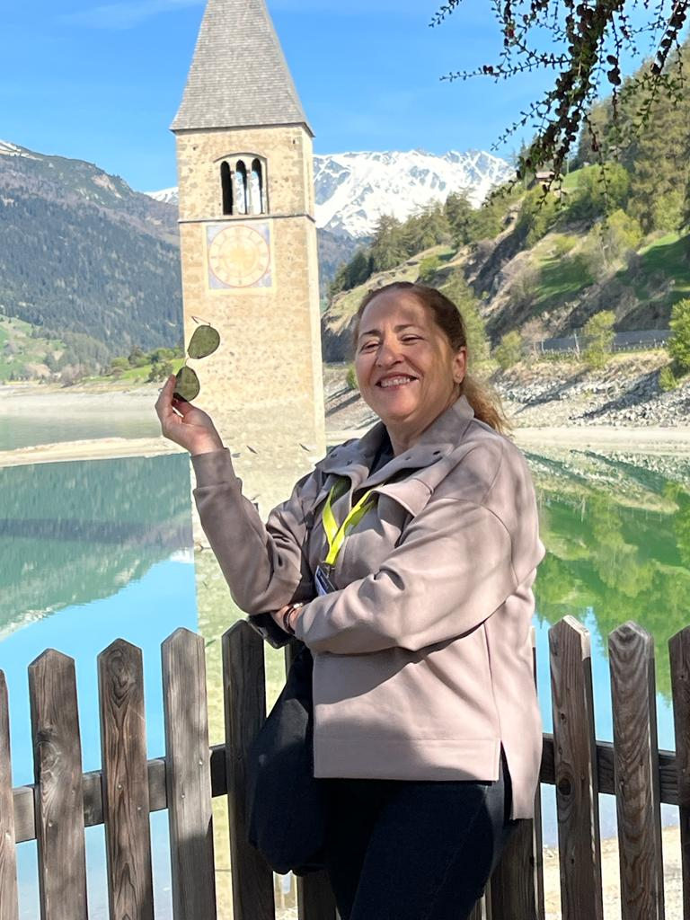
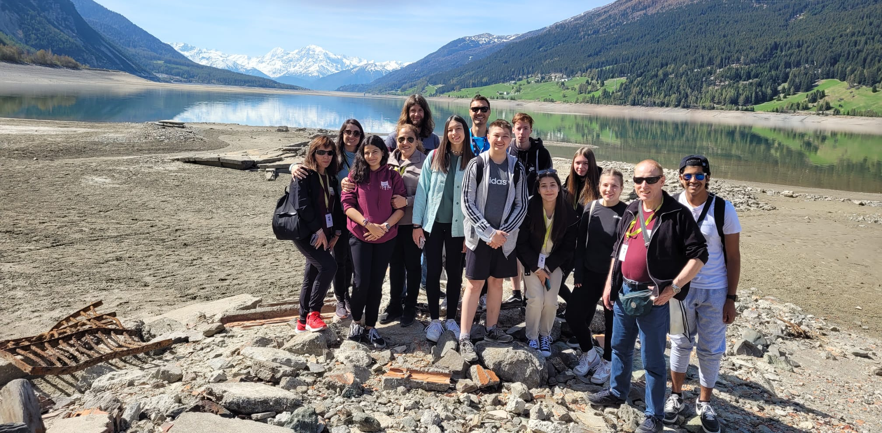
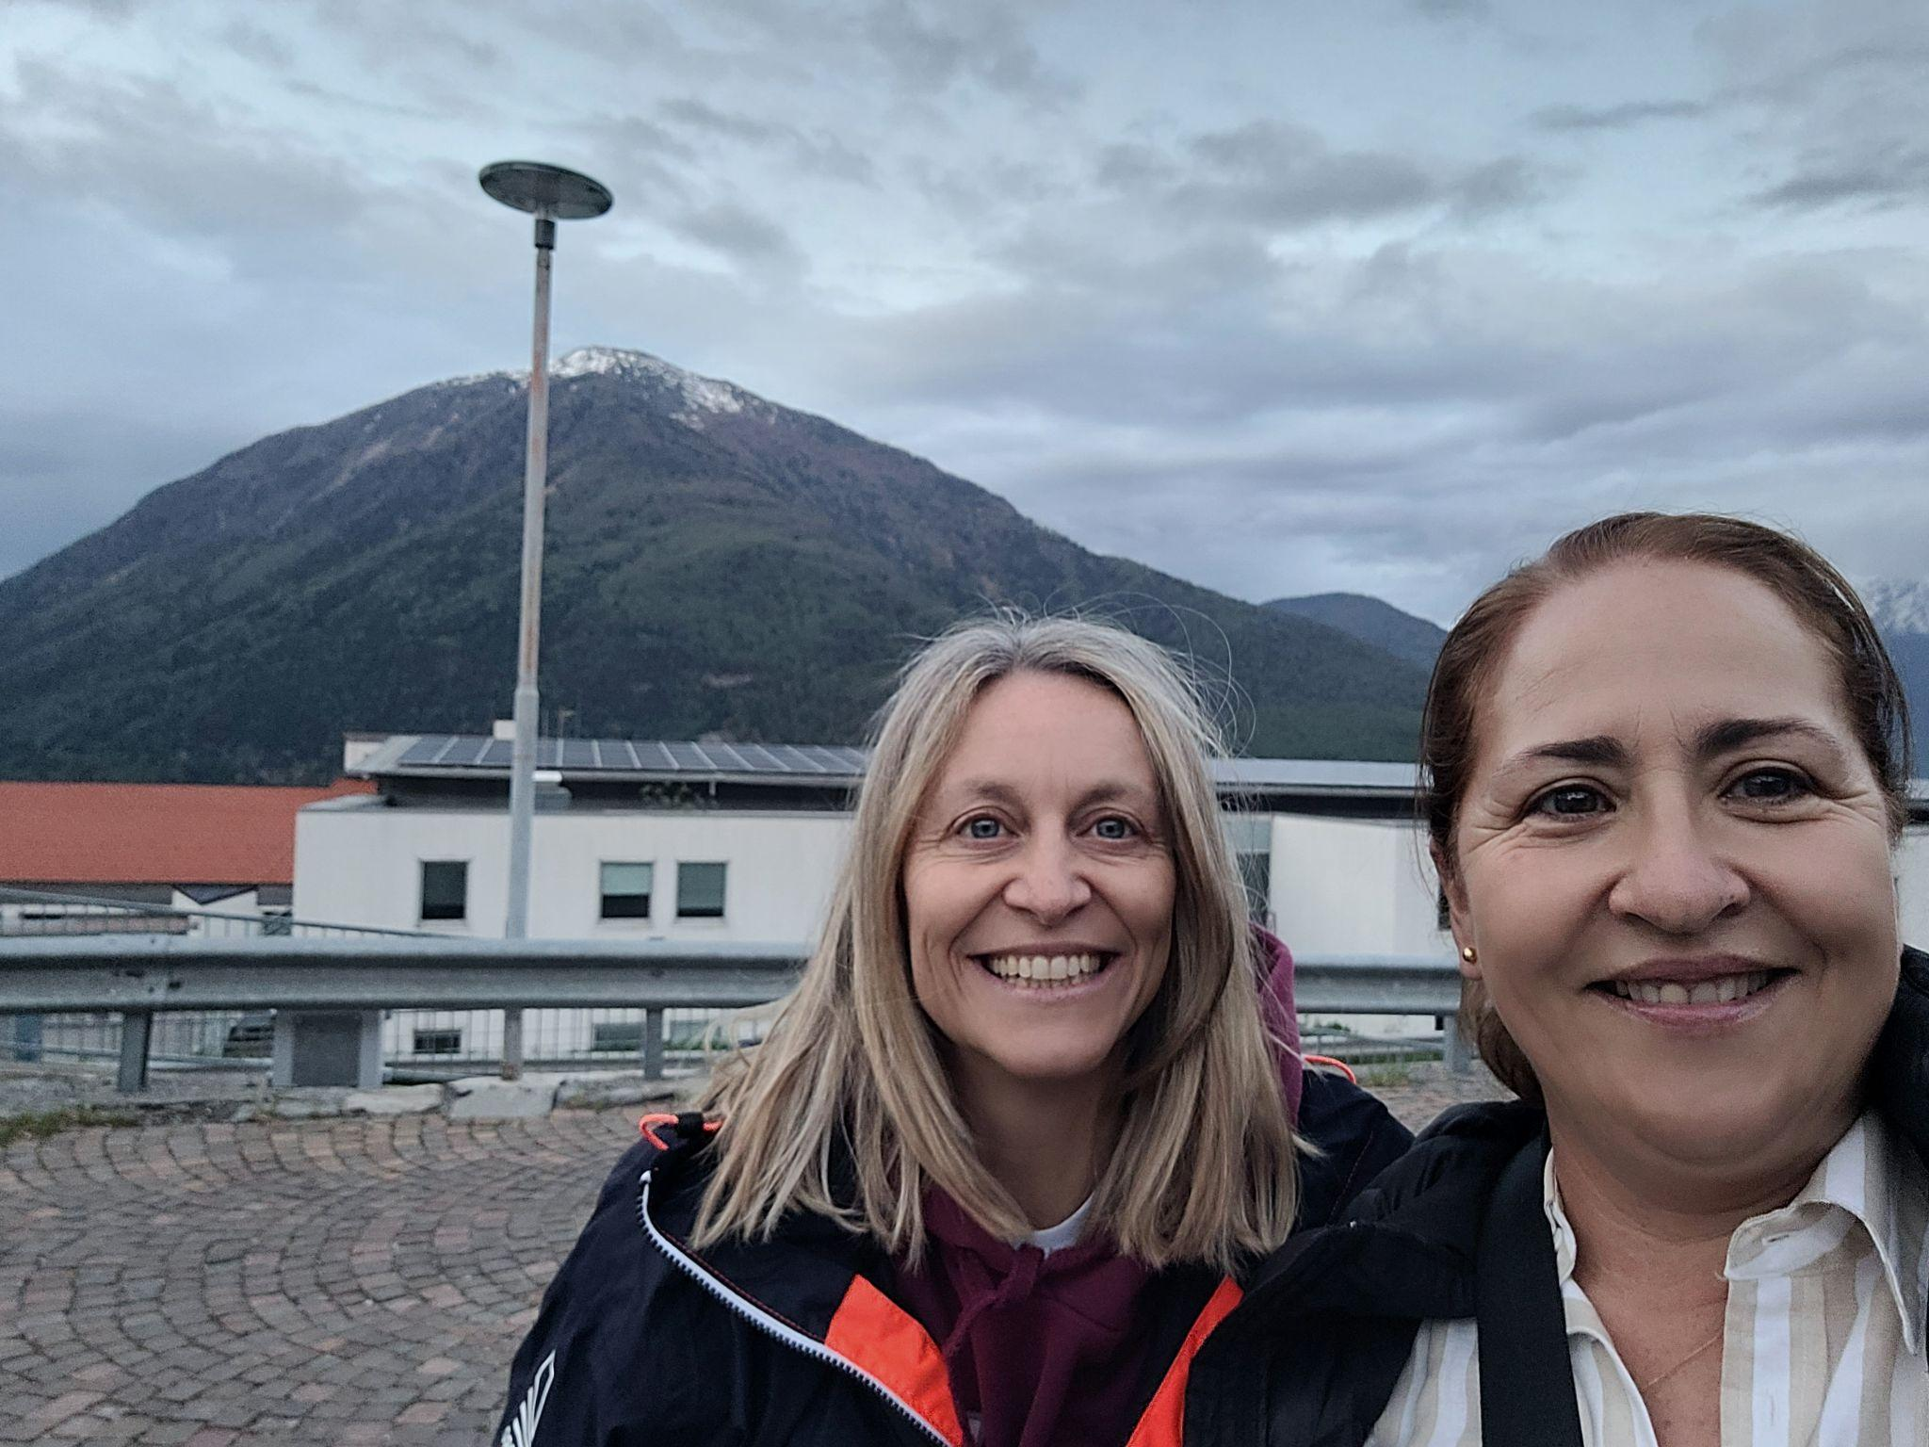
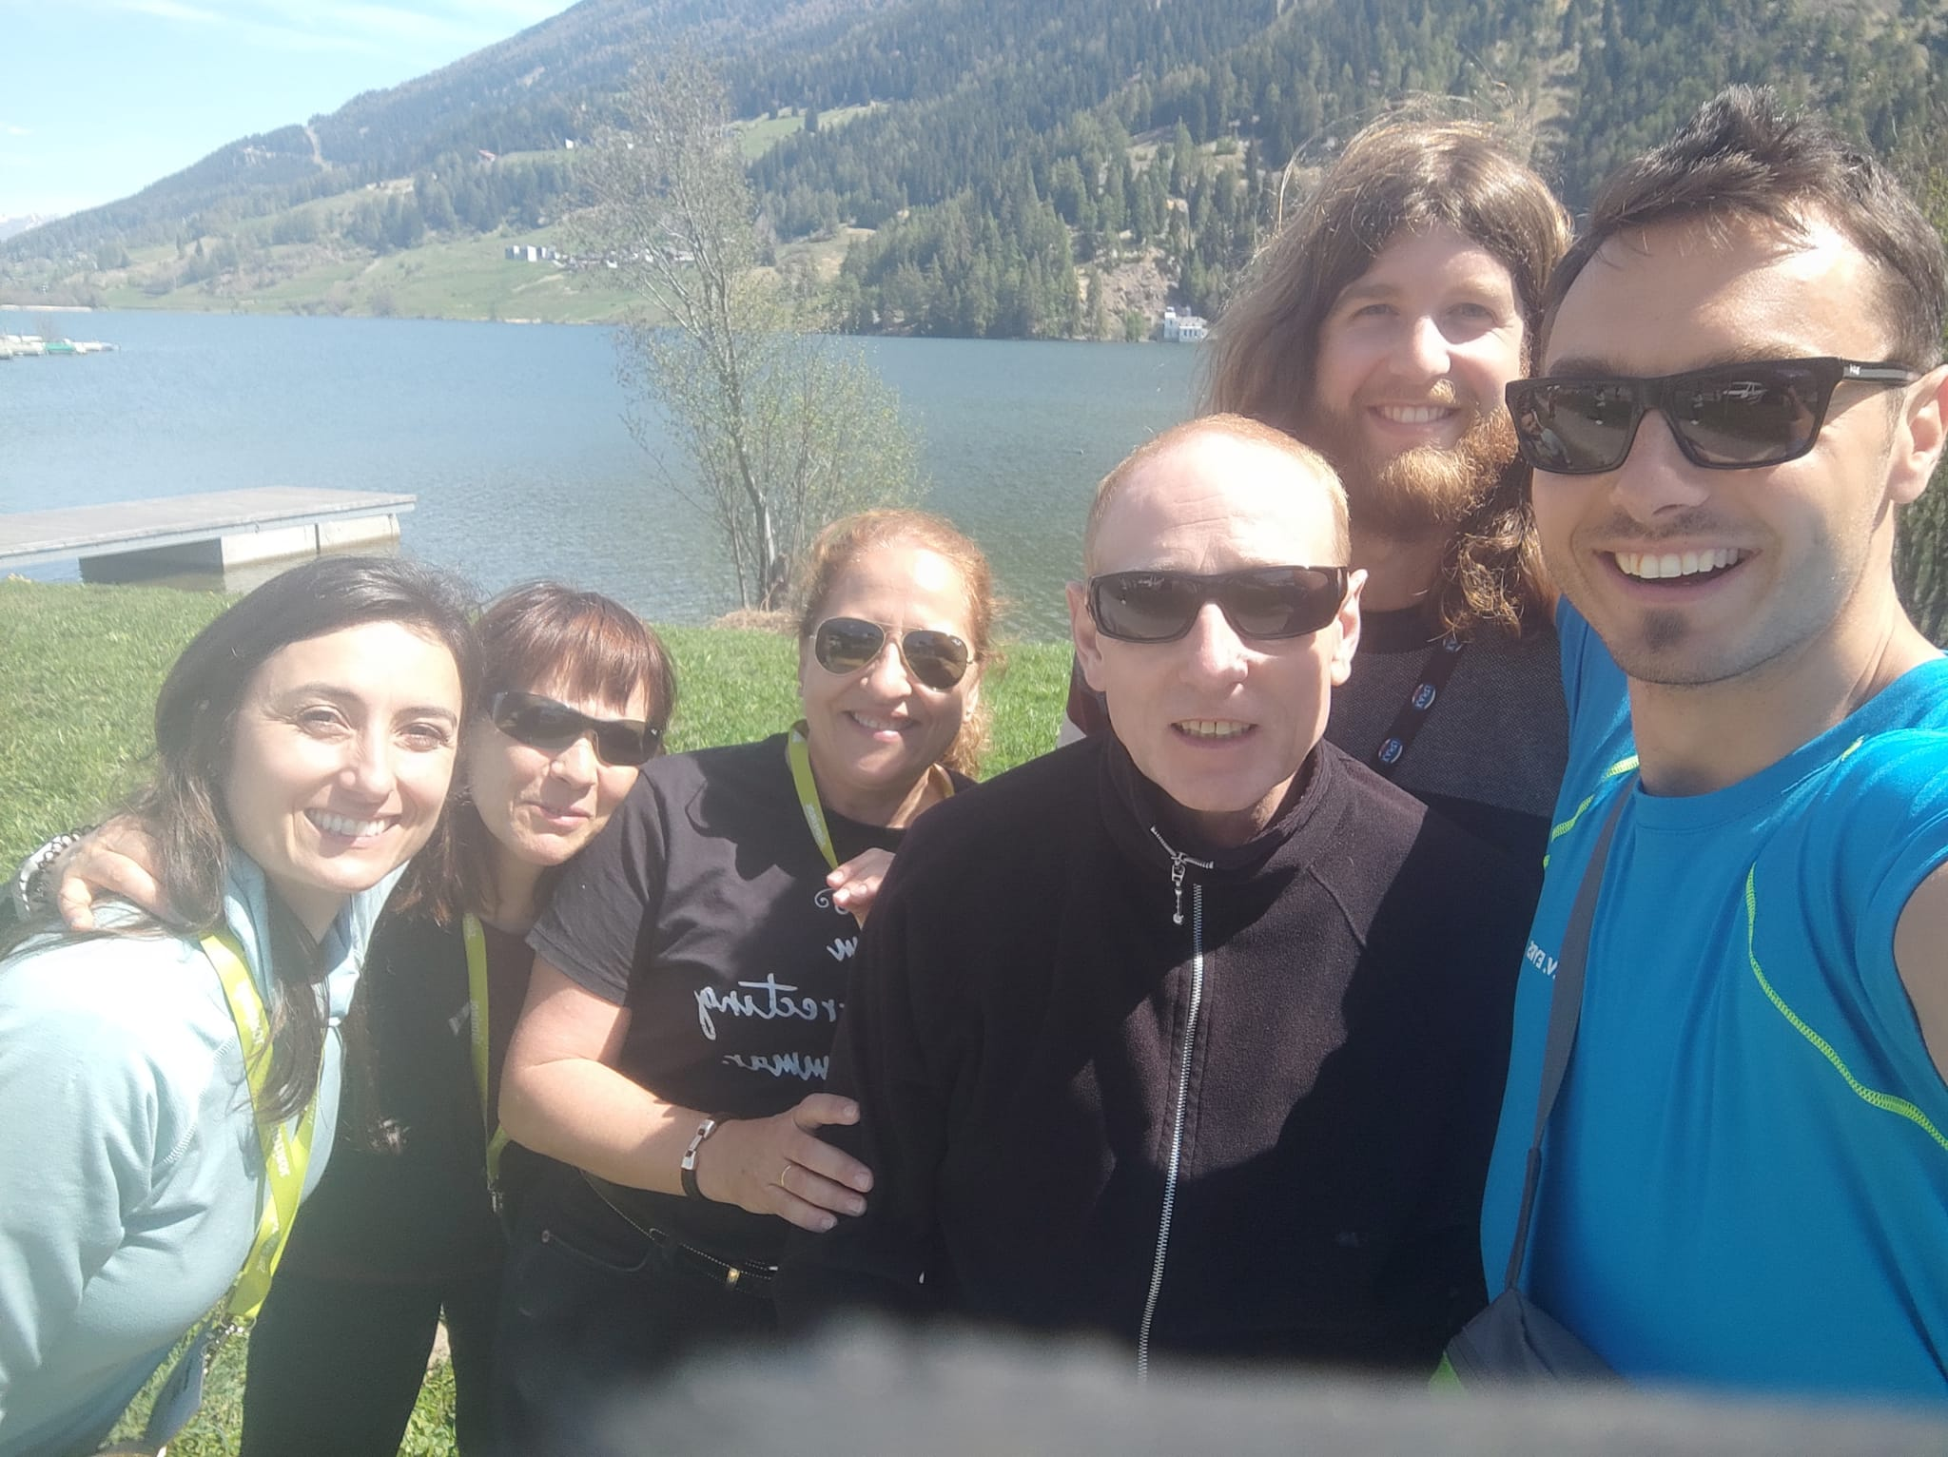
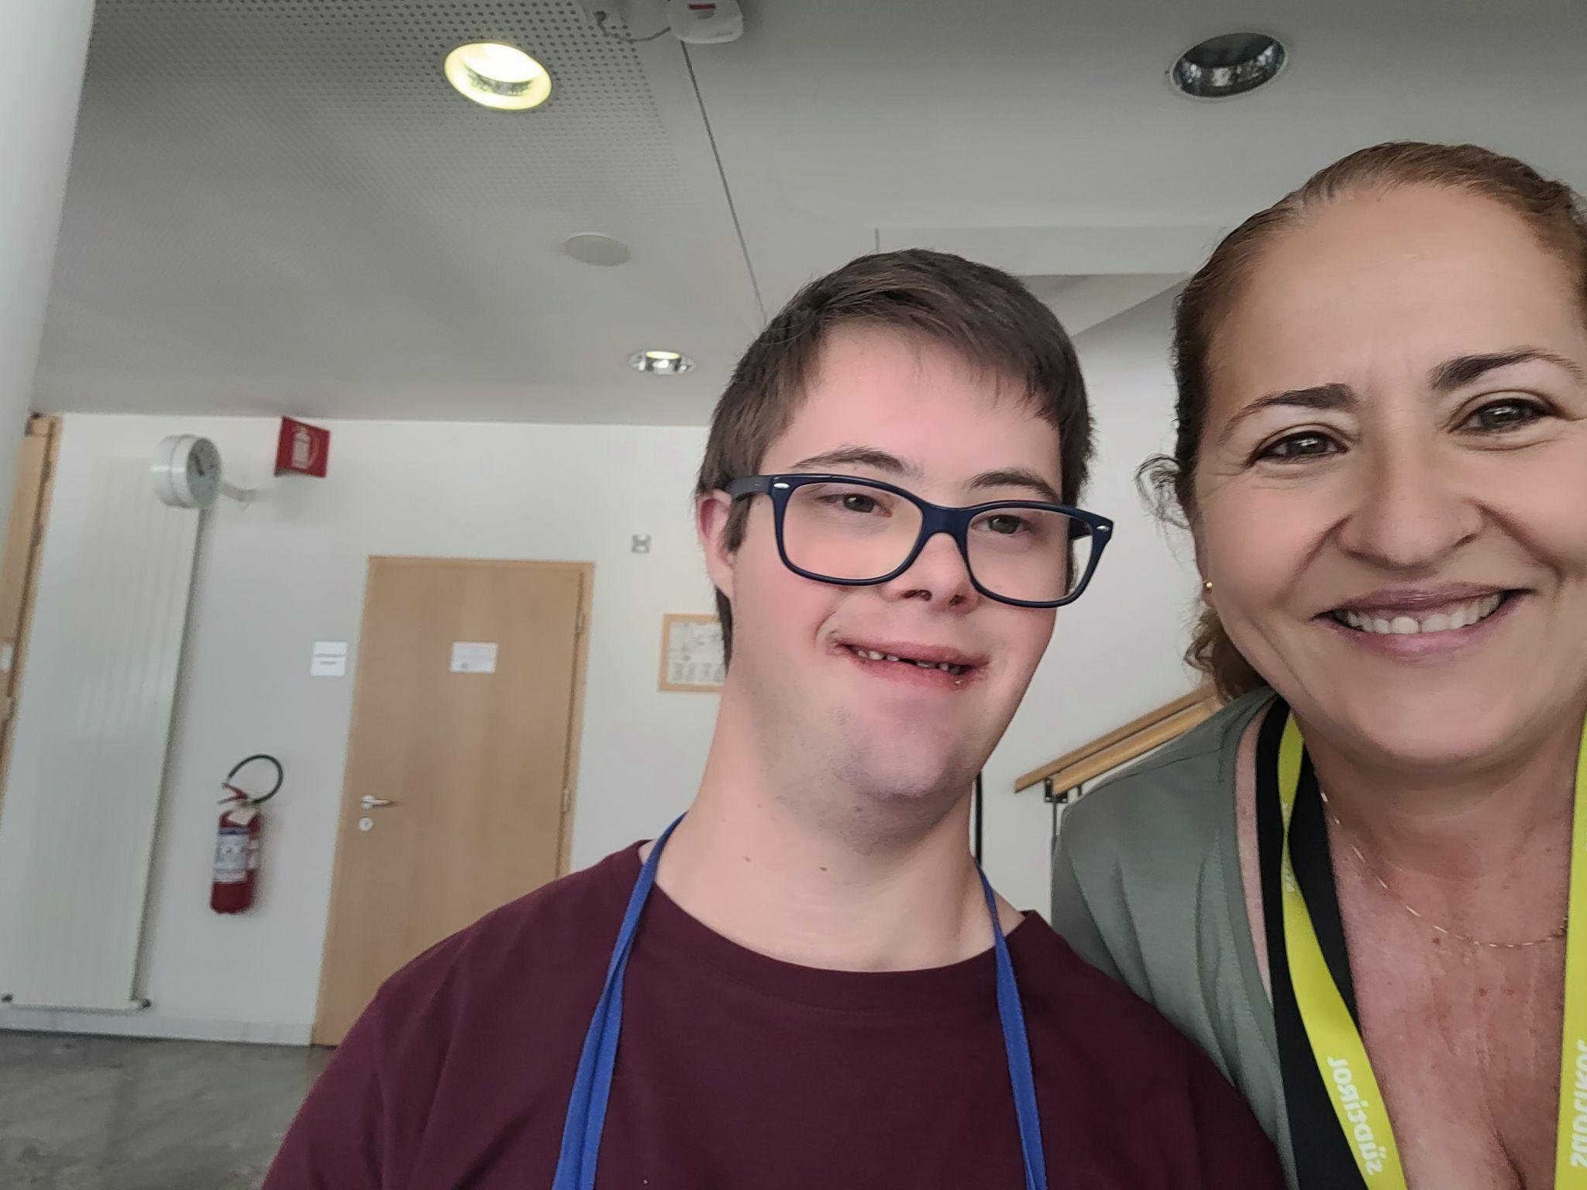
Pilar Romero Candau

