Slide 1
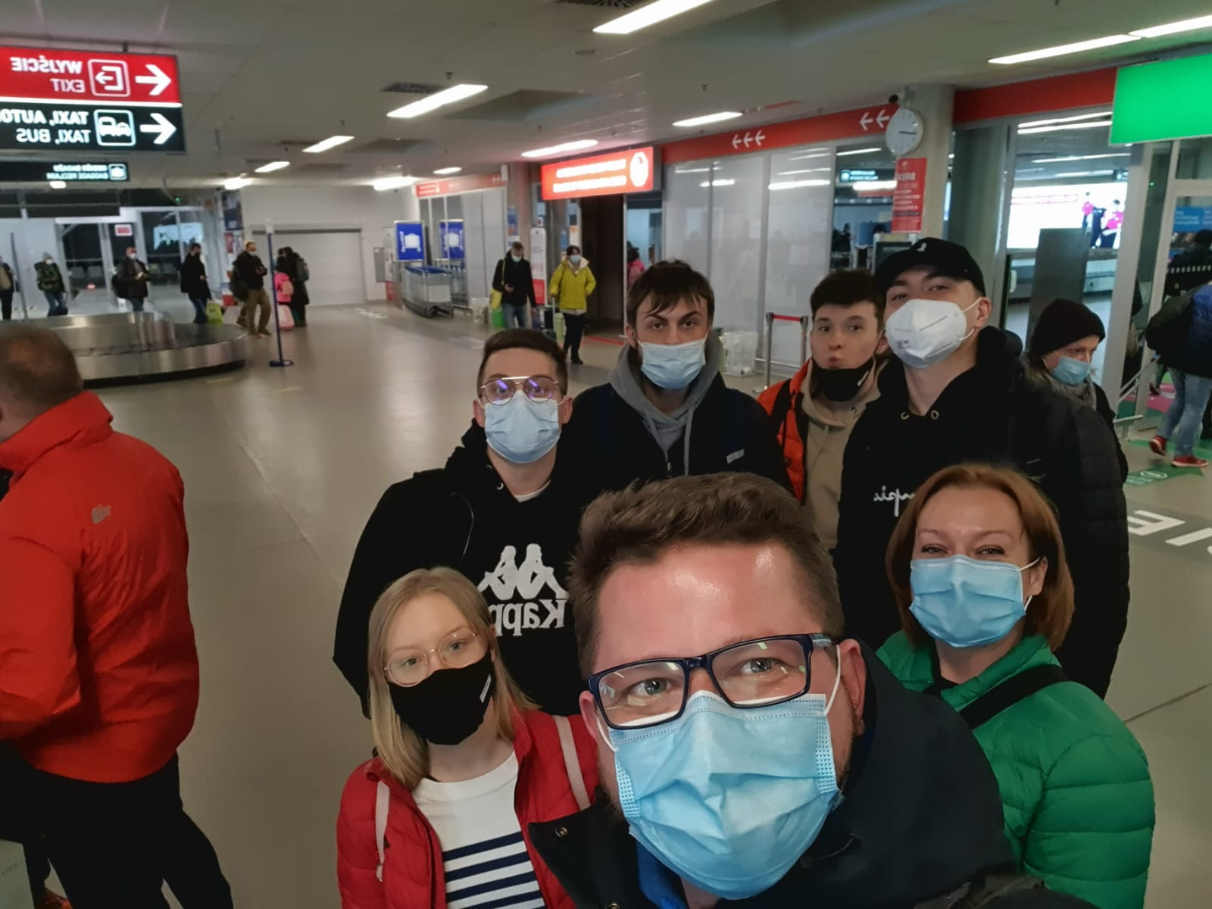
First day was quite nervous. A lot of things going on in my head. Thinking about life in another country with strangers. But soon after arrival at my host family all those negative thoughts just vanished. Really nice people with great hearths.

Slide 2
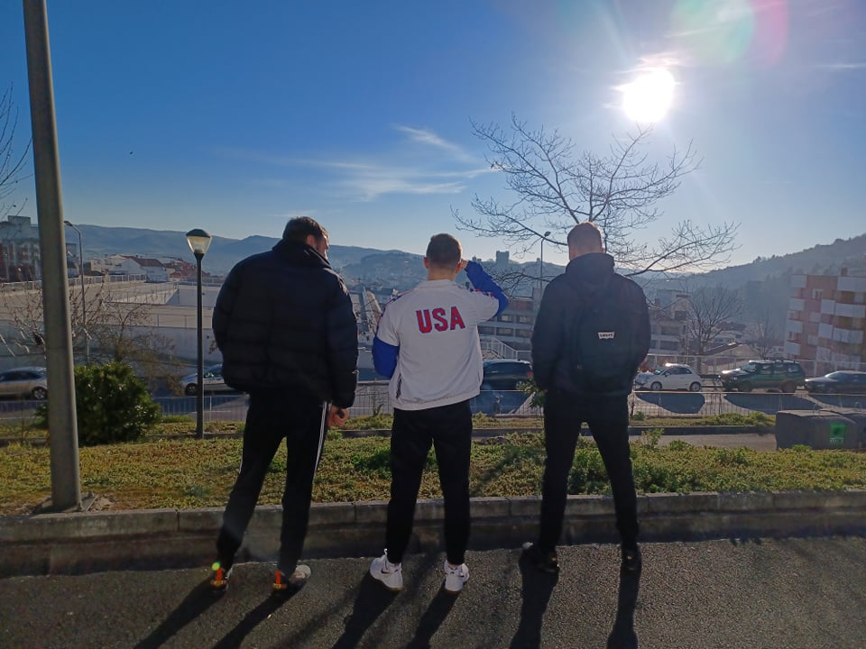
First day after arrival we were excited. Each of us was very eager to meet new people and learn something about foreign culture. And this astonishing place didn't dissapiont us.

Slide 3
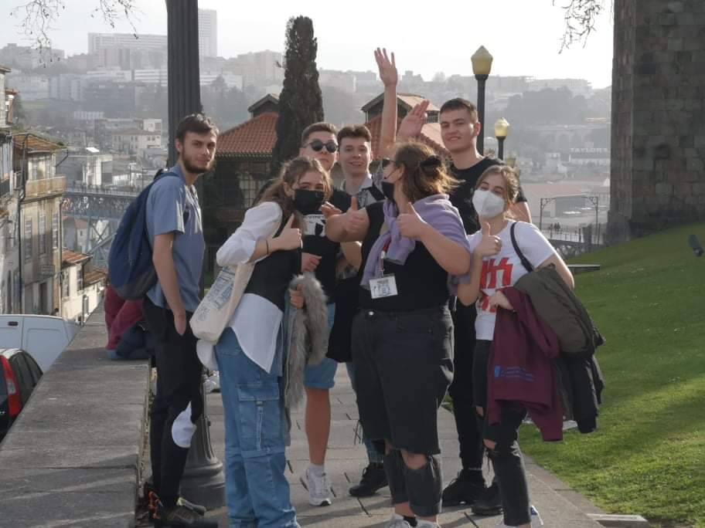
Next day we visited the city of Porto. Amazing place, but it wouldn't be so awesome if it wasn't for those remarkable people that I can call my friends.

Slide 4
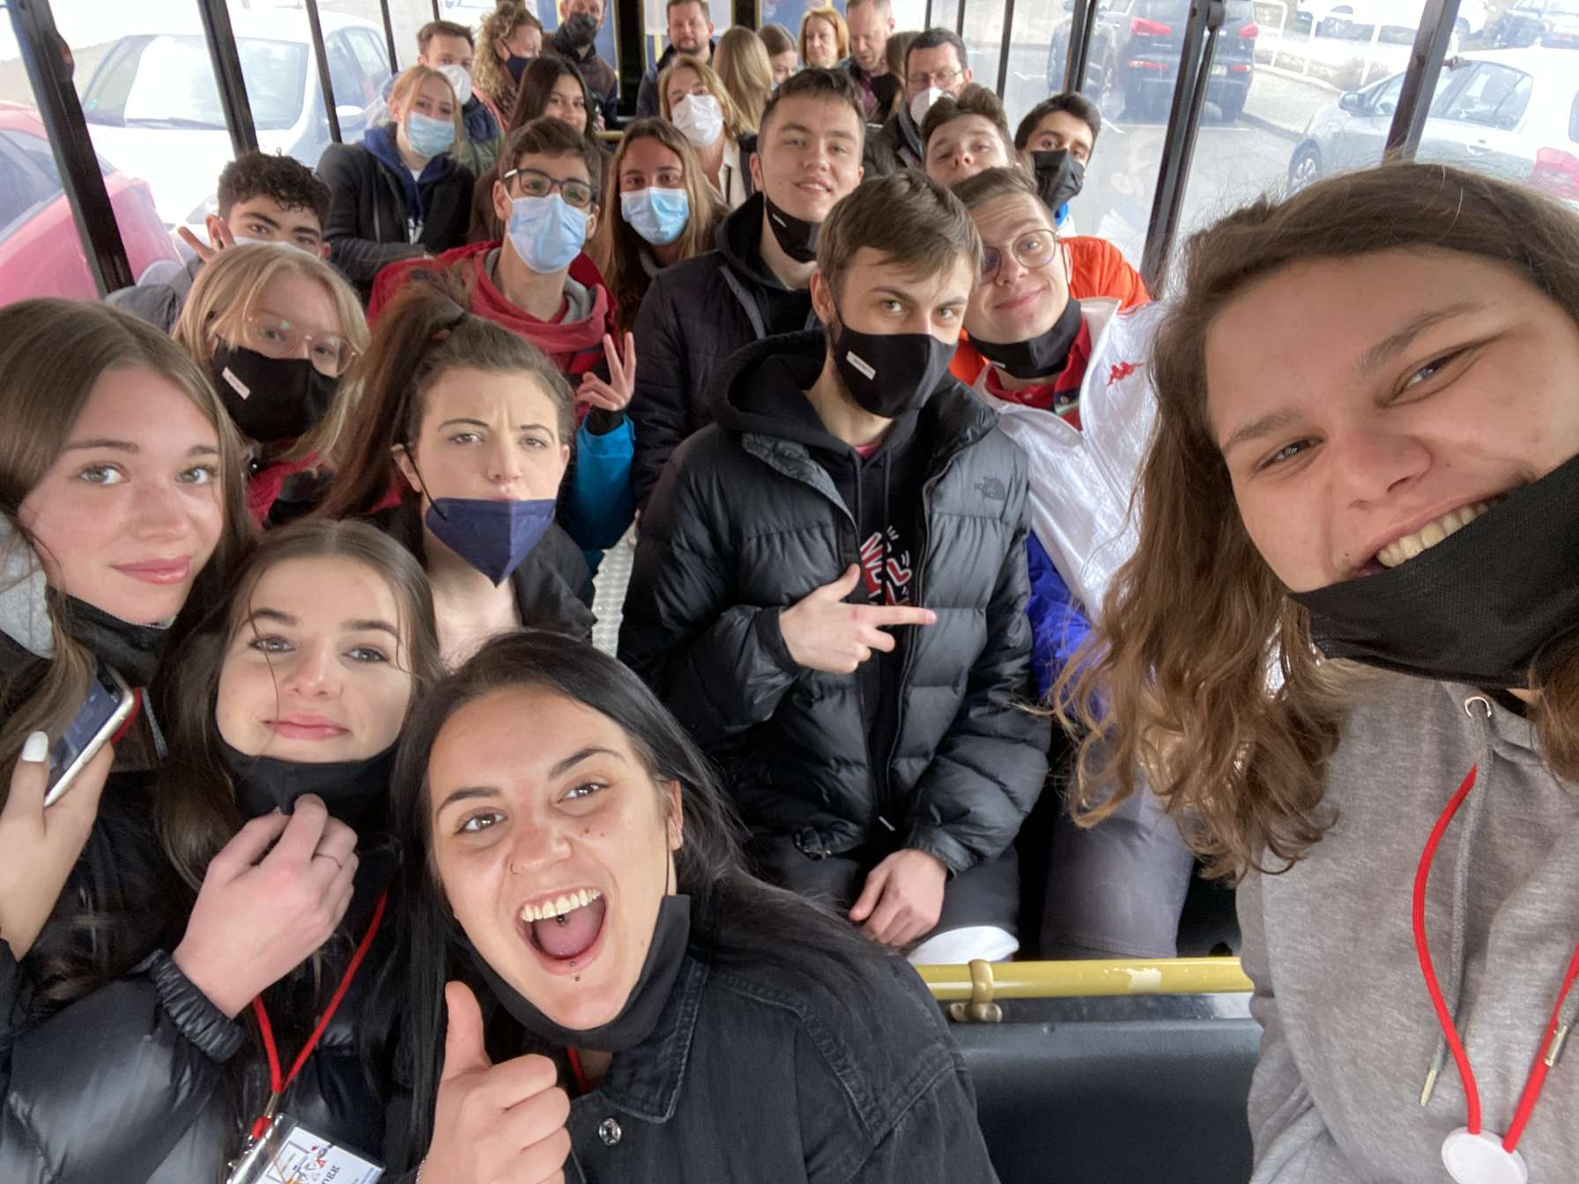
Next day we visited the university of Bragança. I've learned some interesting stuff about technology.

Slide 5
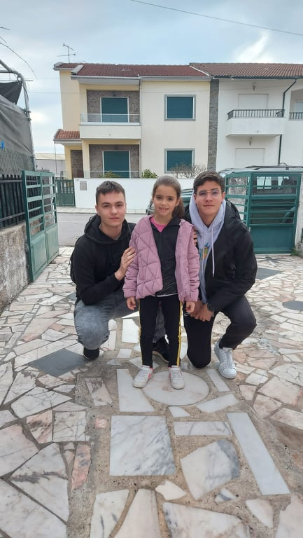
Our last day in Portugal was very emotional. We bought some souvenirs and said our goodbyes. Tears were shed, but the memories will stay with us forever.

Slide 6
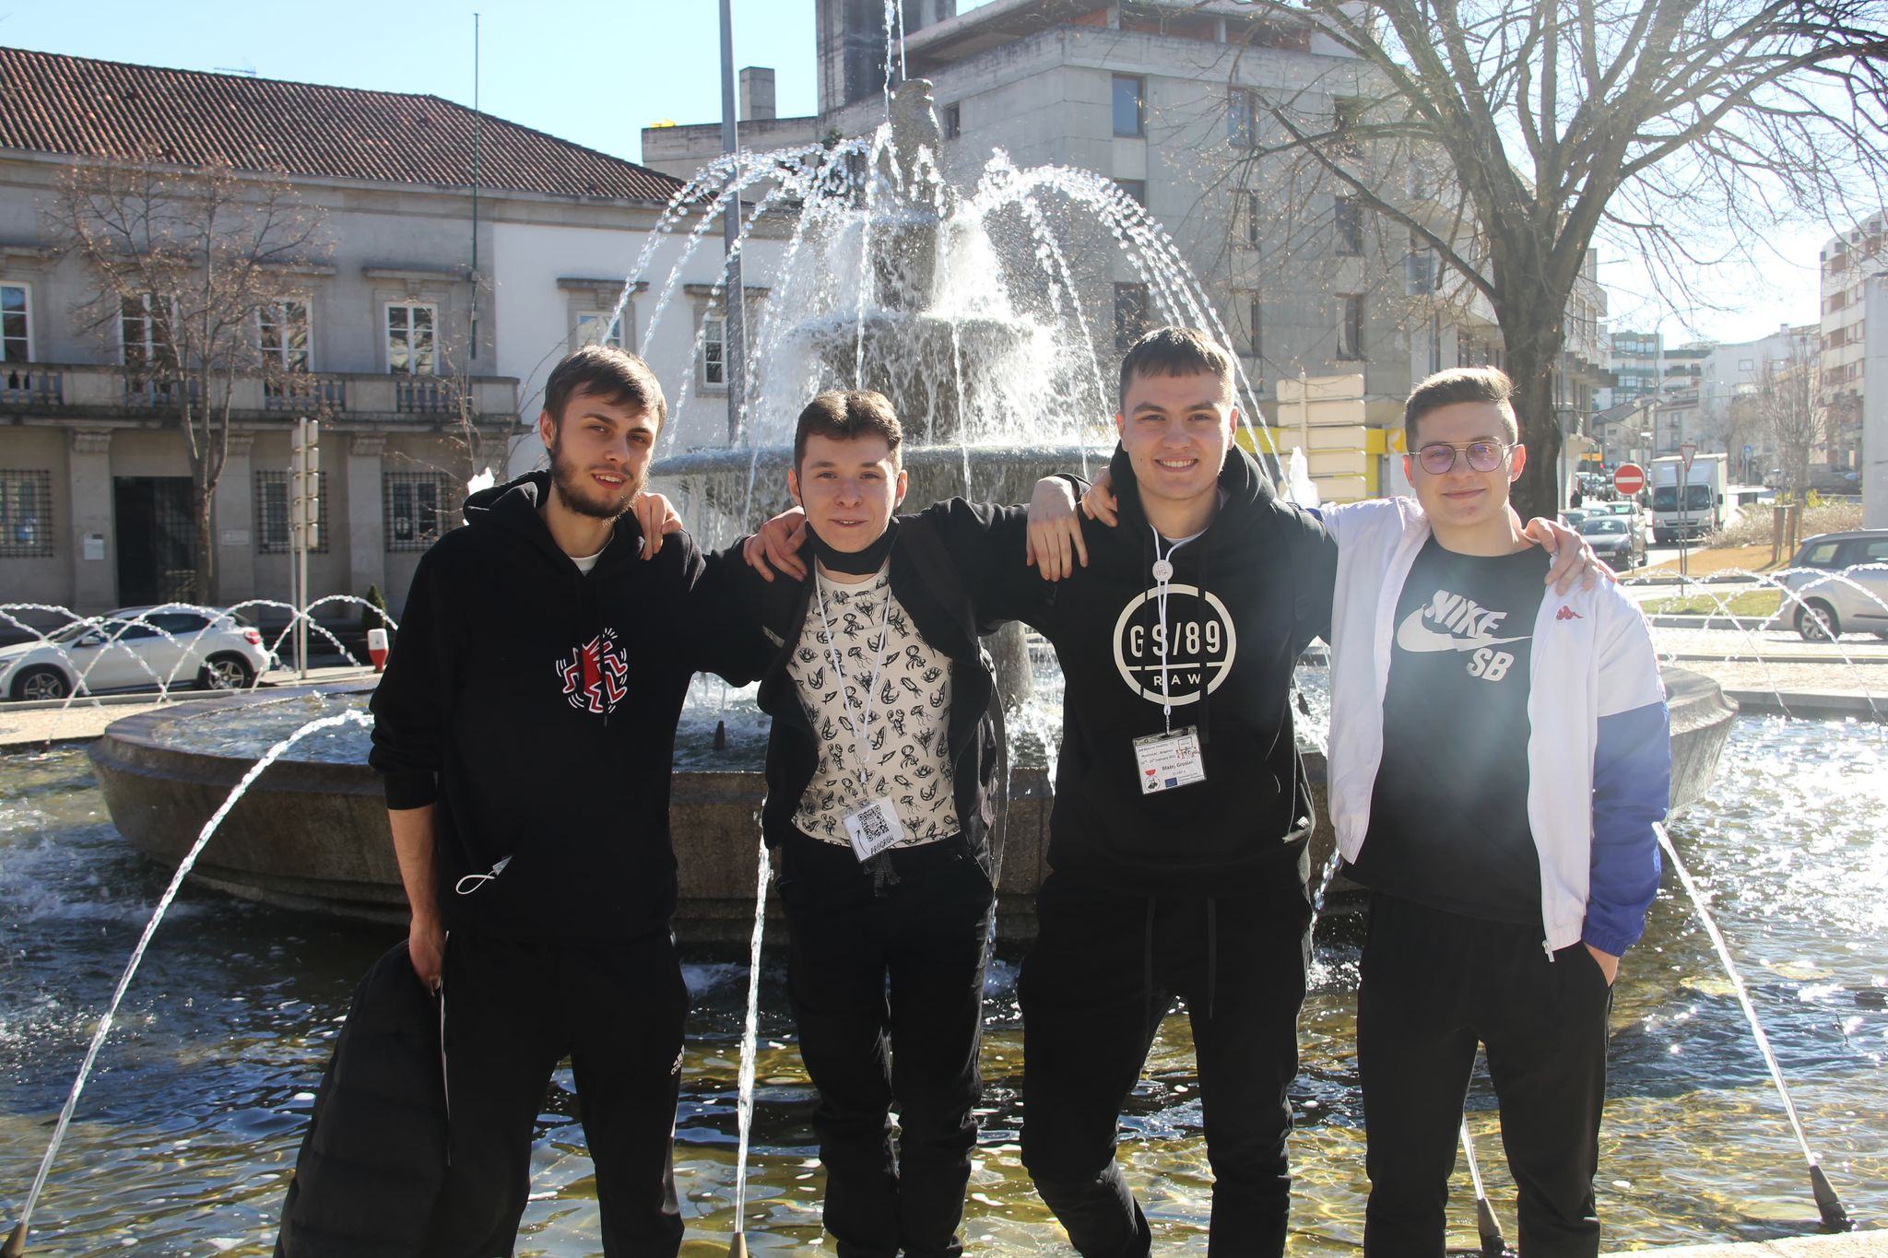
We didn't want to leave so soon. Not after what we have been through these last few days. We've made some new wonderful bonds and strengthen old ones.

