Slide 1
Trip to Italy
BY Mikołaj Niziołek

Slide 2
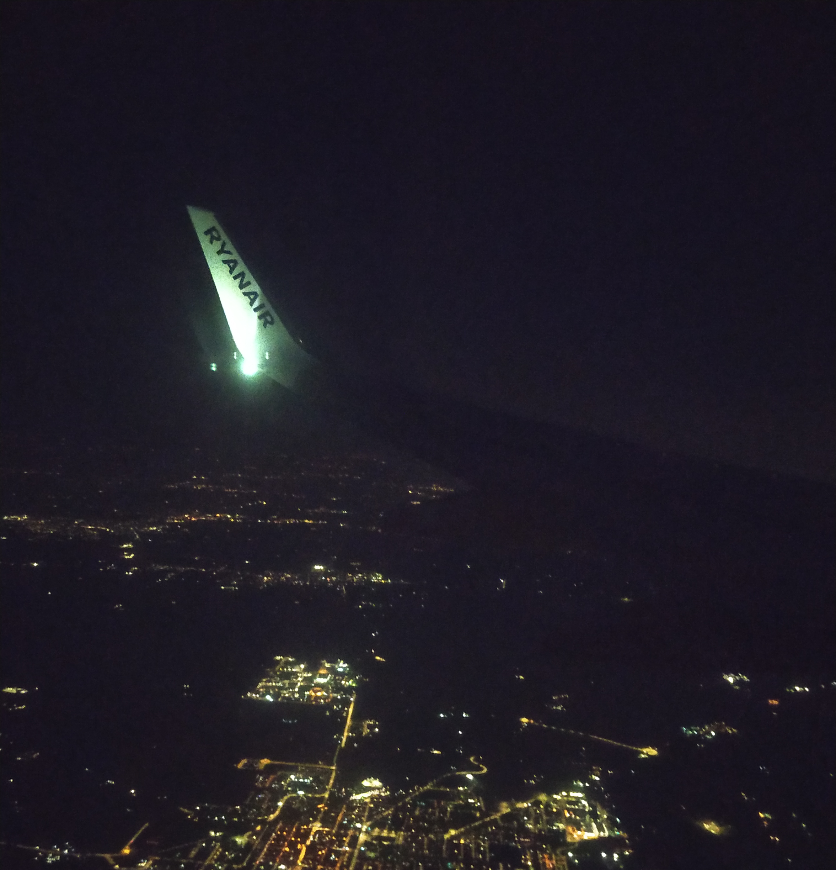
DAY 1
I was on a student exchange "ERASMUS+" for 6 days. First day went quickly. At 3PM we gathered on Mokra street in Radom, then got into the bus and headed off to Warsaw – our capital city. After that we spend about 3 hours waiting at the airplane station. Our group decided to eat something and right after that we got into the Airplane and flew off to Italy. The flight lasted 2 hours straight, so we were really tired. After we arrived immediately we went to sleep.

Slide 3
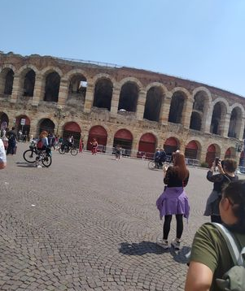
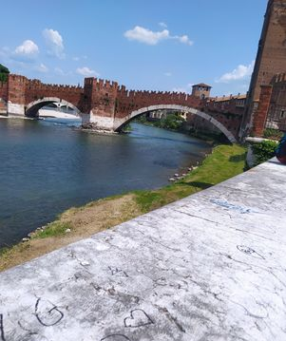
DAY 2
The second day started with a fast breakfast which was continued with our departure to Verona. Right after we got there, we met with our hosts – they took us on a guided tour around the city. Exploring lasted 4 hours, we saw a lot of interesting things, but what excited me the most was the Verona Arena which resembled a big Roman Colloseum. It was very astonishing. After the sightseeing we got into the bus and left off to Malls where Elias's Father – My personal host – took me in into his house. The conversation with his Parents was extremely fascinating and extrodinary. For dinner His mother made a really good lasagne. Then I took a shower, went to sleep because I was really tired .

Slide 4
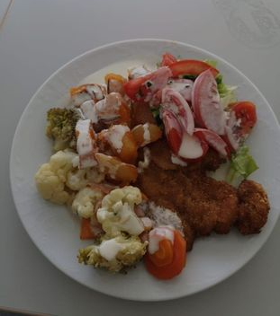
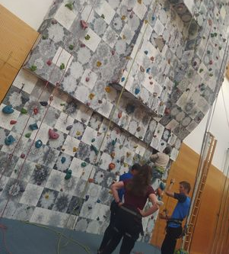
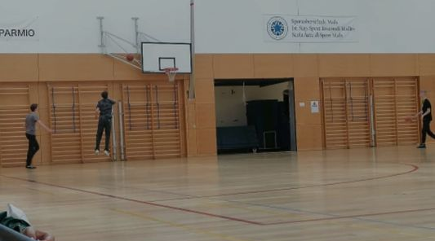
Day 3
We woke up at 7 o'clock because we had to get to school for 7.30 AM. In School we started our Familiarization classes – we played twister, Squid game, we went to the climbing wall . We also were trying to create a blog about our trip to Italy. Some time after that we had lunch in the school bar area.

Slide 5
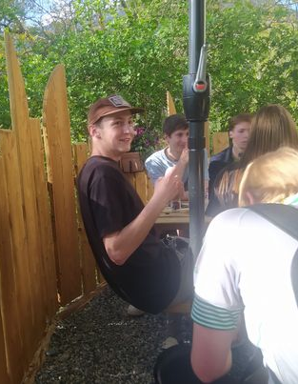
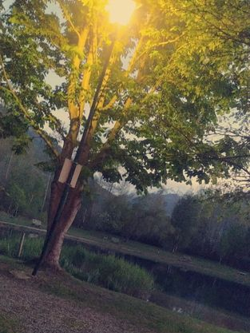
After we ate, we went off for a trip to mountains. Our destination was the Castle placed in those mountains. We spend some time over there and then – without our teachers – we went to a bar placed near the river. We ordered some pizza and we had a really great time. After spending several hours at the bar, we decided to go back to our hosts houses because it was really late and we were really exhausted.

Slide 6
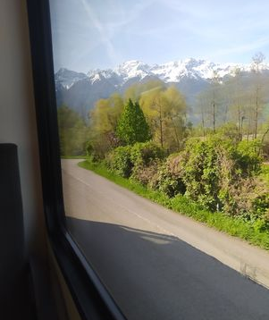
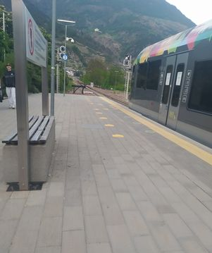
Day 4
The next day was really staggering and full of emotions. Right after we met up with the rest of the contestants, we got into a train, then transferred to a bus which took us to a line park.

Slide 7
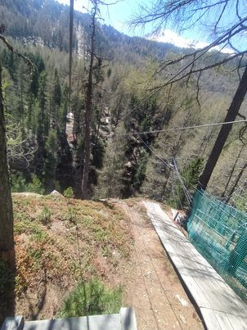
In my opinion this was the greatest experience on this ERASMUS+. I felt thrilling Emotions and Immesurable joy of adventure even though it was a static rope jump I imagined I was in a Big Jungle, thirsty for adventures awaiting me.

Slide 8
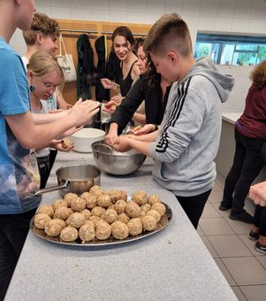
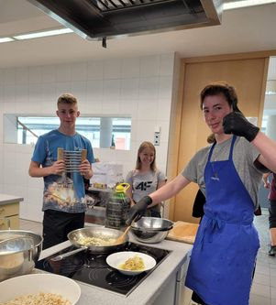
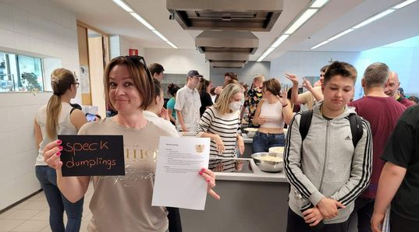
We got back to school where we started to make dumplings and right after making them, we ate them. Then we went to a bar to drink something. At the end of the day, we came back to our staying places and went to sleep.

Slide 9
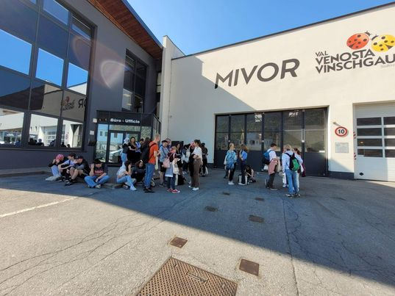
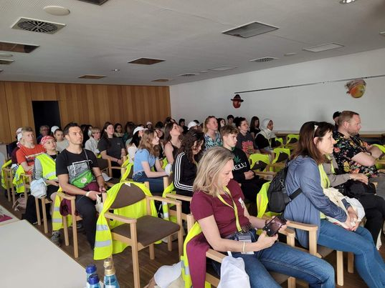
Day 5
We woke up at 7 AM and then we went to a Europe largest apple sorting plant. I really had enough of apples that day. One thing that is worth to mention is that everything there was automated! Everywhere I looked there were apples.

Slide 10
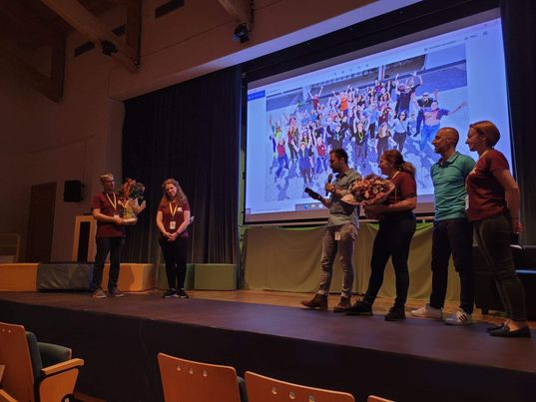
Then we went back to school and ate dinner prepared by master chefs Peter and Felix. After the dinner we decided to finalize the blogs we started making on day 2. At 5 PM we started to show our presentations and Blogs to local press while awarding the best projects and Blogs.

Slide 11
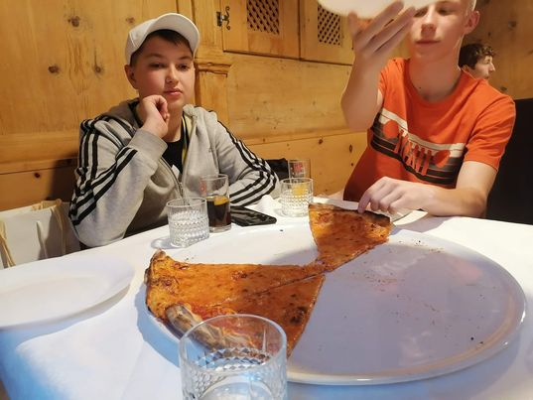
For our last meeting we went to a Pizzeria located in Schlunders and after that we went to our homes.

Slide 12
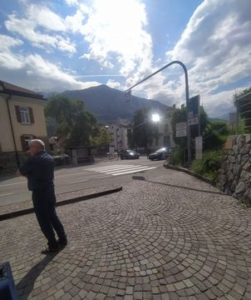
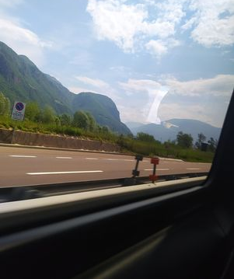
Day 6
This was the last day of ERASMUS. I woke up early to pack my things up, then - in a hurry - I ate breakfast. At 10AM I was already getting into the bus that departed to Mediolan.

Slide 13
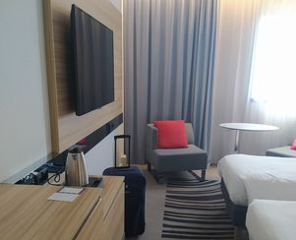
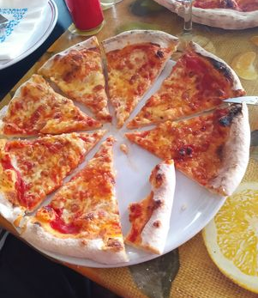
After leaving the bus we left our things at the hotel, then we went to a pizzeria and ate a Pizza.

Slide 14
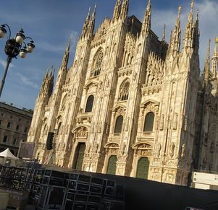
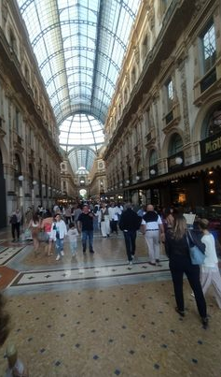
After getting out of the Pizzeria, we decided to go sightseeing. I bought some souvenirs and we also were able to see the famous Cathedral Duomo di Milano. It was enormous. We came back to our hotel by tram and then we went to sleep.

Slide 15
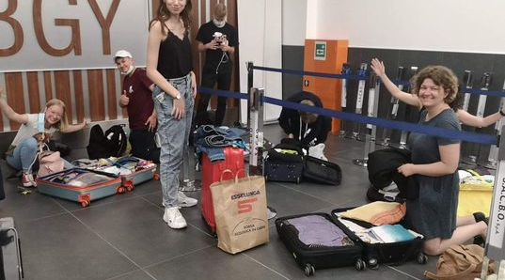
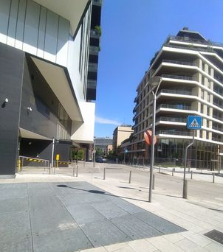
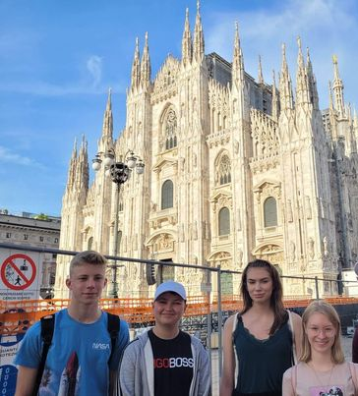
Day 7
We woke up at 9 AM, then ate breakfast. At 12AM we left our belongings at the Deposit and after doing so, we went sightseeing. After that we ate dinner at McDonald's. Then we Came back to pick up our belongings and after doing so we left for the Airplane station.

Slide 16
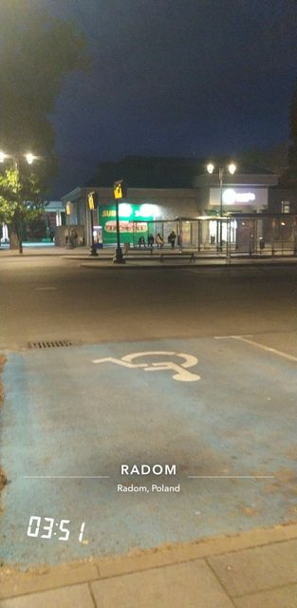
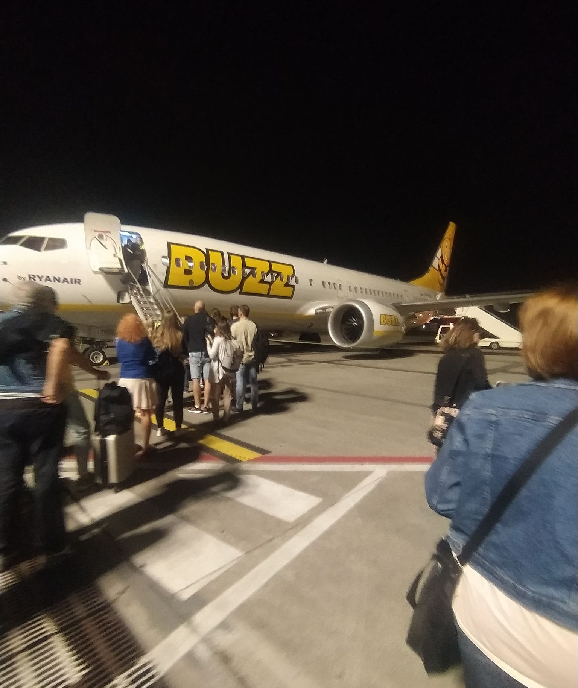
The plane was delayed by an hour which gave us the occasion to eat dinner. After we got back to Poland at 1 AM we left Warsaw by bus at 1.30 AM. We got to Radom at 4.30AM after reaching that goal we disbanded our group and headed off to our homes.

