Slide 1
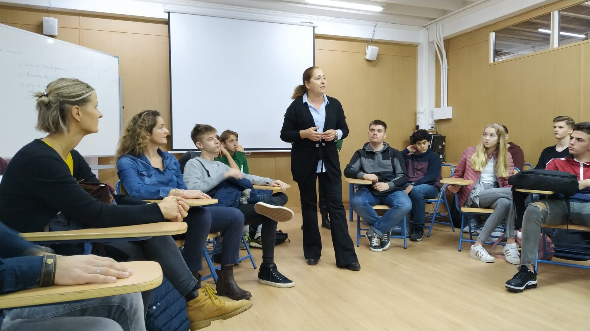
Erasmus Diary ~Spain

Slide 2
First day
23.11.2019
We started our journey at the bus station in Radom.

Slide 3
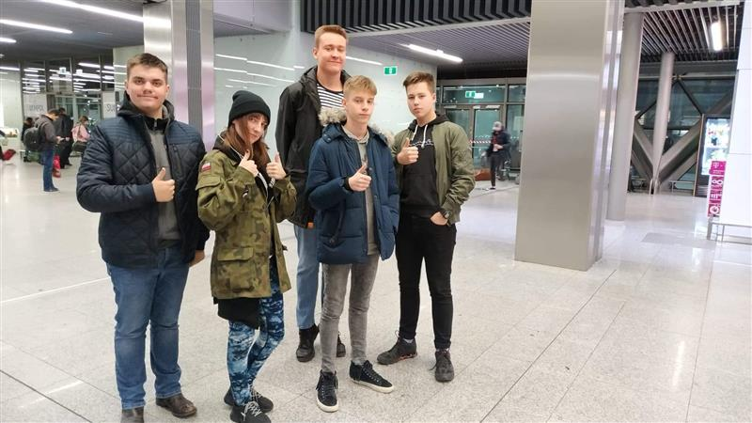
23.11.2019
Our next station was the airport in Cracow.

Slide 4
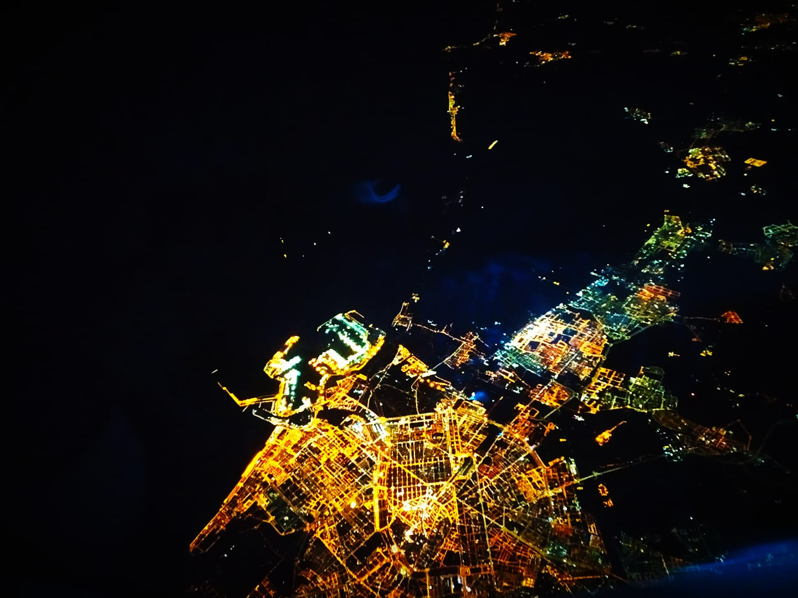
23.11.2019
The flight took about 4 hours.

Slide 5
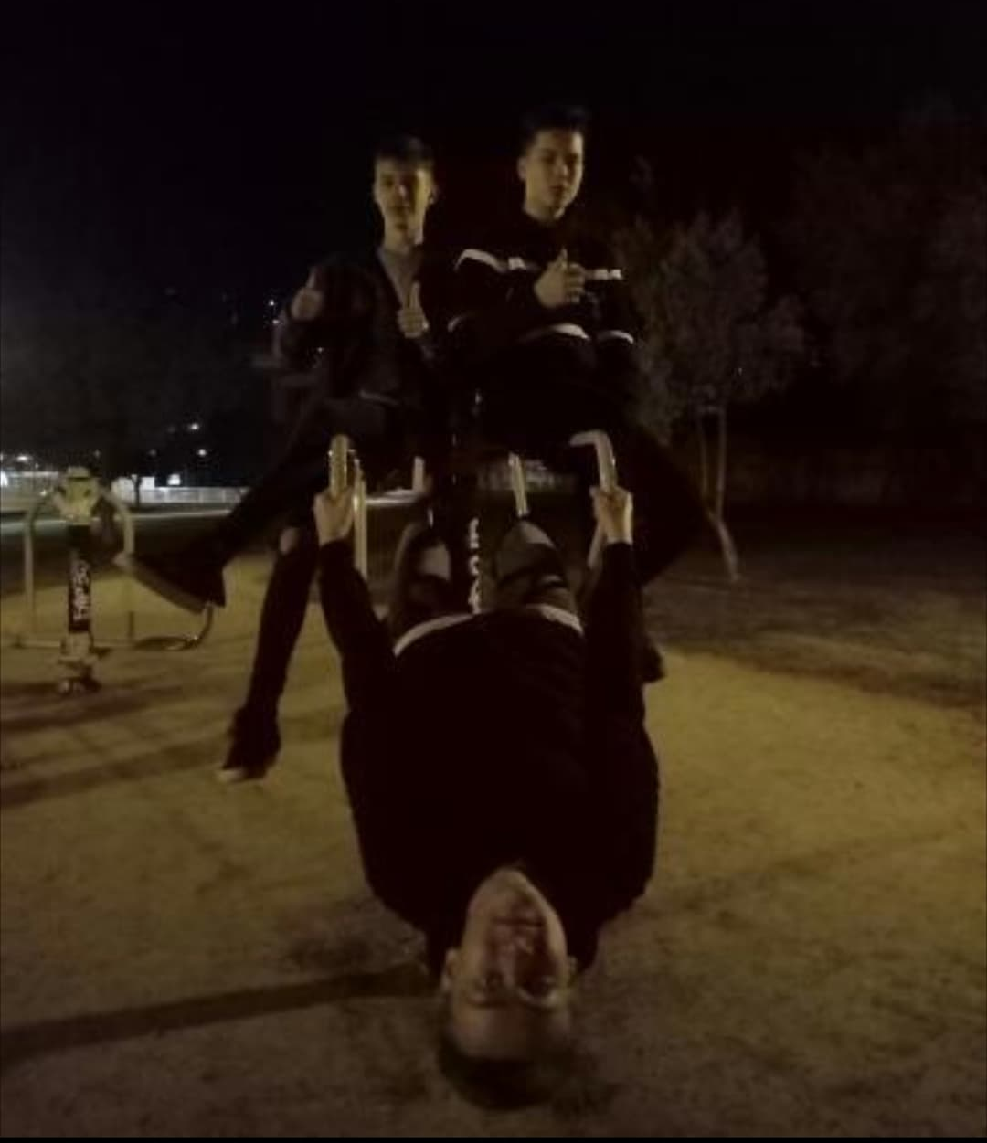
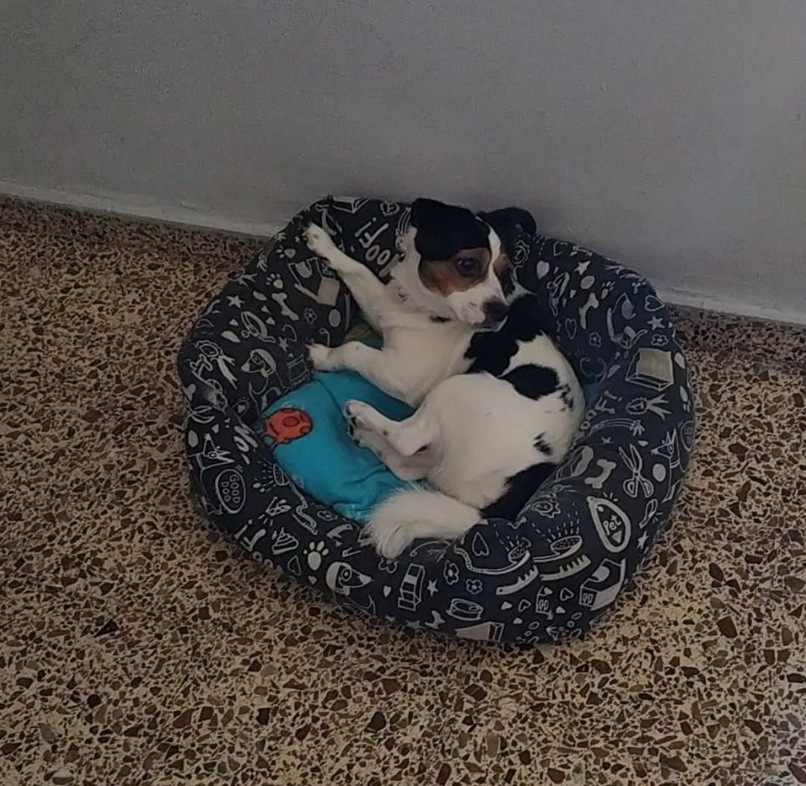
Second day, but first in Seville
24.11.2019
We spent this day with Erasmus families, their pets and our own.

Slide 6
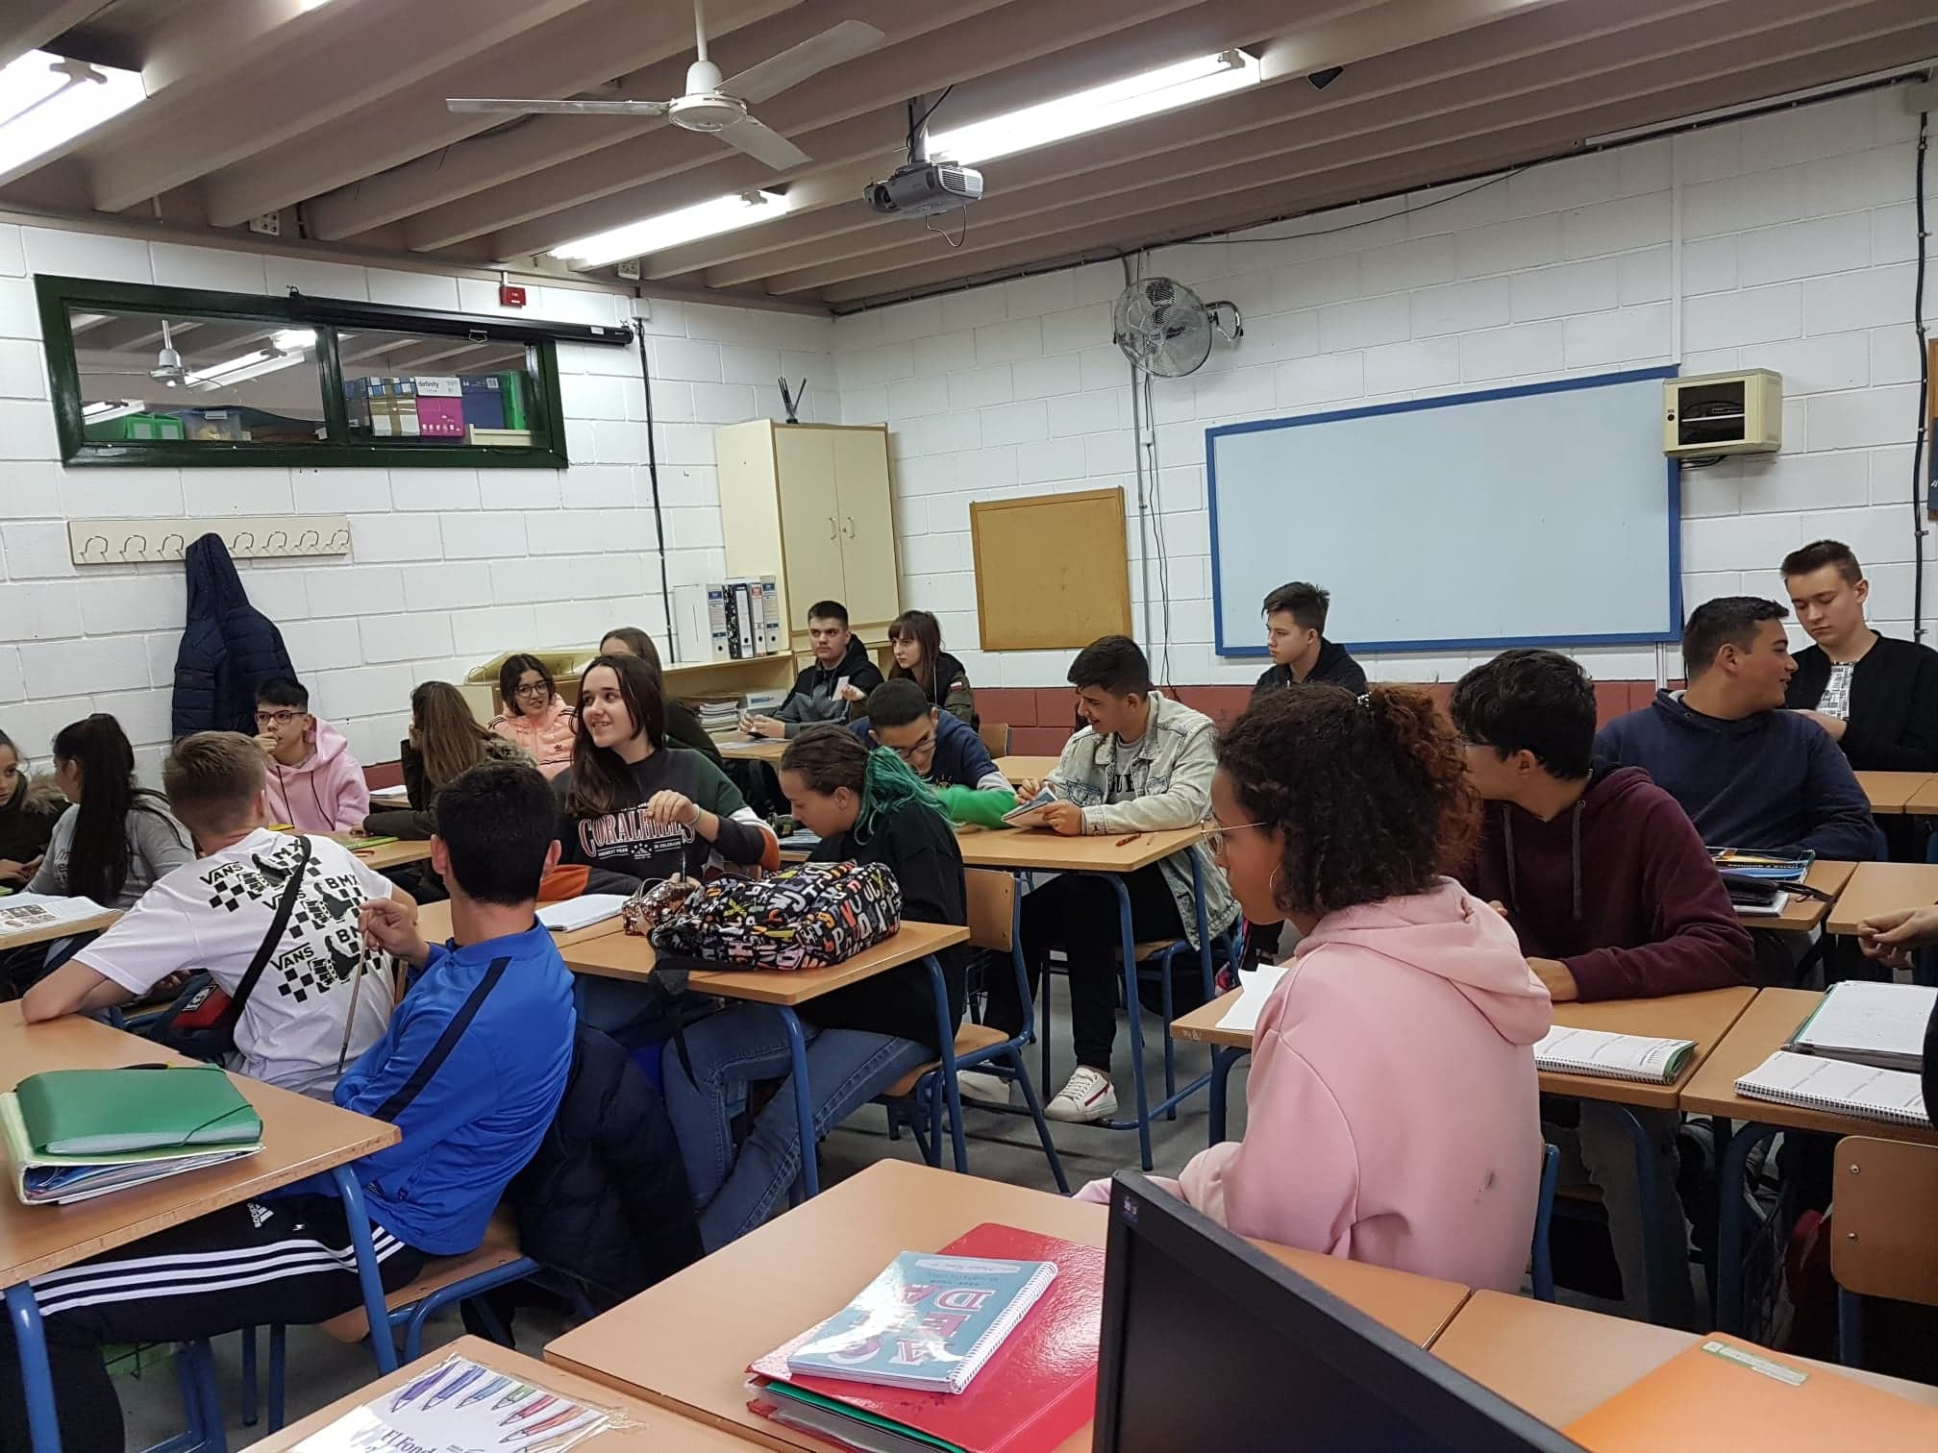
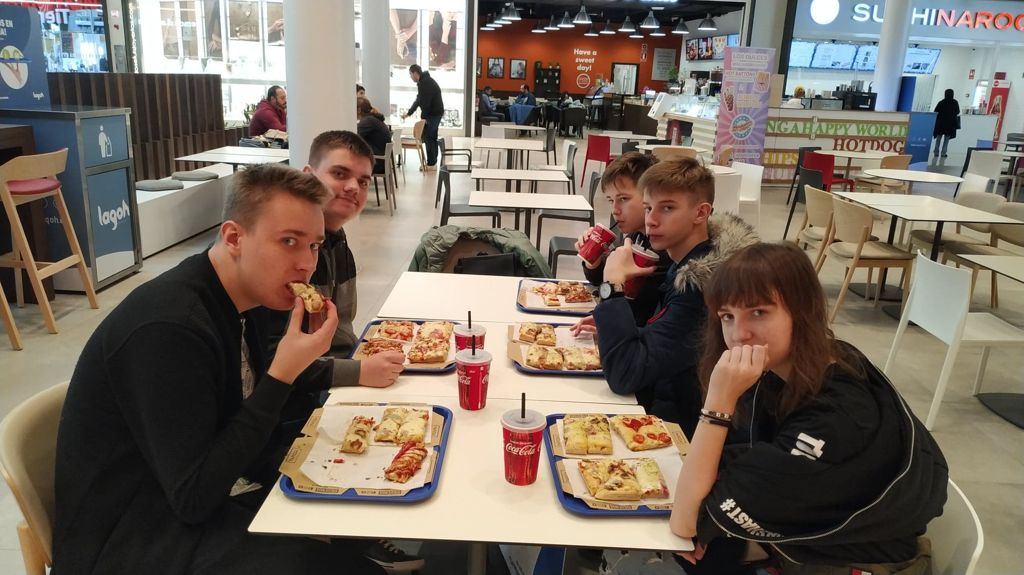
Third day
25.11.2019
The day was full of Spanish school activities and delicious Spanish food.

Slide 7
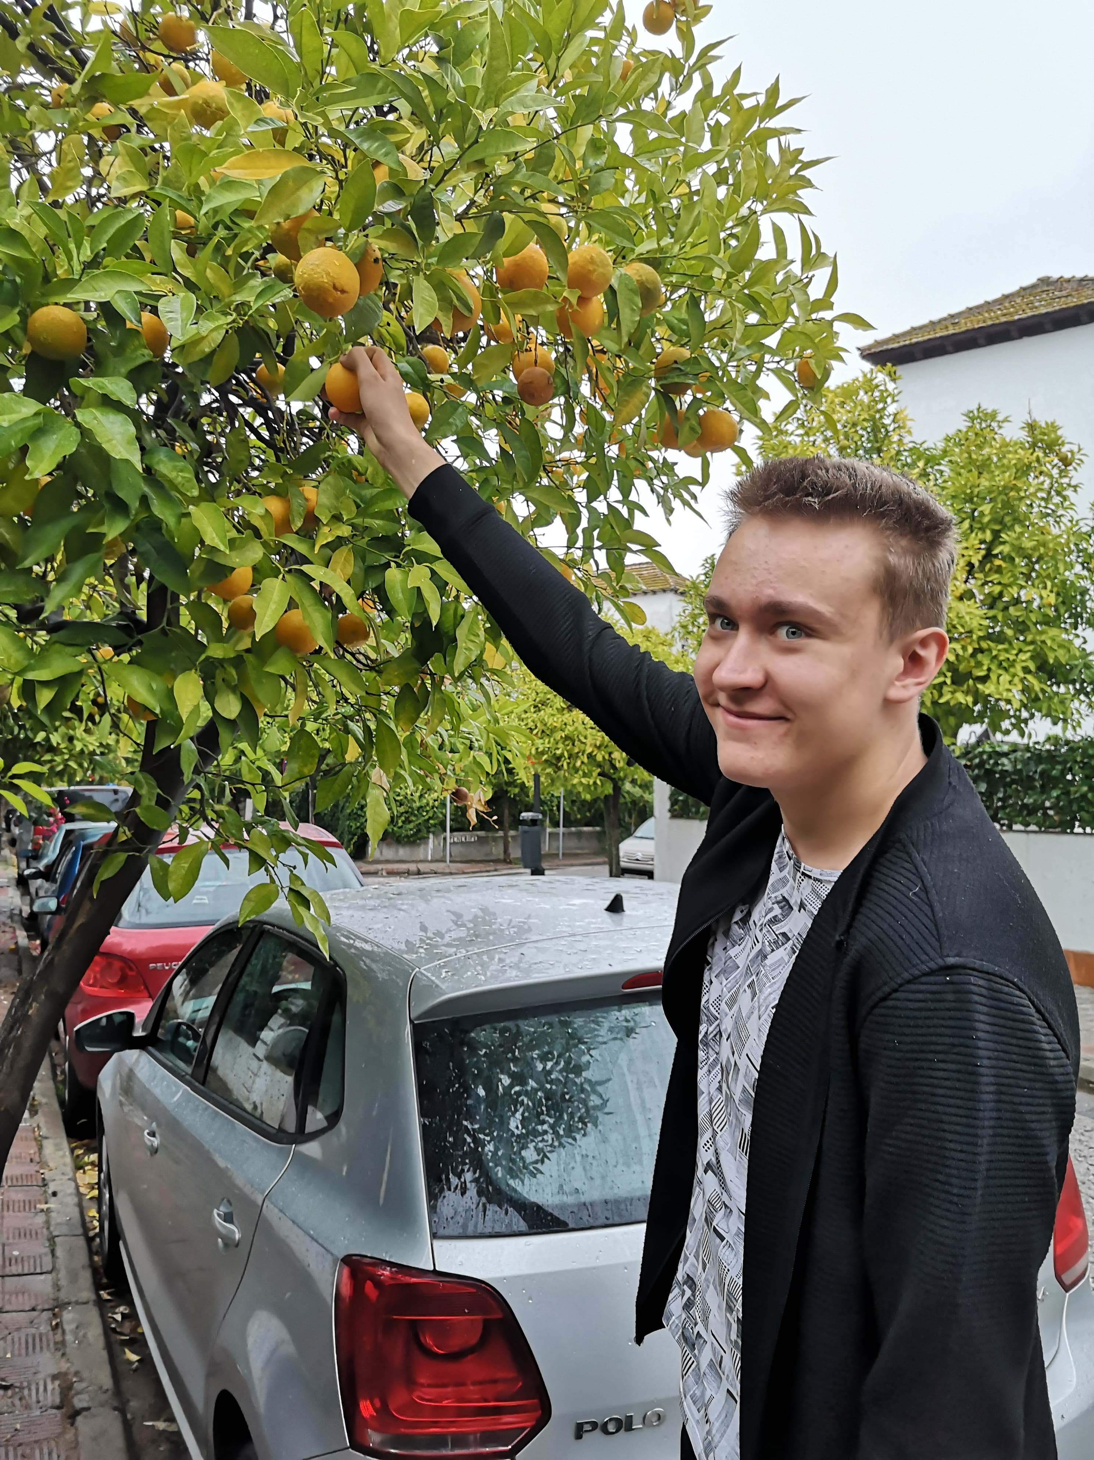
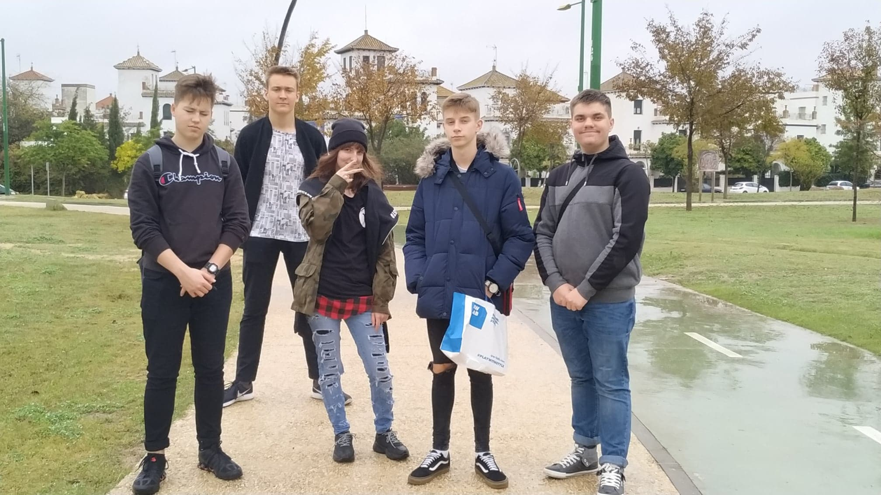
25.11.2019
We tried to eat oranges from the Spanish street but it was very sour, we were also in the park.

Slide 8
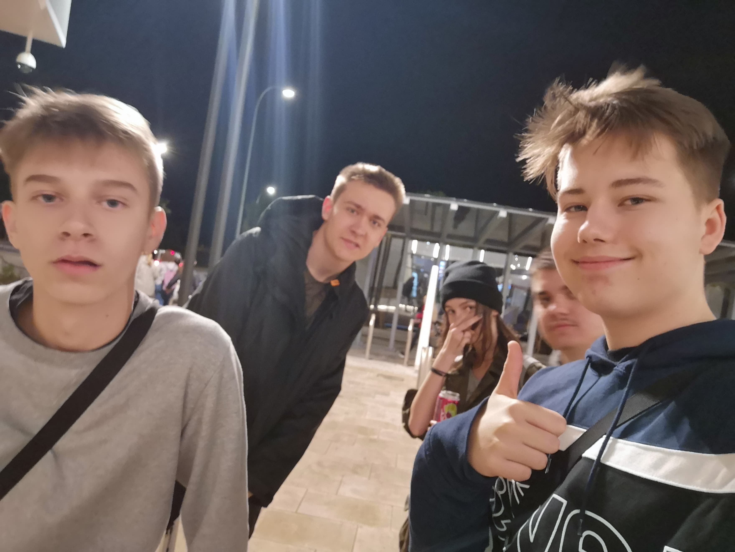
Fourth day
26.11.2019
That day we went back to school in the morning, and in the evening we went to a galery Lagoh located near our whereabouts.

Slide 9
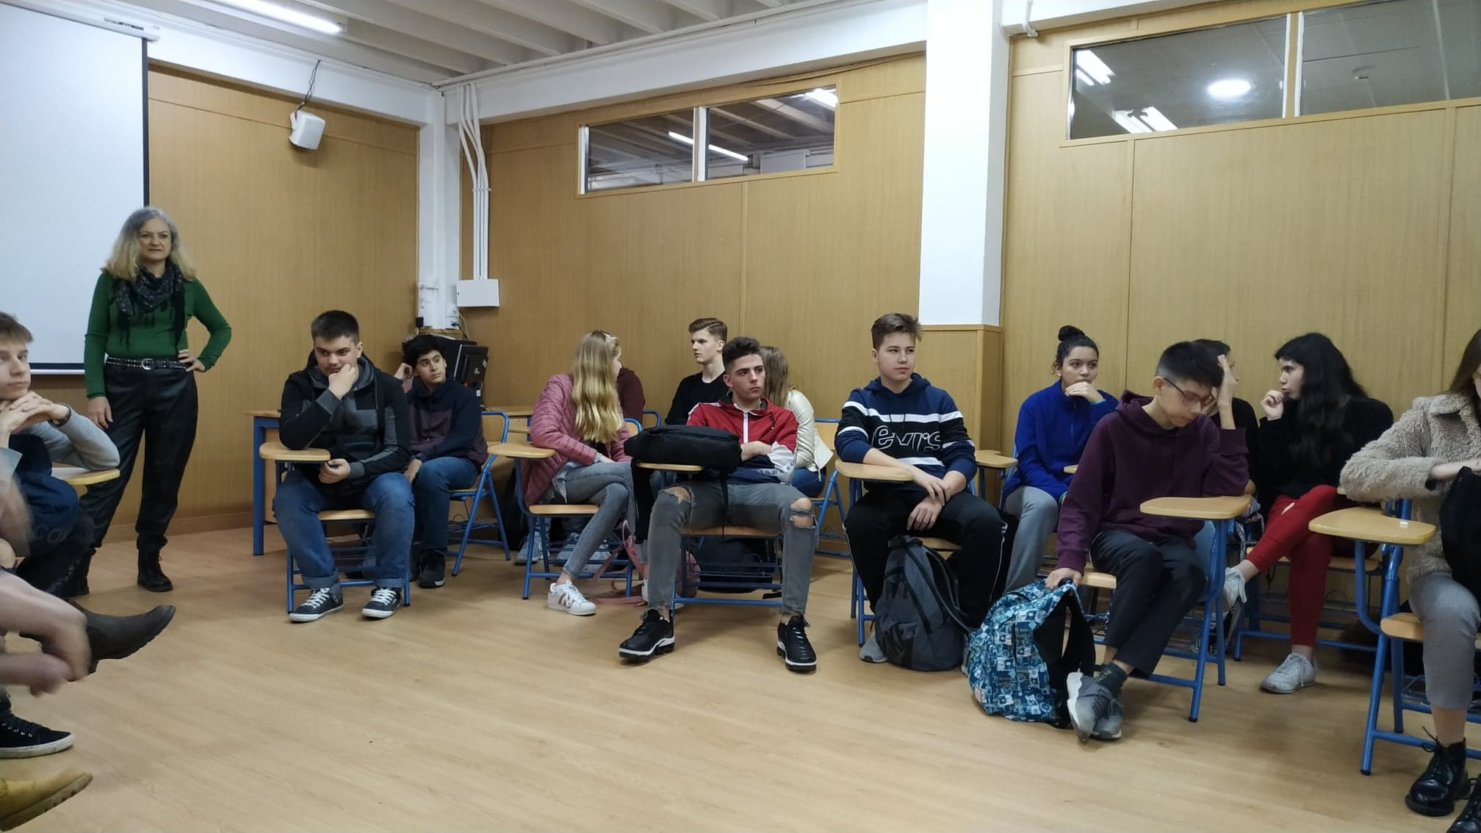
26.11.2019
We also had introductory classes with other students of the school, of course, we worked in English.

Slide 10
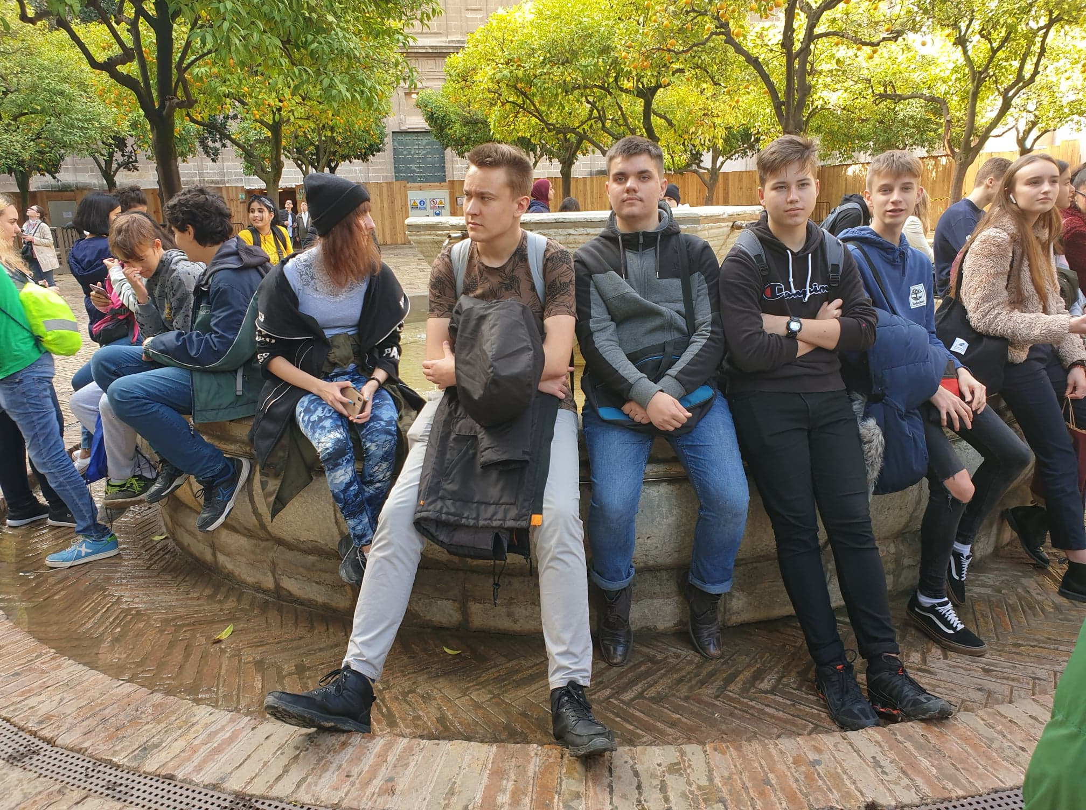
Fifth day
27.11.2019
At the beginning, we saw the Gardens of the Royal Alcazar.

Slide 11
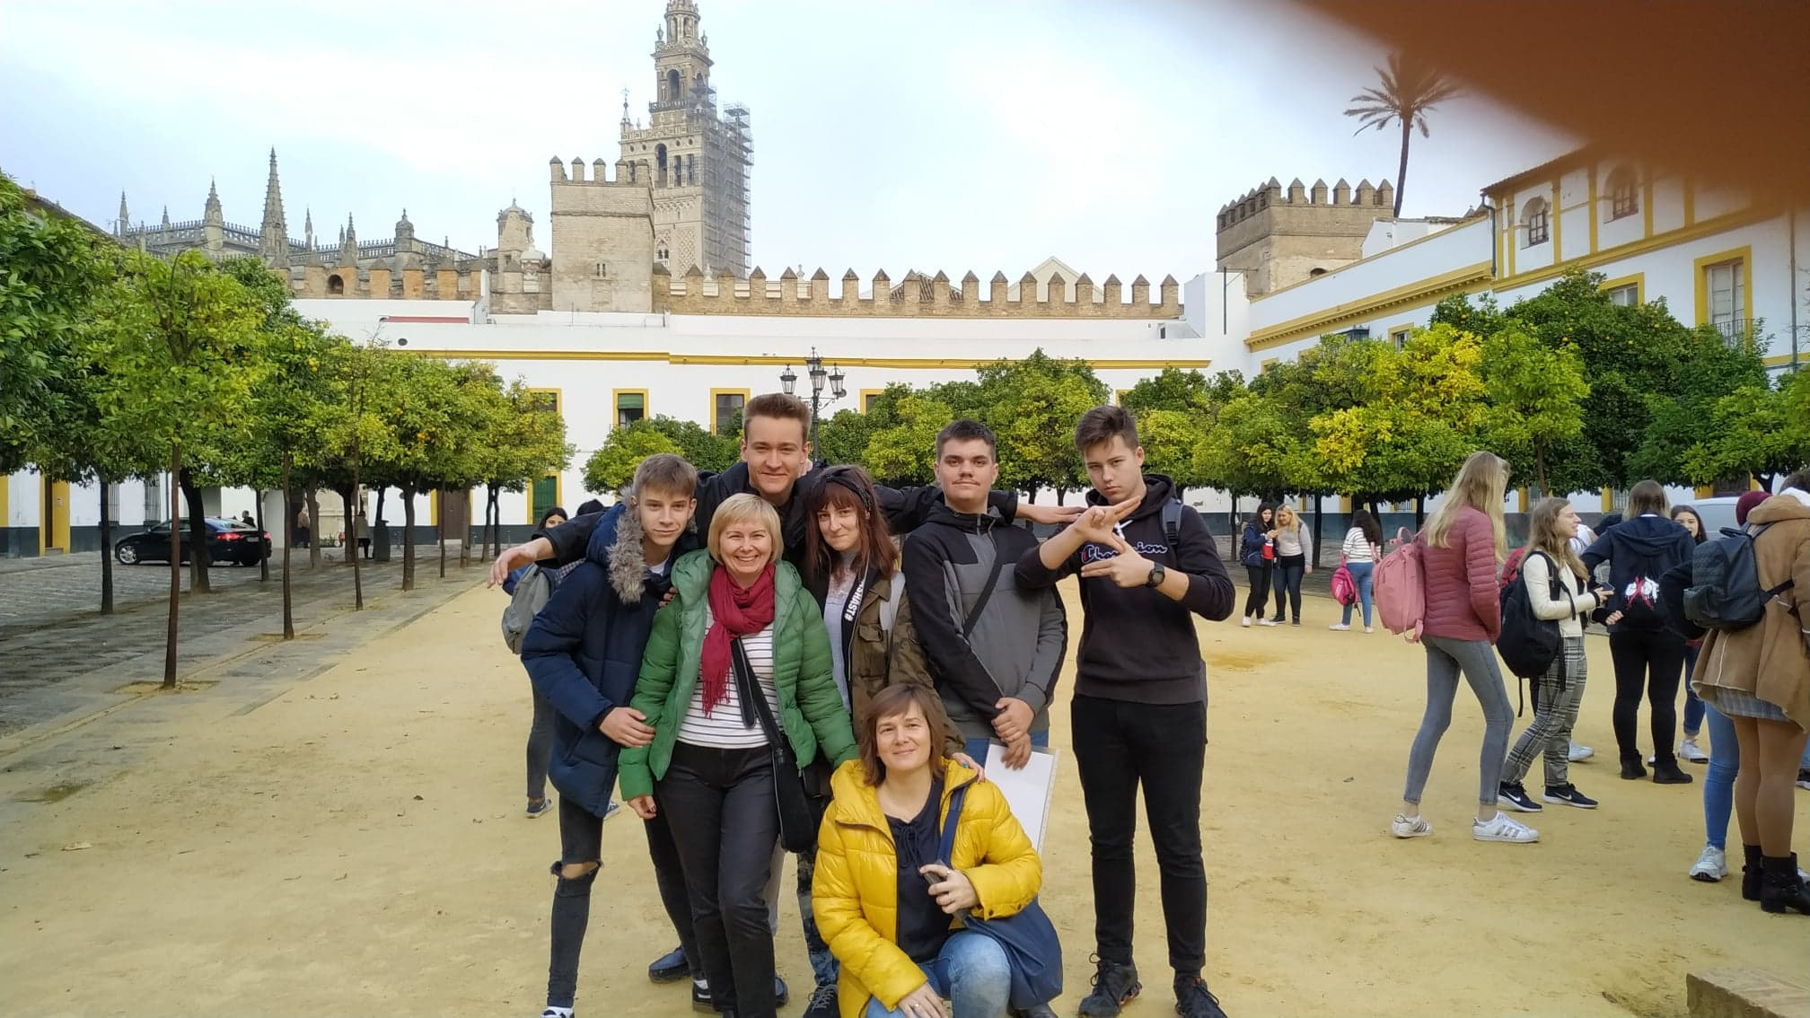
27.11.2019
We also visited the Spanish Square, where there were riddles waiting for us, which we had to solve in groups.

Slide 12
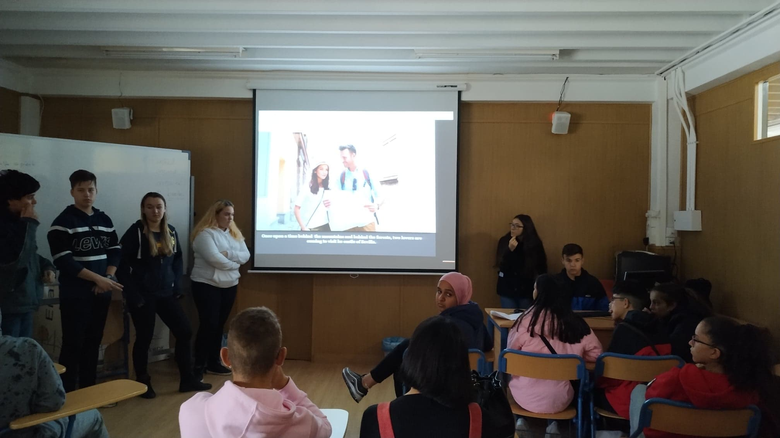
Sixth day
28.11.2019
On that day, we presented presentations about Spain, prepared by us in Poland.

Slide 13
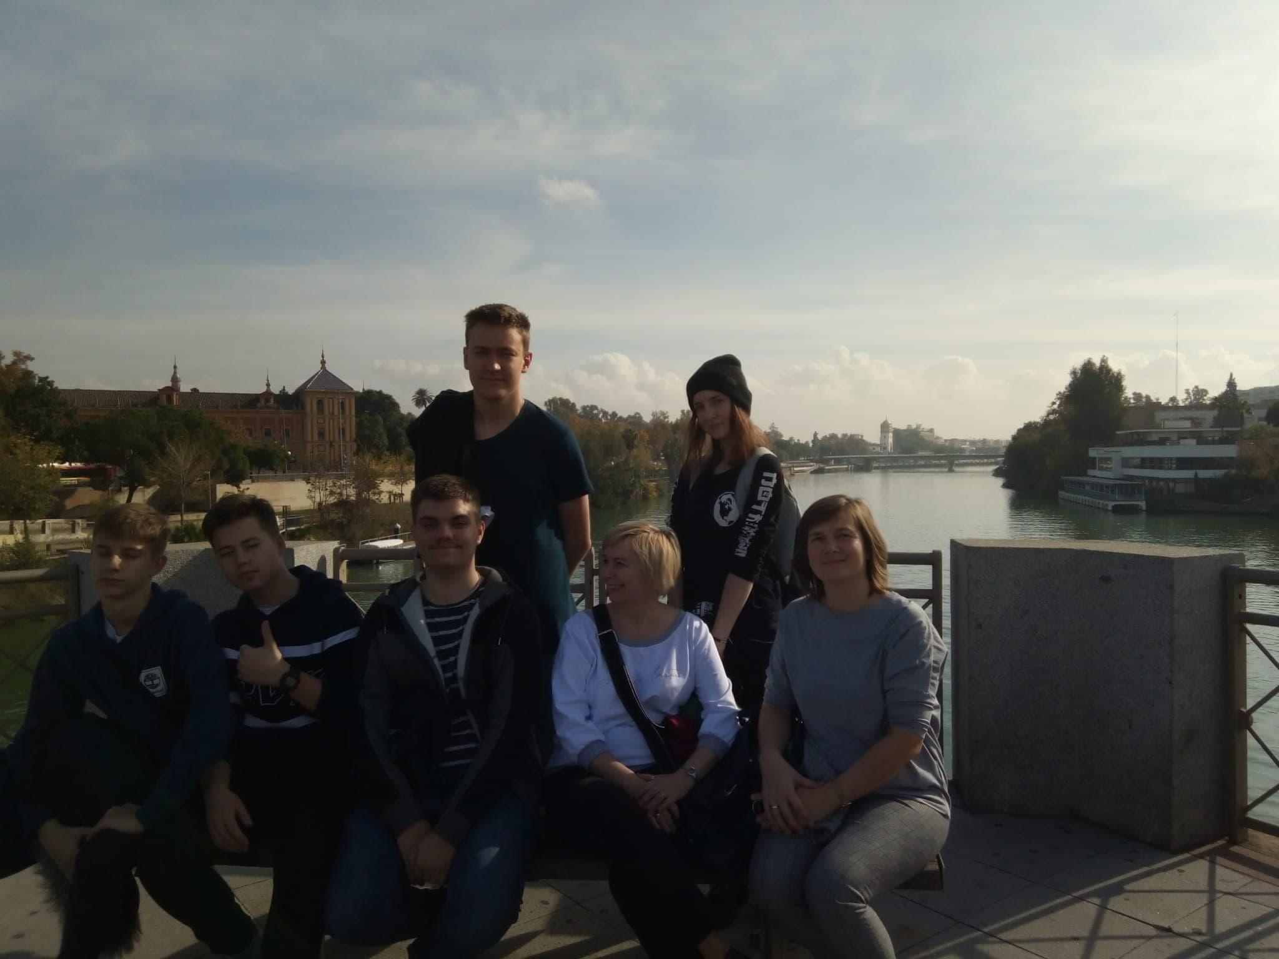
28.11.2019
We also visited the city center and important places for everyday Spanish life.

Slide 14
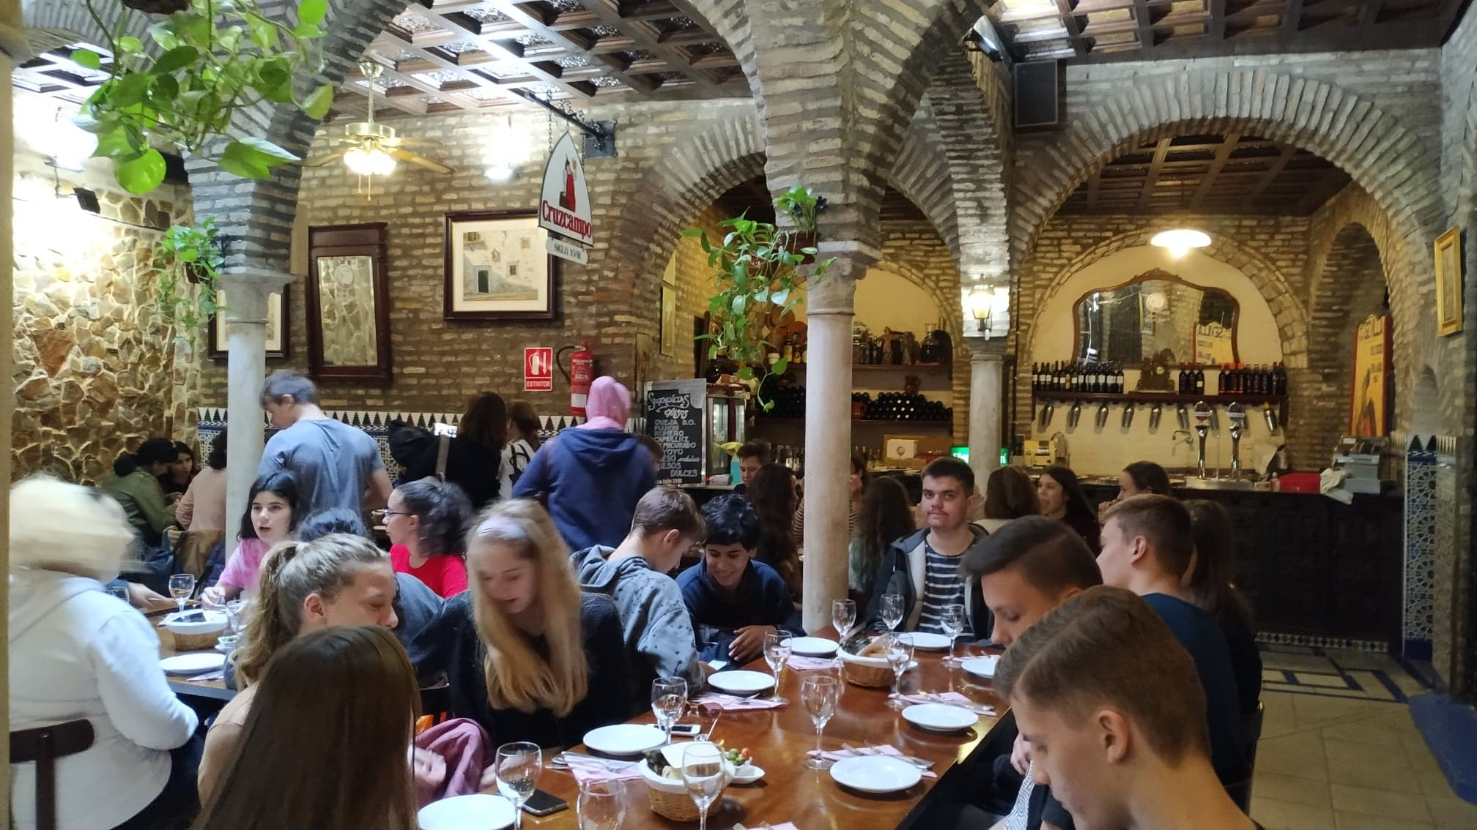
28.11.2019
We had dinner with our exchanges in Cruzcampo too.

Slide 15
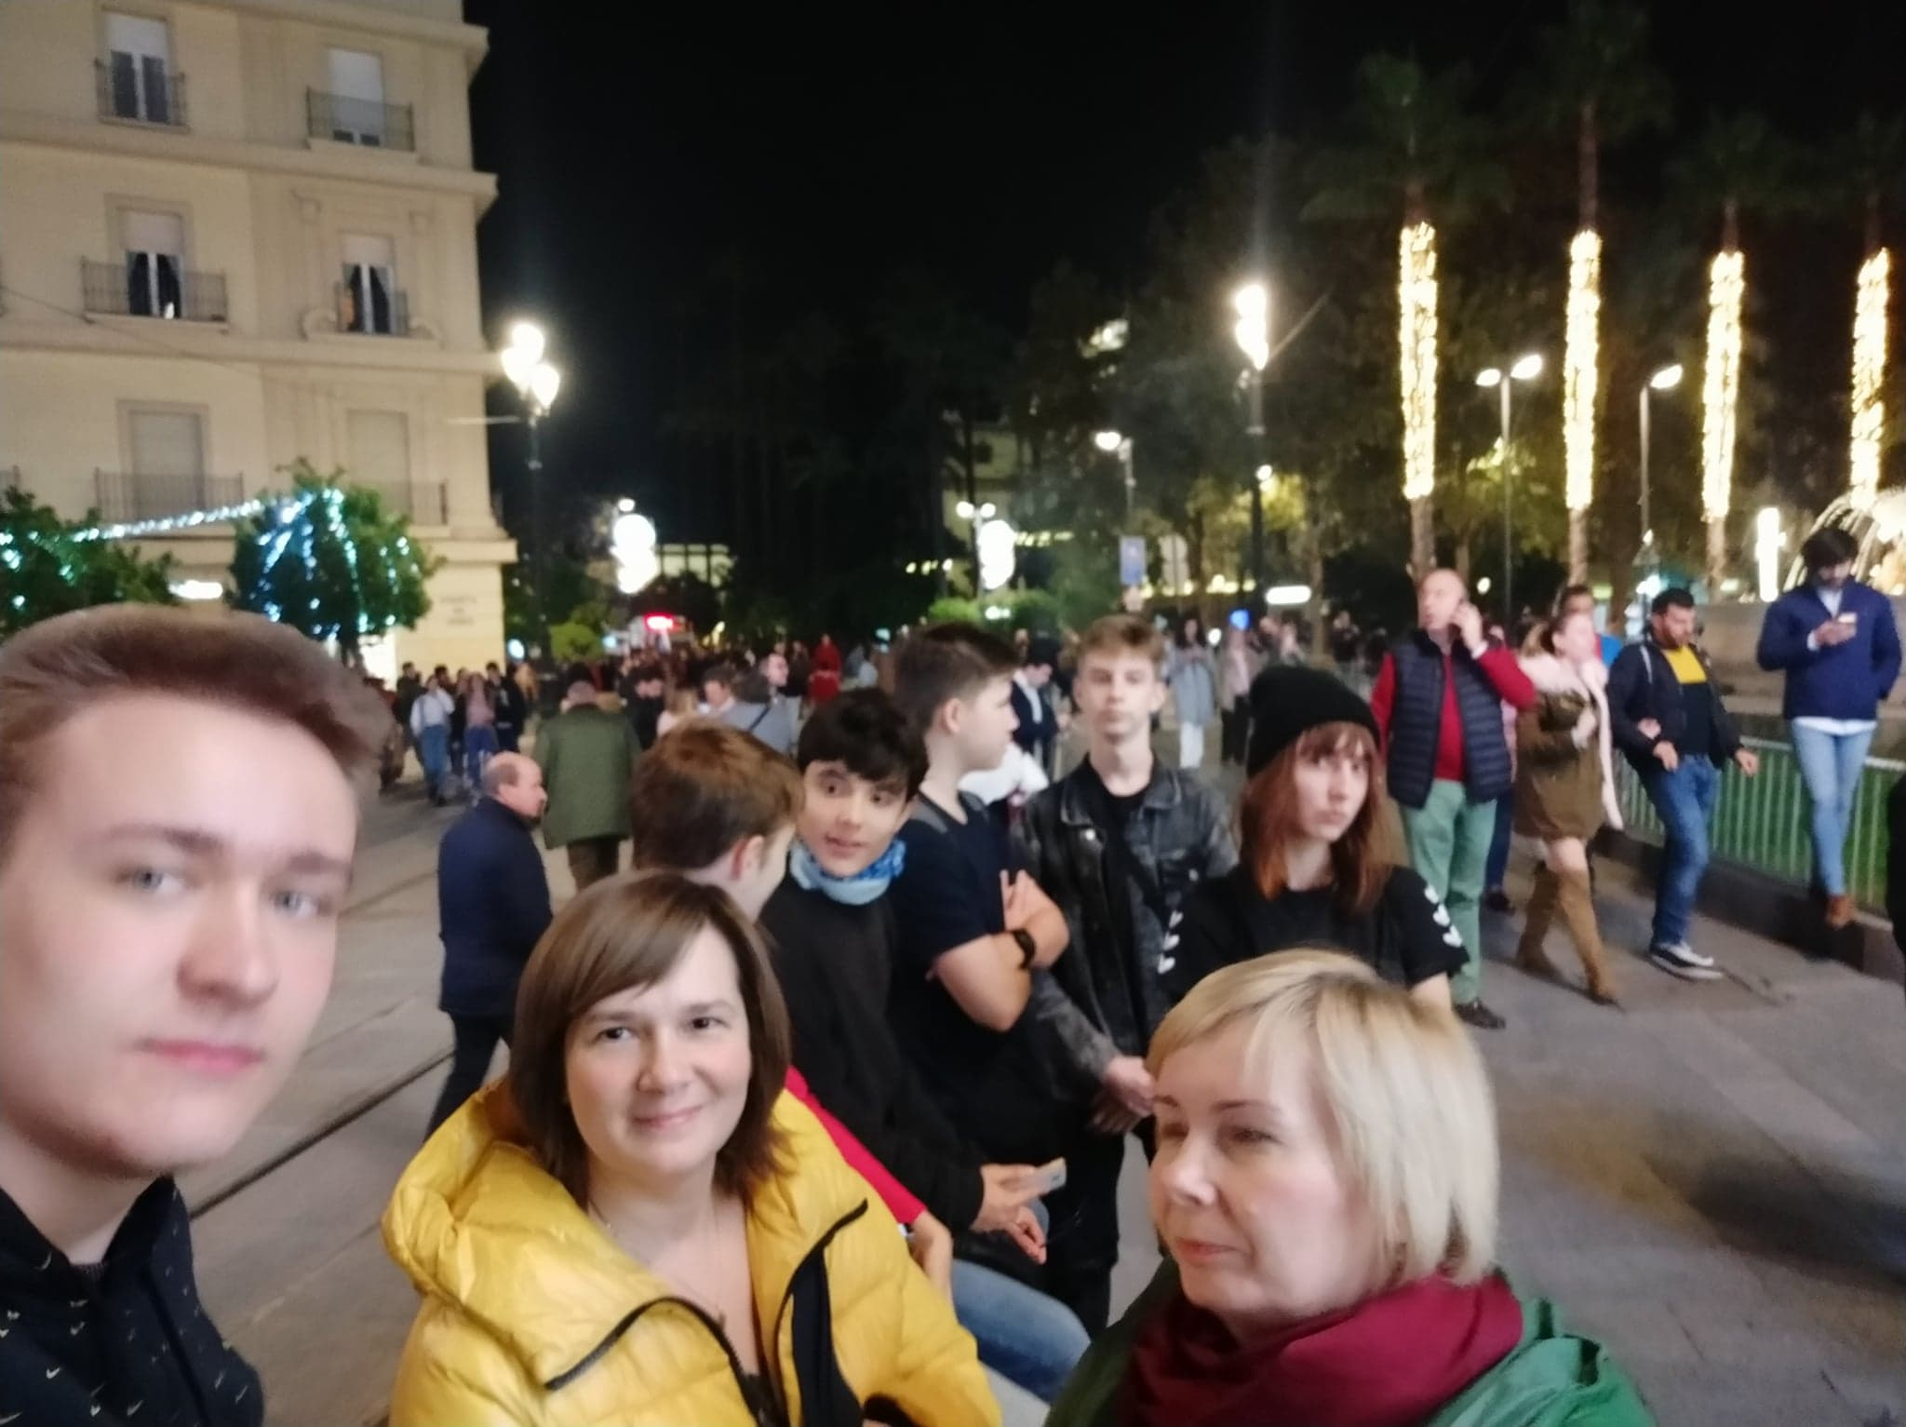
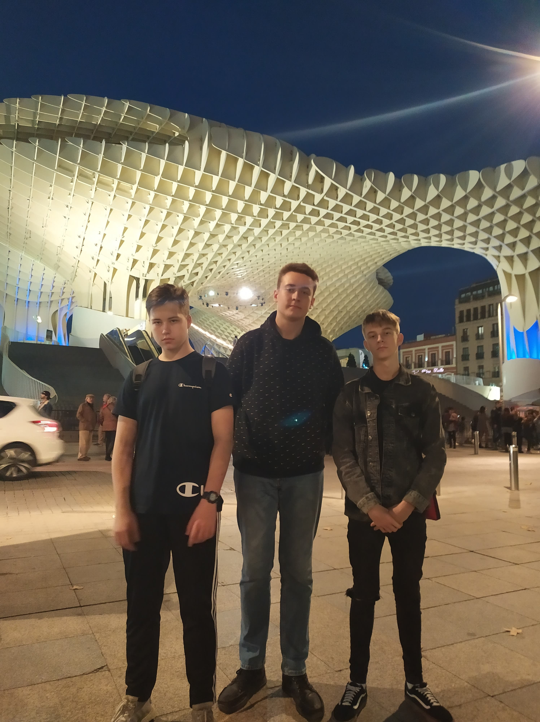
Seventh day
29.11.2019
We were in the pedestrian zone in the center and saw many interesting monuments..

Slide 16
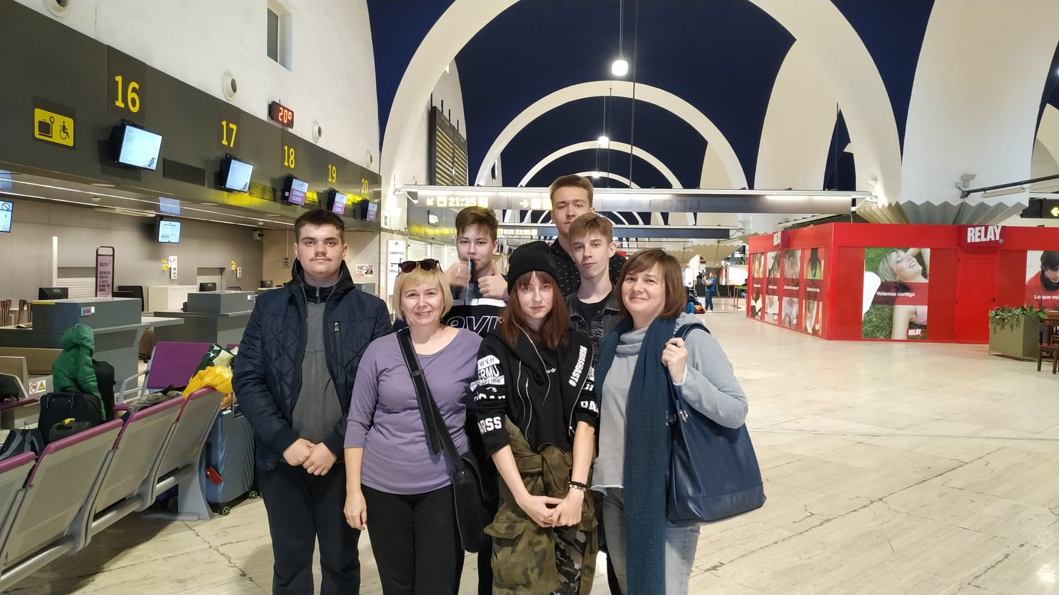
Eighth day
30.11.2019
We packed up, gathered at the airport and returned to Poland.

