Slide 1
ERASMUS+
NETHERLANDS

Slide 2
MONDAY

Slide 3
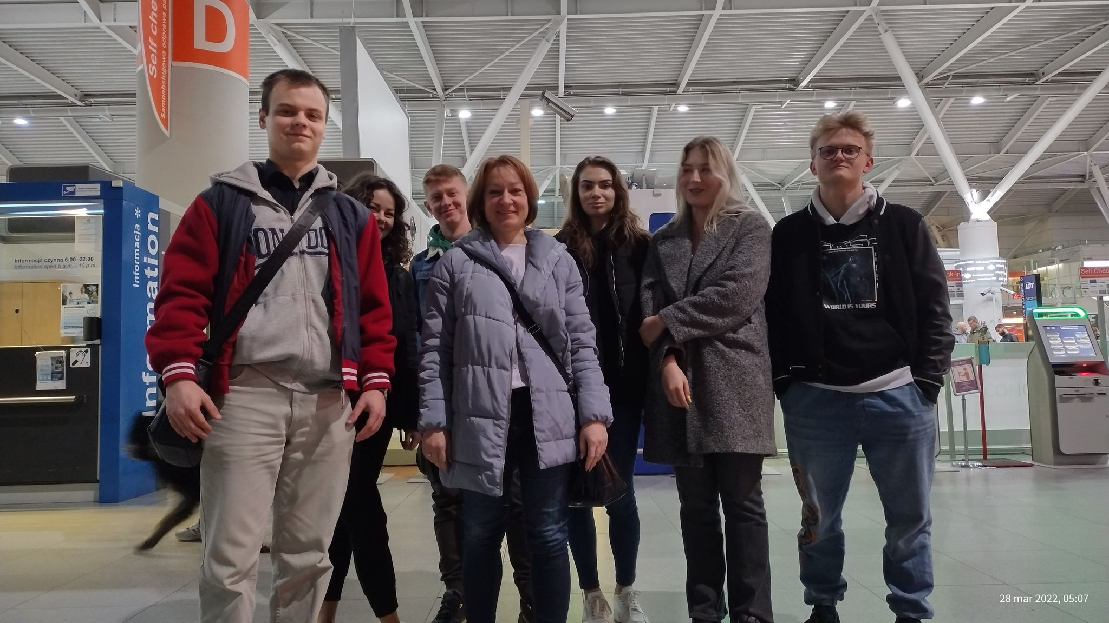
On Monday we arrived in Amsterdam and had a boat a bout tour exploring the city.

Slide 4
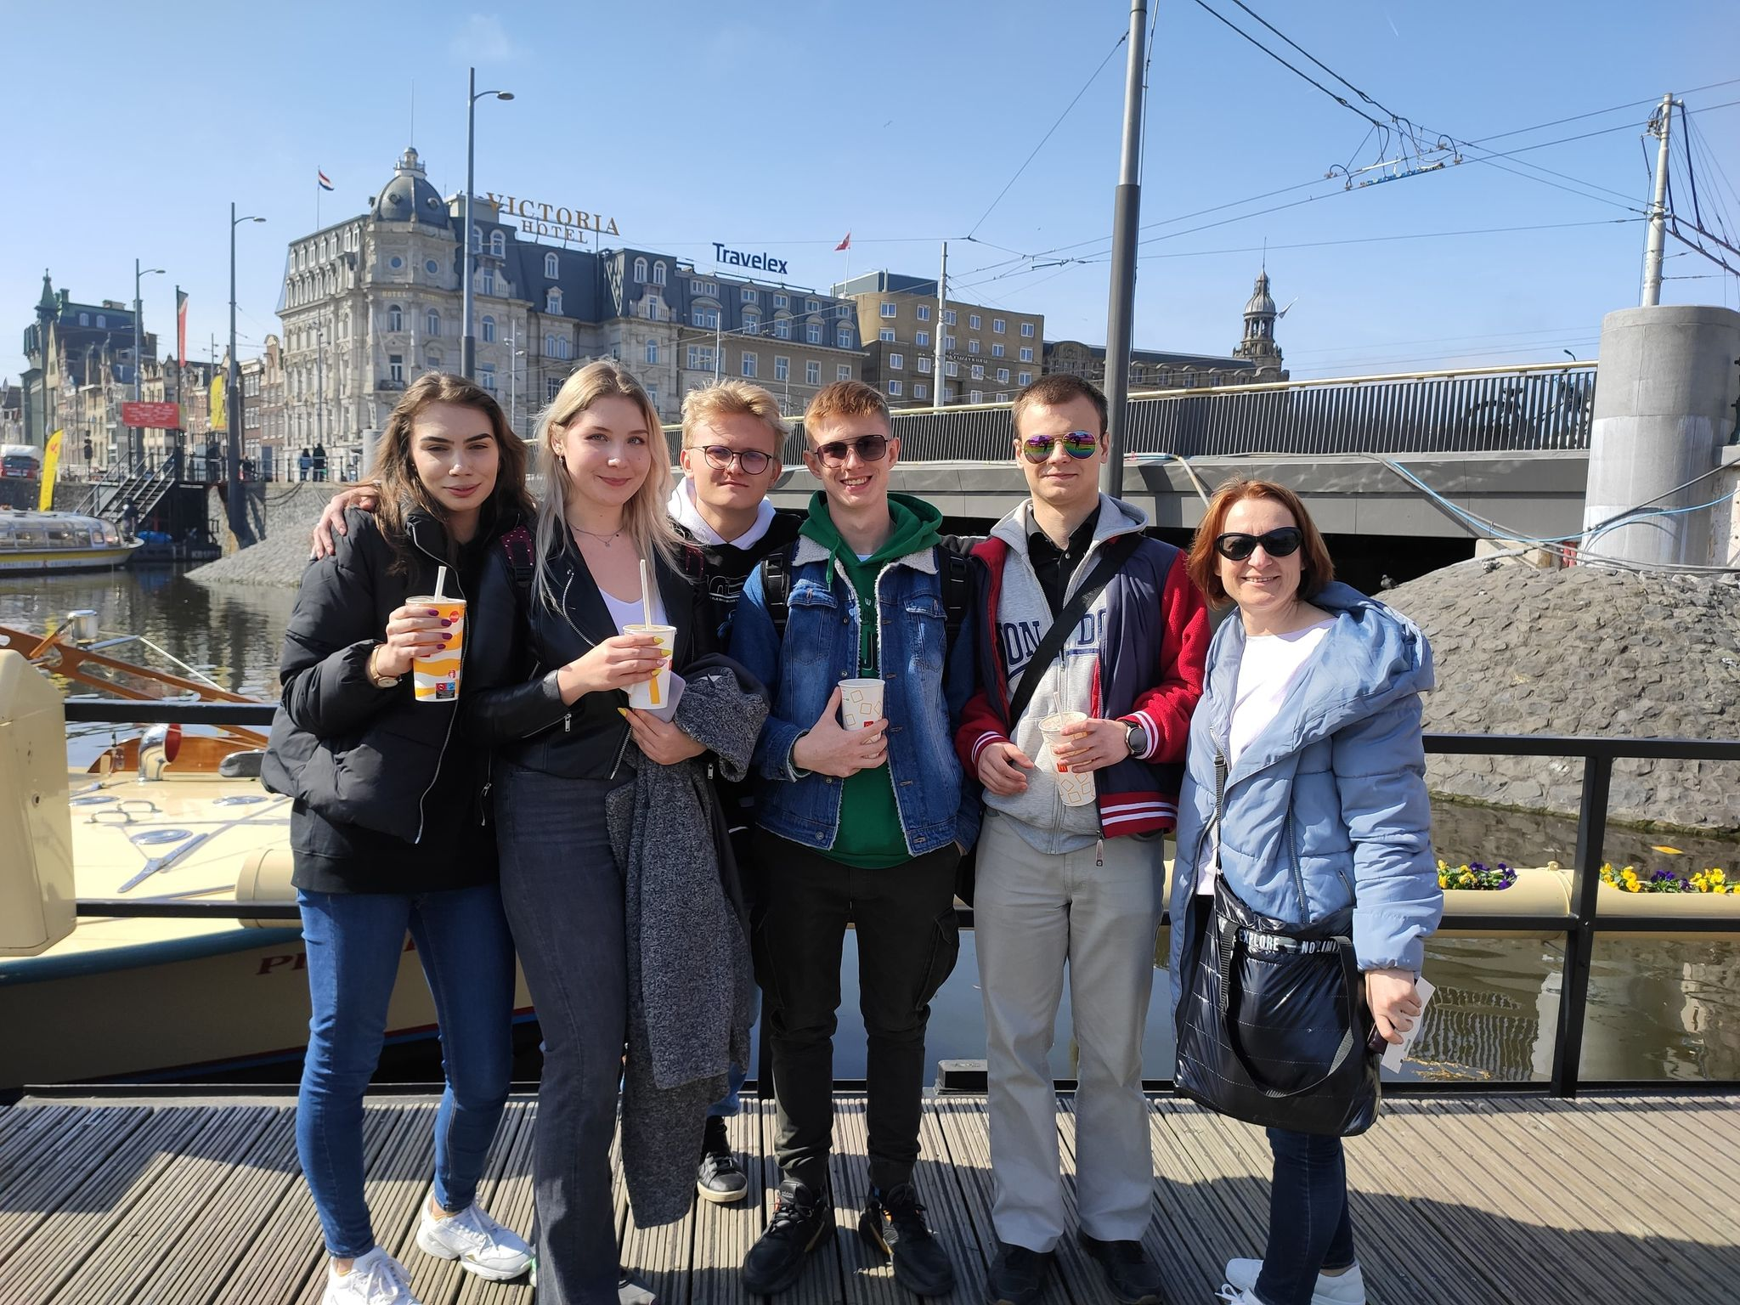

Slide 5
TUESDAY

Slide 6
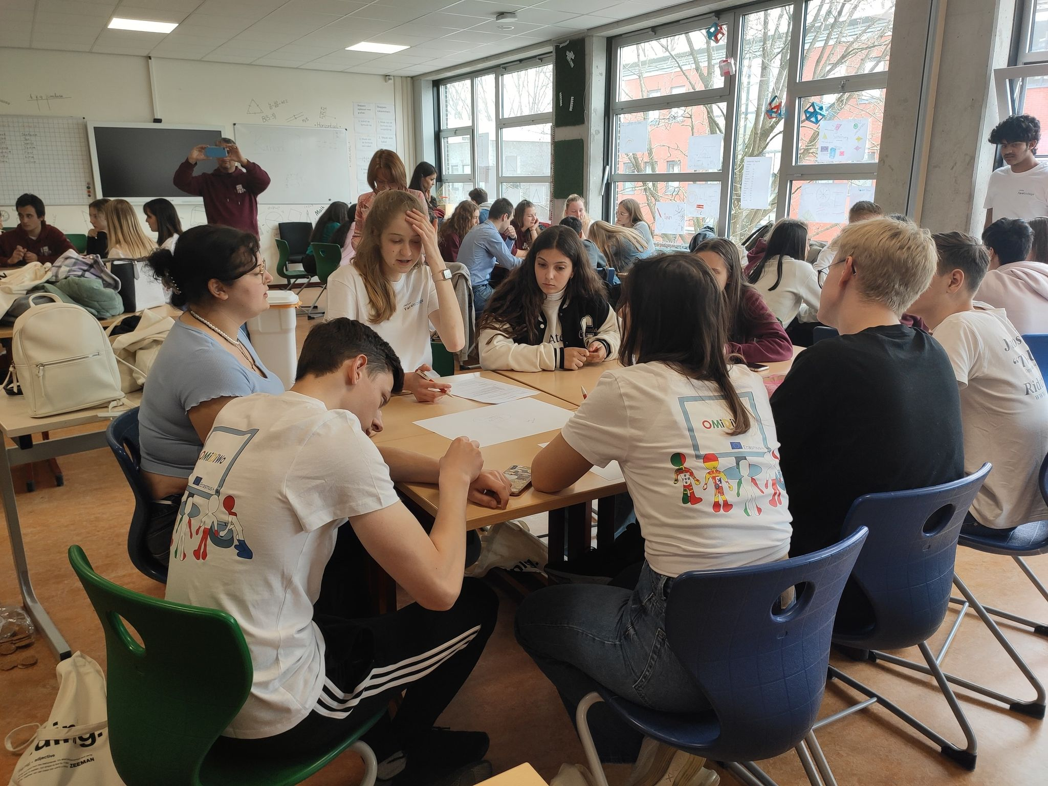
On Tuesday we started work on the project ’’What is the European identity?’’. We got to know Dutch games and tasted traditional dishes.

Slide 7
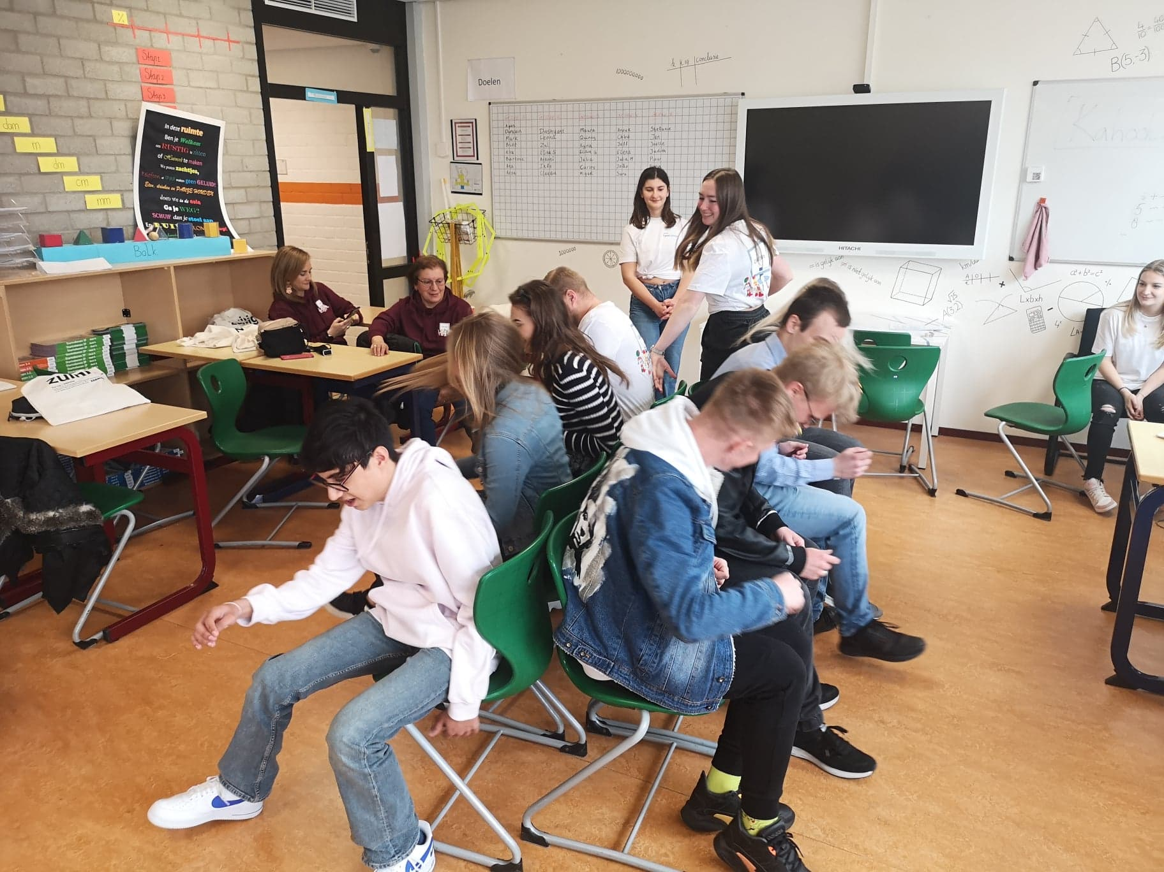

Slide 8
WEDNESDAY

Slide 9
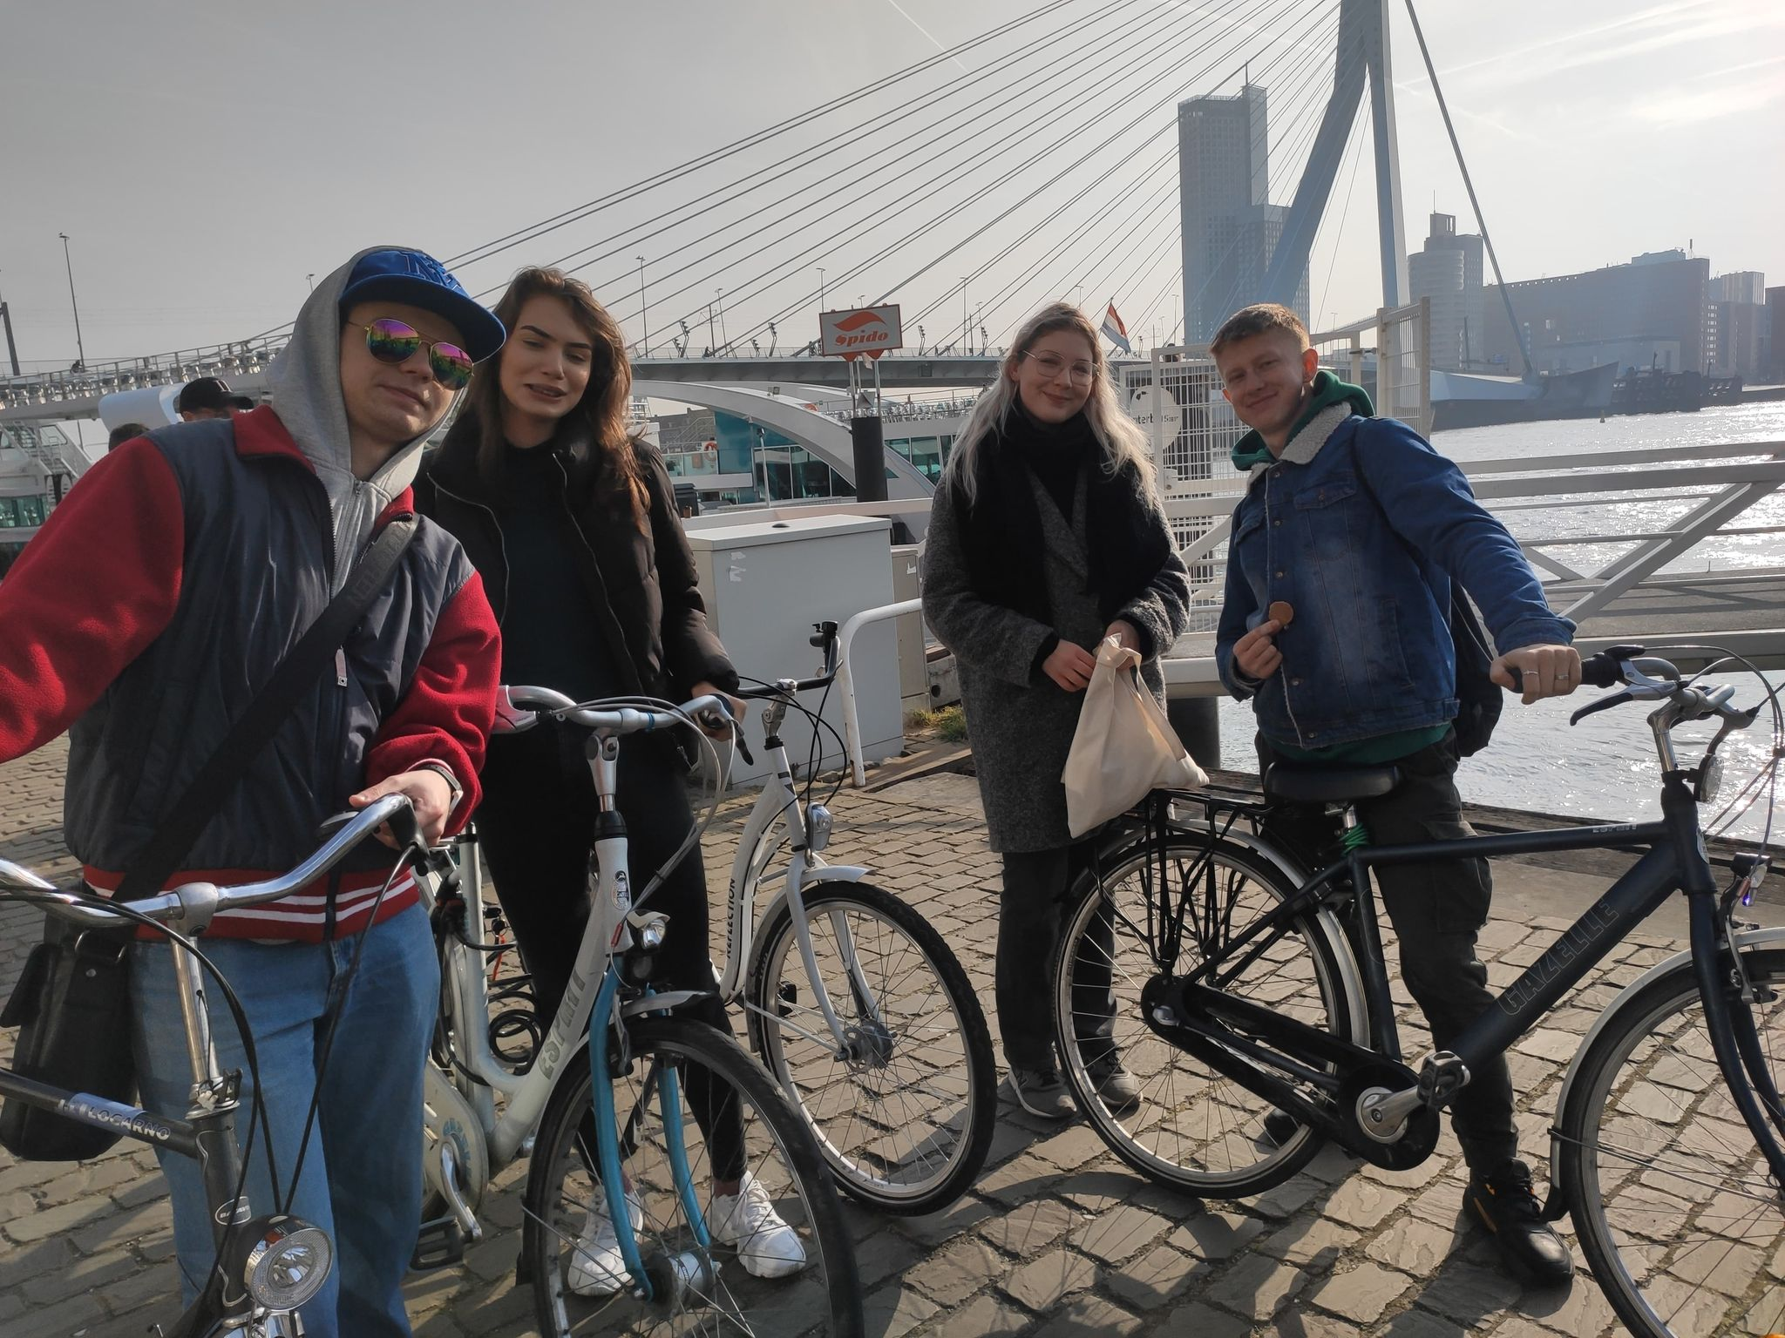
On Wednesday we went by boat to Rotterdam, where we did a bike tour and visited the Euromast.

Slide 10
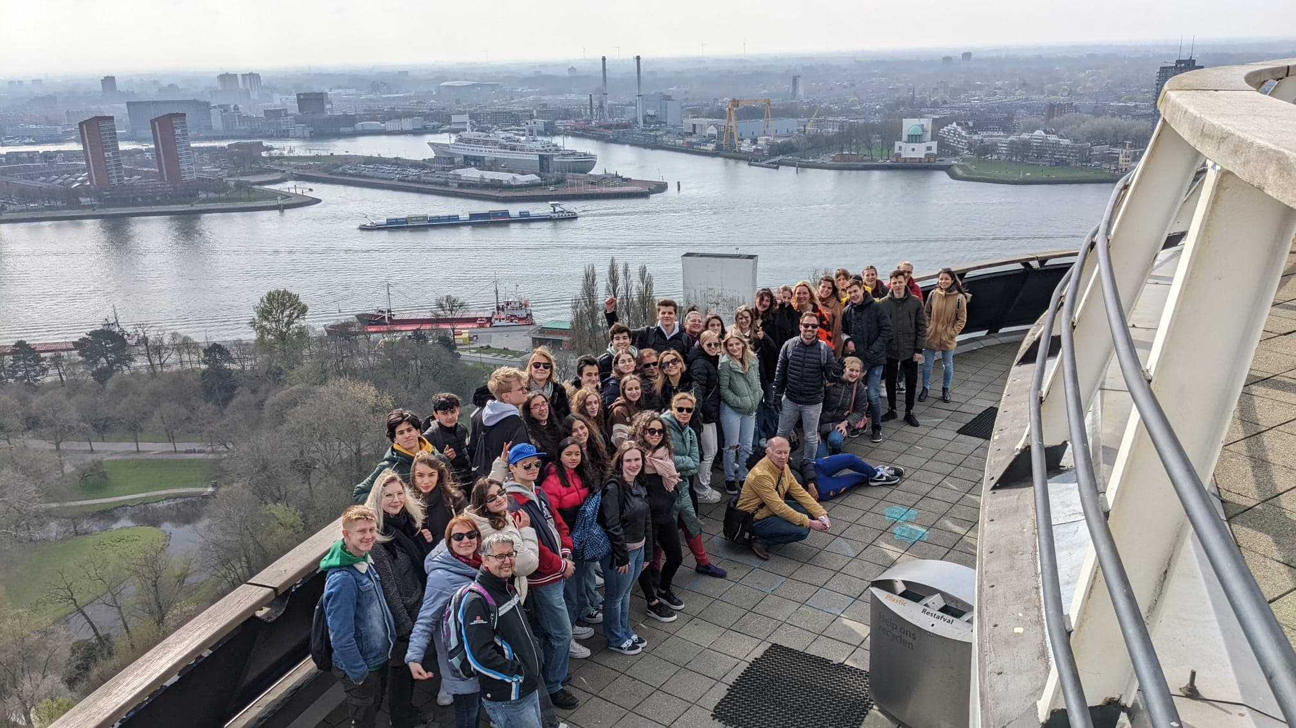

Slide 11
THURSDAY

Slide 12
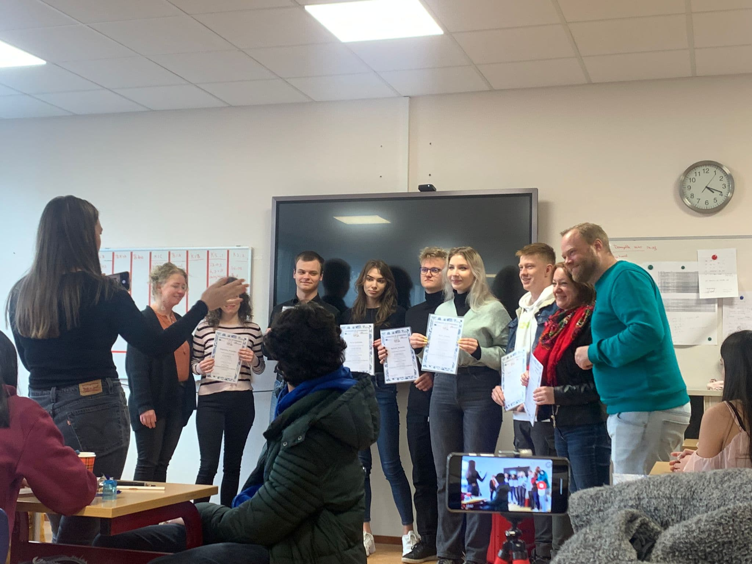
On Thursday we finished the work on the project and visited the village where there were typical Dutch monuments.

Slide 13
FRIDAY

Slide 14
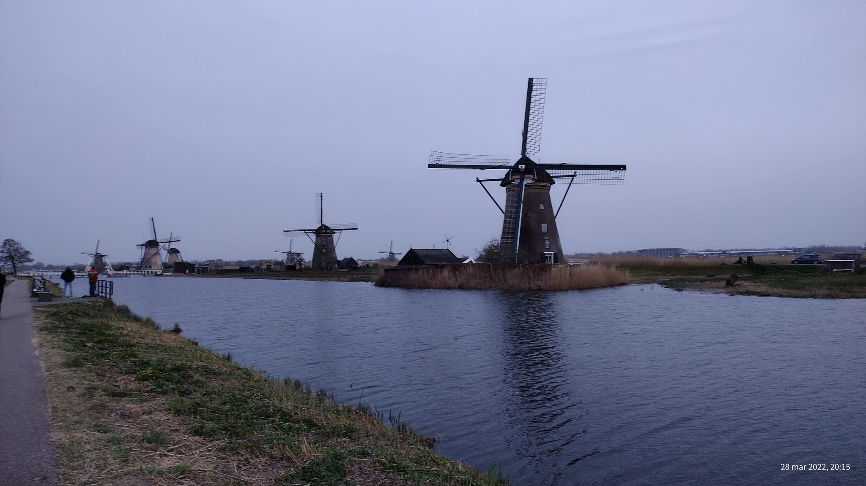
On Friday we returned to Poland.

