Slide 1
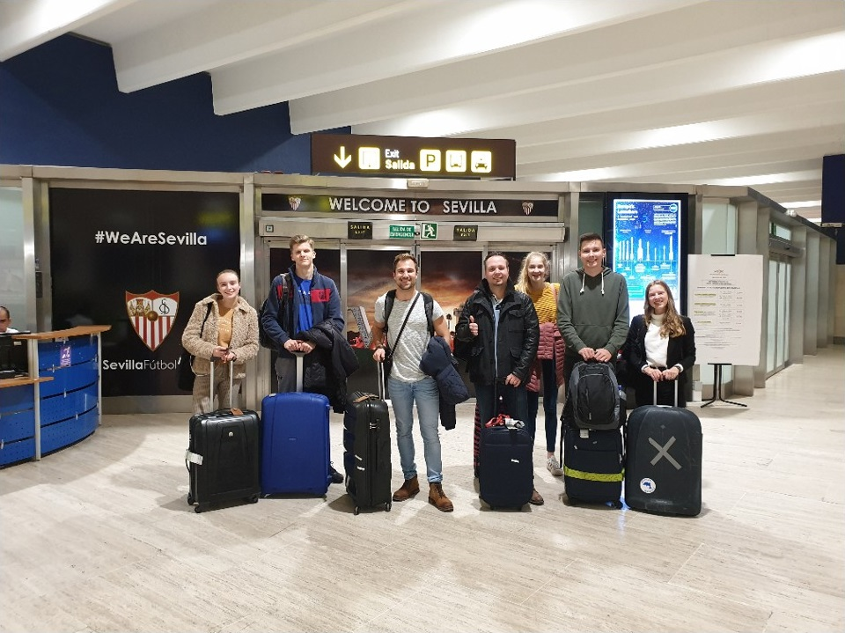
Erasmus+ exchange Spain
25-29 November 2019

Slide 2
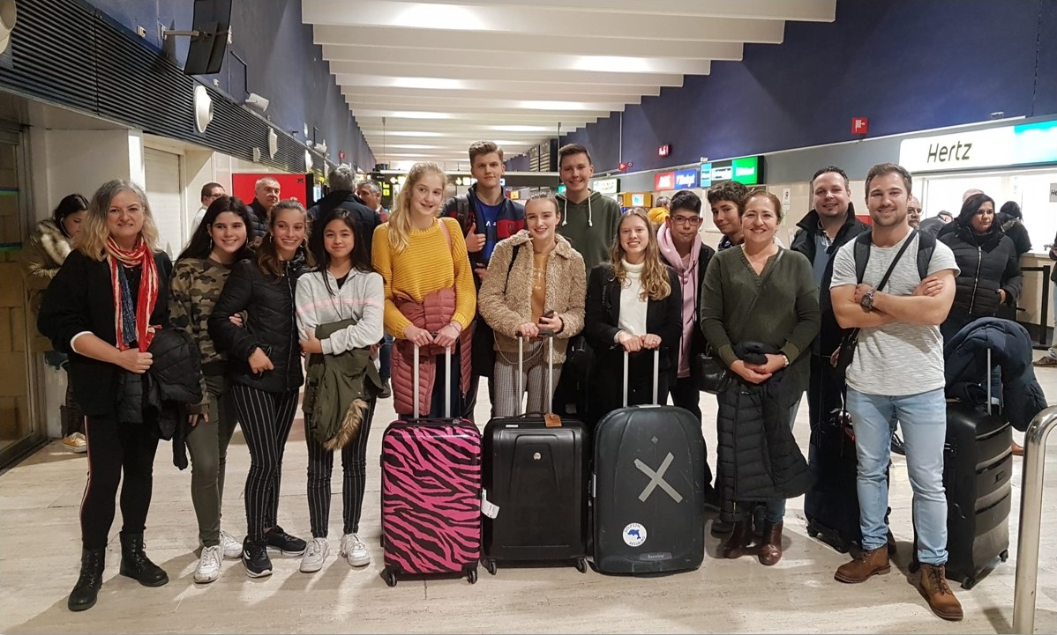
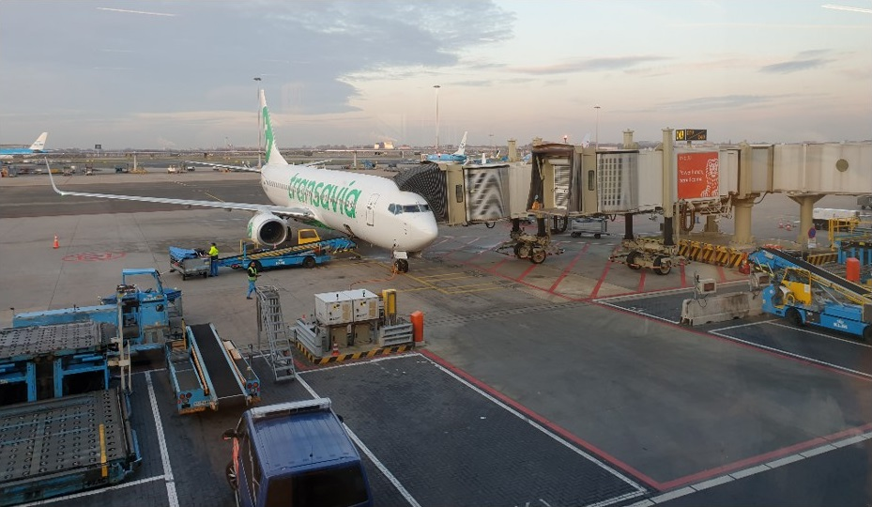
Day 1; Monday (travelling)
Travelling
Meeting the host families
Eating out together

Slide 3
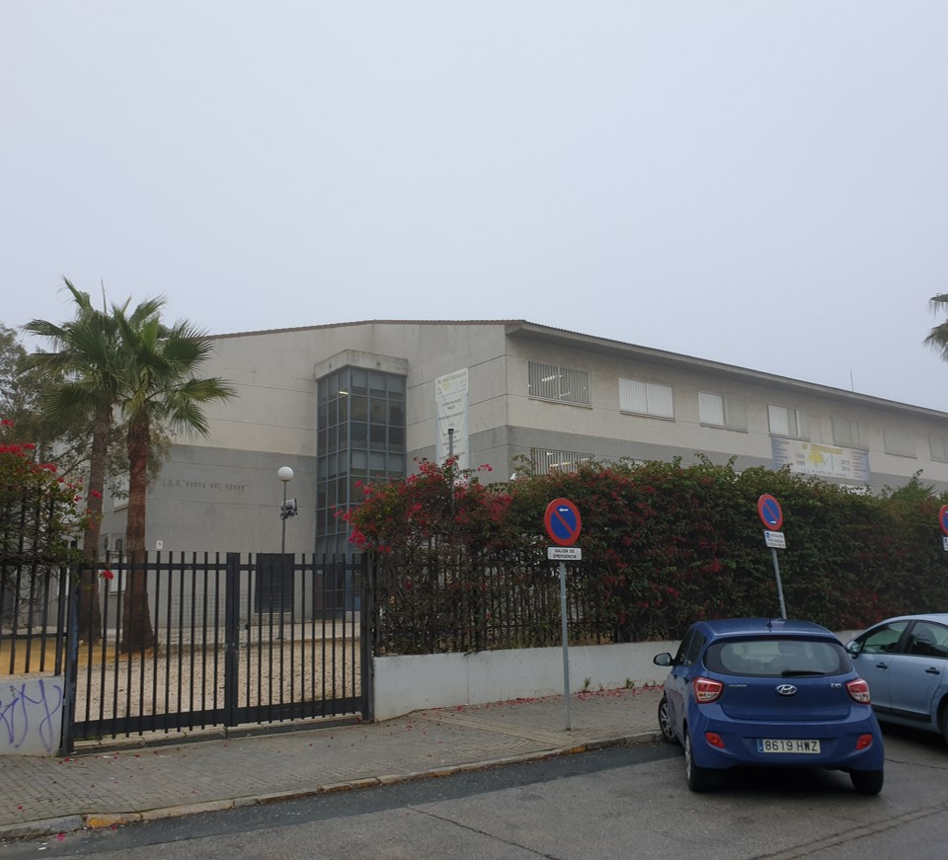
Day 2; Tuesday (school)
Going to the Spanish school for the first time
Tour around the school
Introduction presentation
Computer ’workshop’
Going to the shopping centre

Slide 4
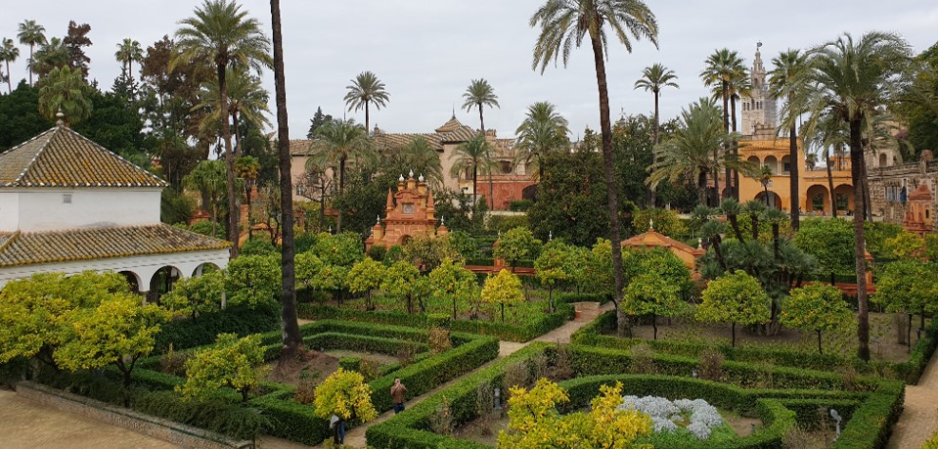
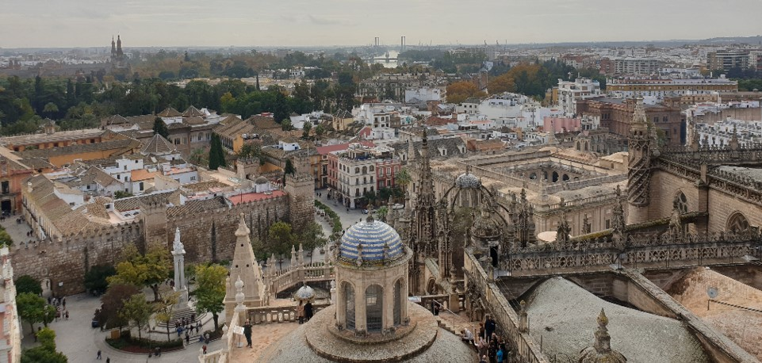
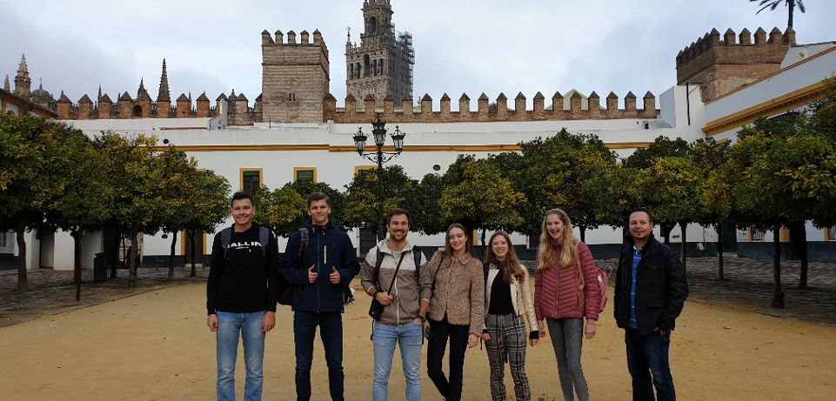
Day 3; Wednesday (Seville’s centre)
Barrio Santa Cruz
Royal Alcázars of Seville
Seville cathedral
Leisure time
Shopping Mall

Slide 5
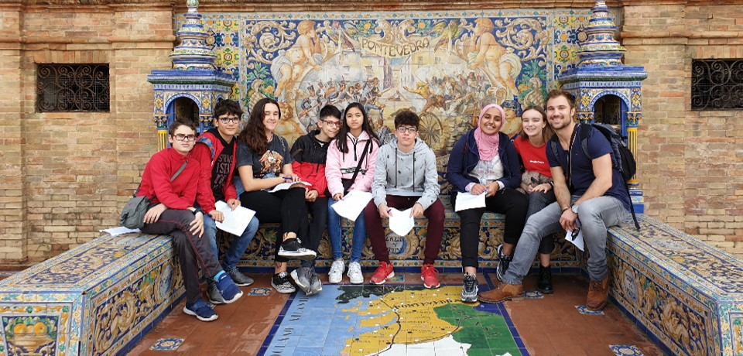
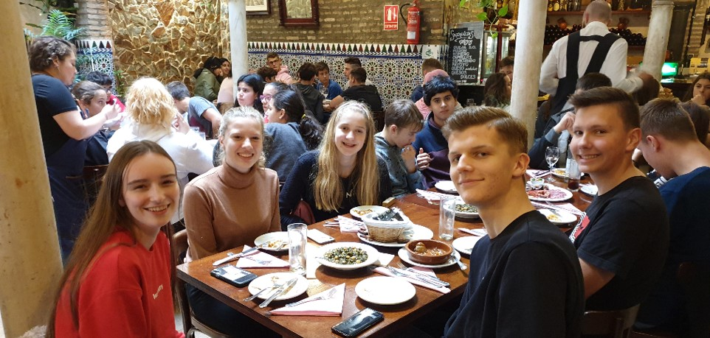
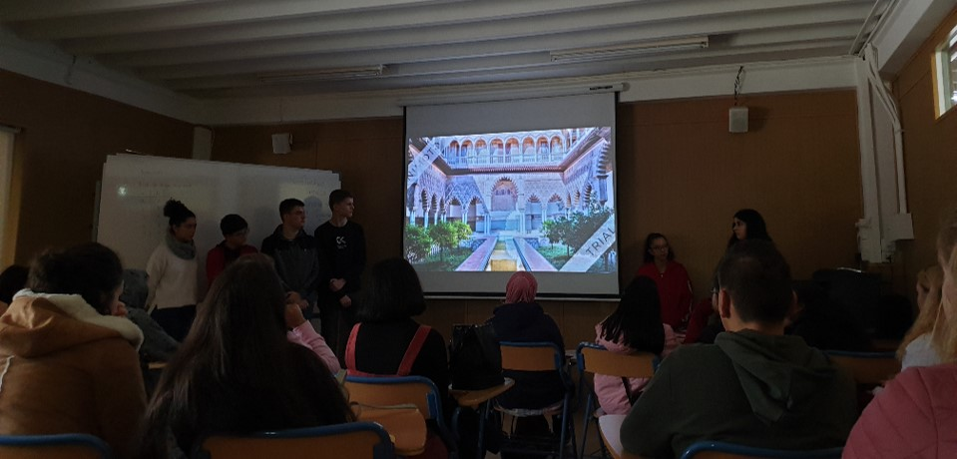
Day 4; Thursday (storytelling, scavenger hunt, sightseeing)
Storytelling presentation
Digital functions
Scavenger hunt
Bittersweet
Poetry
Lunch
City centre
Day 5 - Departure

Slide 6
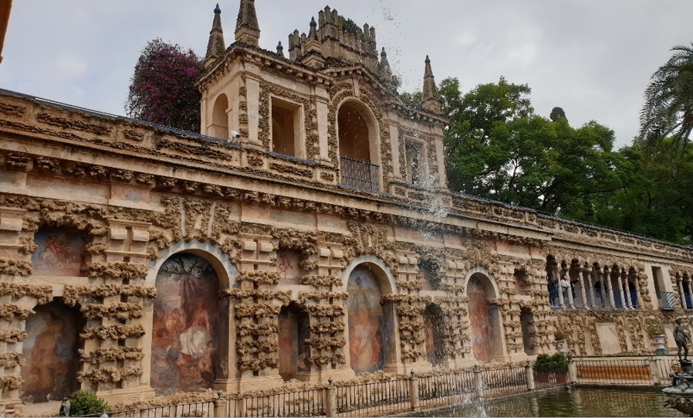
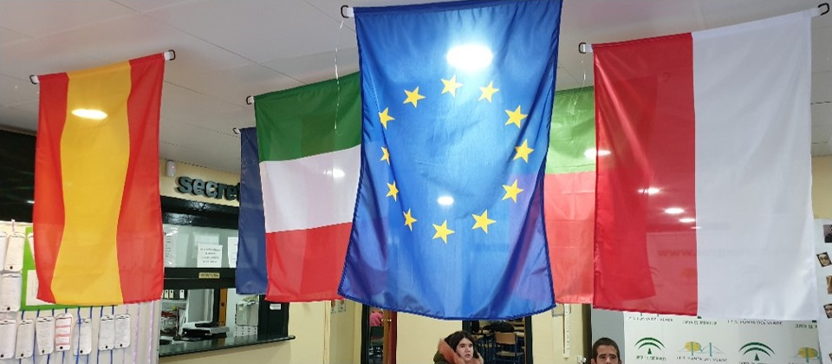
What we learned
Storytelling
English
International collaboration
Spanish culture
School systems in different countries

Slide 7
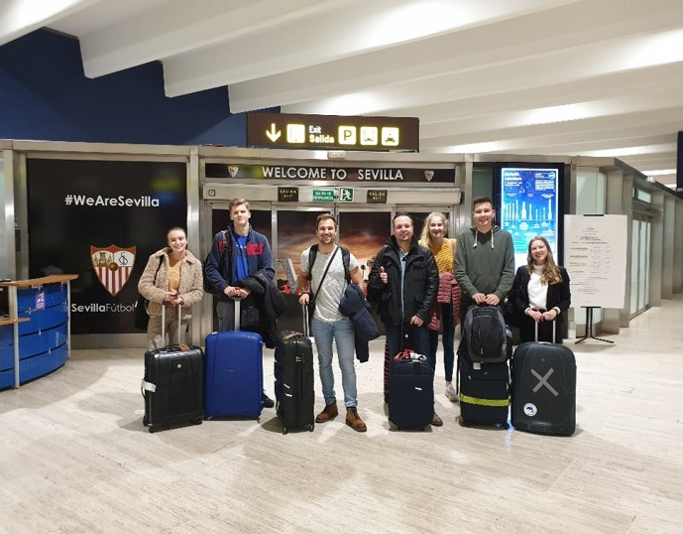
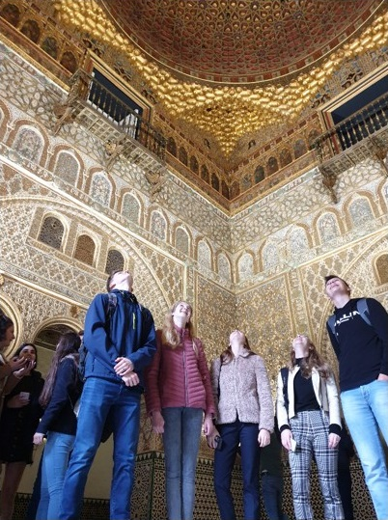
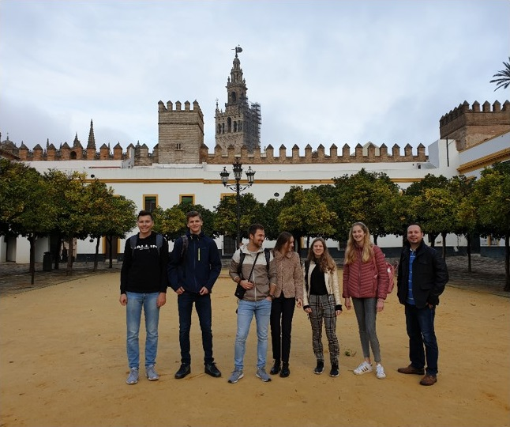
Conclusion
Great week
Learned a lot
Met a lot of great people

Slide 8
Questions and answers
Does anybody have any questions?

