Slide 1
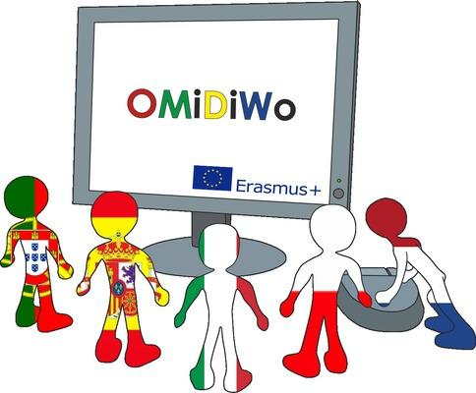
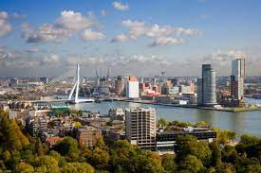
Impressions of Spanish team for the mobility C5 in Ridderkerk (The Netherlands)

Slide 2
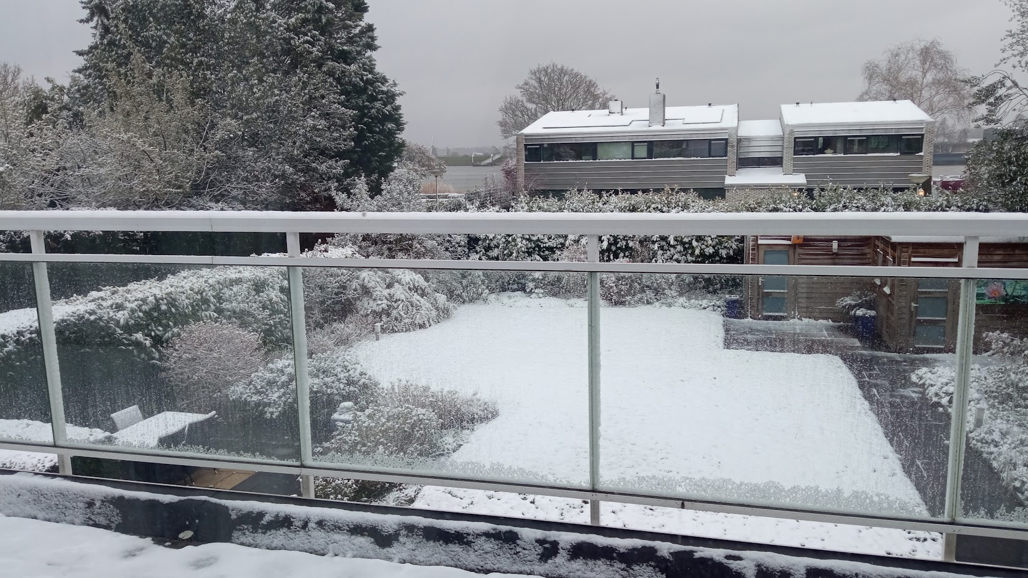
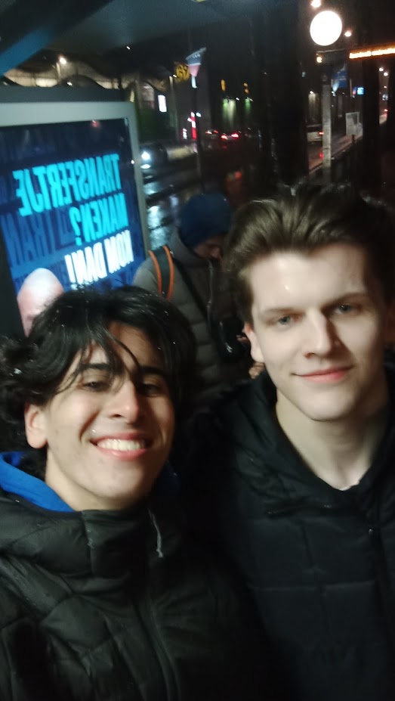
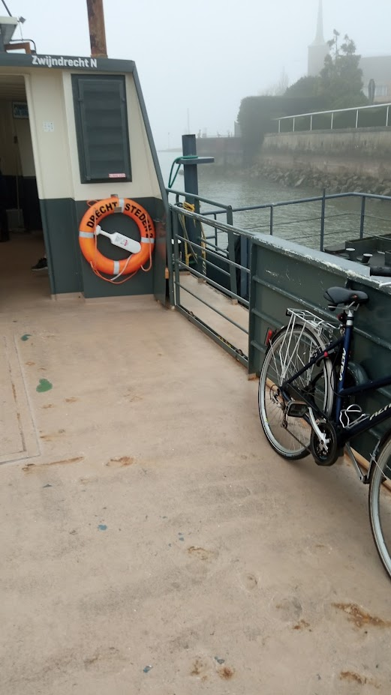
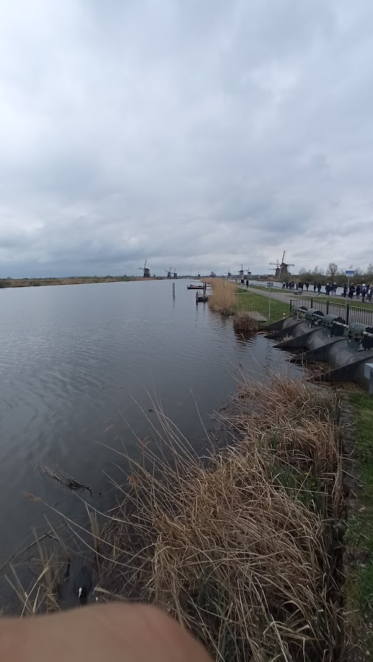
Miguel Ángel Camacho
I liked too much the exchange I had a lot of very good moments and I met people from all the countries. Once I arrived Jeff’s house (My exchange) in first stead I was a little nervous, but when we started talk I took confidence and we became very good friends.
For the rest of the project I went out with people from all countries and got along with all of them. Definitely my best exchange. Even Jeff asked me to come to Spain in the summer. And I’m proud to say I don’t have too many photos because I preferred to have as much fun as I can.

Slide 3
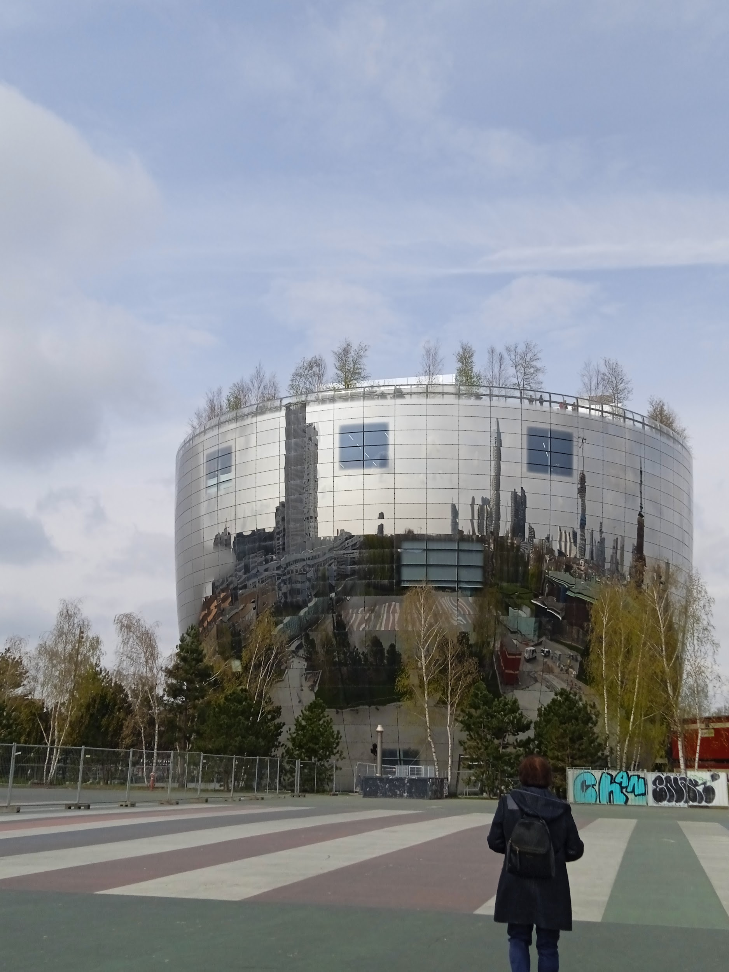
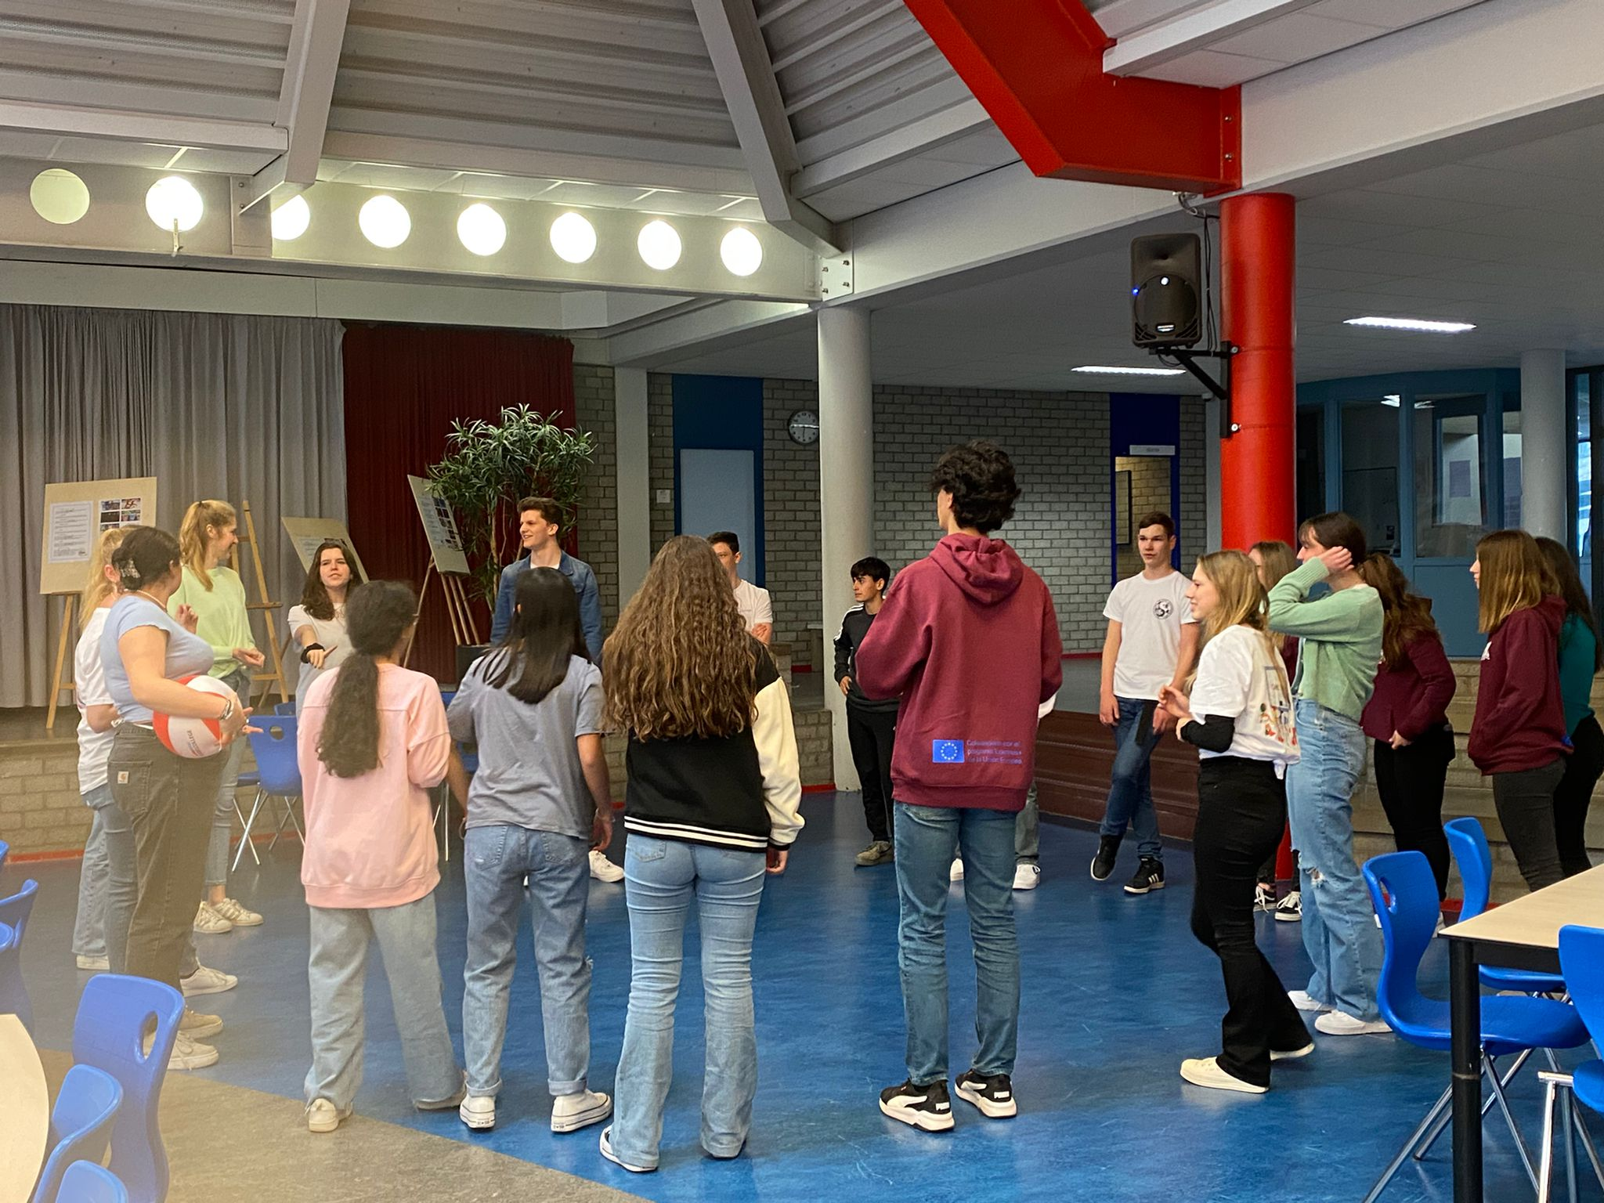
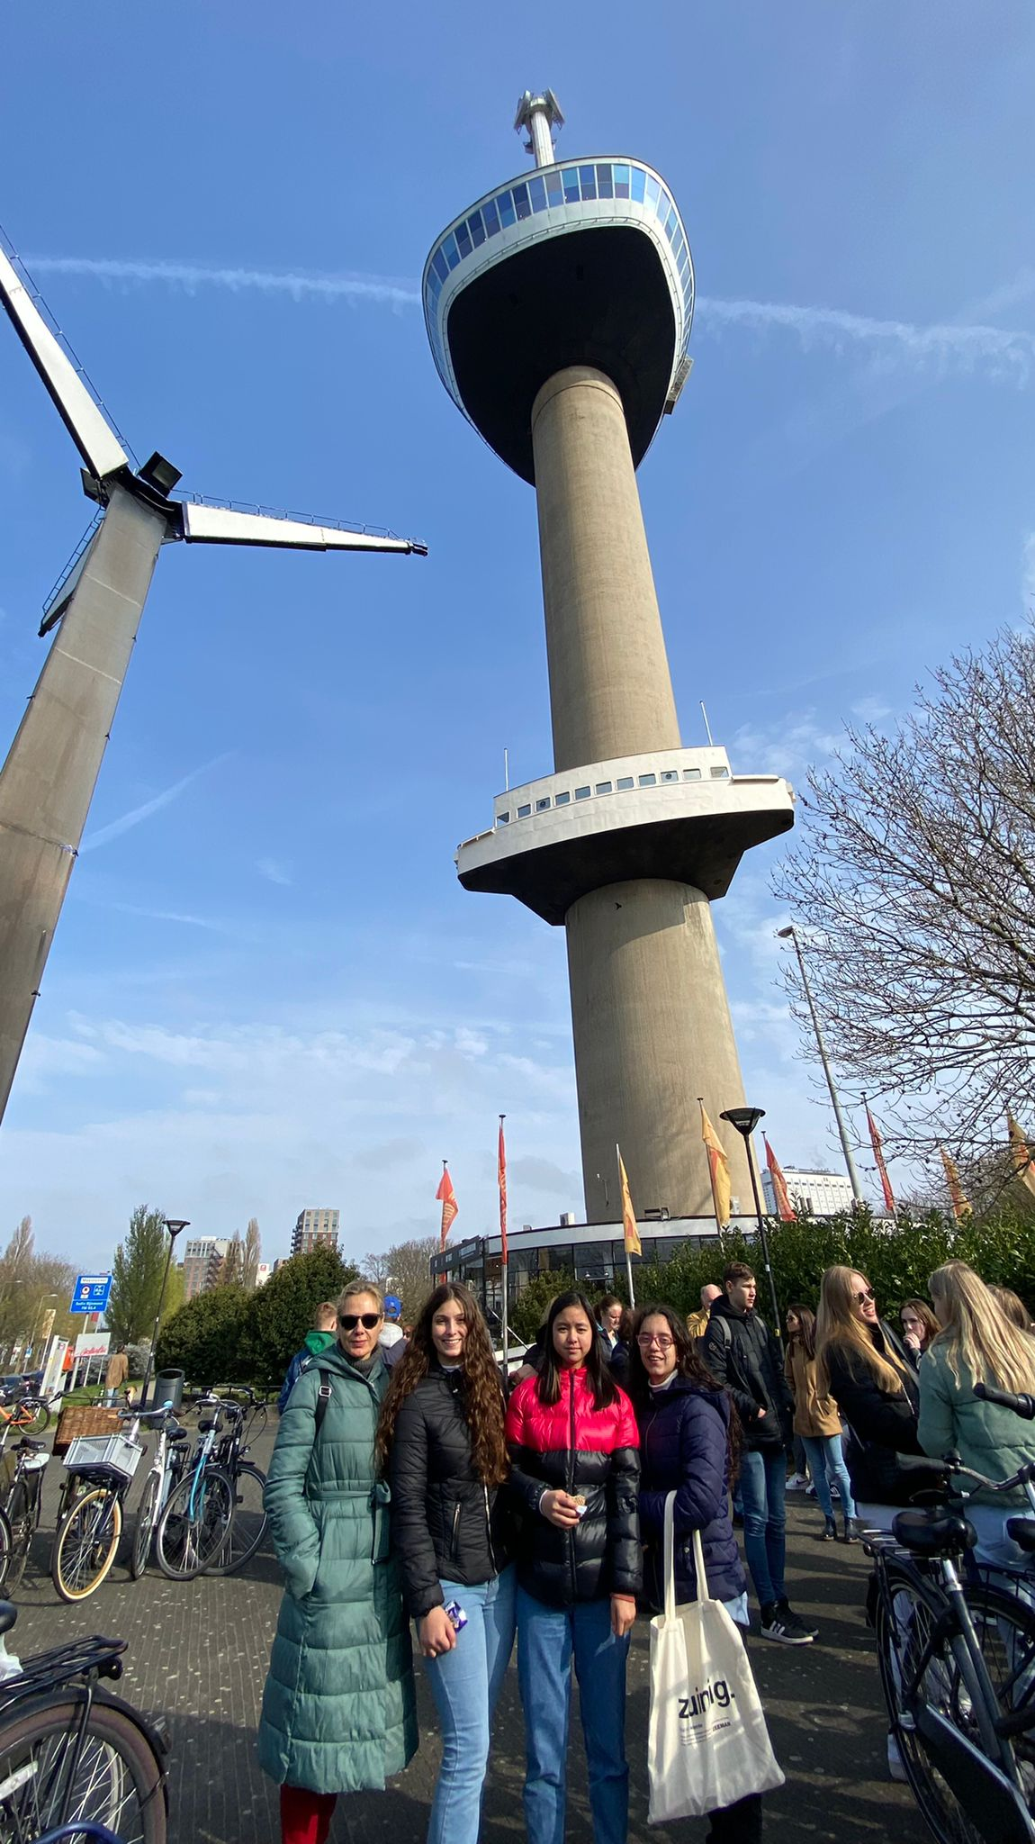
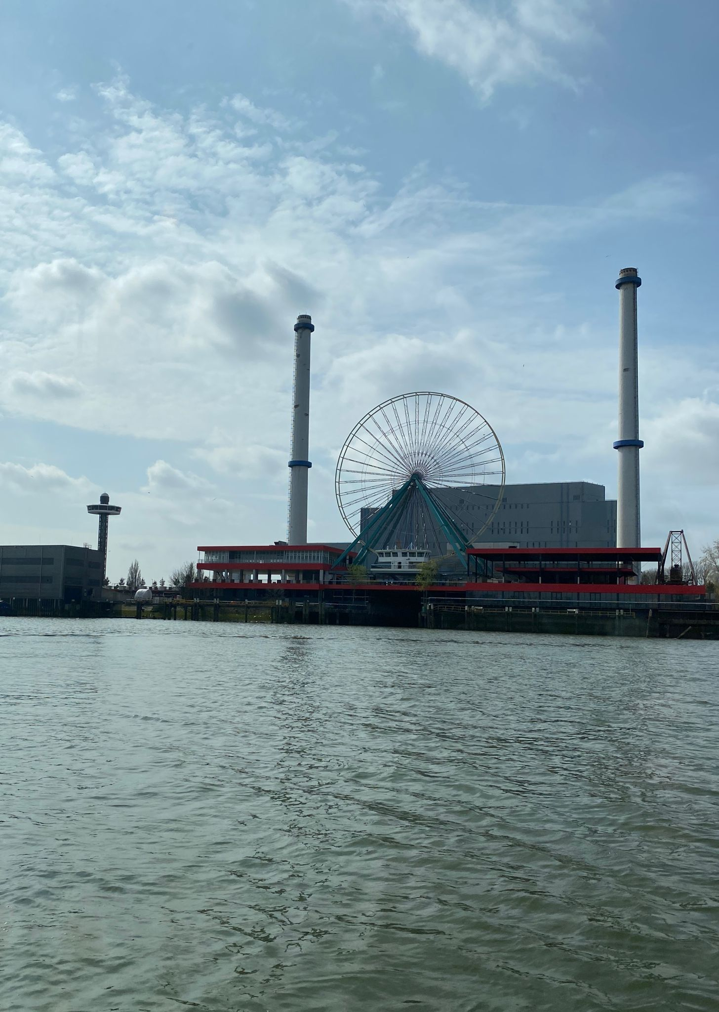
Sara Pavón
my experience at ridderkerk has been very good. I have met very good and pleasant people, the city is very beautiful and large, the landscapes were very natural. We did many activities outside the town, which was very large and with very beautiful landscapes, and we toured the city
As for the family that housing to my , they were very welcoming to me.

Slide 4
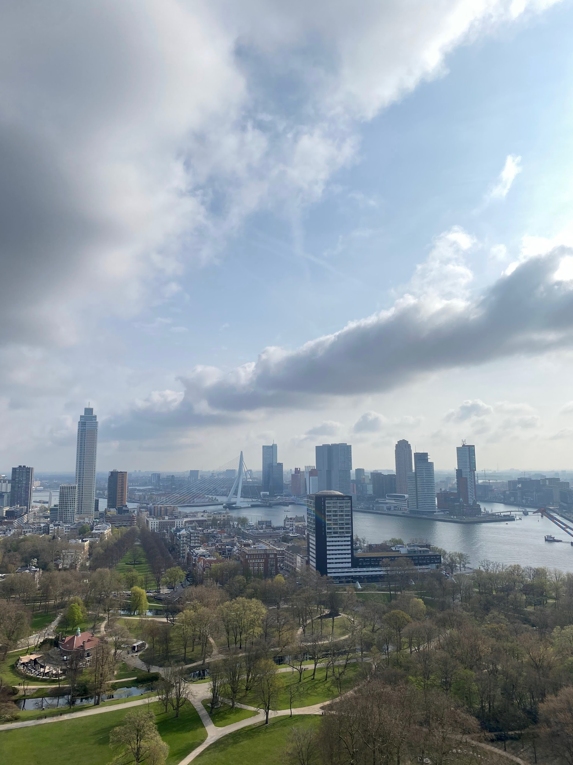
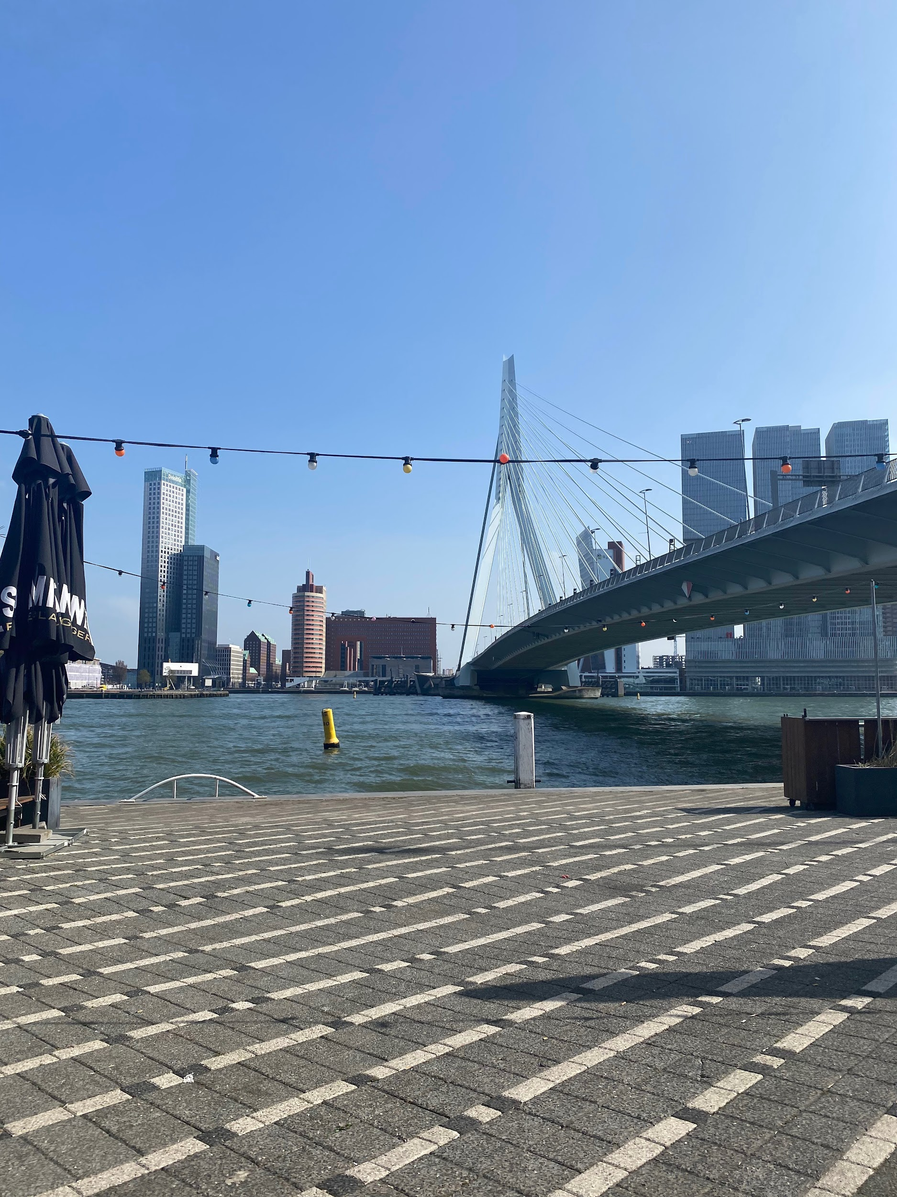
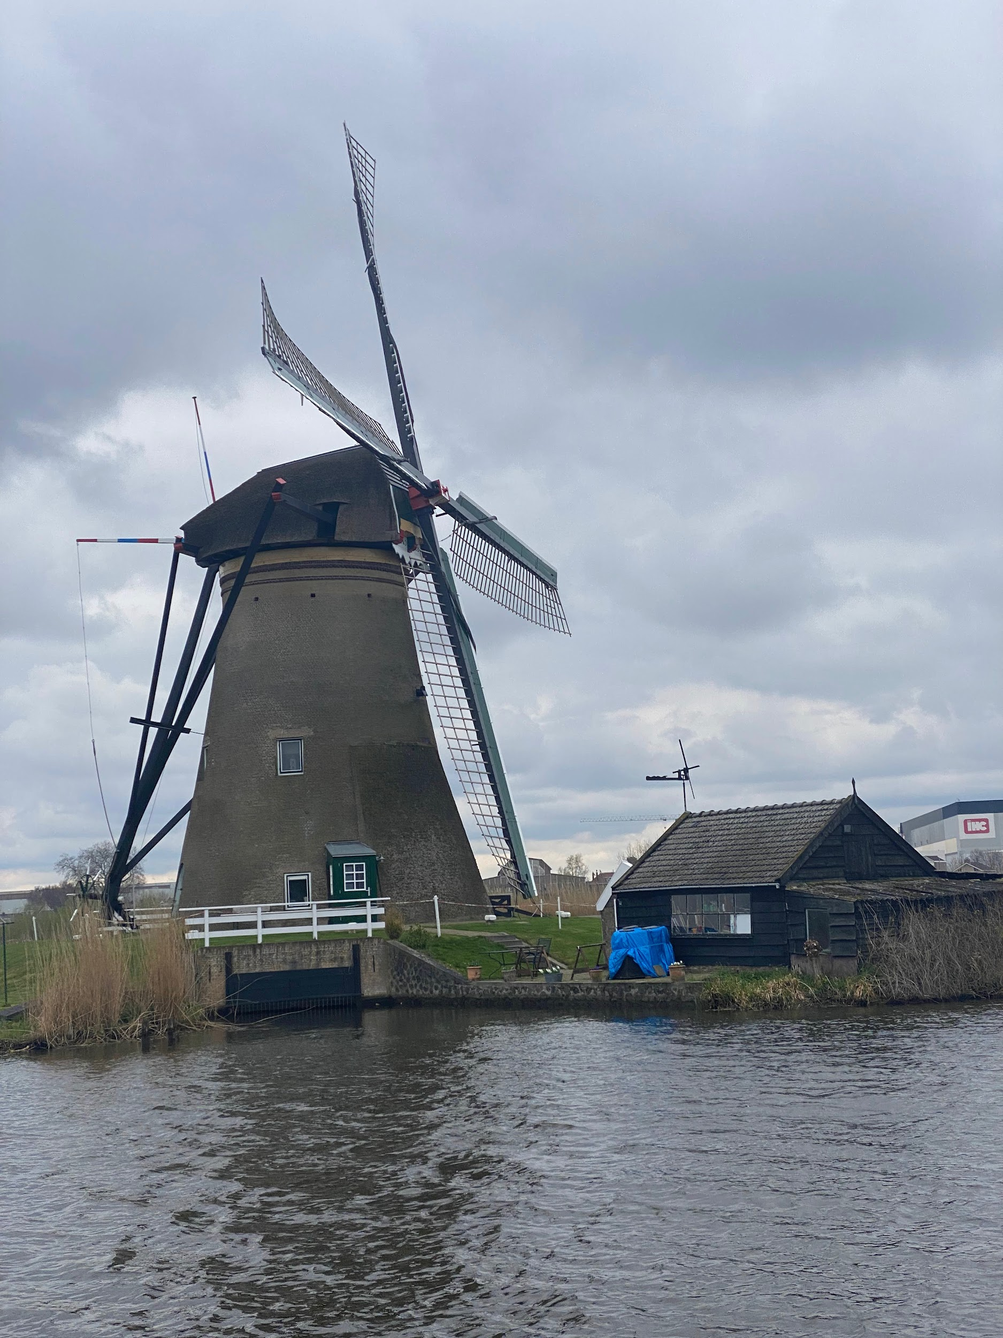
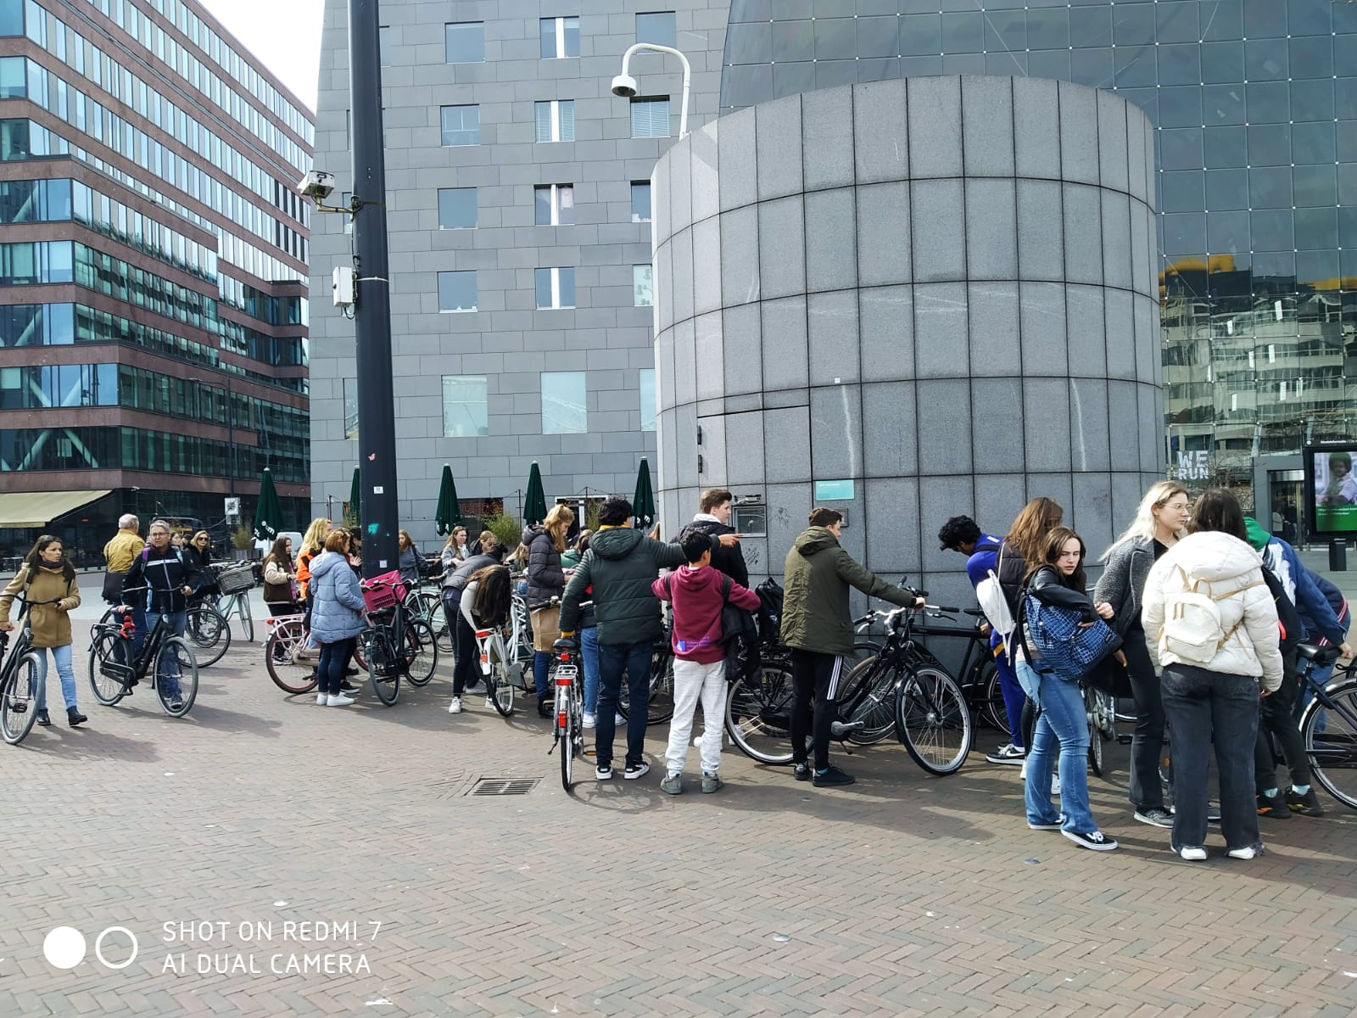
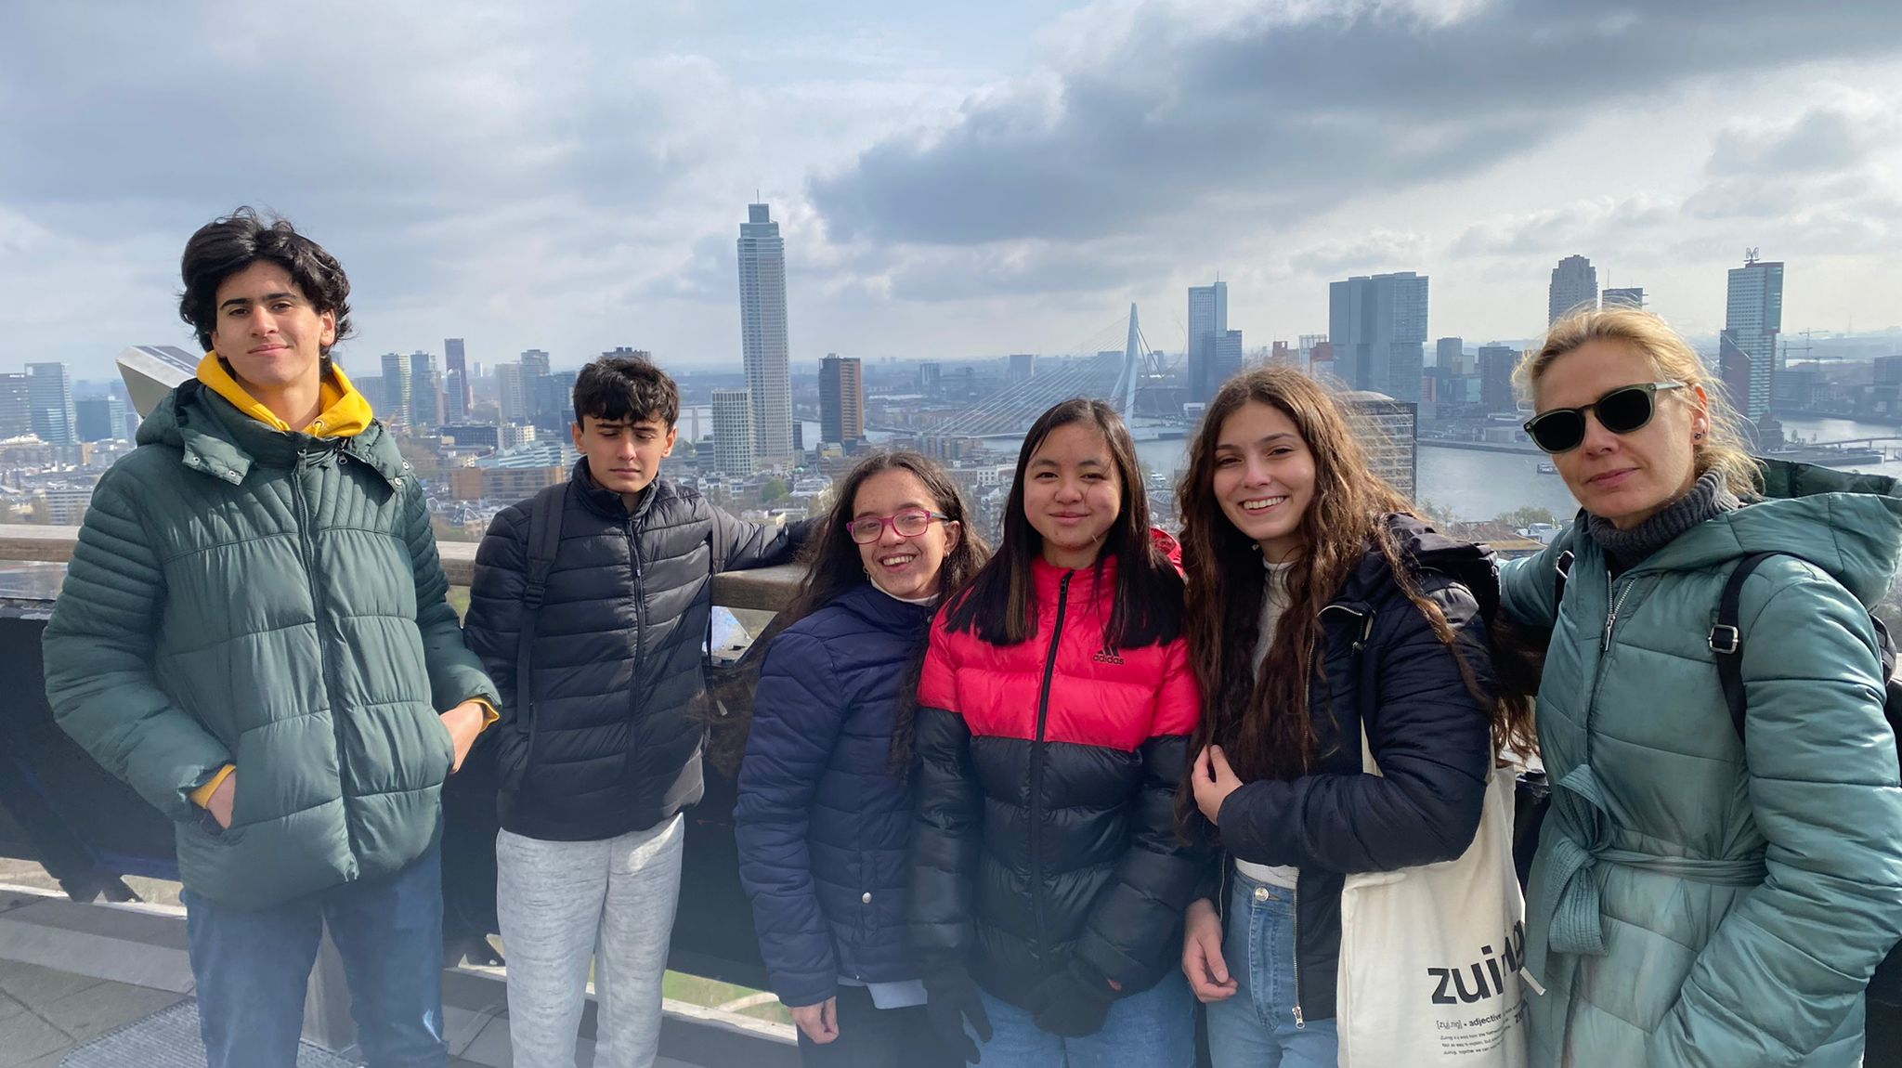
Rosa Rojas
My experience in ridderkerk has been very welcoming, the city has enchanted me. One aspect to highlight is the large number of people who cycle through the city and the large buildings that it has. About the highschool, it was a huge space with many classes and many possibilities to work in the future.
In general, the experience has been incredible, I have met charming people, the atmosphere of the people is very good, we visit more sites and the activities carried out have been super cool.

Slide 5
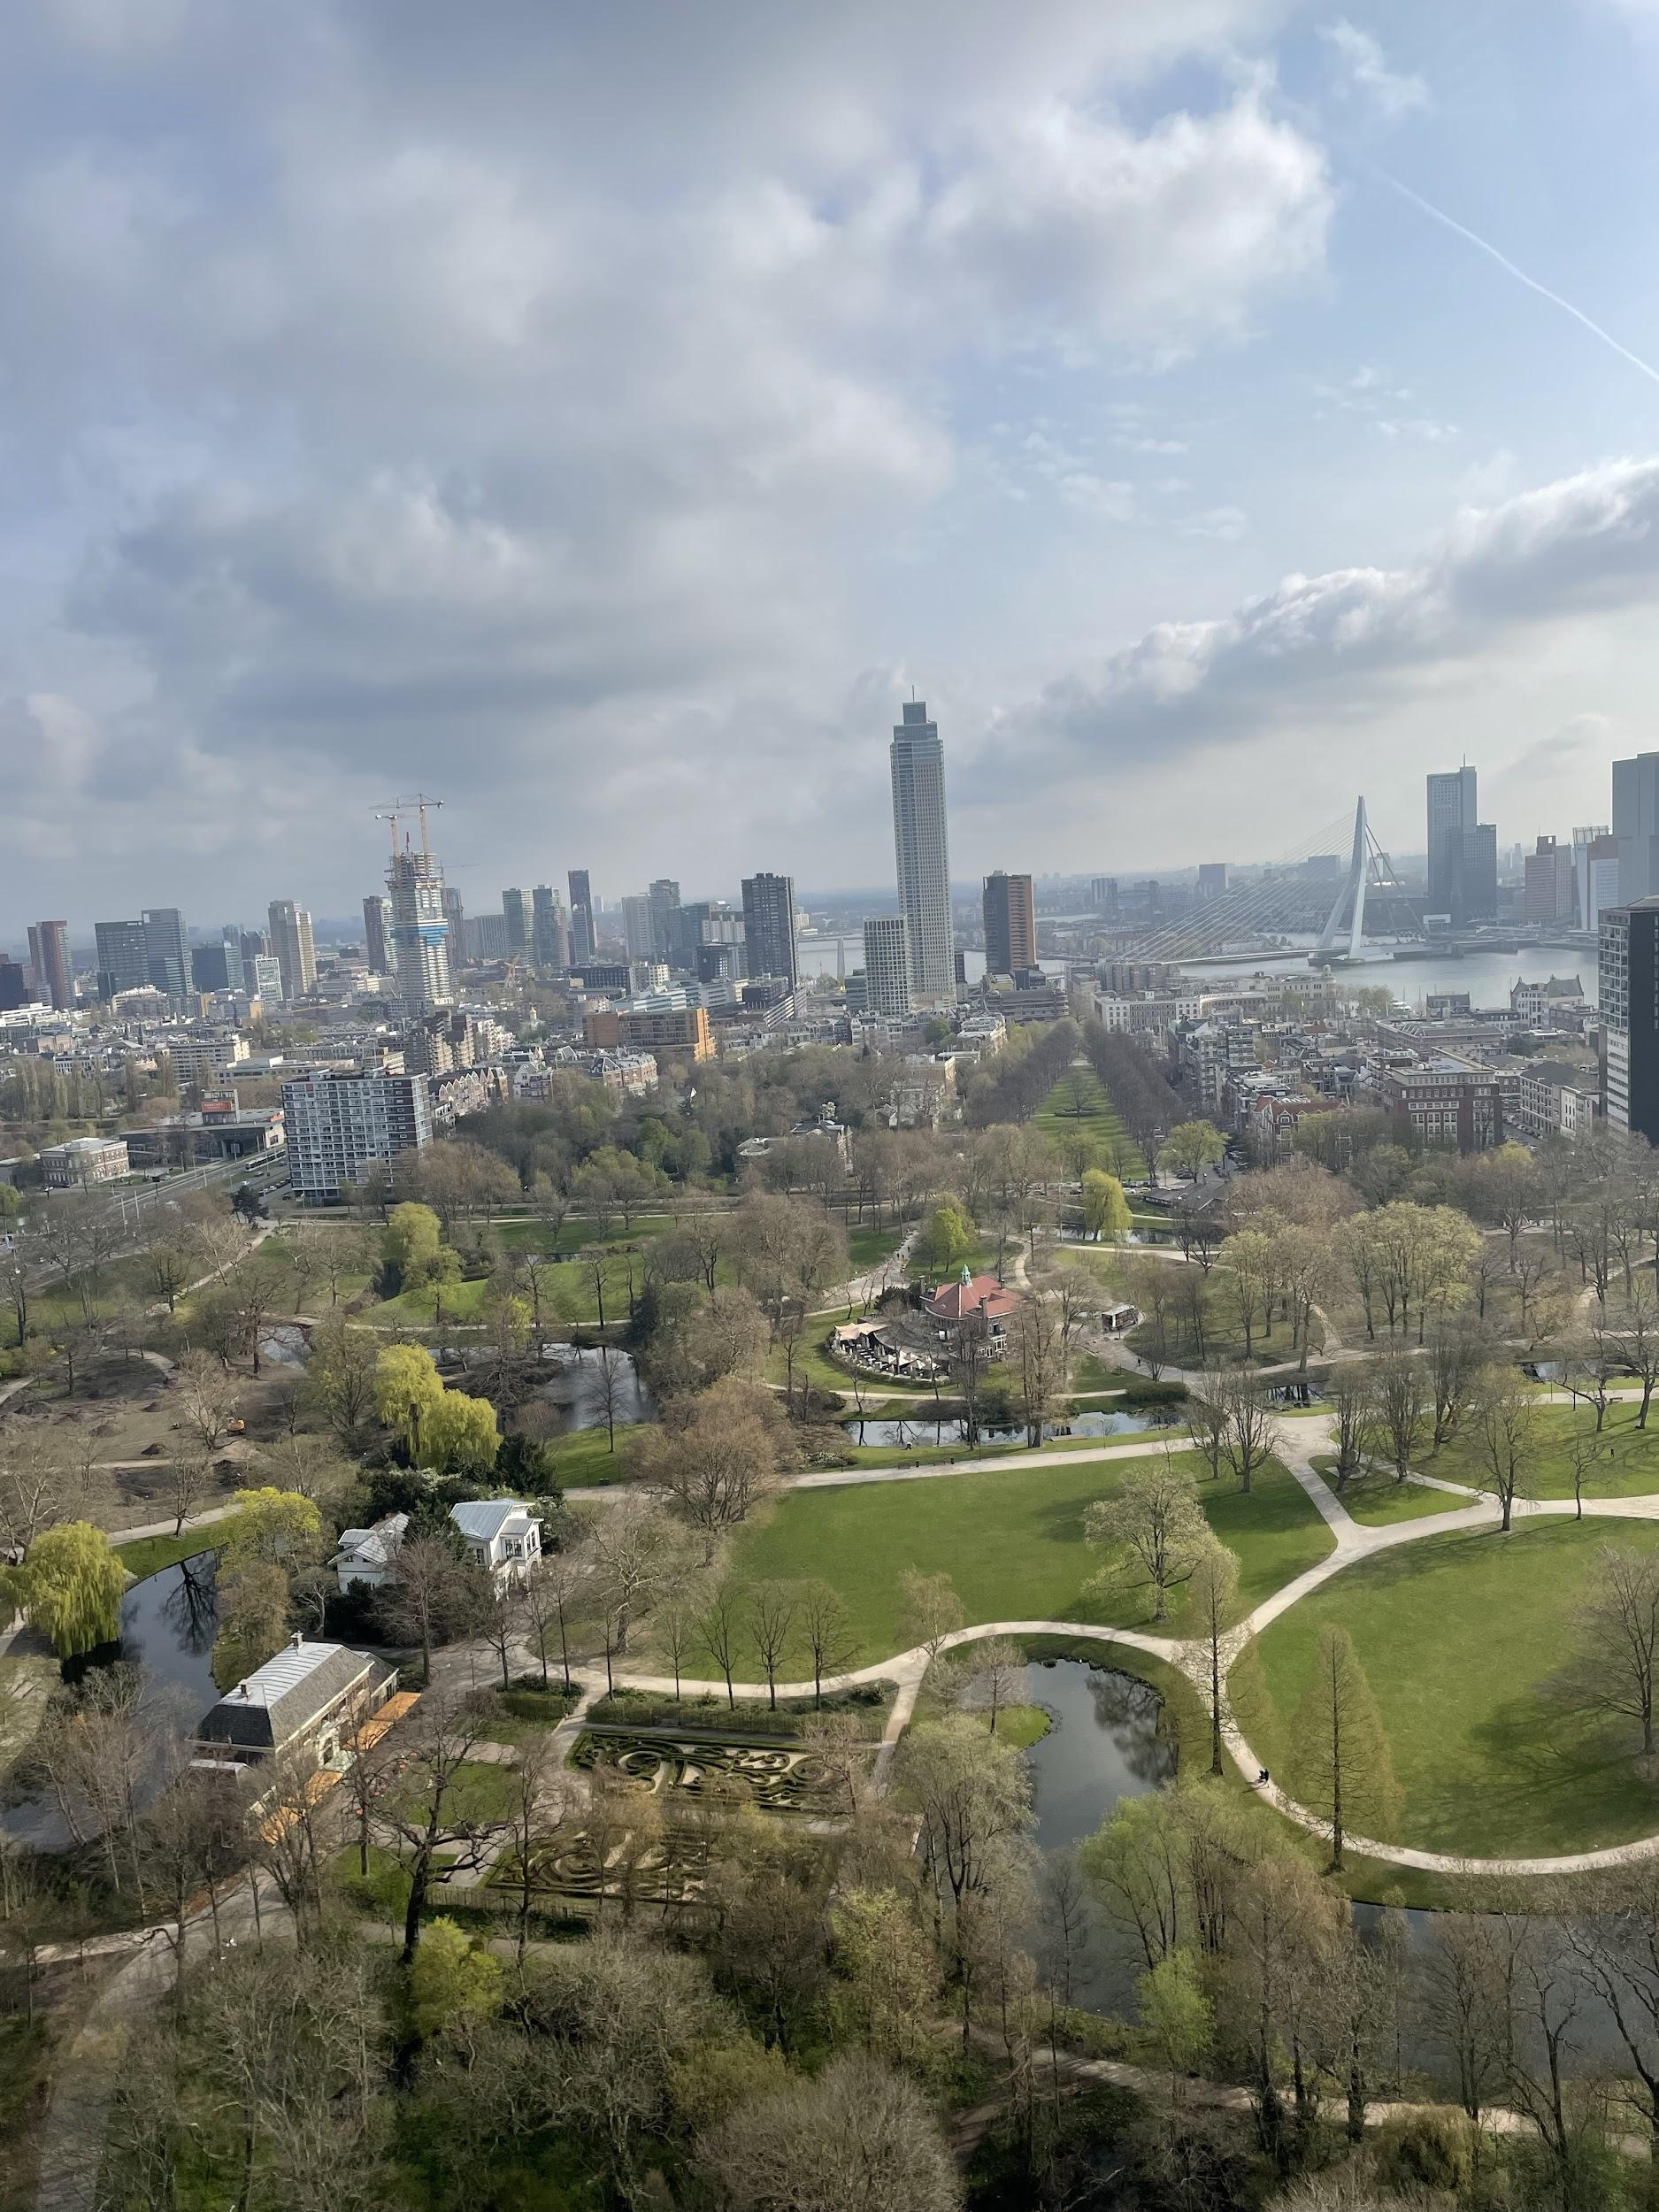
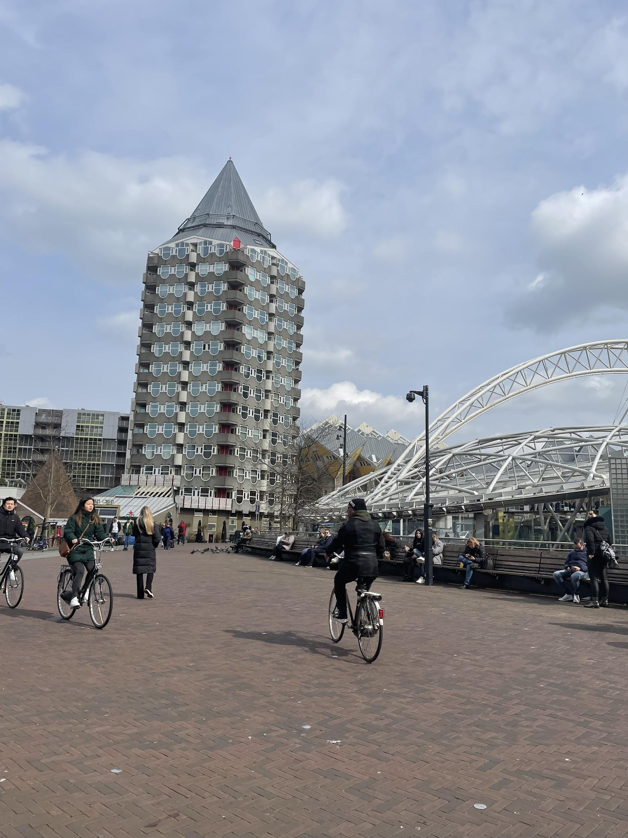
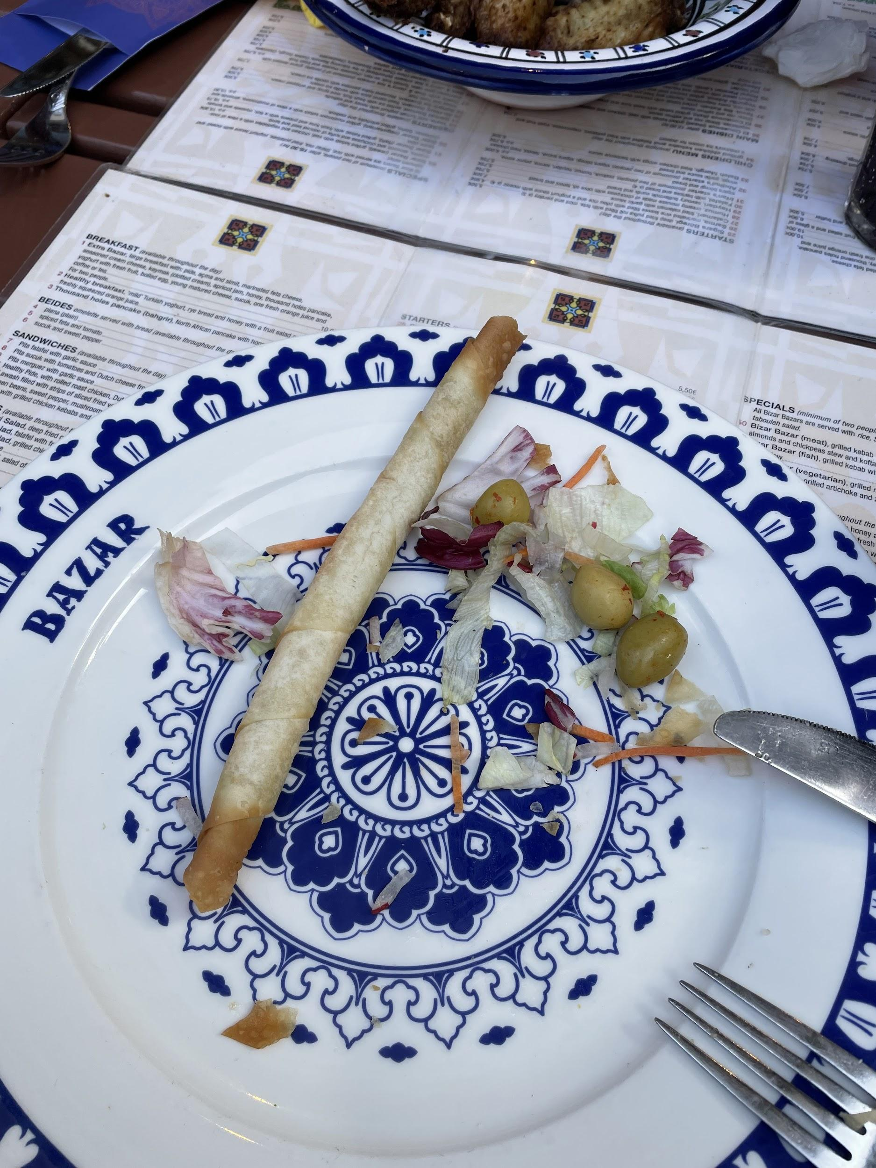
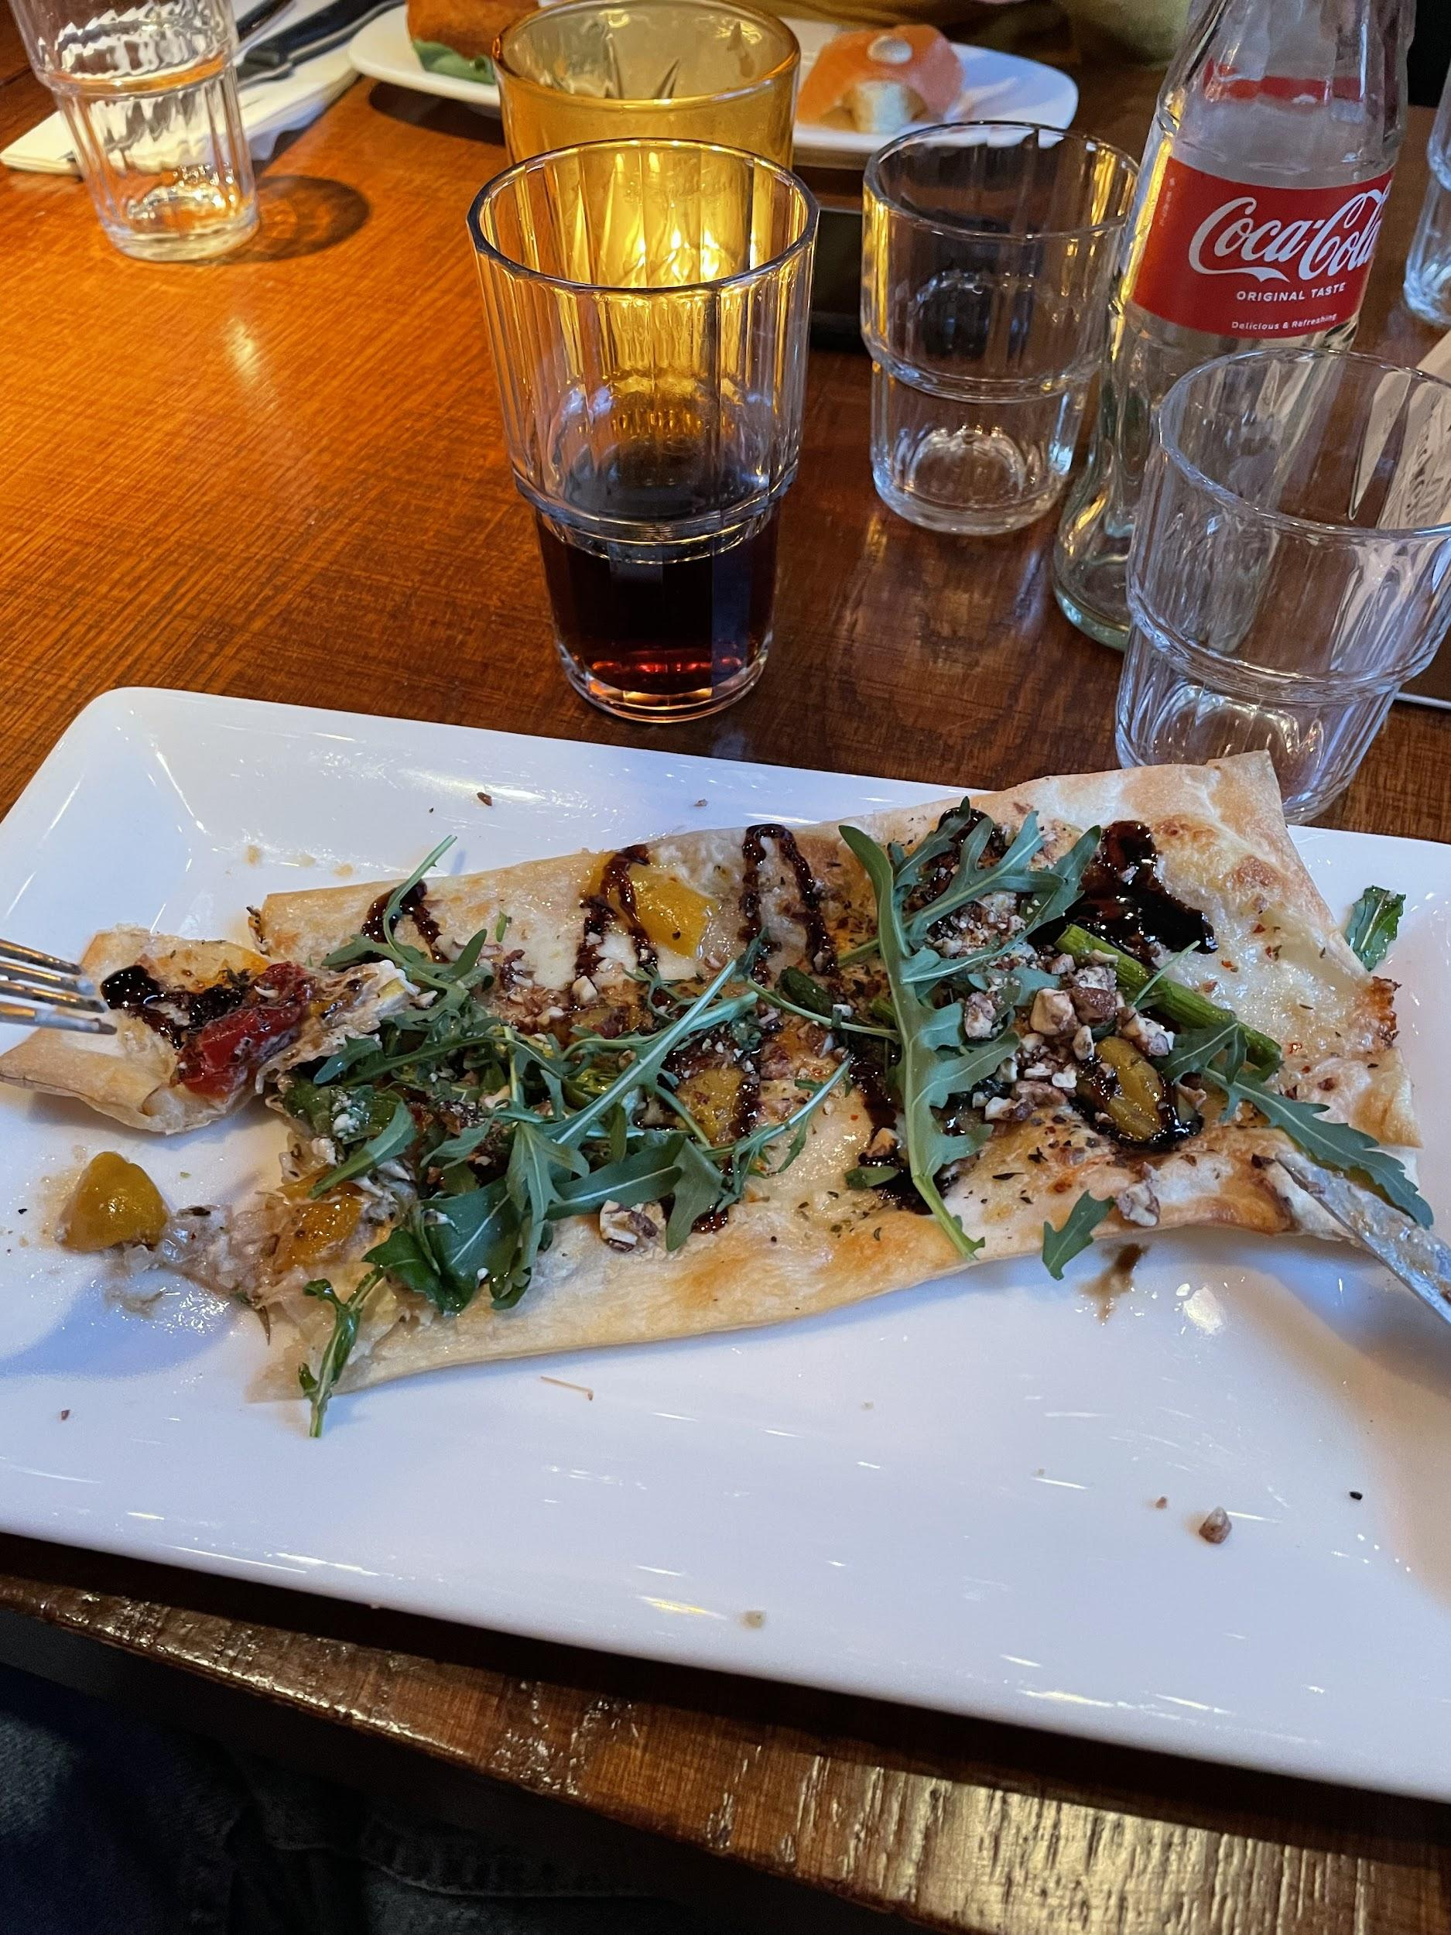
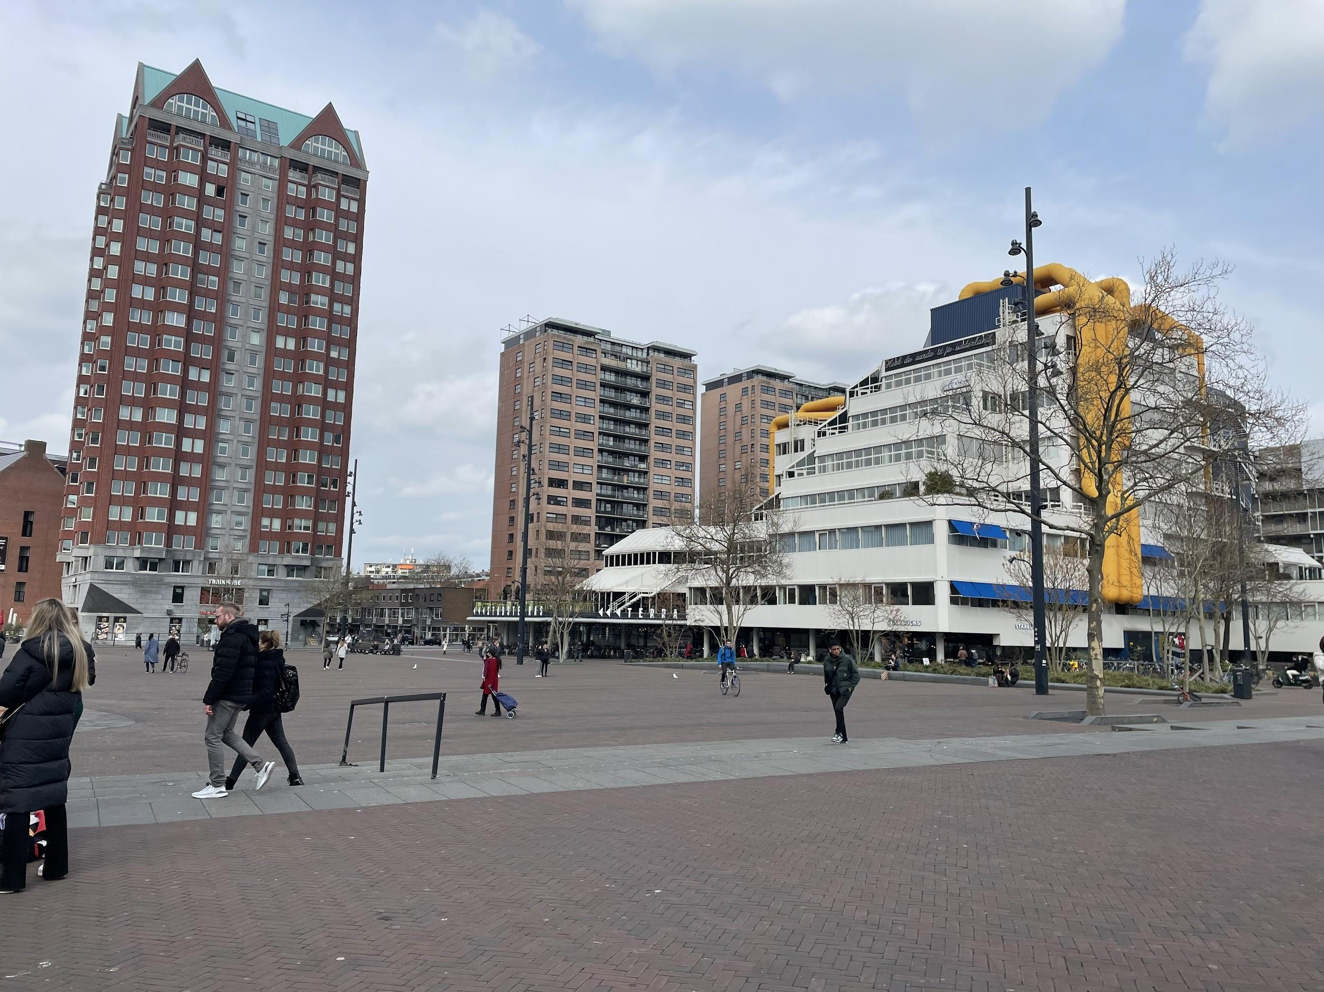
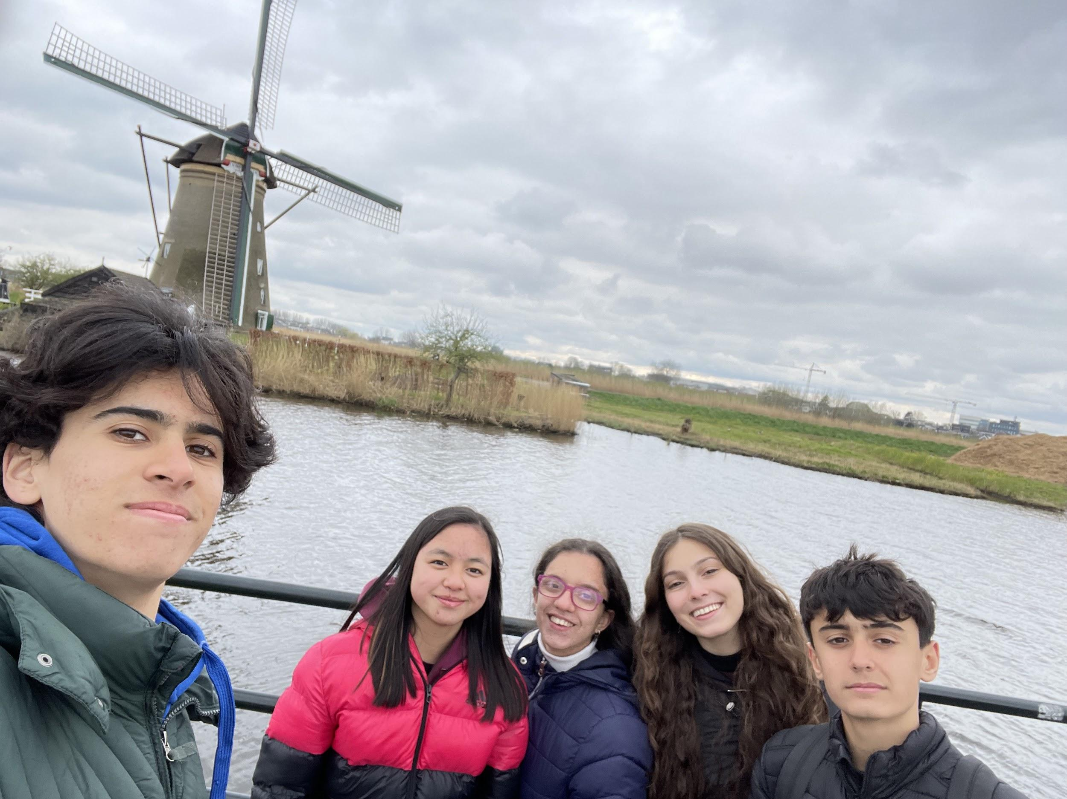
Claudia Mei Vera
My experience in Ridderkerk was stunning. When I got there, I saw a lot of skyscrapers. Also when they did a high school tour was nice, their high school was very big in addition they have a big dining room. The thing that impressed me the most is that all students go on bike or boat to the school.
My host family was fantastic with me, we ate exotic food
In conclusion I would like to do another erasmus project because is an unforgettable experience.

Slide 6
Silvio Benavides
My experience in Ridderkerk was very good. In It I discovered many things, for example, the kids go to school in ship, this is very interesting. My host family in Rotterdam was nice with me. In the city there are skyscrapers and many blocks of flats. In addition, in it there were too many malls.
In conclusion, the experience was gorgeous.
Silvio

Slide 7
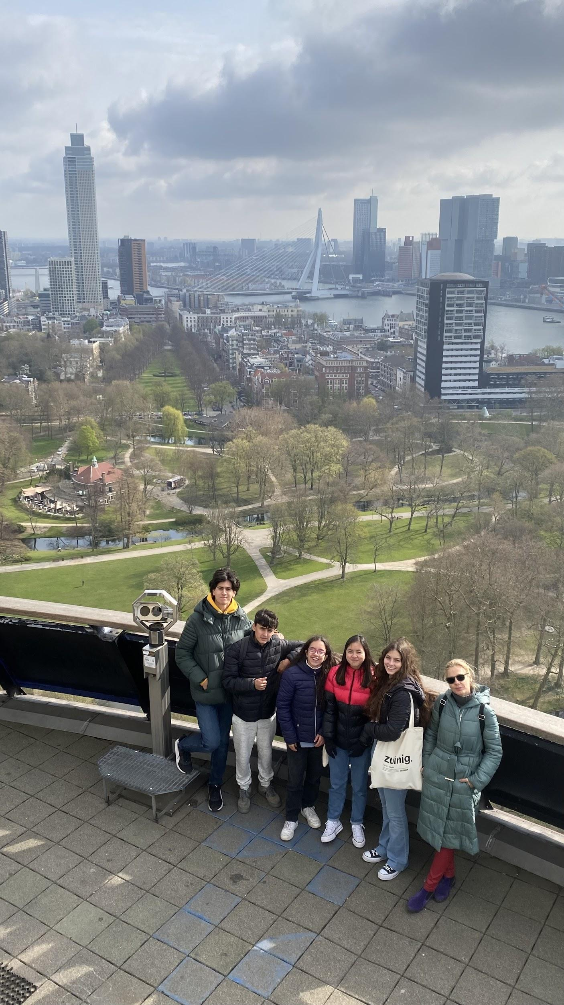
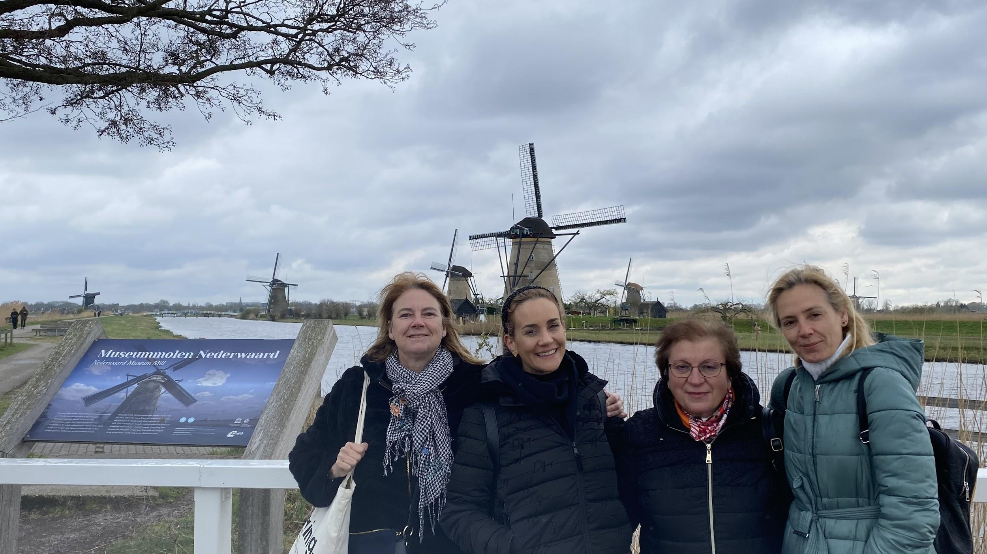
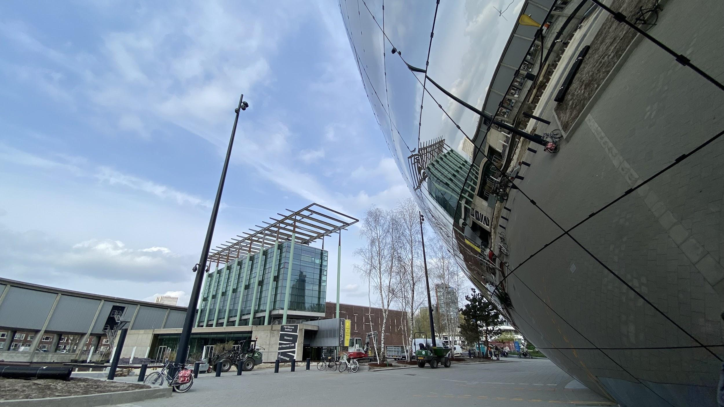
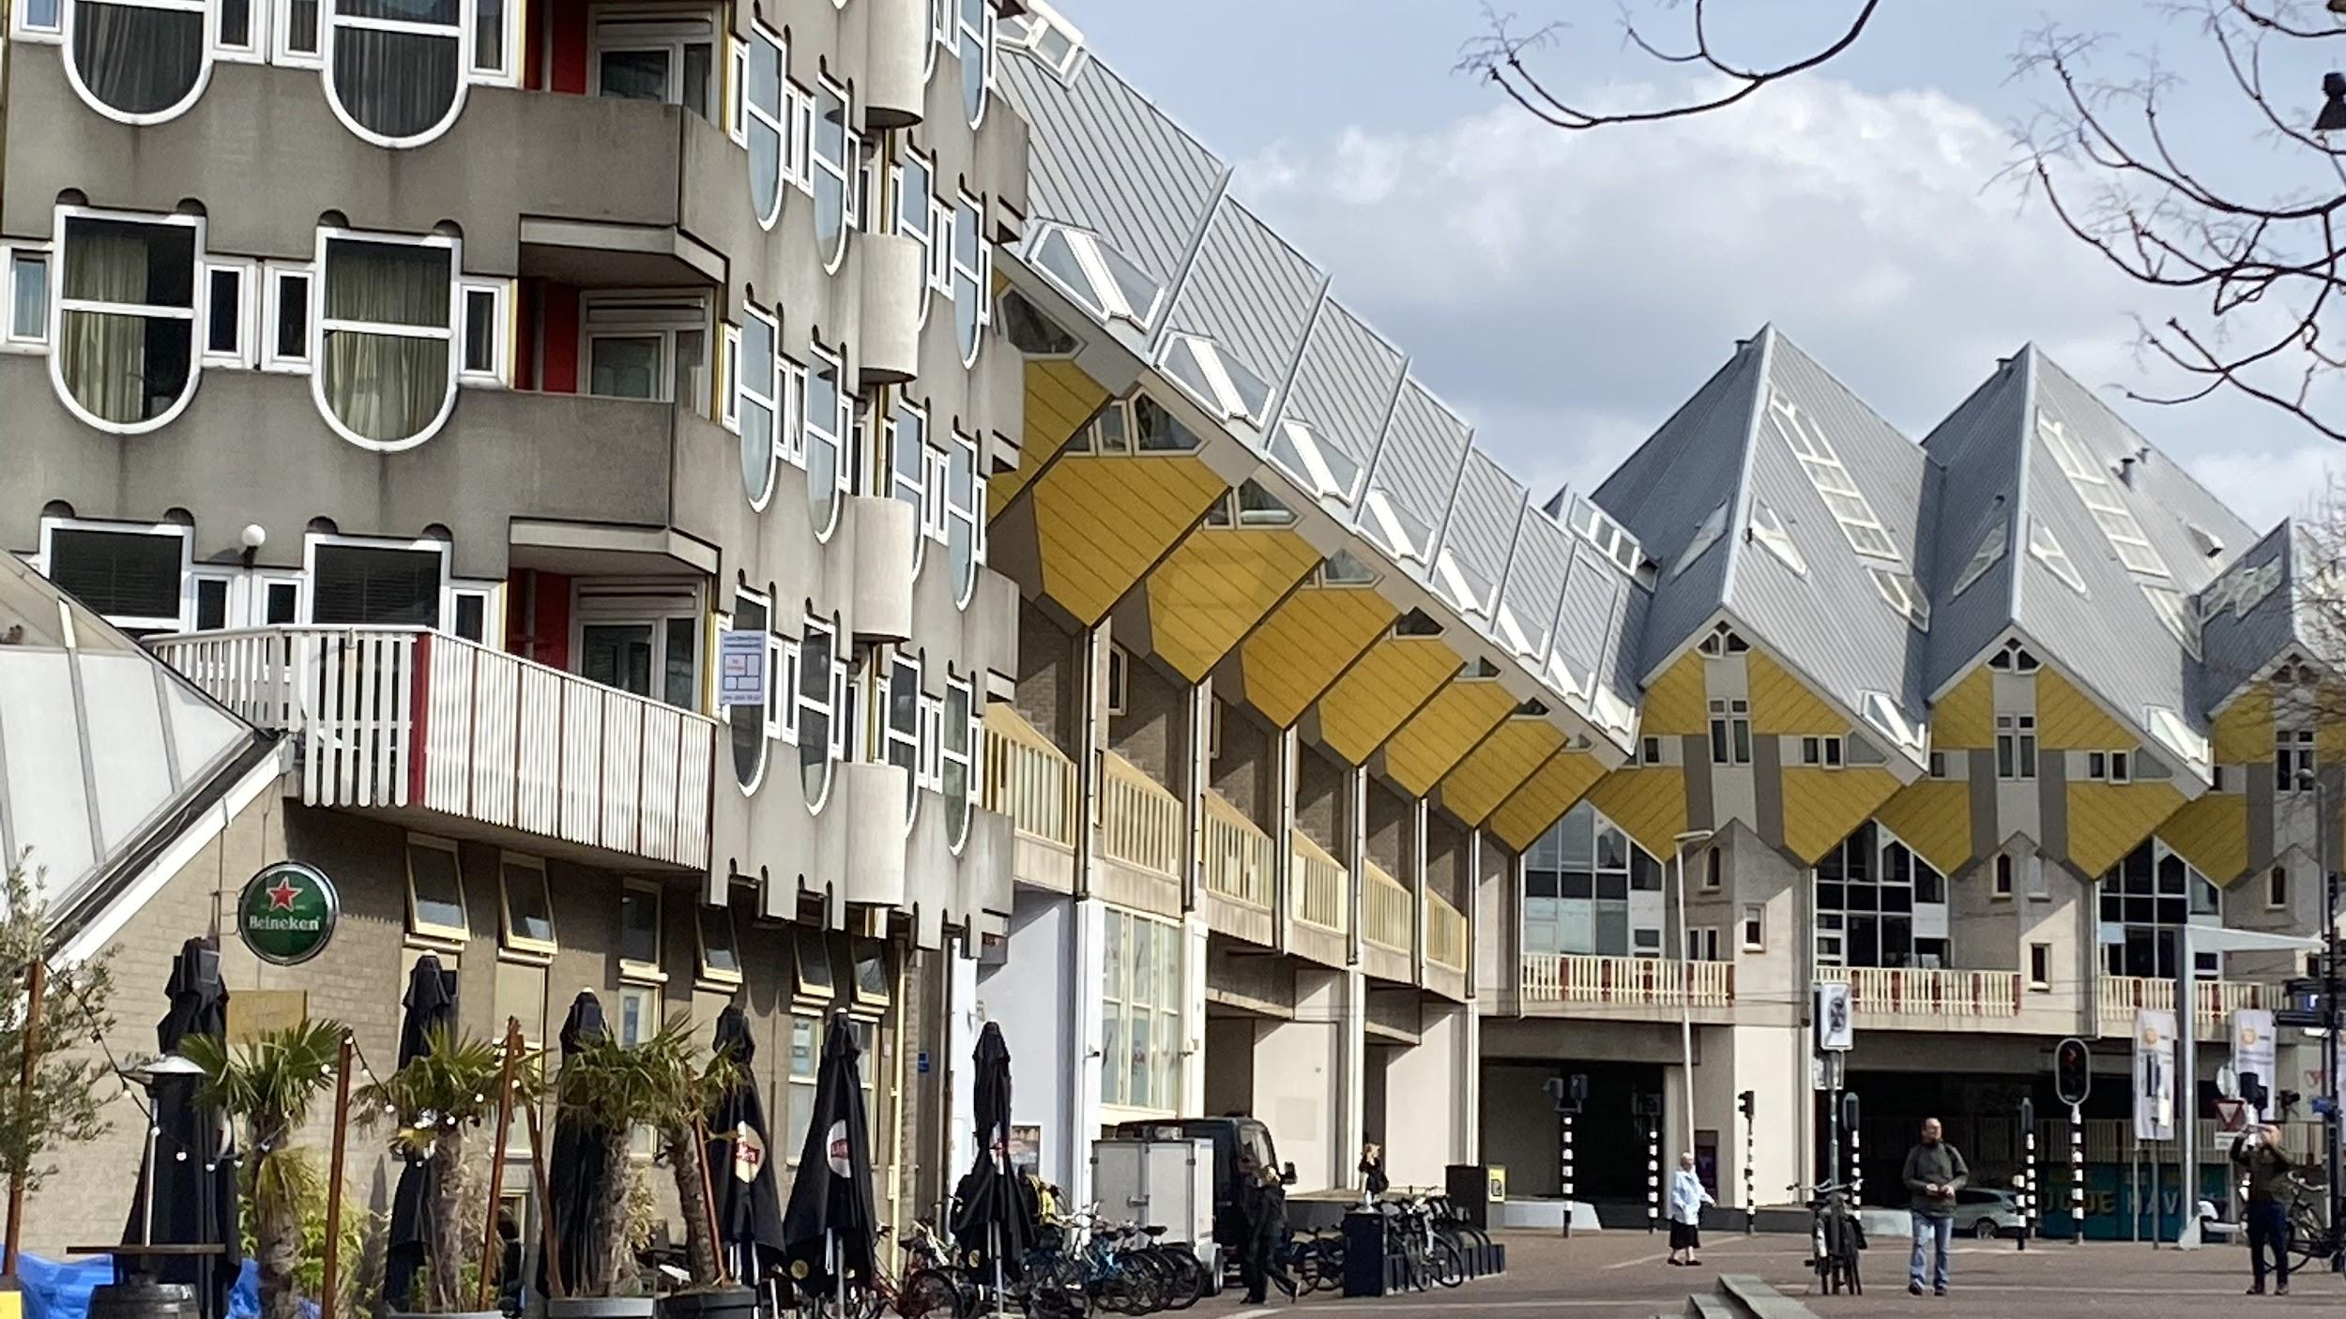
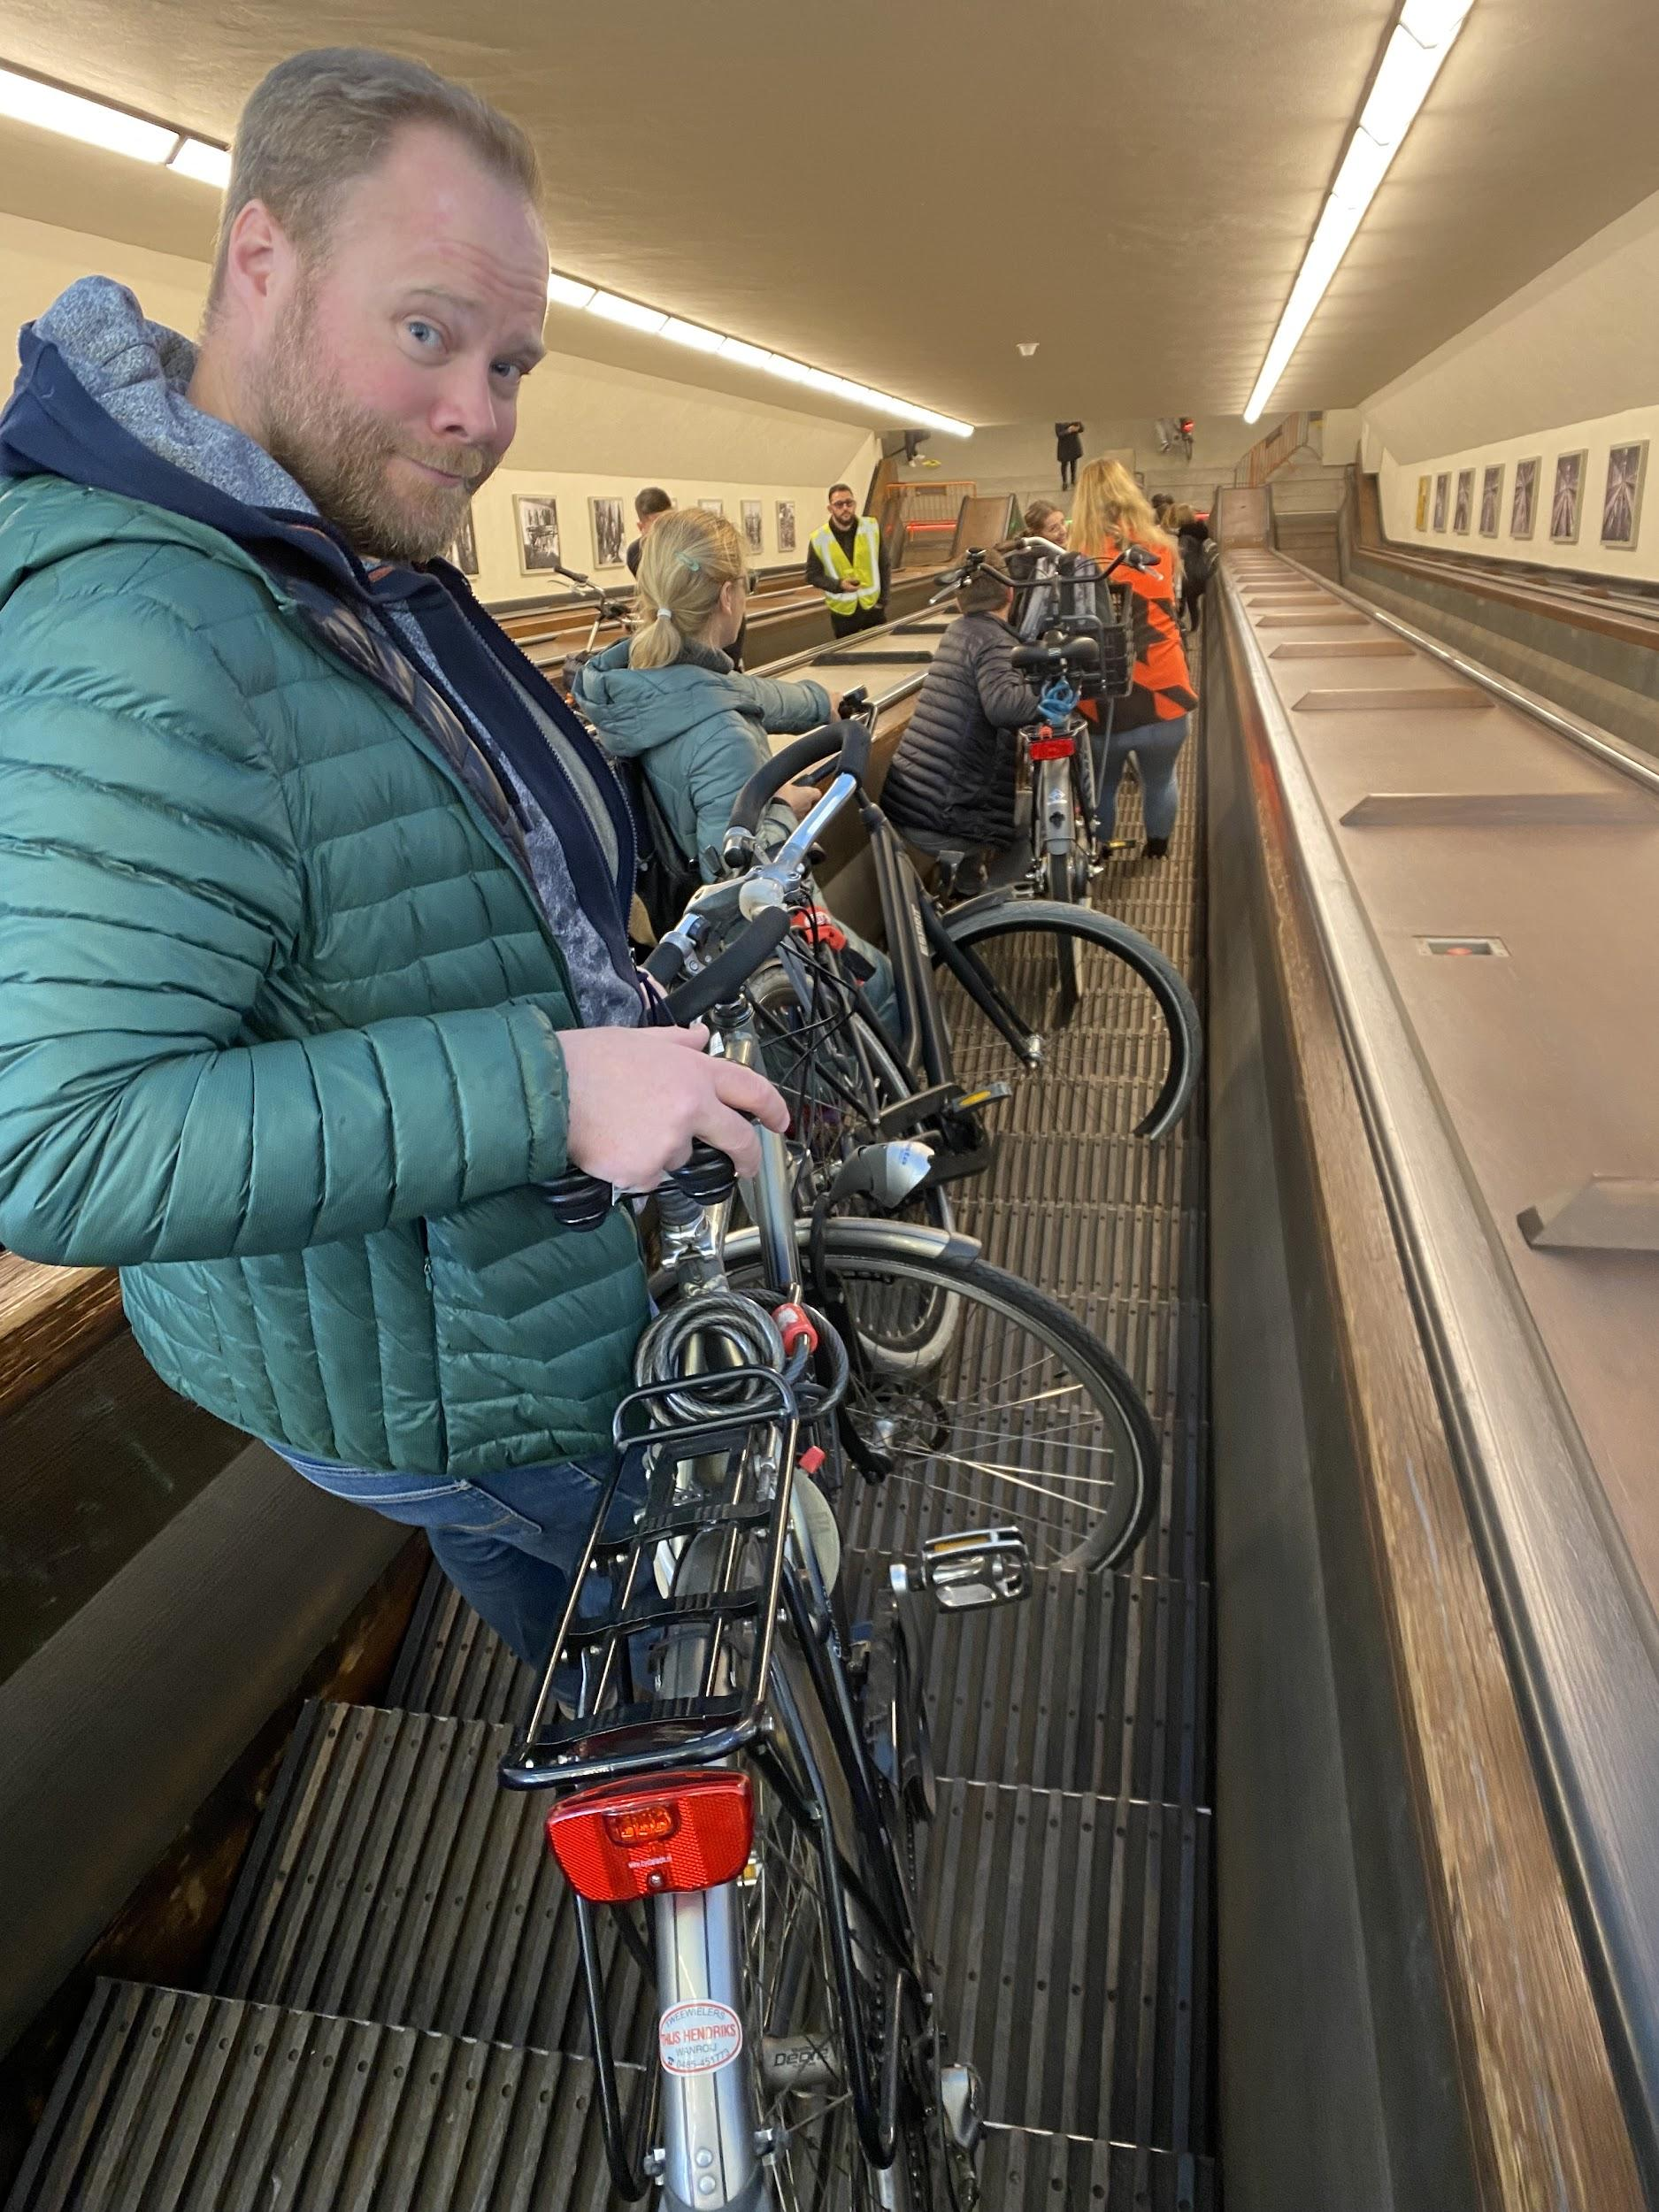
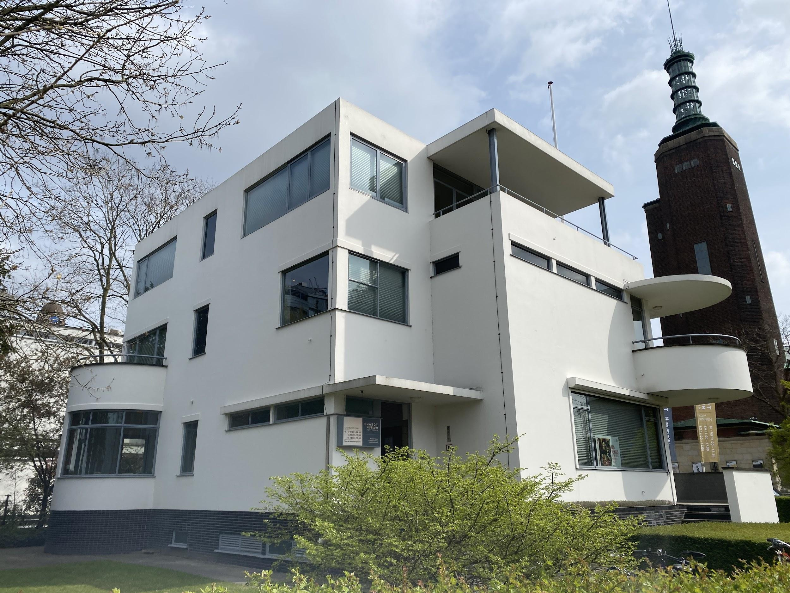
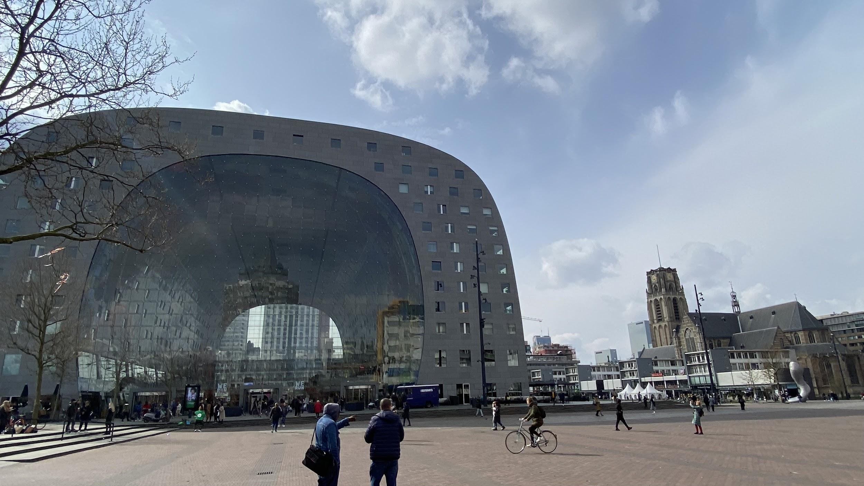
Nelly
This mobility have given to us the experience to learn the way of live in Central Europe,the food, the timetable, the school organization or the educational system are developed looking for the society improvement and the conciliation between work and family. In this mobility we have observe people care the environment in their daily life using the bike and the public transport combine.Has been very interesting the topic worked “ what is Europe for you” because I think European citizens are losing the European identity and the confidence in European Union. Erasmus projects are the main way to create the European feelings in people in this uncertain time we are living of wars and crisis. The most surprising thing for me is how has been created the new Rotterdam after to be destroyed in Second World War, like a place where has been developed all the architecture modern and contemporary movements getting an authentic museum of architecture relationship with the industrial heritage without lose their traditions

Slide 8
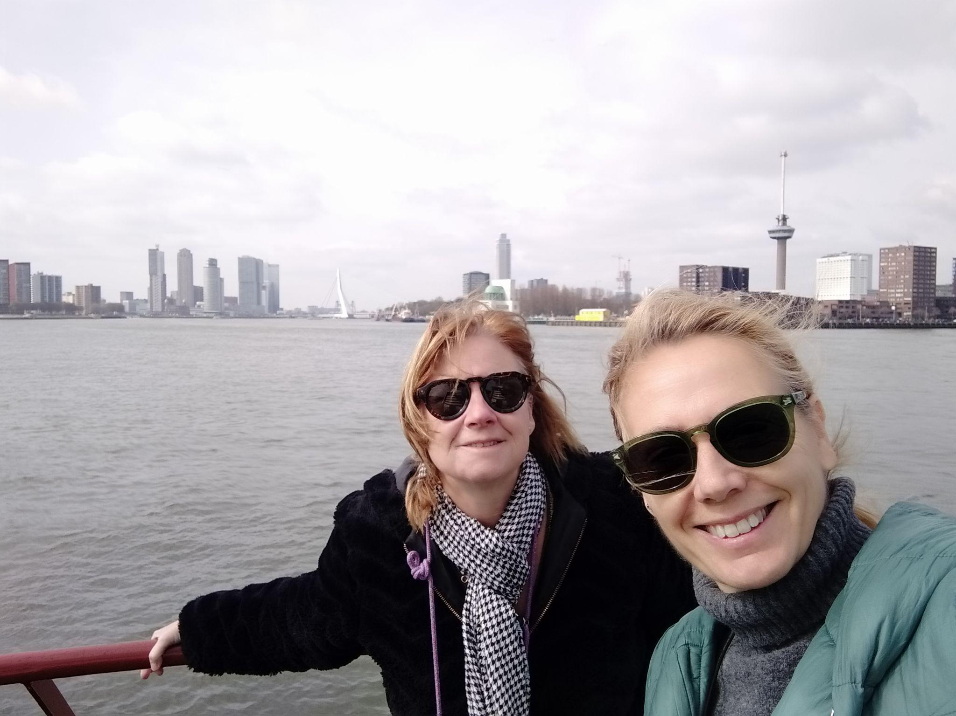
Josefa Cortés
Despite the inconvenience of the weather, the stay in Rotterdam has been rewarding. I would highlight having been able to enjoy the typical life of that quiet city, especially bike rides. Also being able to check another educational system different from Spanish: different methodology and large economic investment.
The topic of work, European identity, it seemed very appropriate in the days we are living.I think it is very good to reflect on the values ​​we share. It is a way of thinking about the true essence of Erasmus exchanges.
On the other hand, as in all Erasmus exchanges, the experience of getting to know other teachers and students better.

