Slide 1
ERASMUS+
Italy

Slide 2
SUNDAY

Slide 3
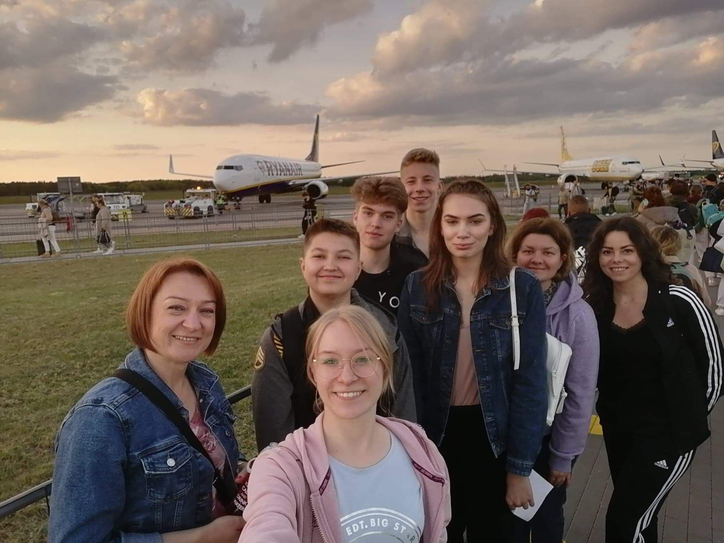
On Monday we had a flight from Warsaw to Bologna.

Slide 4
MONDAY

Slide 5
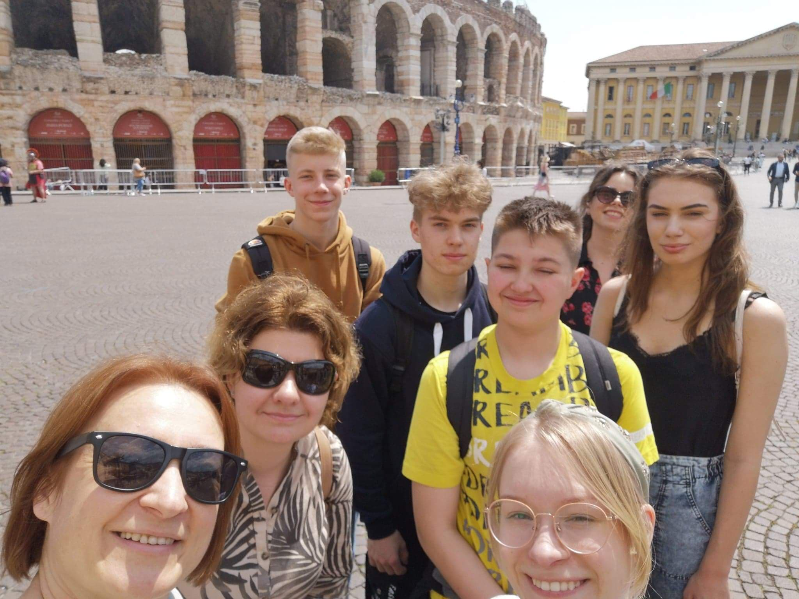
On Monday we went to Verona, where we explored the city. We saw sights like the House of Juliet and the amphitheater.

Slide 6
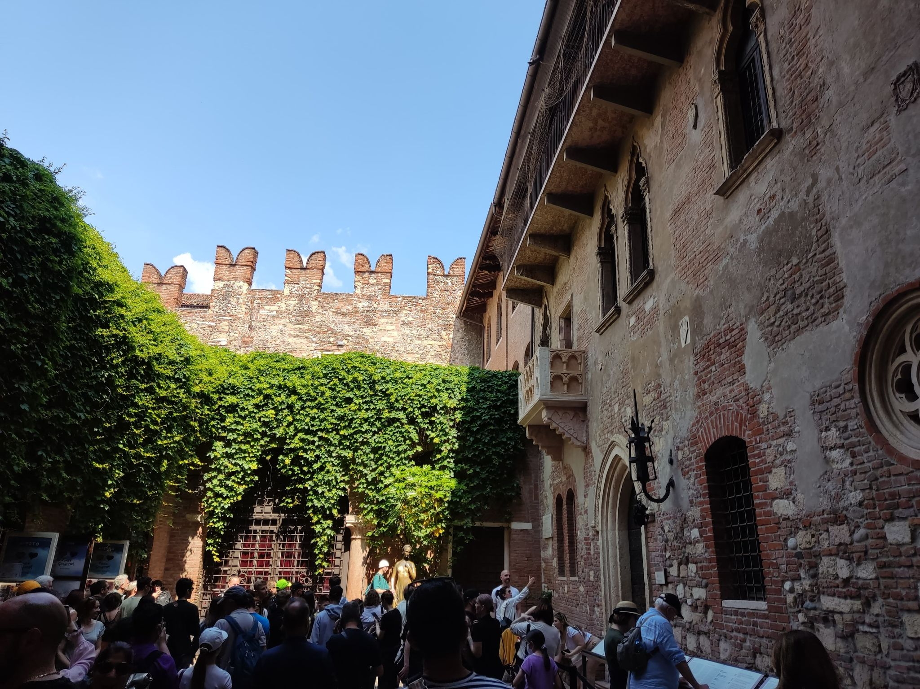

Slide 7
TUESDAY

Slide 8
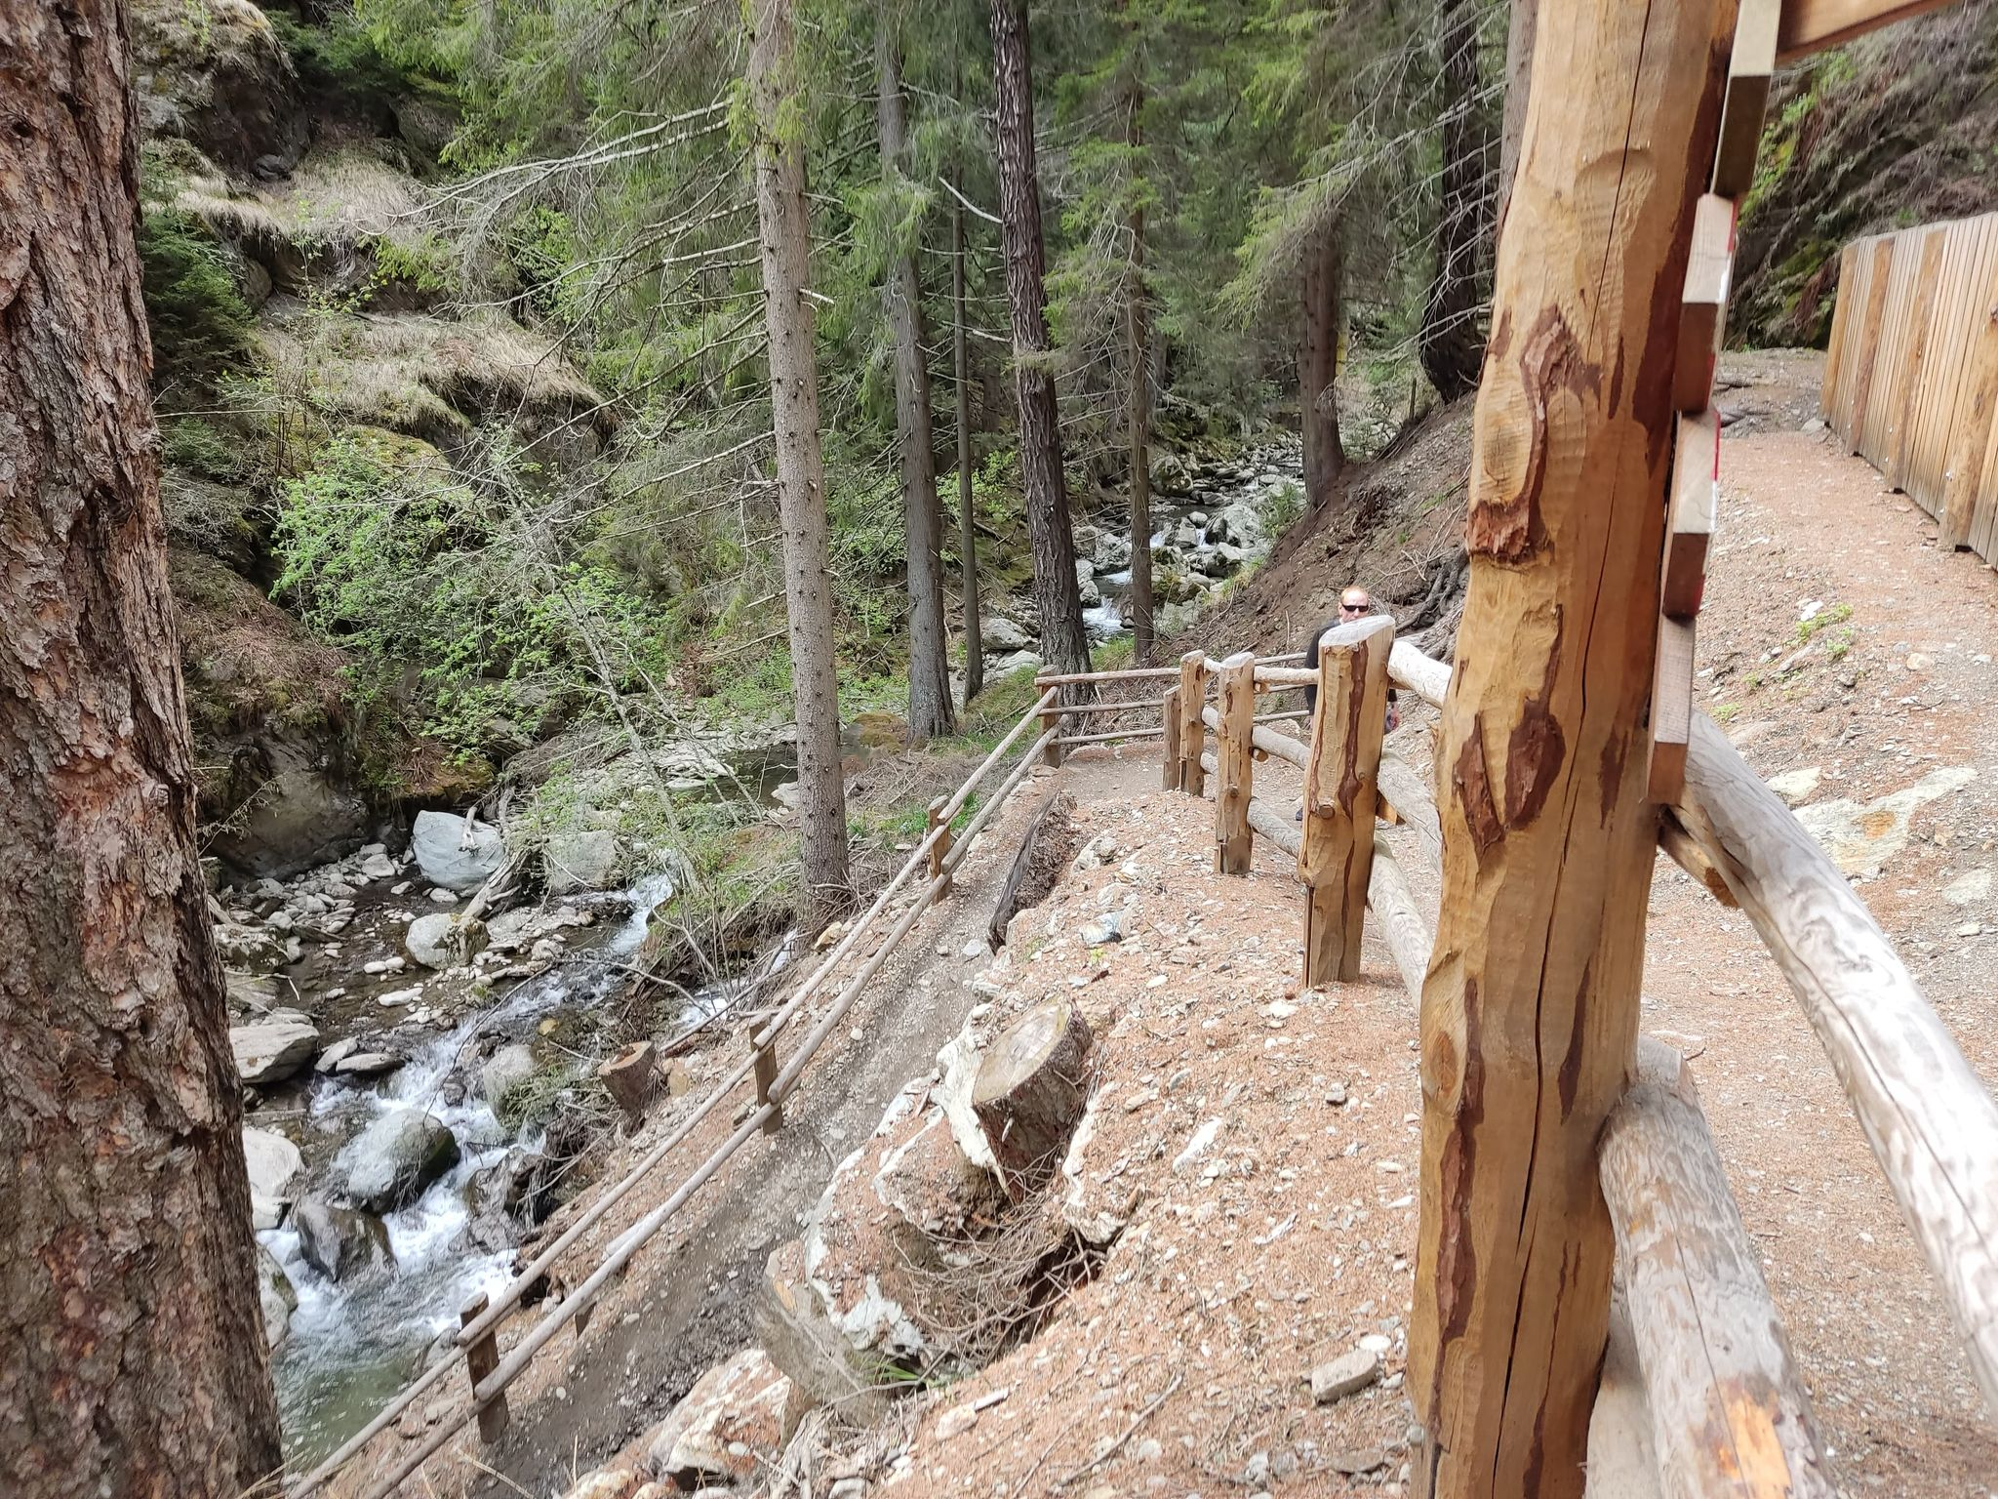
On Tuesday I prepared an interview with Elias about his visit in Poland. In the afternoon we went whole group on the hiking trip from Tartsch via Ganglegg.

Slide 9
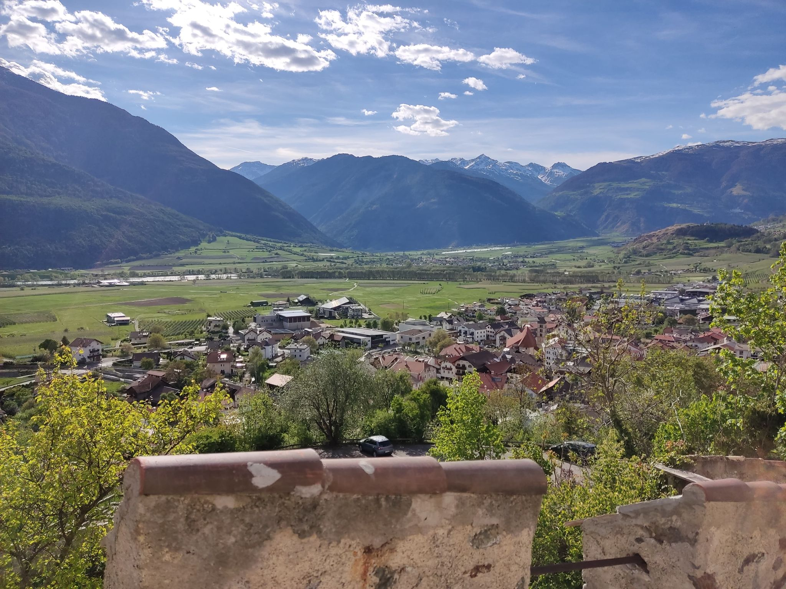

Slide 10
WEDNESDAY

Slide 11
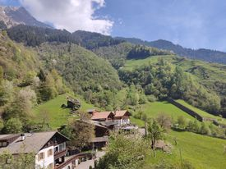
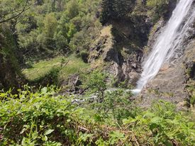
On Wednesday we went on trip to Partschinser Waterfall. In the evening we participated in dumplings competition.

Slide 12
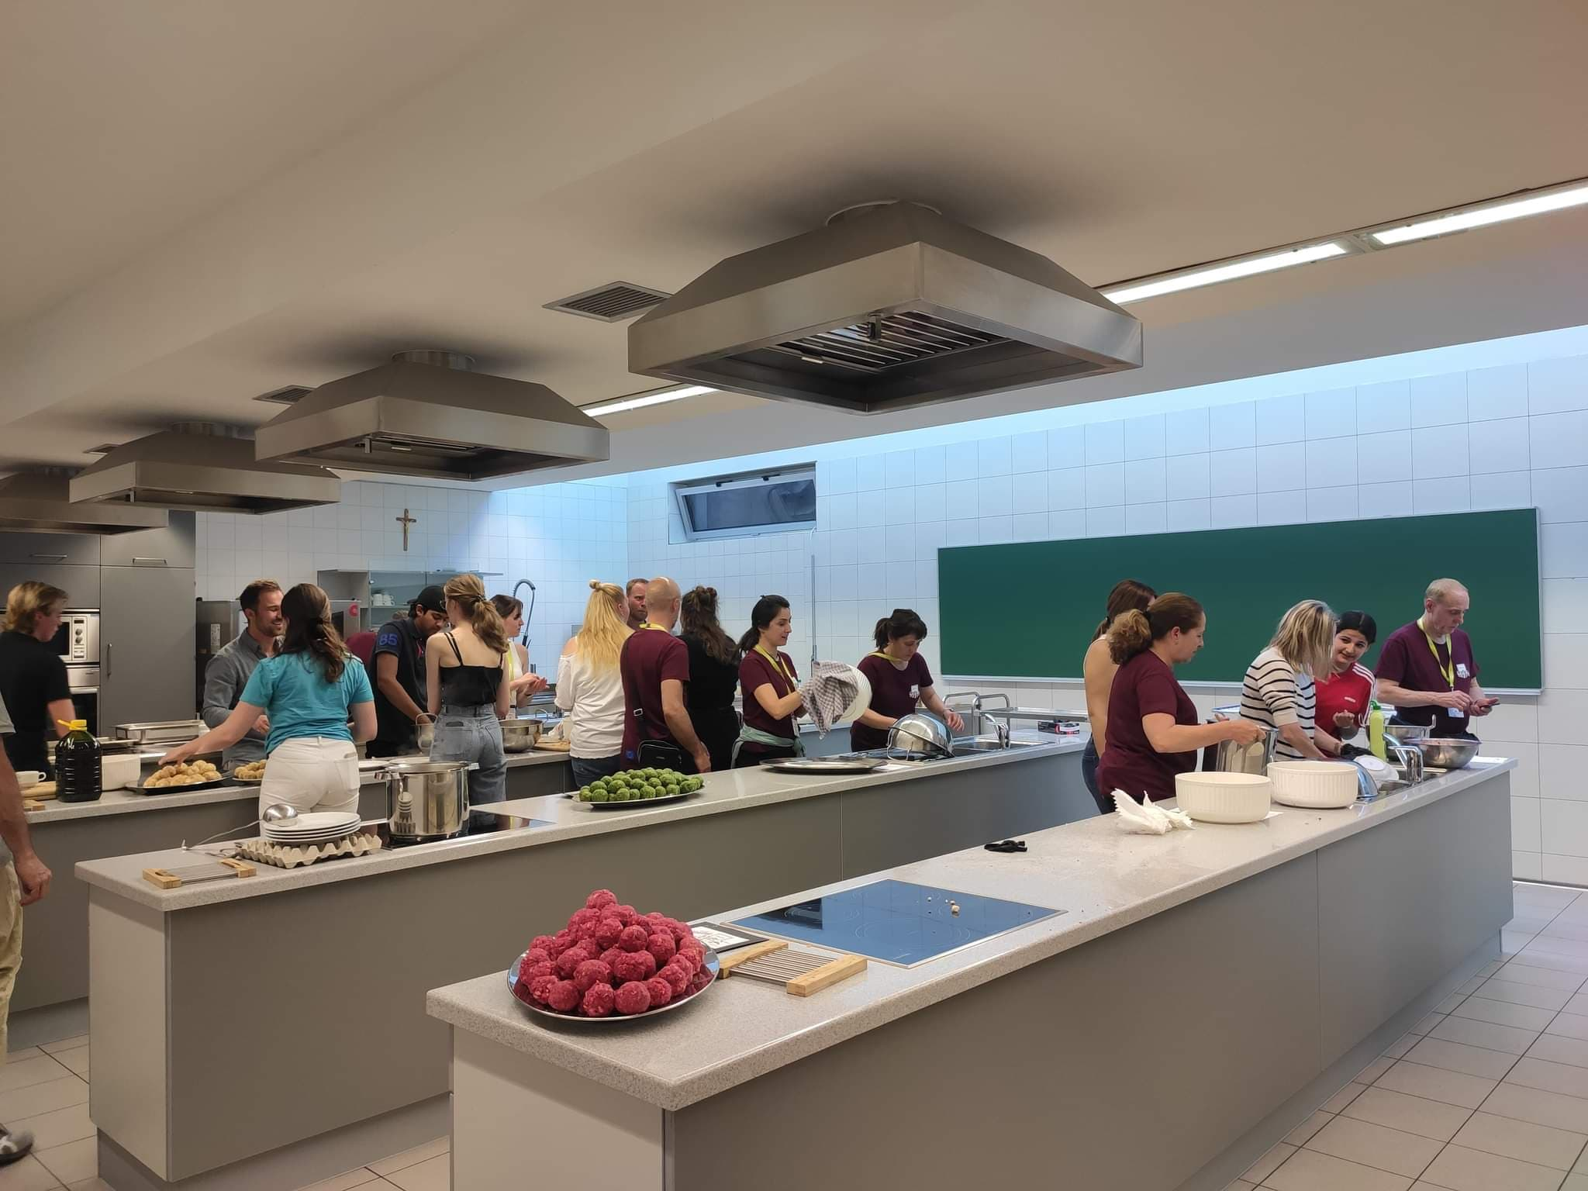

Slide 13
THURSDAY

Slide 14
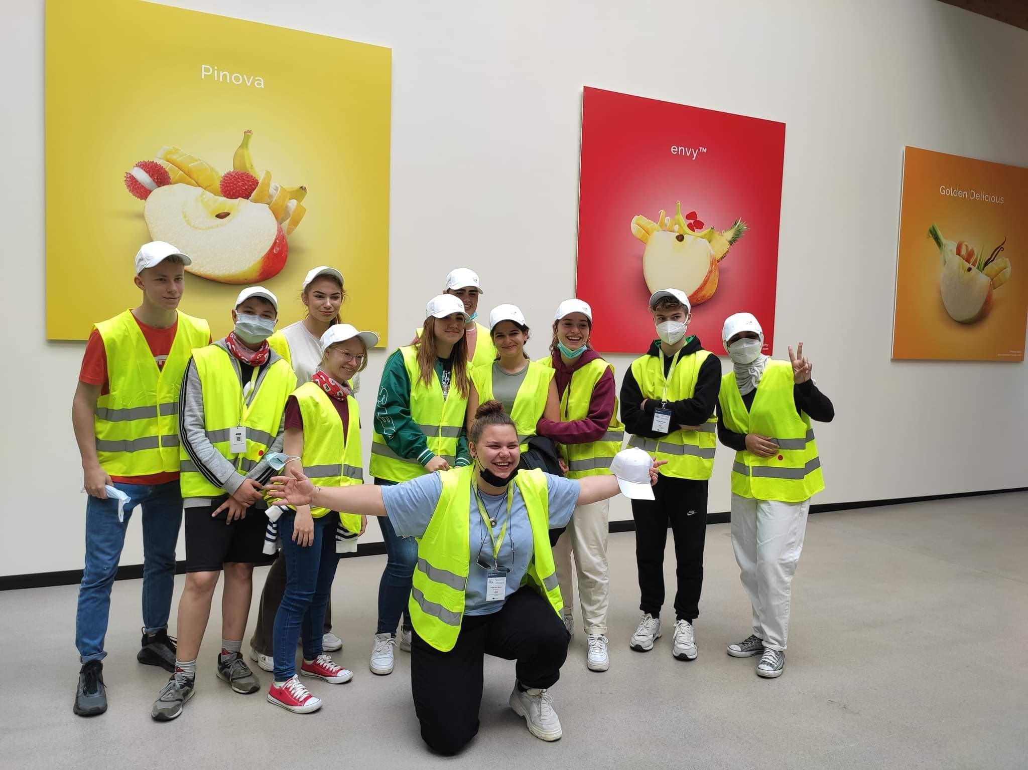
On Thursday we finished the work on the project and visited the VIP. Coop.

Slide 15
FRIDAY

Slide 16
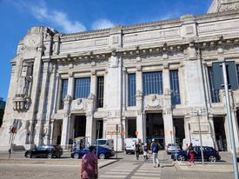
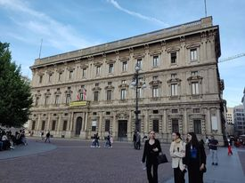
On Friday we were sightseeing Milan.

Slide 17
SATURDAY

Slide 18
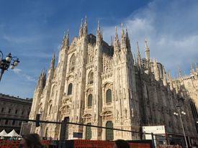
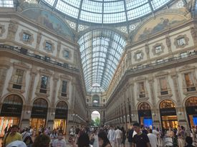
On Saturday we returned to Poland.

