Slide 1
AN AMAZING ADVENTURE BETWEEN TWO PATRIMONIAL CITIES ROME AND SEVILLE
Rome

Slide 2
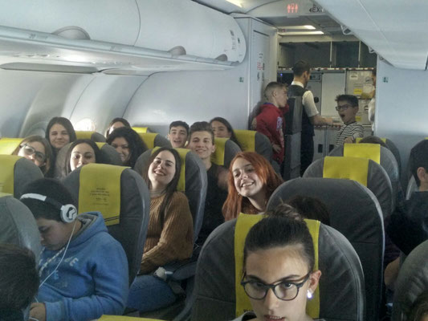
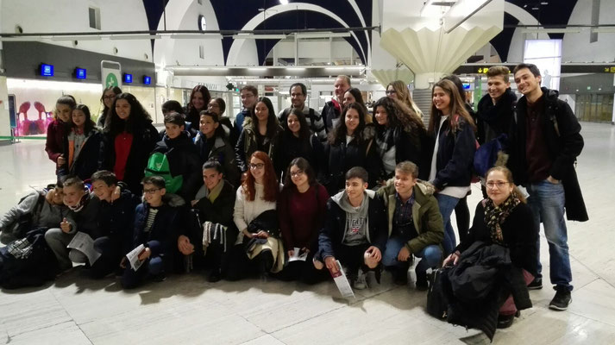
TRAVEL
At 7:00 departure from Seville to Barcelona
At 12:00 departure from Barcelona to Rome
At 14:00 arrival in Rome

Slide 3
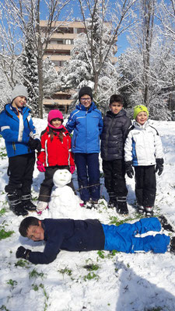
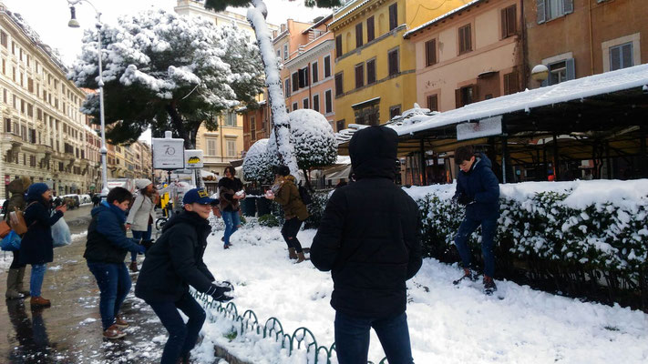
THE SNOWY MONDAY
On monday the students didn’t go to school because of the snowfall of the last night.

Slide 4
THE FREE TUESDAY

