Slide 1
The Basilica Aemilia
CARBONE Francesco

Slide 2
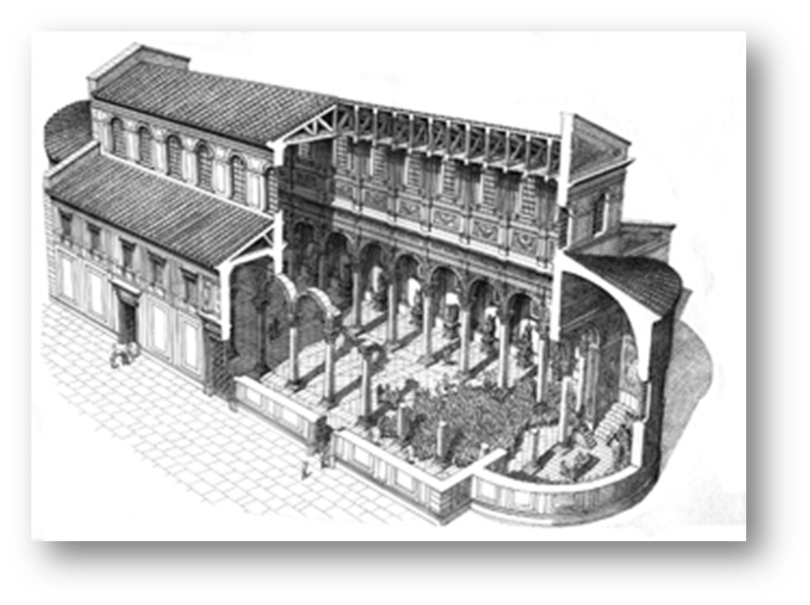
The civil basilicas in ancient Rome
The Latin word “basilica” derives from a Greek word referring to the tribunal chamber of a king. In fact, the ancient Roman basilicas were public buildings where courts were held. These places were also used for other official and public functions and became the town halls of ancient Roman life; they had no religious function at all.
The plan of a basilica is generally rectangular with a central nave and aisles and with a slightly raised platform. There is an apse at each of the two ends, adorned with the statue of the emperor. The entrances are from the long sides. The central aisle is higher than the others and the light penetrates through the clerestory.
In every Roman town, near the main forum, there was usually a basilica.
The oldest known basilica is the Basilica Porcia, built in Rome in 184 BC by censor Marcus Porcius Cato.
Later, this kind of building was adopted by Christianity as model for churches.

Slide 3
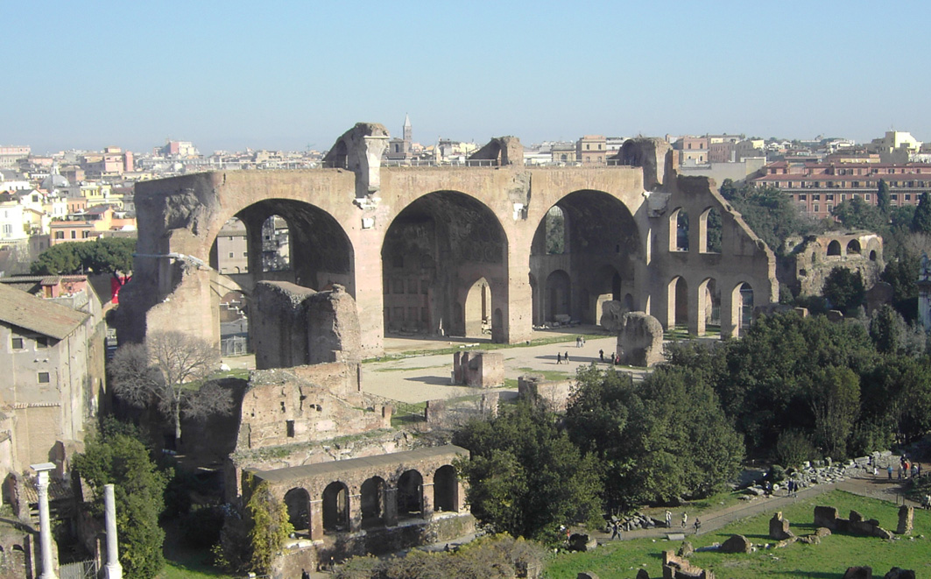
The basilicas in the Roman Forum
In the Roman Forum there were six basilicas built between 184 BC and 312 AD: the Basilica Porcia (the first basilica built in Rome), the Aemilia Basilica, the Basilica Sempronia, the Basilica Opimia, the Julian Basilica (initially dedicated to Julius Caesar and completed by Augustus), the Basilica Argentaria and the Basilica of Maxentius and Constantine.

Slide 4
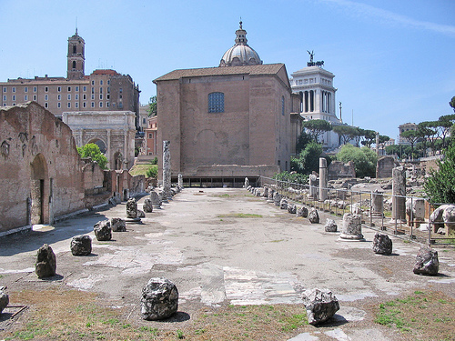
The Basilica Aemilia (1/2)
The basilica is built on a site of the tabernae lanienae, the "butcher shops", (5th century BC) and of the tabernae argentariae, the city's bankers, (4th century BC). A first basilica had been built behind the tabernae argentariae between 210 BC and 191 BC: it had three naves paved with tuff and was opened to the Forum Piscatorium and the Macellum.
In 179 BC the censor Marcus Fulvius Nobilior erected the Basilica Fulvia. It was completed, restored and redecorated by the members of the Aemilian gens, giving the basilica its current name. According to many archaeologists, the Basilica Aemilia was very different from the previuos Basilica Fulvia.
Although in the form of ruins, the Basilica Aemilia is the only one of the Republican Rome that we can visit today.
In 55 BC Lucius Aemilius Lepidus Paullus began a new edifice in substitution for the basilica: it was inaugurated by his son in 34 BC. This new edifice was similar but shorter than the previous. It has columns in African marble with Corinthian capitals and friezes with deeds from the history of Republican Rome.

Slide 5
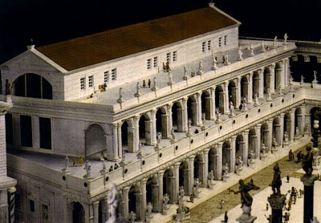
The Basilica Aemilia (2/2)
The basilica was restored by Augustus in 14 BC after a fire. The two upper floors of the basilica were totally rebuilt and decorated with vegetable elements and statues of barbarians.
The basilica was restored again in 22 AD: Pliny considered this buildings one of the most beautiful in Rome. In the porticus of Gaius and Lucius (the grandsons of Augustus), fronting the Roman Forum, there were the Tabernae Novae. The main hall (100 m long and 29.9 m deep) was located behind these shops.
In 410 AD, during a fire set by the Visigoths, the wooden roof, the Tabernae and the facade of the basilica were completely destroyed: on the coloured marble floor we can still see today the green stains of bronze coins that were melted in the fire. The basilica was rebuilt but the earthquake of 847 caused the final collapse of the building. During the Renaissance the remains were used as building material for a noble which is no longer existing. So, today, we can see only the plan and some rebuilt elements.

