Slide 1
Erasmus+ change Rome-Seville
Matteo De Col
Migel Angel Camacho

Slide 2
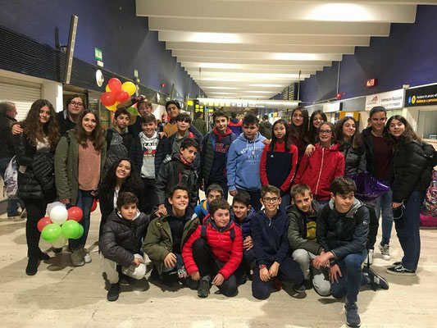
Monday
Matteo arrive to Seville.
Matteo is in Seville at 21:30.
Go to the restaurant at 22:00.

Slide 3
Tuesday
The students of Erasmus go to the centre of Seville.
At 10:00 go to the town hall
At 12:30 go to the Giralda.
Eat at 15:00.
At 16:00 go to the Antiquarium.
At 17:00 arrive to the school.

Slide 4
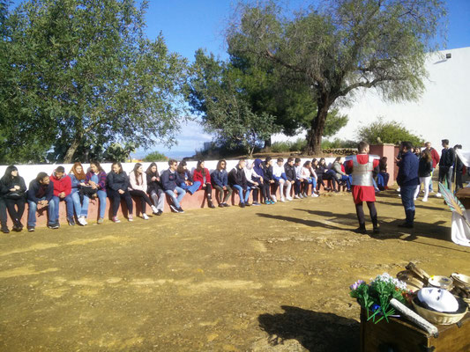
Wednesday
We went to Carmona at 8:30.
Visited at 9:30 tombs of the Necropolis.
We went to the park and ate at 13:15.
We visited Alcazar of Carmona at 14:15.
At 16:00 the italian students looked the show of the spanian students.
At 18:00went to play football.

Slide 5
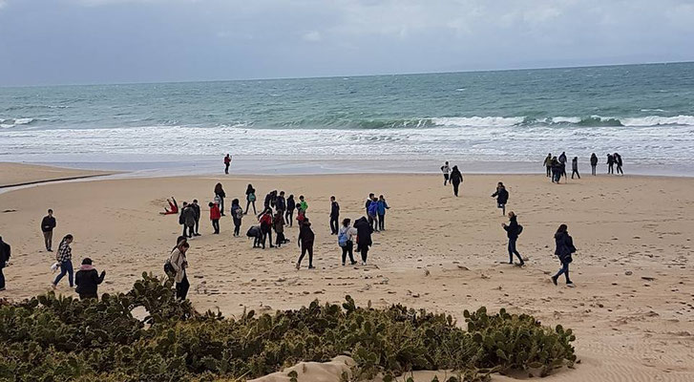
Thursday
We went to Bolonia ruins
At 12:00 went to the beach.
In the afternoon we went played paintball.

