Slide 1
The Saturn’s temple
A presentation of Alessandro Doro

Slide 2
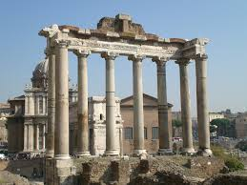
A short introduction
The construction of the Temple of Saturn started in the royal period but was only inaugurated in the early years of the Republic, probably in 498 BC.
The building was completely rebuilt from 42 BC by Lucio Munazio Planco with the spoils of the war of Syria and restored after the fire of 283 AD by the Senate: this last restoration belonged to what remained of the temple.

Slide 3
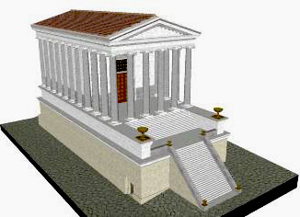
Reconstruction of the temple
The grandiose podium covered of travertine belonged to the restoration of Munazio Planco, internally empty, guarded the Treasury, or the Treasury of the Roman State. In front of the façade there was a forepart (today almost completely destroyed) having inside a very large environment, which was most likely intended for the Aerarium.

Slide 4
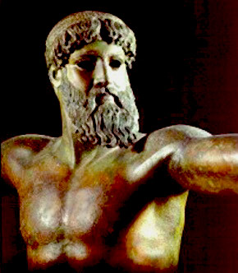
The Temple of Saturn is the oldest sacred place in Rome after the Temple of Vesta and Jupiter, the temple contained a statue of Saturn that was filled with oil and wrapped in woolen bandages. During the Saturnalia, the festivities held from December 17th to 23rd, the bandages were removed, when a public banquet was held.

Slide 5
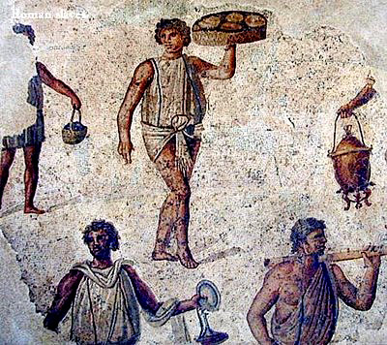
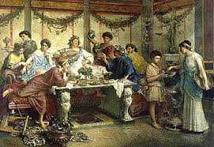
During the seven days of celebrations, the most famous in Rome, the social order based on masters and slaves was subverted and the owners put themselves in charge of their slaves at mealtimes. In this place there was a very ancient altar, to be connected, according to tradition, to the mythical foundation of the city on Campidoglio.
A Roman slave
A Roman lunch

Slide 6
Thanks for the attention!

