Slide 1
An Amazing Adventure through two Patrimoial Cities:Rome and Seville
PAULA MANRIQUE AND ALESSADRA GIANI

Slide 2
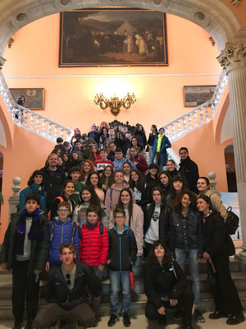
TUESDAY
*First, at quarter past eight we had an Andalusian’breakfast. Then, we went to the town hall. At half past twelve, we went to the cathedral and the giralda. We ate in the city centre. After the lunch, we went into the Antiquarium.

Slide 3
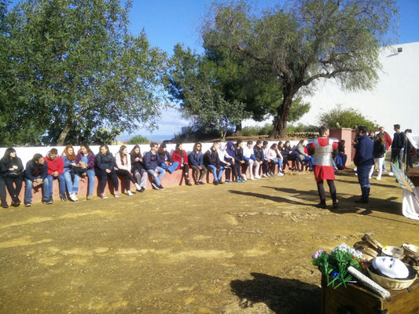
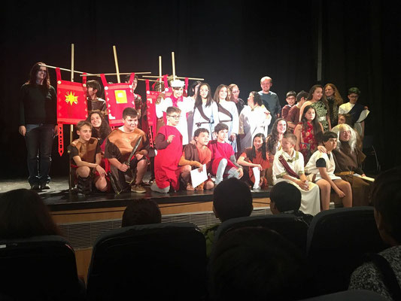
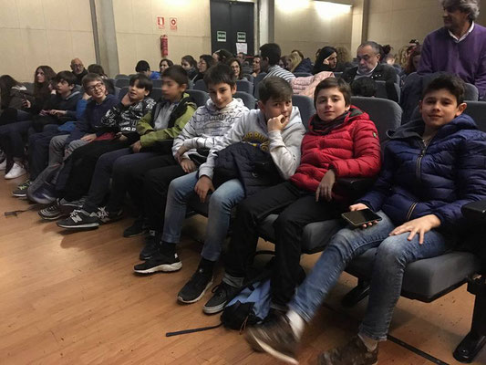
WEDNESDAY
* This day, we went to Carmona(we learned rites and customs of Rome).
In the afternoon we went to the Civic Centre. We did a theatre. And then they saw a exhibition of Flamenco.

Slide 4
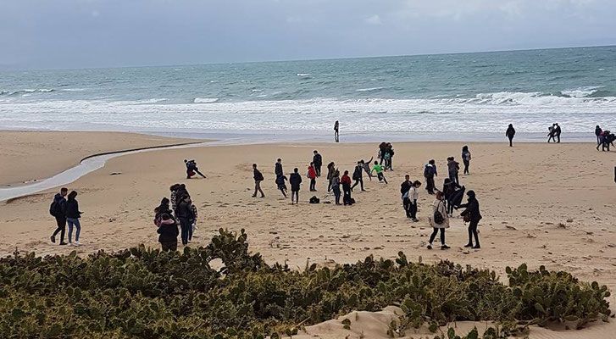
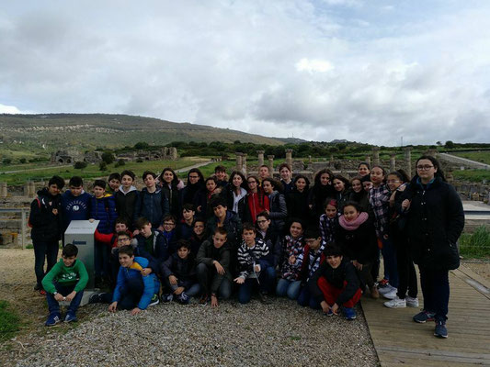
THURSDAY
*We left at half past seven and we went to Baelo Claudia, Bolonia. We had a lot of fun. We visit the ruins and the museum. And then we had the breakfast. After that, we stayed in the beach. In the afternoon, we went to the paintball and we had a lot of fun. We had dinner there.

Slide 5
FRIDAY
*Today all the student, have been working with the computer. In the afternoon, we are going to Italica and eat in Ventorrillo Canario.

