Slide 1
An Amazing Adventure Through Two Patrimonial Cities: Rome And Sevilla

Slide 2
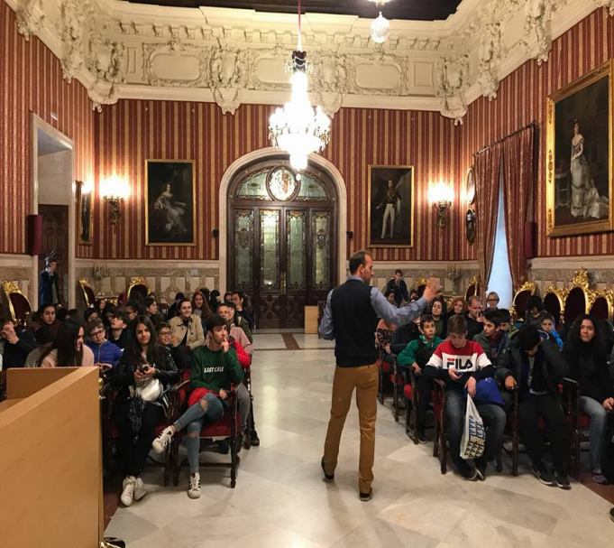
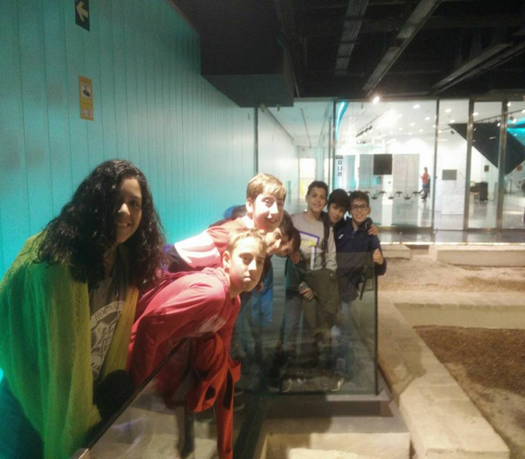
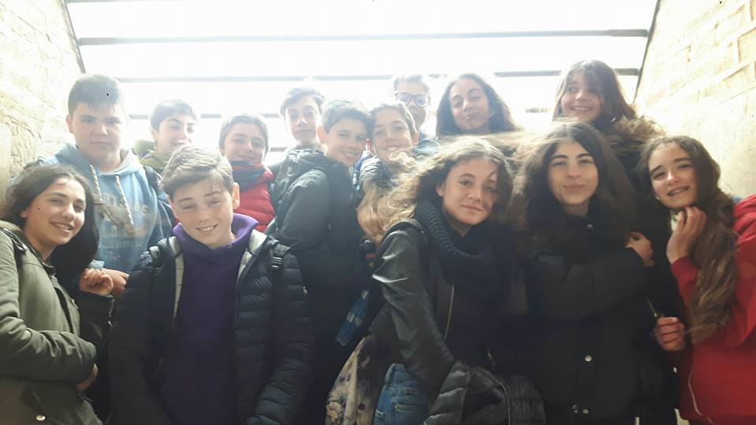
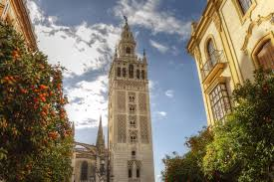
TUESDAY
On Tuesday all the people go to the center and see the Town Hall, the Giralda and the Anticuarium

Slide 3
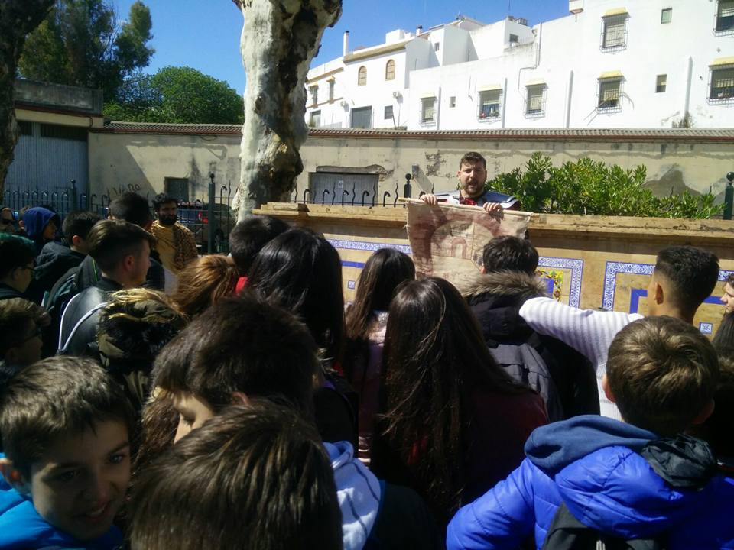
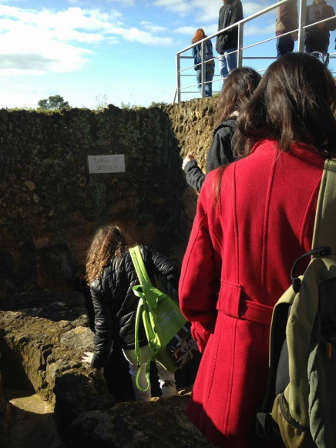
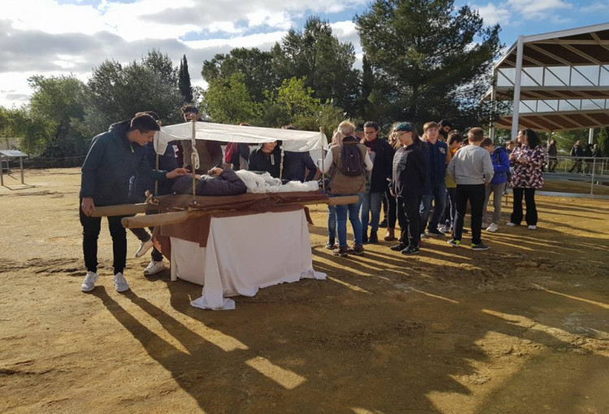
WEDNESDAY
On Wednesday 1B go to Carmona’s Necropolis , where we perform a small theatre and go to a castle

Slide 4
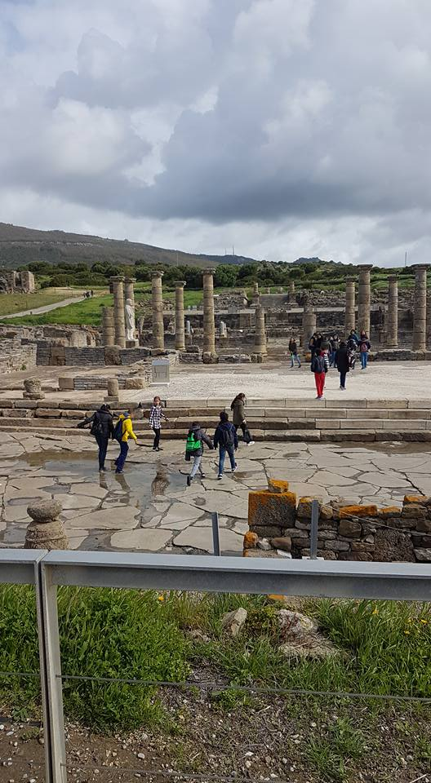
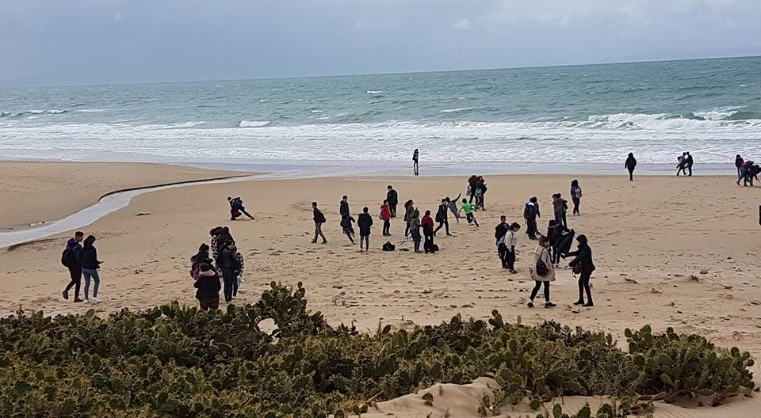
THURSDAY
On Thursday 1ª go to Bolonia and see the ruins and go to the beach

Slide 5
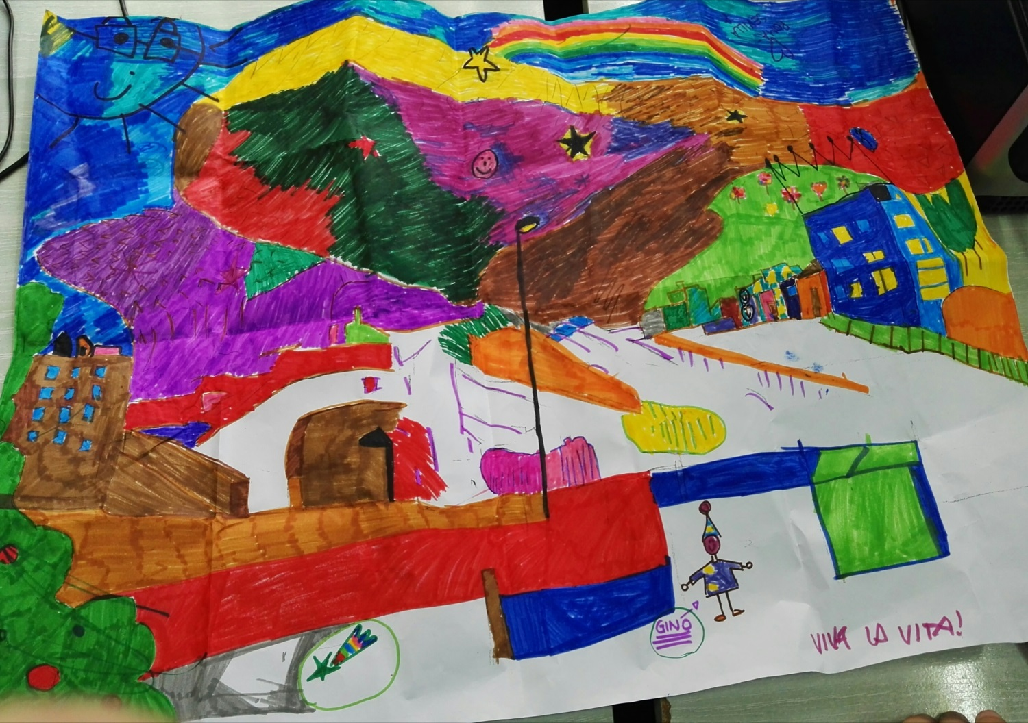
FRIDAY
Today we stay in the school and do this presentation and draw

