Slide 1
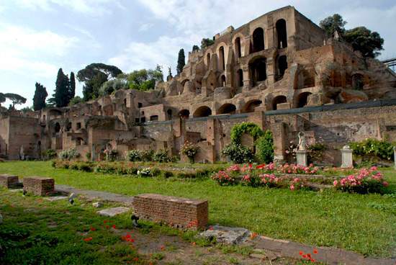
PALACE OF TIBERIUS Made by Leonardo mastrantonio

Slide 2
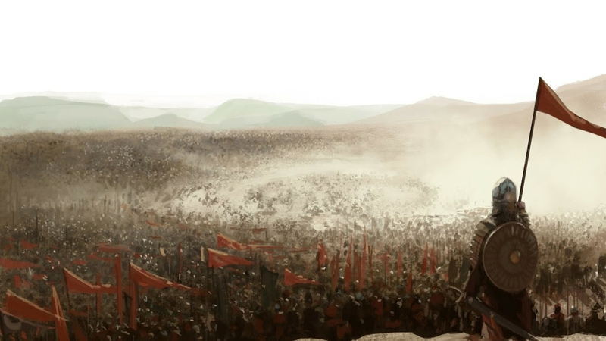
Summary
Pag. 3: Who was Tiberius
Pag. 4: How was the palace
Pag. 5: The two periods
Pag 6: Roman empire and now

Slide 3
Who was tiberius
Tiberius was a Roman emperor. He was born in 42 BC and died in 37 AD. His mother, Livia, married emperor Augustus, who became Tiberius's step father.
Tiberius built a huge villa on the Palatine hill, like his step father Augustus. The emperor Caligula, Tiberius' nephew, continued to build the Tiberian Domus. Emperor Nero finished it.
Tiberius

Slide 4
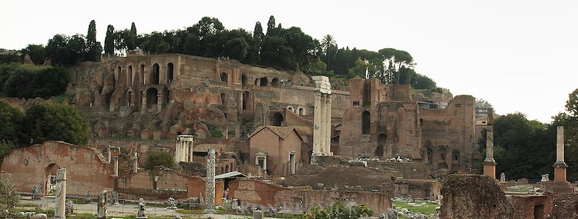
How was the PALACE
Initially the palace could have been 150 meters long, 120 meters large, and about 20 meters high, but then it was enlarged on each side.
In the center there was a very big peristily and around that there were some rooms.
In the south part of the domus there was Livia’s house, with 18 rooms.
Tiberian domus

Slide 5
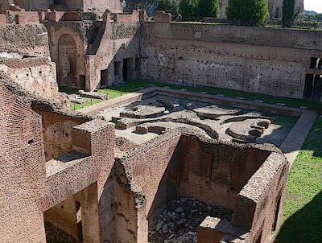
The 2 periods
In this part of construction we have two historical periods, Domitian’s age and Adrian’s age.
The rooms of the Domitian’s age were all around one big room.
In the rooms of the Adrian’s age we can see some calculation and drawings of coins, so we might think that the it could have been the revenue headquarters.
Tiberian domus

Slide 6
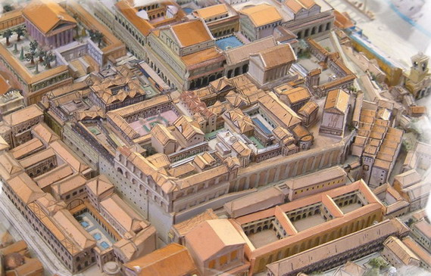
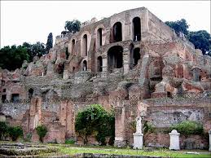
Roman Empire
Now

Slide 7
THANKS FOUR YOUR COOPERATION

