Slide 1
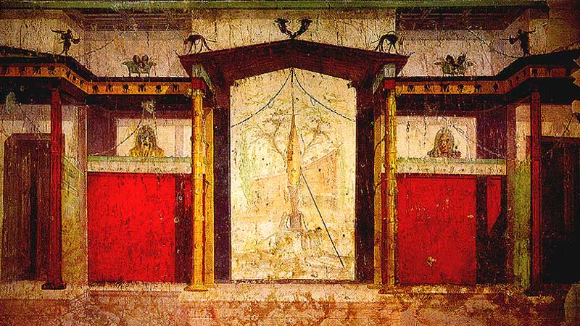
The Augusto’s house
Done by Rachele Iori

Slide 2
What is that and where is it?
The house of the emperor Augustus,or the Domus Augusta served as the primary residenceof Augustus during his reing; is on the Palatine Hill, is a History place and there are some elegant examples about Roman pictorial decoration in a private setting. The spaces that today can be visited are accessed by a ramp, both on the ceiling and walls, with frescoes; the two small rooms on either side were probably used to host visitors whereas the final room, on the highest level, was for the emperor's private and exclusive use.The expressive style of the décor dates the rooms to the mid "second style", between the late first century b.C. and the early first century A.D.: the official halls, where guests were hosted, are clearly more austere, whereas Augustus' private study presents fantasy and airy motifs, highlighted by the well-preserved brightness and colour.

Slide 3
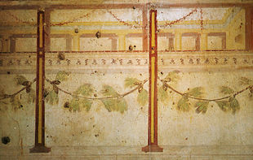
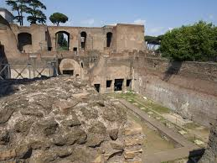
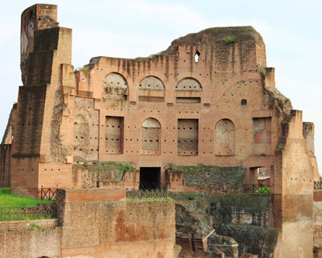
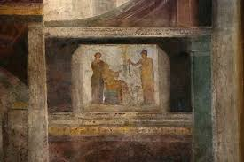

Slide 4
The story
After being awarded tribunica potestas for life in 23 BC, Octavian decided to buy the house of Quintus Hortensius on the Palatine and made it his primary place of residence. It was in keeping with the return to traditional ideals promoted during the Augustan period, and it was located near the Hut of Romulus. In antiquity this residence contained two levels, each leading to a garden courtyard. The bottom floor is not accessible today, but it is possible to make out the basin of a fountain and the rooms beyond it that were paved in coloured marble.
He lived at first near the Forum Romanum, afterwards on the Palatine in a modest dwelling remarkable neither for size or elegance, having but a short colonnade with columns of local stone and rooms without any marble decorations or handsome pavements. He used the same bedroom in winter and summer.

Slide 5
The architectural and artistic structure
Some of the rooms containing the most spectacular wall paintings are known by their recurring motifs: the “Pine Room”, the “Room of the Masks”, the “Room of the Perspective Paintings”. The first two rooms were domestic cubiculae (bedrooms). They occupied the western section of the house.
The architecture depicted is a one-storey structure with a central recess and narrow side-doors on each side, probably evoking a scaenae frons, a wooden theatre stage building.
The frescoes located at the top of the south and north walls depict a simple single-level, stage-like structure with human figures in different poses. Underneath are painted bands with acanthus stem and floral design. One of the female figure wears a cloak as well as a rich diadem and necklace while others are carrying votive offerings.

Slide 6
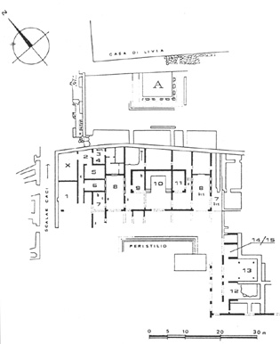
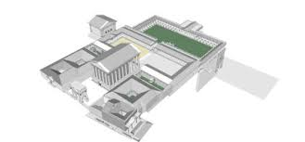
The map of Augusto’s house

Slide 7
The optical illusions
Illusionistic painted coffering on the vault of the “Ramp Room”, the painter emphasized the depth effect by using appropriate shading.
The ceiling is decorated with a painted pattern of rhomboidal and square coffers containing rosettes, whose relief was suggested by the use of shading as well as by means of perspective. The frames were rendered in shades of red, yellow and white, the inner moulding in orange, yellow, blue and green, and ornaments of the coffers in purple, black, white and yellow.
Illusionistic painted offering on the vault in the “Ramp Room”.

Slide 8
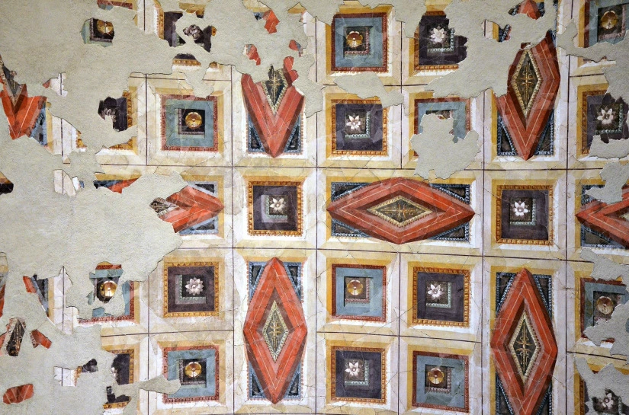
The ramp room
Illusionistic painted coffering on the vault in the “Ramp Room”.

Slide 9
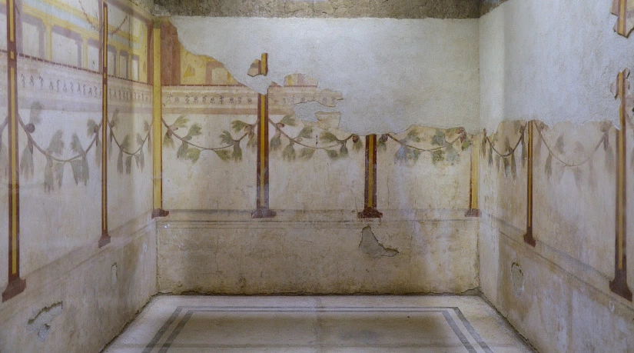
The others roomsof the domus Augustea :
The Pine Room: decoration with pilastered portico and pine festoons.

Slide 10
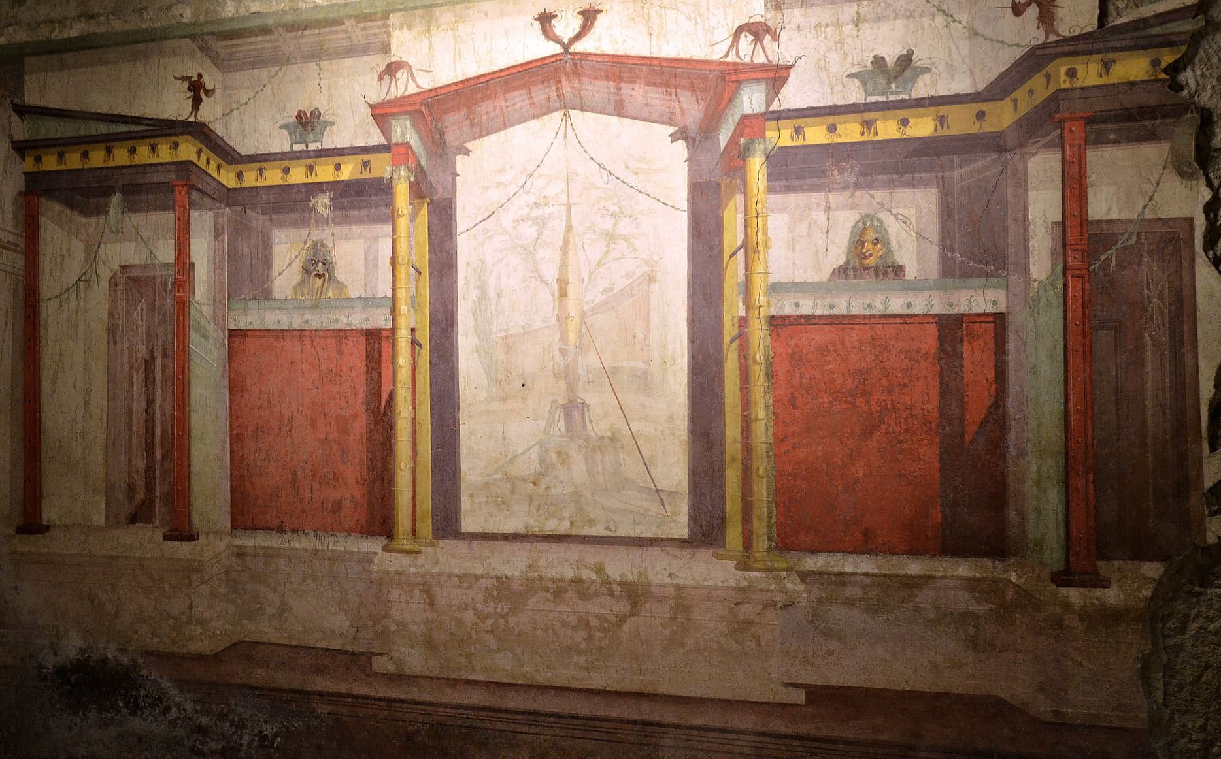
South wall of the Room of the Masks in the Second Pompeian style.

Slide 11
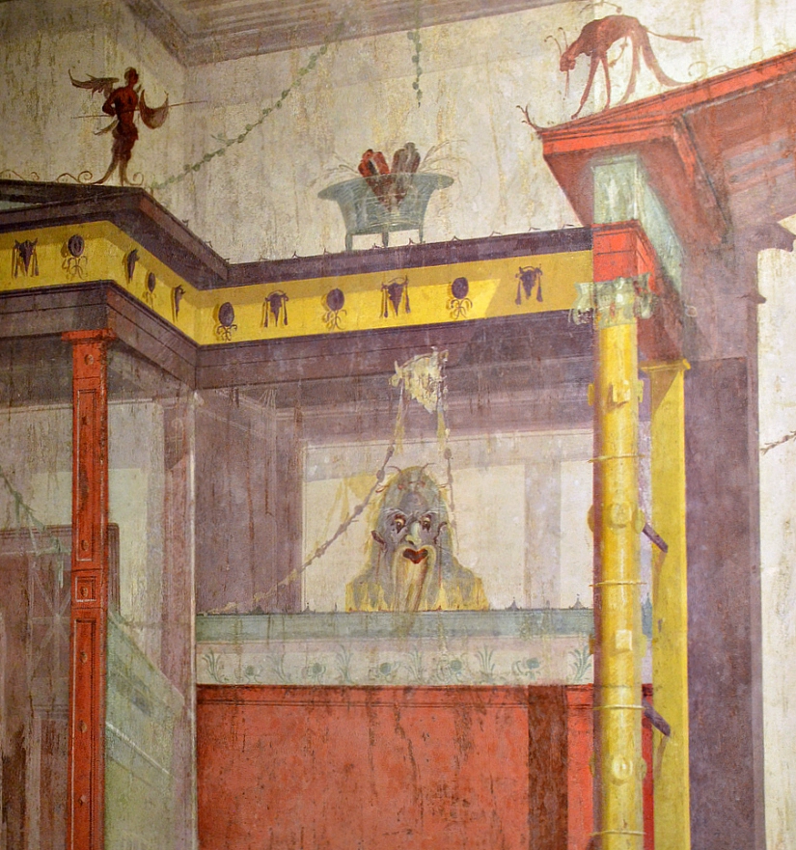
Detail of South wall of the Room of the Masks.

Slide 12
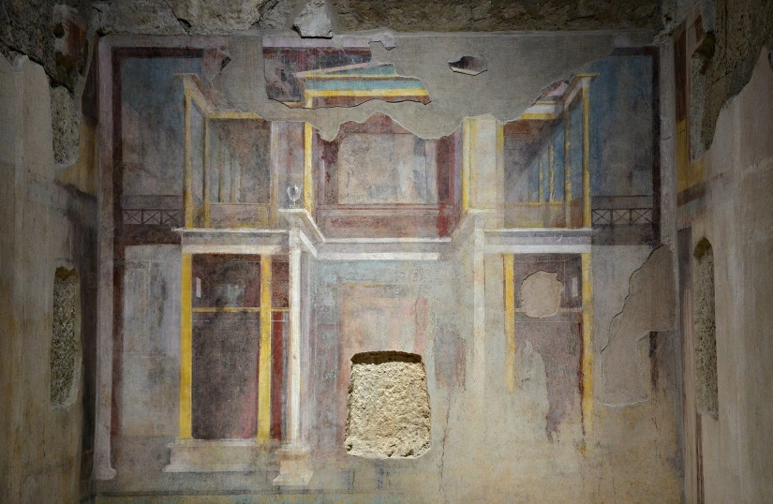
The Room of the Perspective Paintings: architectural composition with perspective rendition of colonnades.

Slide 13
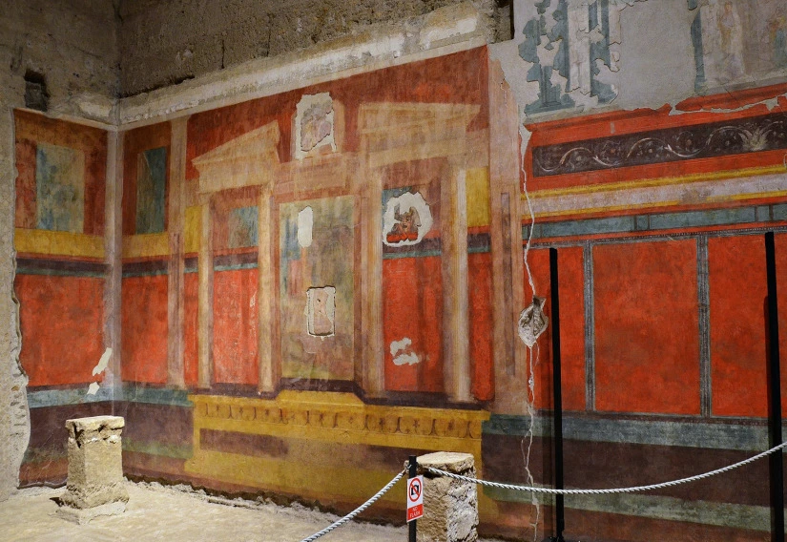
South wall of the “Large oecus” with architectural wall painting of the Second Pompeian Style.

Slide 14
Thank you for your attention!

