Slide 1
ERASMUS+
di:
Jose Antonio
Francesco Carbone

Slide 2
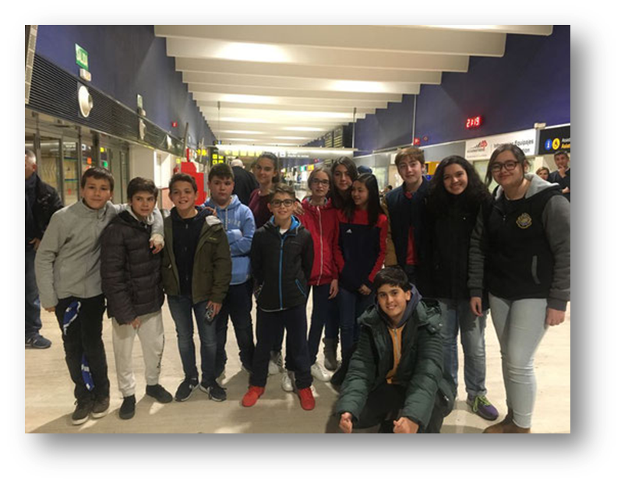
MONDAY
Francesco arrived to Spain at 9:30
We ate tortilla of potato

Slide 3
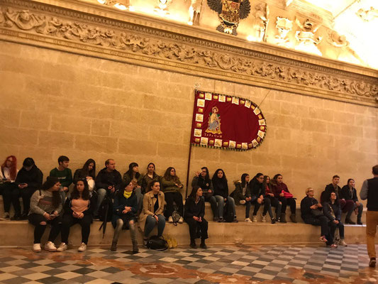
TUESDAY
At 7:00 we woke up and make breakfast.
At the 10:00 we went to town hall.
At the 12:30 we went to the Giralda
We ate the sandwich at 15:00
At 16:00 we went to Anticuarium
At 17:00 we went to the high school

Slide 4
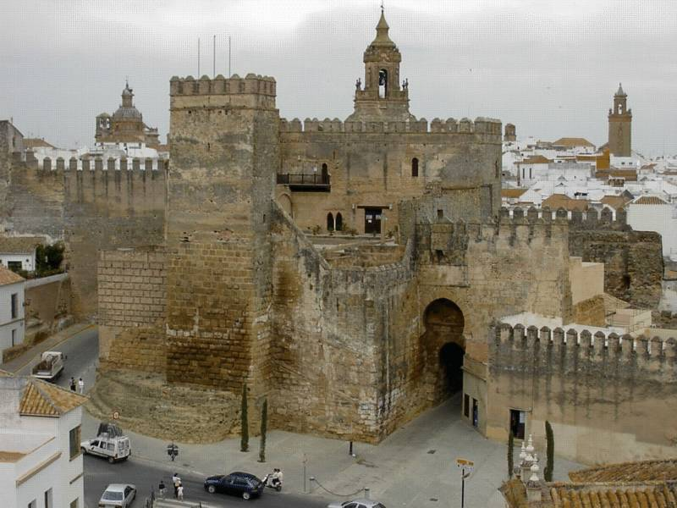
WEDNESDAY
We went to Carmona at 8:30
We visited the necropolis at 9:15
We went to the park at 13:15
We ate in the park
We visited the Alcazar of Carmona
And the spanish class did a roman teatre

Slide 5
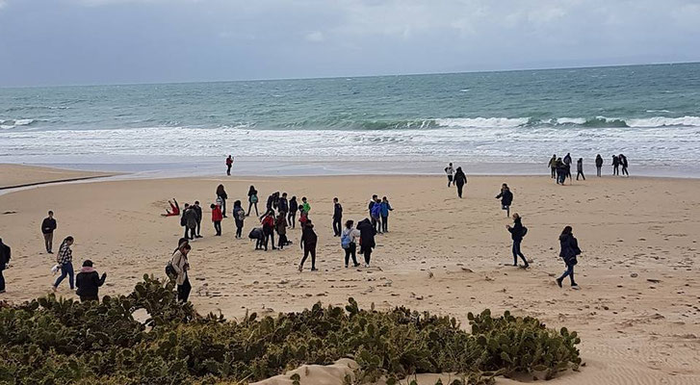
THURSDAY
We went to Bolonia ruins
We went to the beach
In the afternoon we played paintball

