Slide 1
SALVADOR CHURCH

Slide 2
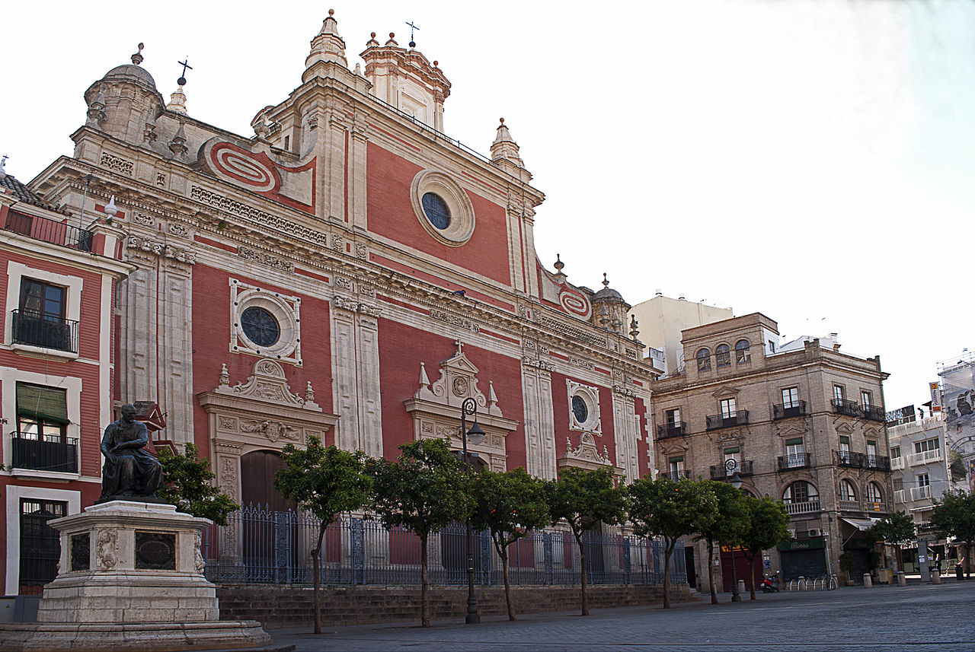
In Seville we have many churches. One of the main christian temples in the city is Salvador Church.
It is located in Salvador Square one of the most famous and touristic places in our city.

Slide 3
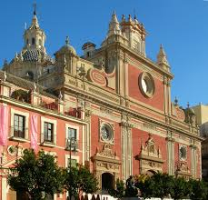
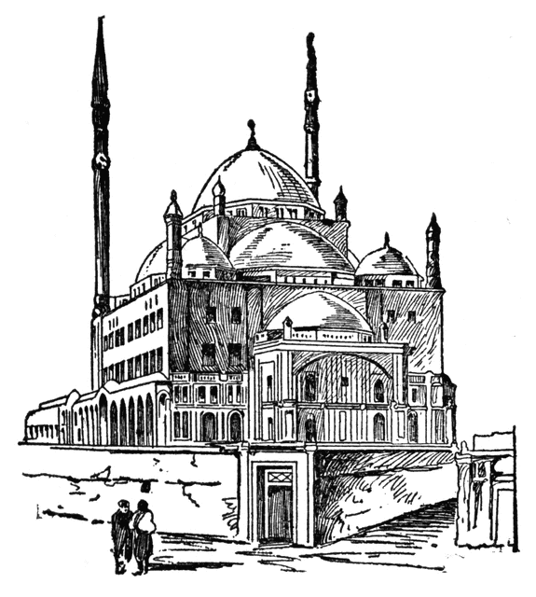
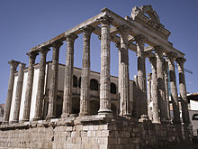
This building shows the different cultures living in the city through the Centuries: Romans, Muslims and Chritians.
LA IGLESIA DEL SALVADOR: Current building
2. Muslim Mosque
1- Roman building.

Slide 4
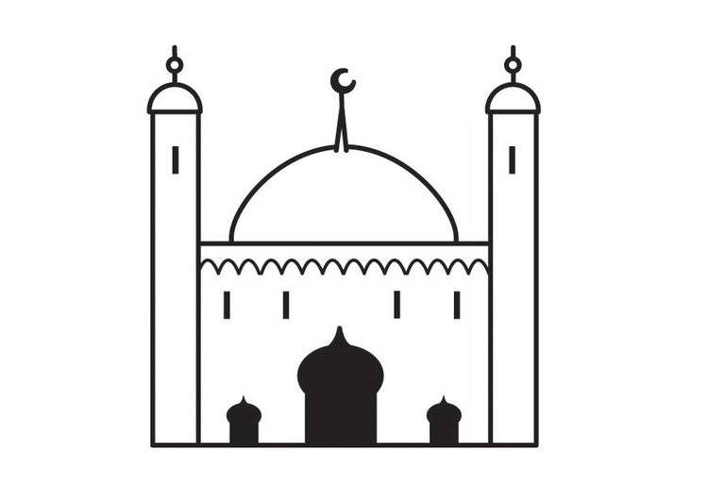
MUSLIM BUILDING
It was based on the remains of the Mezquita Mayor, which was then the main mosque of Seville. From this Arabic building of the 9th century, still remain its Patio de Abluciones and the basement of its tower.

Slide 5
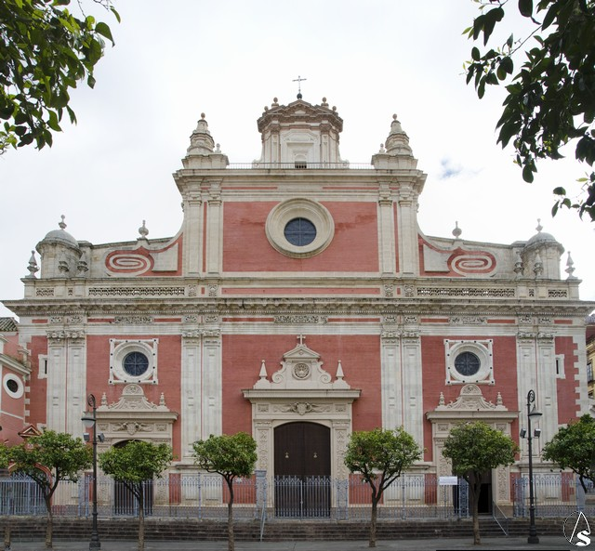
SALVADOR CHURCH
This amazing baroque church was built between 1674 and 1712. The red-brick facade is actually Mannerist in style.
Mamma mia, brilla piú del sole!

Slide 6
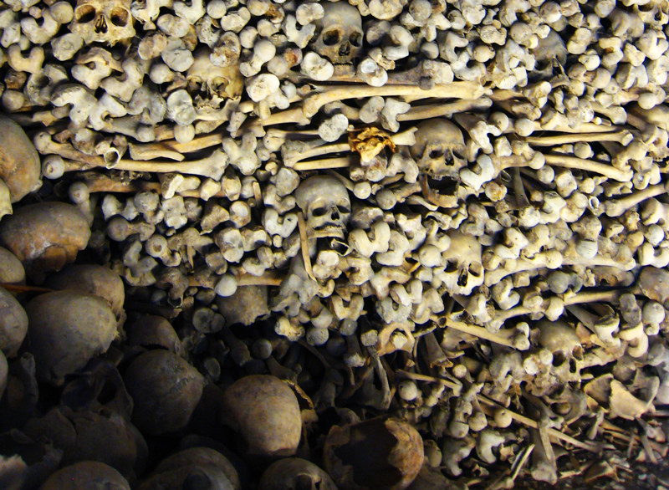
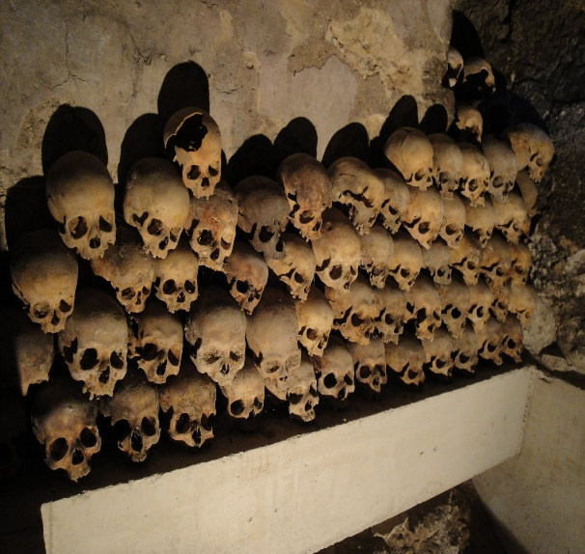
Crypt
Salvador Church is visited by people from Seville and from other countries.
Underneath the church we can find an ancient crypt where children were buried. There are more than seventy children skulls.
Mondie! che atrocitá é chesta?

Slide 7
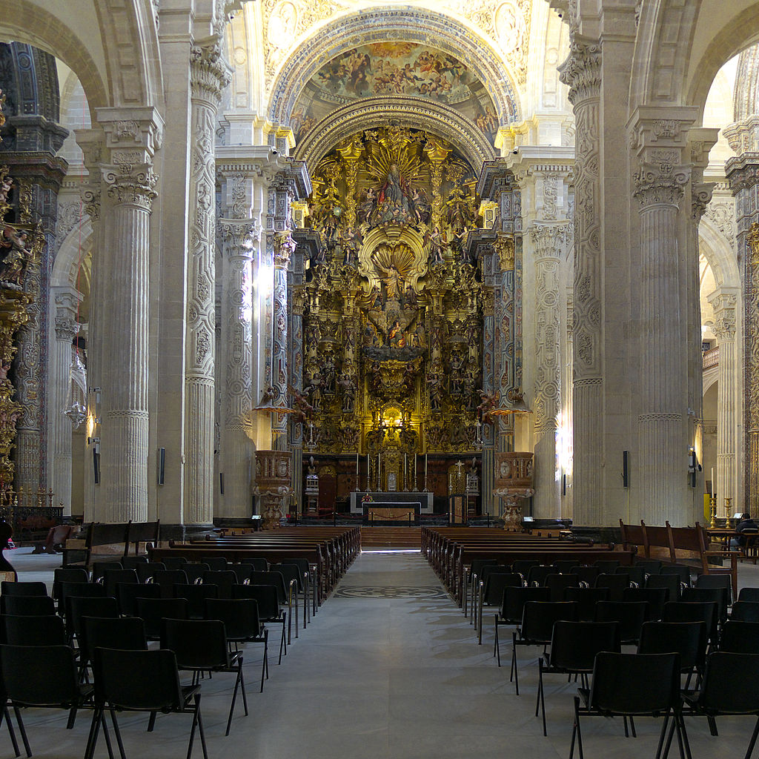
Inside the church there are many religious scultures and decorations.

Slide 8
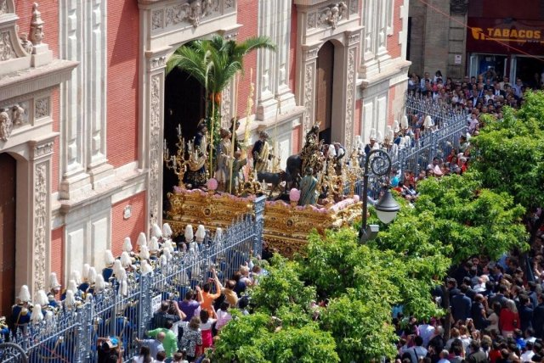
The Holy Sunday, from this building, ‘La Borriquita’ starts its way through the city.

Slide 9
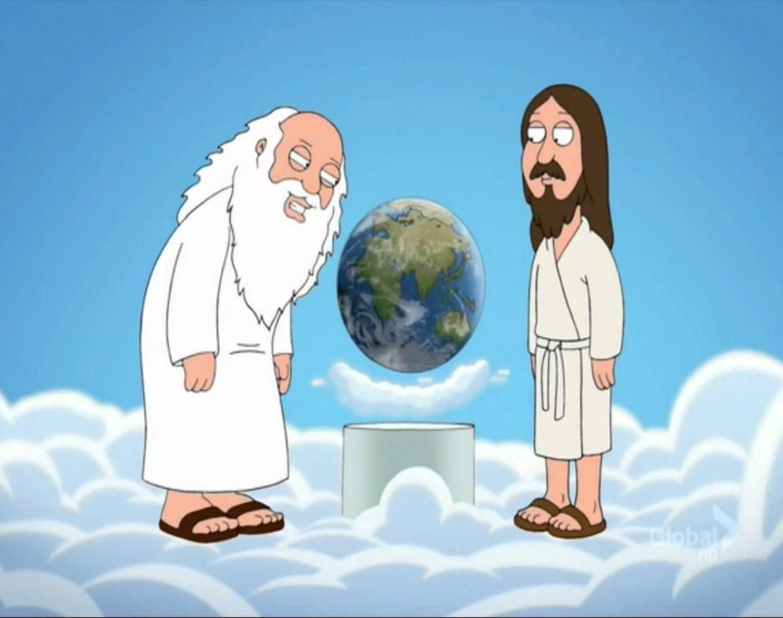
FIN
This ‘Salado Church’ is really small…!!!
Not Salado. No!
It’s Salvador! And it is in Spain, not in Norway!!!
I hope you enjoyed my presentation!!!

