Slide 1
An Amazing Adventure through two Patrimonial Cities :Rome and Seville
By Miriam Benjumea Santisteban and Rachele Iori

Slide 2
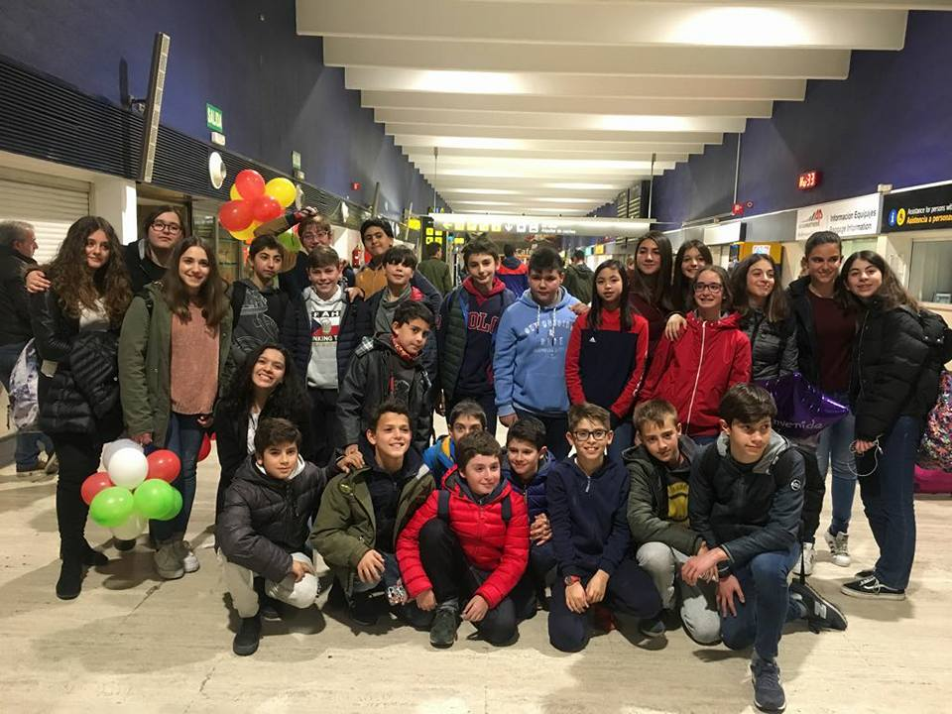
Monday
In the evening the Italian boys and girl arrived in Seville airport

Slide 3
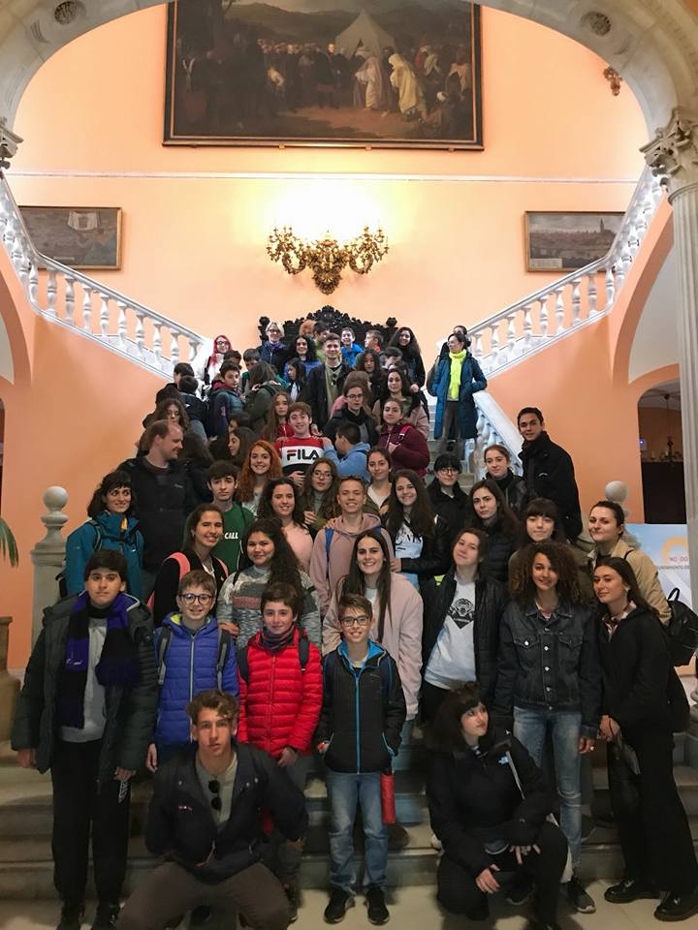
Tuesday
After attending the presentation of the school, the teachers and the principal, we went by public transport to visit the Cathedral and the Giralda and the city center.

Slide 4
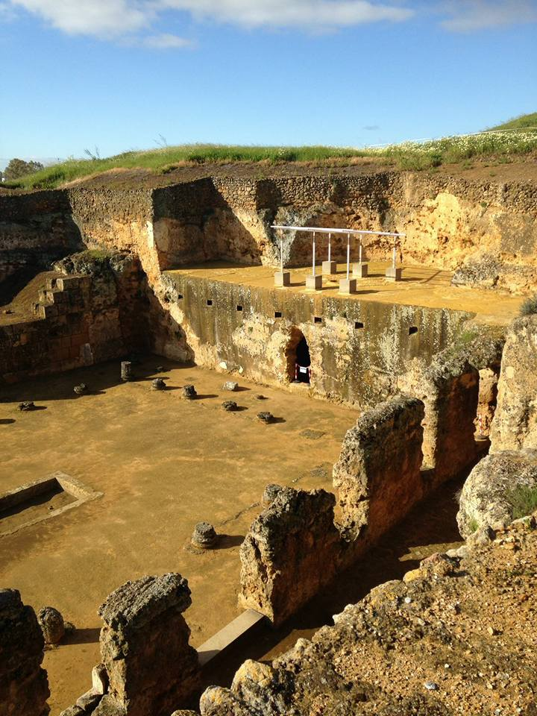
Wednesday
We go to Carmona and we carry out cultural activities and in the afternoon we go to the theater.

Slide 5
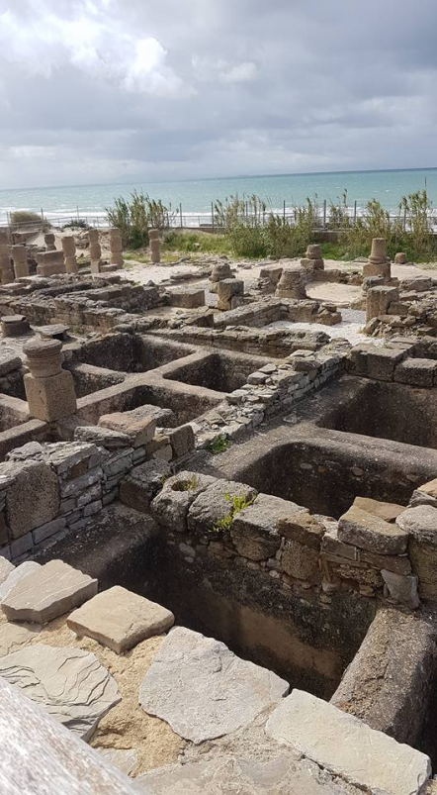
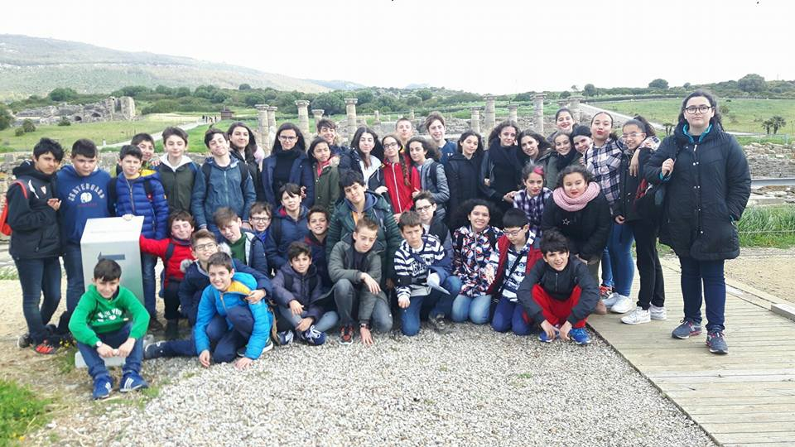
Thursday
We go to Bologna to see the necropolis and then we go to the beach

