Slide 1
DOMIZIANO’s Palace
di Leonardo Milana

Slide 2
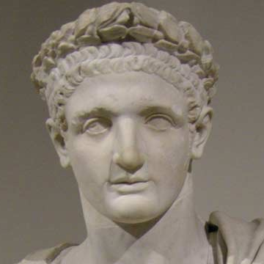
Domiziano
The Domiziano's Palace is a big building in the south est zone of Palatino.
It was the emperor's house and it had functions to govern the Roman empire.
The architect was Rabirio; he worked in the age of Tito Flavio Domiziano.
Under this palace there were other buildings of previous age.

Slide 3
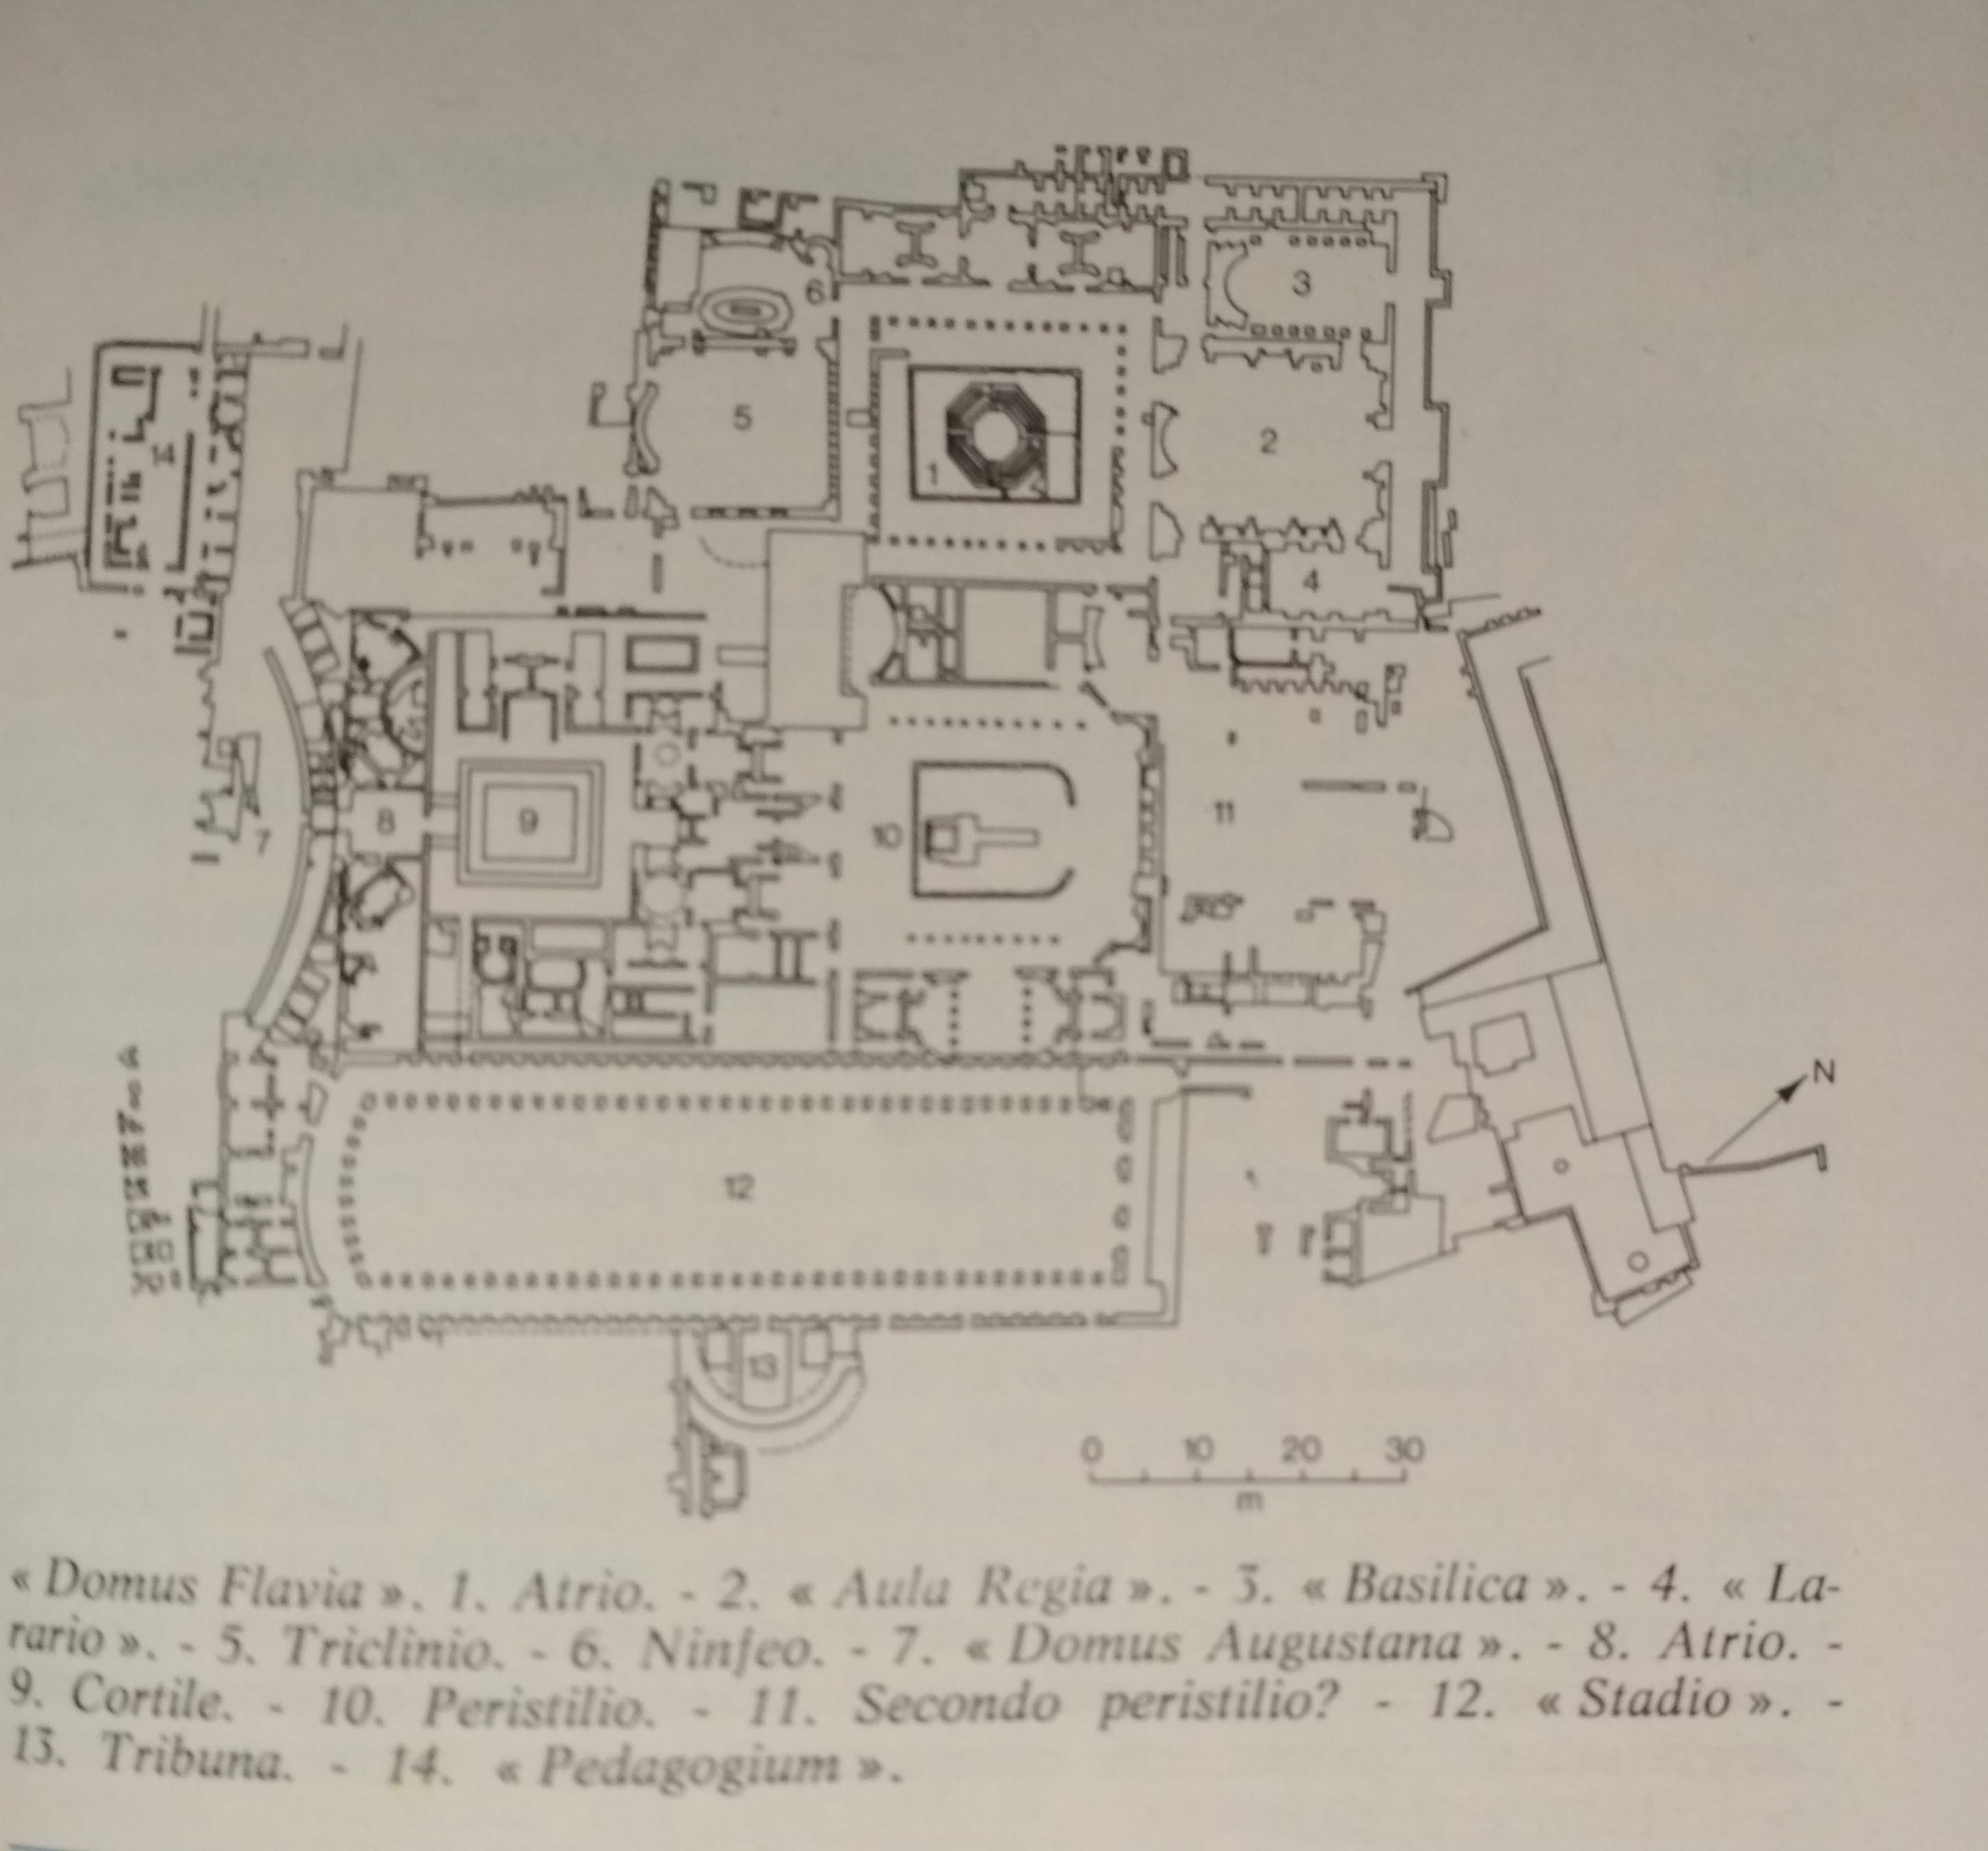
There are three areas: the first is the Domus Flavia, the official palace; the second one is the Domus Augustana, the emperor private house; the third one is the Stadium.

Slide 4
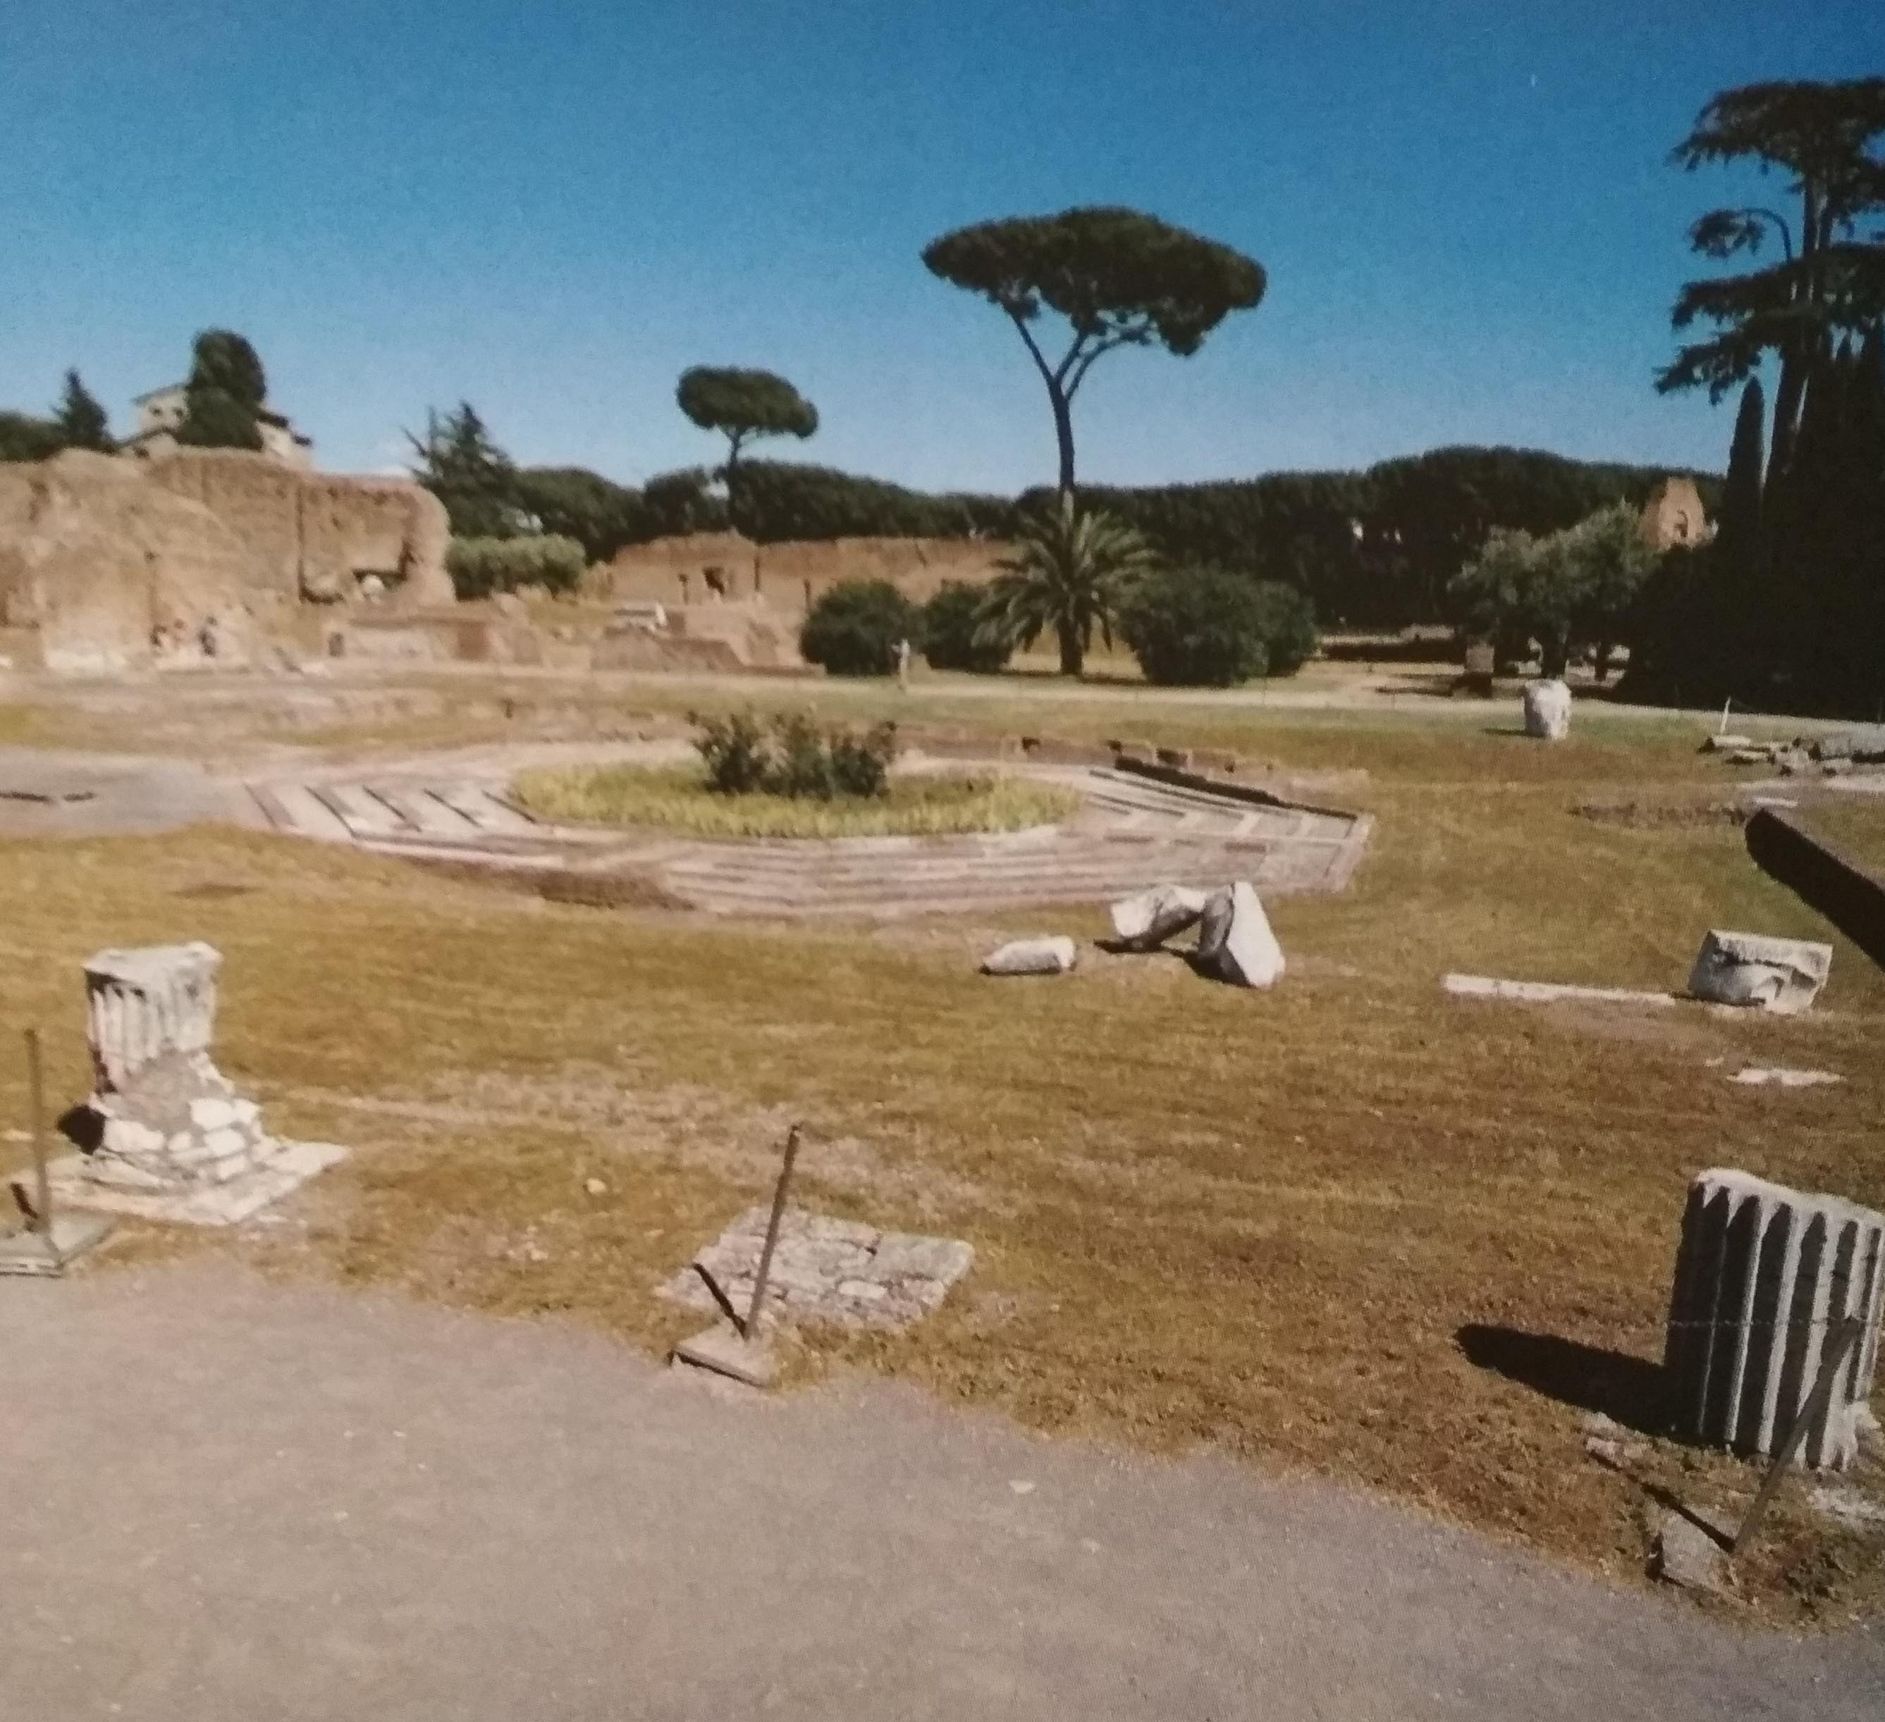
domus flavia
In the centre of Domus Flavia there is a rectangular peristyle, with an arcade, marble columns and an octagonal fountain.
According to the literature Domiziano loved walking in this arcade; it was covered with marble to let reflected imagines that allowed the emperor to watch out for enemies.
In the peristilio there are:
⁻ the Aula Regia, with alcoves and statues. In this area there were the salutationes to the emperor; he was in the centre like Dominus et Deus (Lord and God);
⁻ the Basilica, where the Empire's politics was decided;
⁻ the Larario, the religious area with the praetorian guards;
⁻ the Cenatio Iovis, triclinio, was the dining room, with a marble floor above the hypocaust. (a dual floor system used to warm the rooms); near it there were some oval fountains with water games.

Slide 5
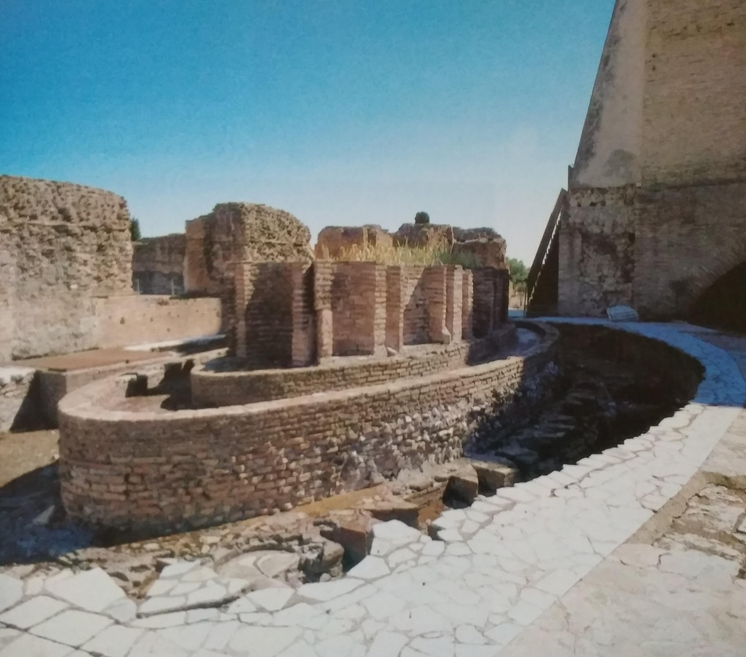
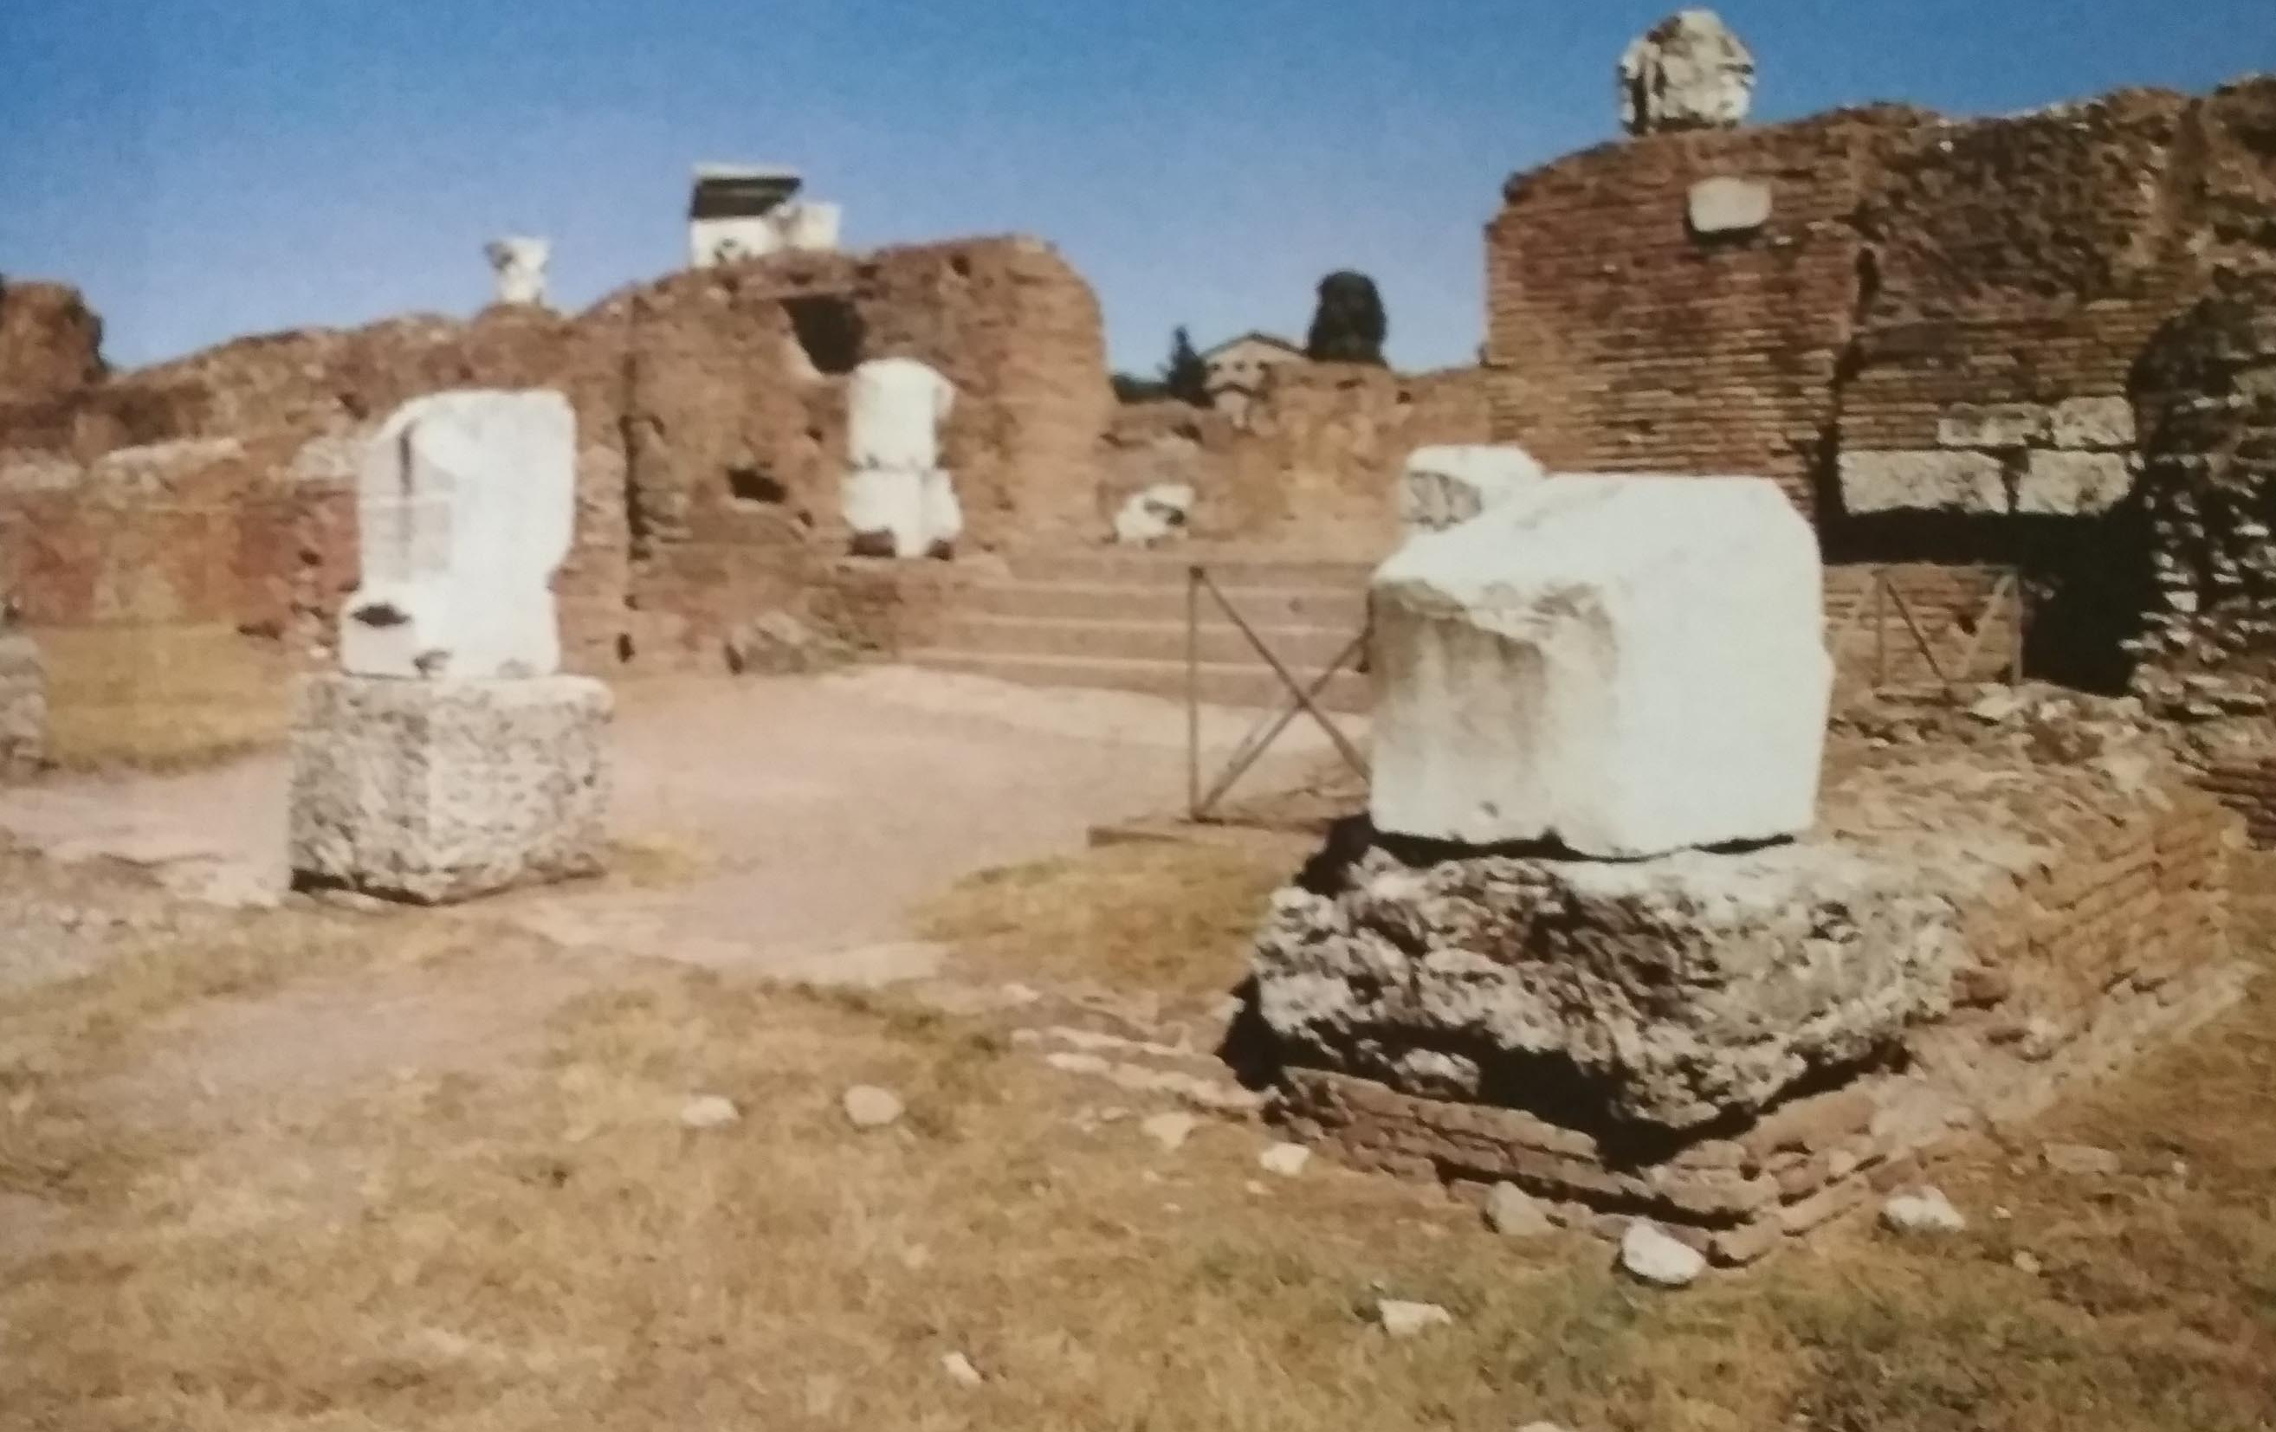

Slide 6
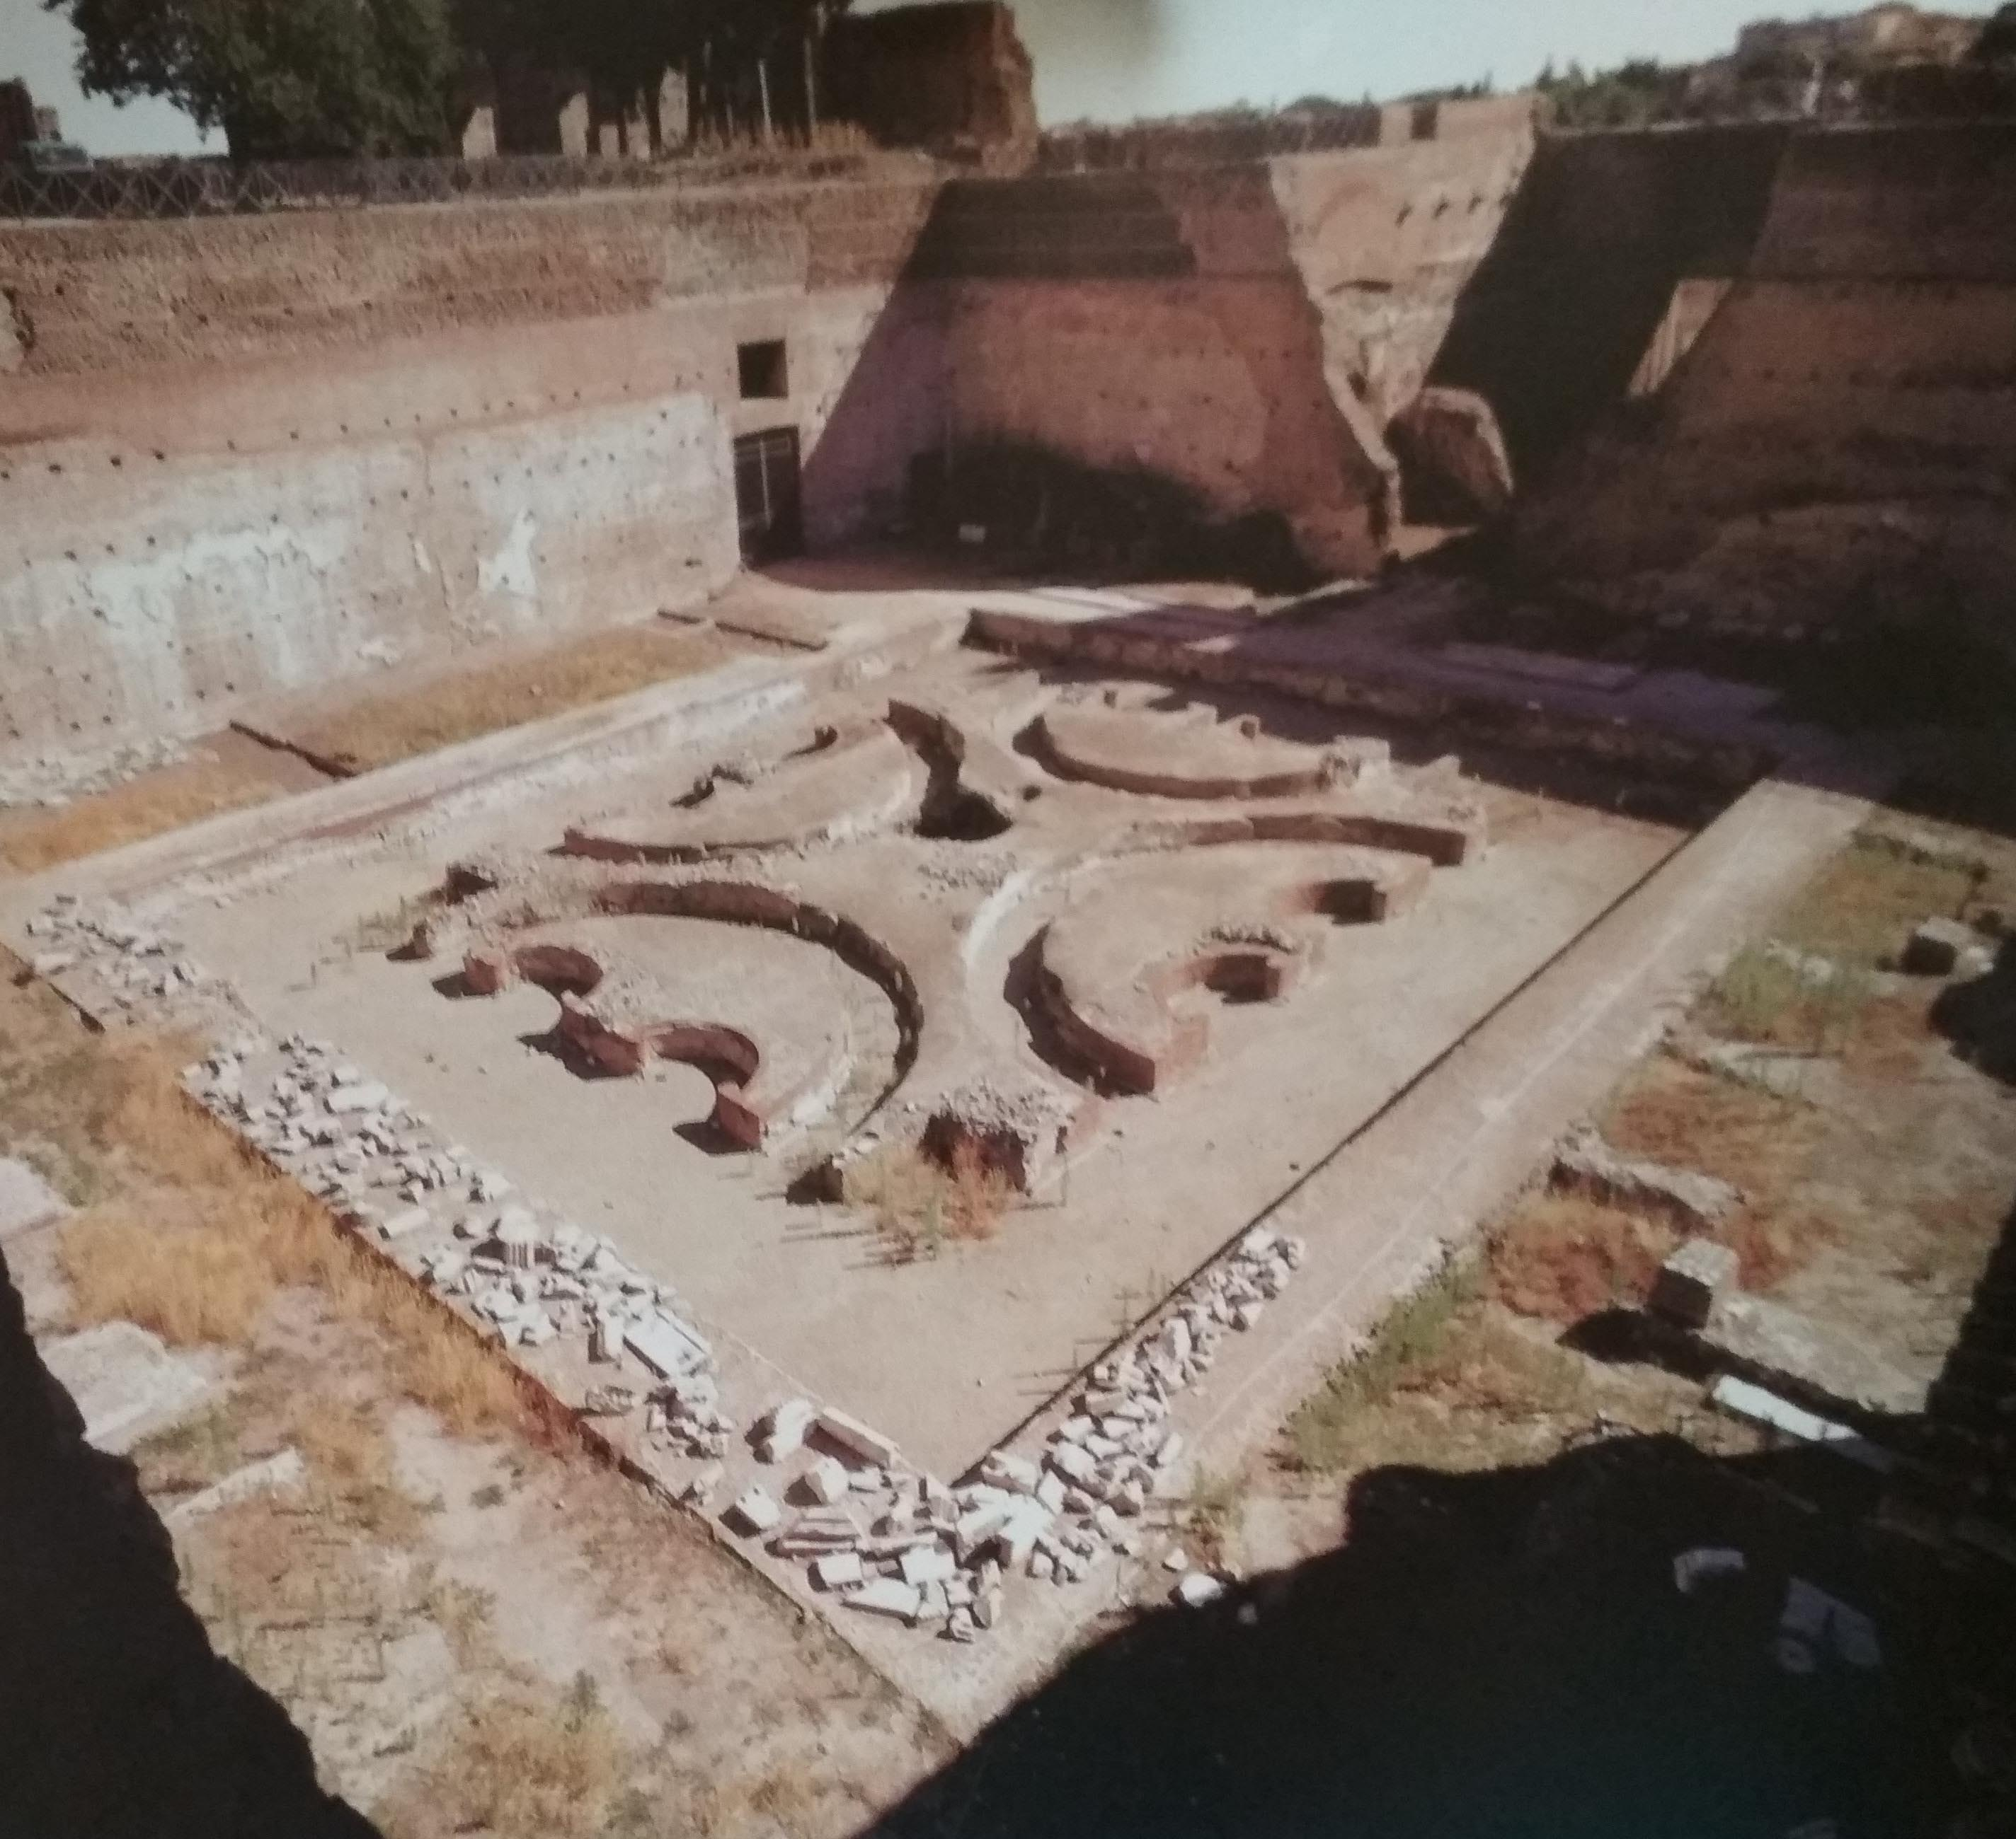
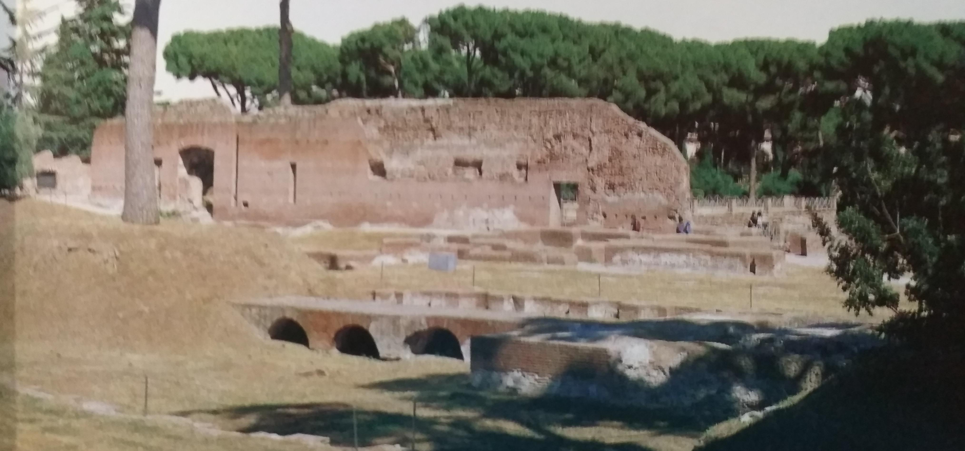
Domus augustana
Next to Domus Flavia there was another area: the Domus Augustana, a big building that was the emperor’s private house. In the centre there was a small temple for Minerva, the divinity that protected Domiziano. Under this area there was an inferior peristyle (10 metres), with a fountain.
There were also a courtyard and a big Esedra (towards Circo Massimo).

Slide 7
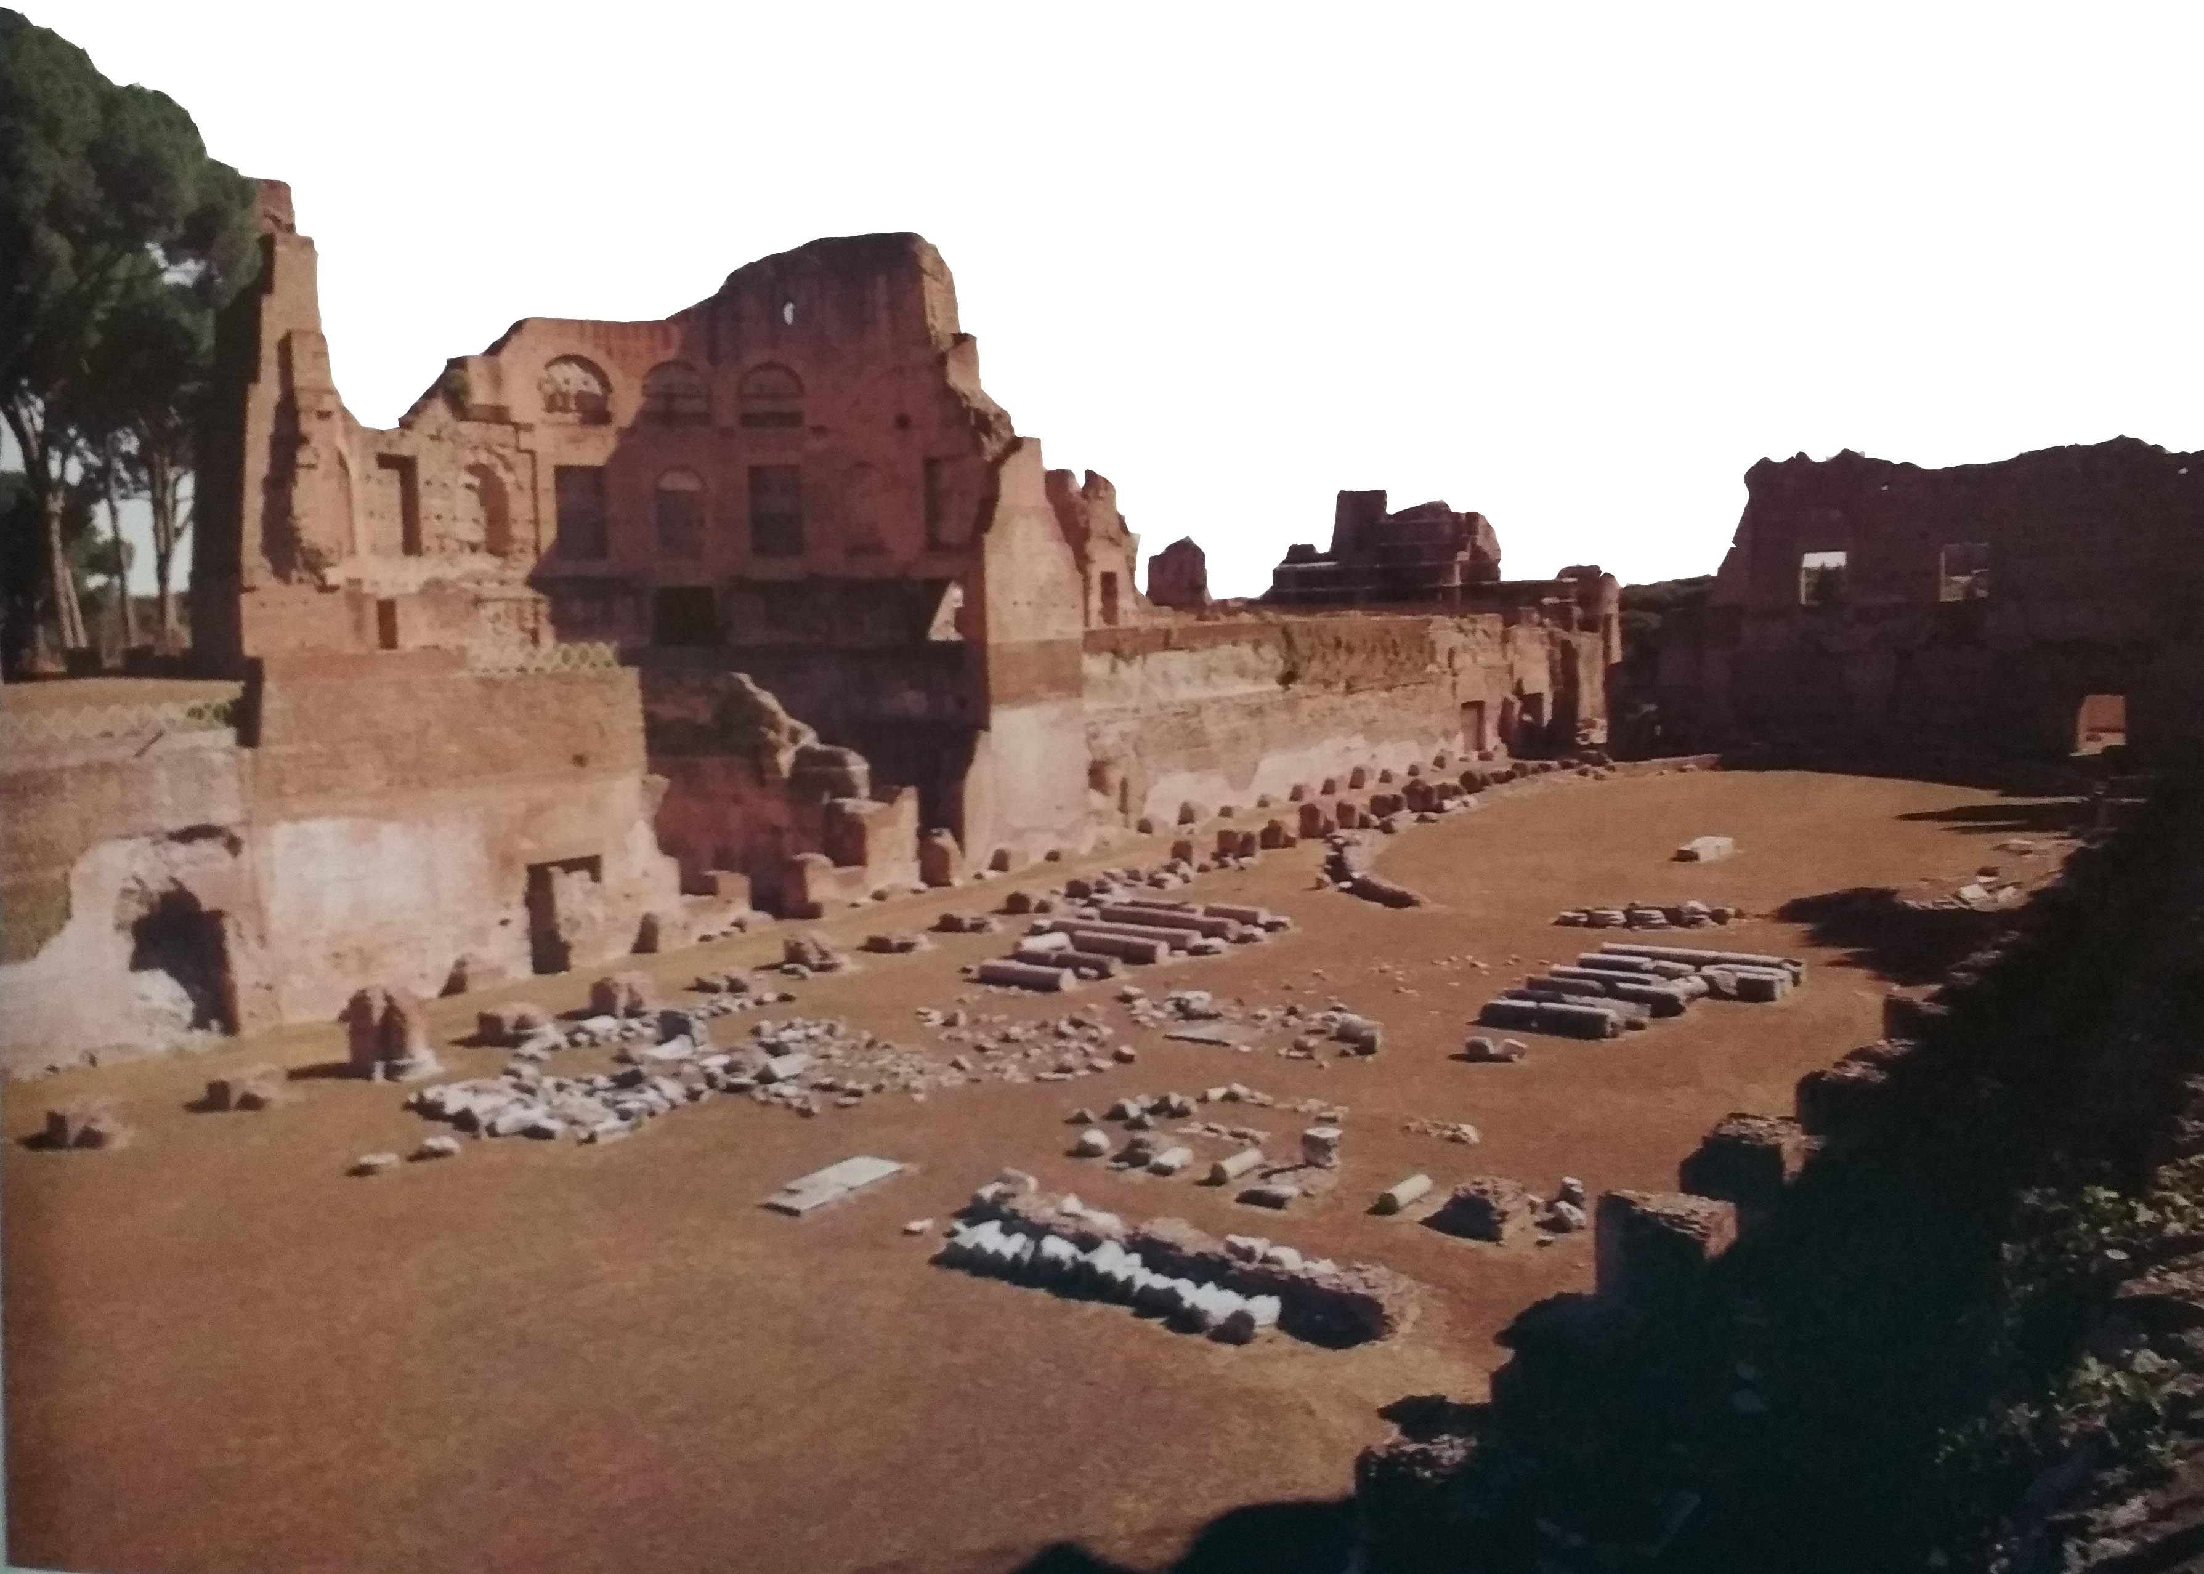
stadium
The last area of the Palace was the marbling Stadium; it was 150 metres long, with a double arcade and a spine in the middle. The emperor’s family walked here.

