Slide 1
ITALY & SPAIN
An amazing adventure through two patrimonial cities: Seville & Rome

Slide 2
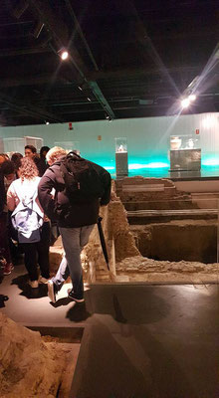
Antiquarium
Antiquarium is a
Roman museum
underground
is in the center of seville.

Slide 3
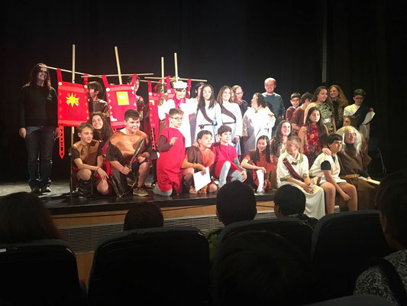
Theatre
The theatre was on Wednesday afternoon
The theatre was in Bellavista and is called BRAGGART SOLDIER

Slide 4
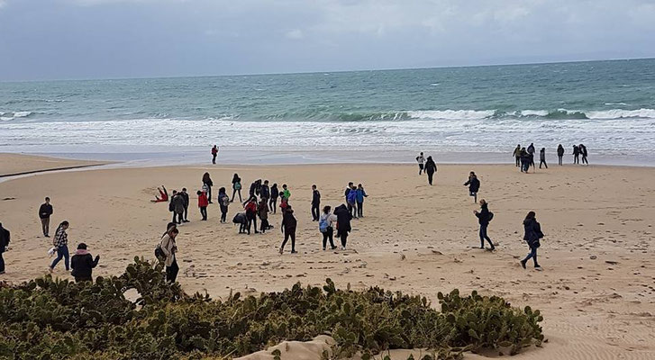
Bolonie
It is in Cadiz, the ruins of Baelo Claudia.
There is a beach.

Slide 5
My Personal Opinion
The monuments in Spain are very beautiful and interesting. (Mattia Bolognese)
The monuments are impressive and I'm proud of having them in Seville. (Daniel Diaz)

