Slide 1
AN AMAZING ADVENTUIRE THROUGH TWO PATRIMONIAL CITIES:ROME AND SEVILLE
Matteo Donofrio
Daniel Jiménez

Slide 2
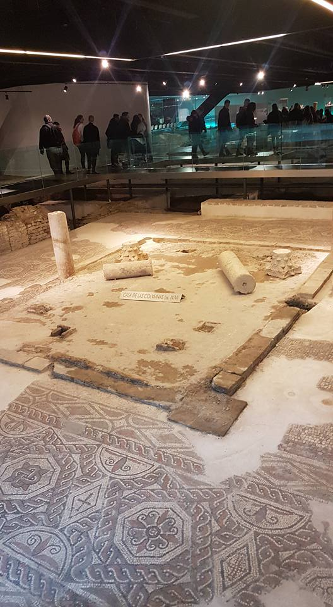
the first day in seville
The first day the exchanges went to
the Cathedral of Seville , the Giralda,the
Anticuarium and the town hall.
It was brilliant, we like it a lot !

Slide 3
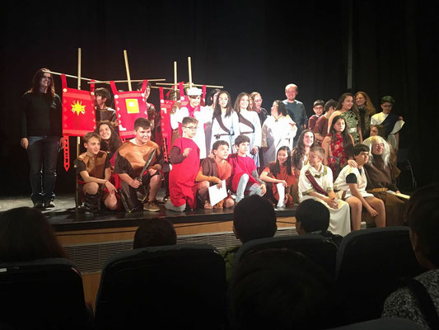
The second day in seville
We went to Carmona(a Roman Necropolis in Seville) and we went to the theater ,too.
The Necropolis was very nice and interesting and the most exiciting part was when we went inside the
tomble;the theater it was
impresionant because the actors acted
very well.

Slide 4
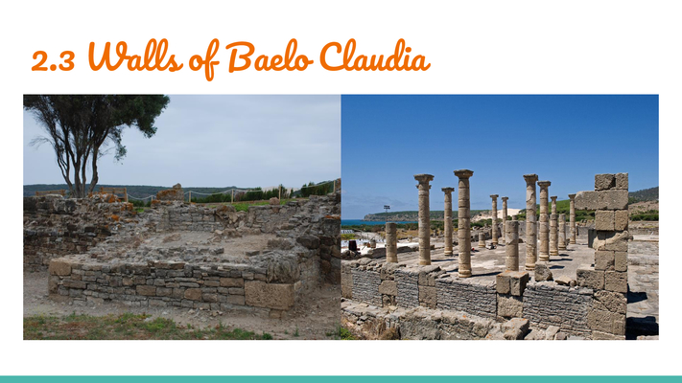
The third day in seville
We went to Bolonia (Cadiz) into a museum where a lot of Roman ruins were preserved . After, we went in the archeologich park and
we went to a fantastic beach.

Slide 5
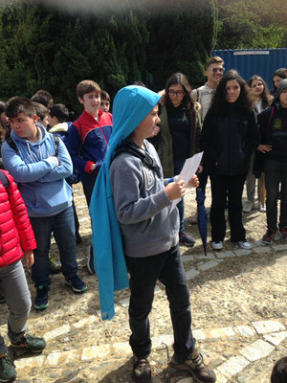
The forth day in seville
We went to Italica(Roman city in seville)and before we ate in the “Ventorrillo Canario” we ate spagheti and then a vanilla cream.
It was funny and baeutiful the firth day

