Slide 1
The Arch of Titus
Of Francesco Manna

Slide 2
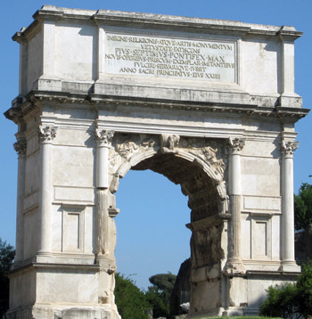
The history of its construction
The Arch of Titus is a Roman Triumphal Arch. It was built by Domitian in 81 A.D. on the Palatine hill. It commemorates the victories of his father Vespasian and Domitian’s brother, Titus in the Jewish War in Judaea in 71 when Jerusalem was sacked and its Temple destroyed. The arch has also a political and religious value as it expresses the divinity of Titus.

Slide 3
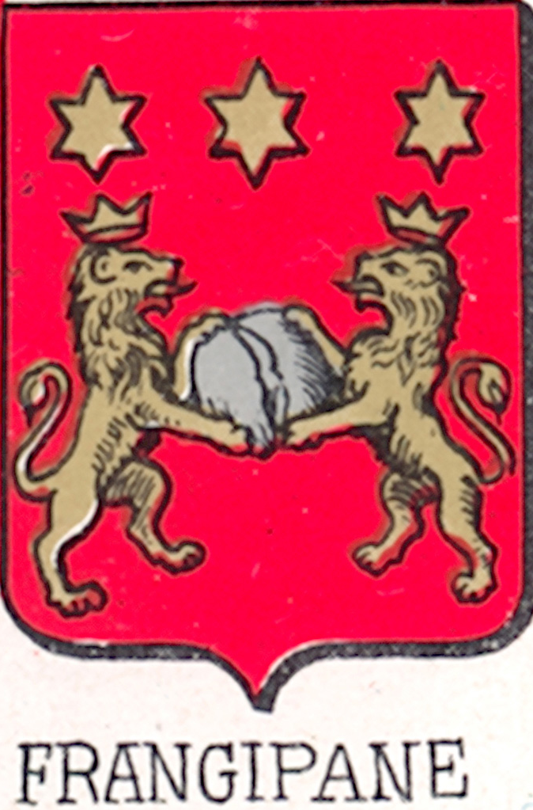
Later History
The arch was incorporated into the fortifications built by the Frangipani family in medieval times.
The significant restoration of the monument was carried out in the 19th century.
The arch was completely dismantled and reassembled piece by piece.
The foundation blocks of the arch are currently visible, as the original roadway was higher.

Slide 4
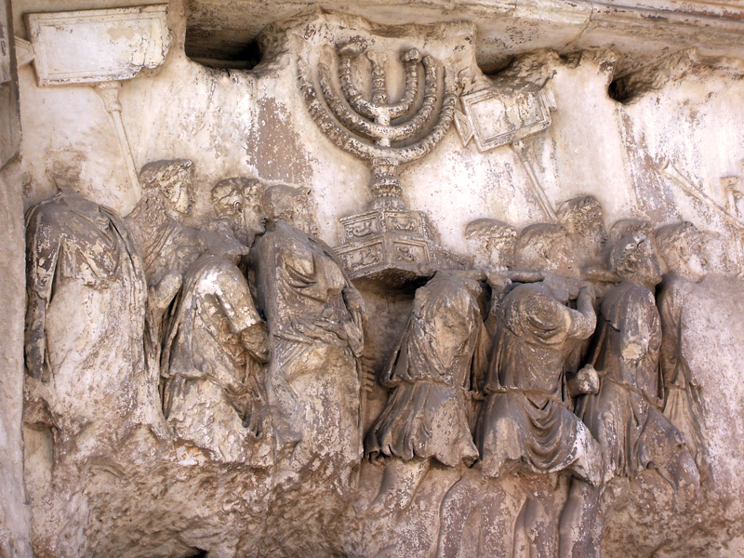
Material, Inscription and Decorative Sculpture
The arch is made of Pentelic and Luna marble. On the top of the Arch of Titus is written: “Senatus / populusque romanus / divo Tito divi Vespasiani f(ilio) / Vespasiano Augusto” which means “The Senate and People of Rome, to Divus Titus, son of Divus Vespasian, Vespasian Augustus”. The use of ‘Divo’ for Titus indicates that the arch was erected after the death of the emperor in 81 A.D.
The Arch has a single opening and it is smaller and more modest than the Arch of Costantine and the Arch of Septimius Severus.
The decorative sculpture is not well preserved, but some scenes are still visible, for example the victory triumph procession, Titus being crowned by a personification of Victory.

