Slide 1
ITALY & SPAIN
An Amazing Adventure through two Patrimonial Cities: Seville and Rome

Slide 2
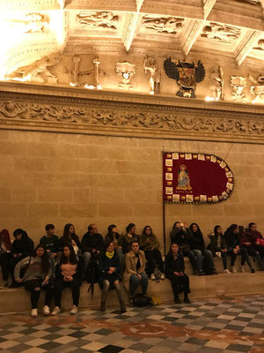
THE TOWN hall
The town hall is very big and impressionant and we really like this.

Slide 3
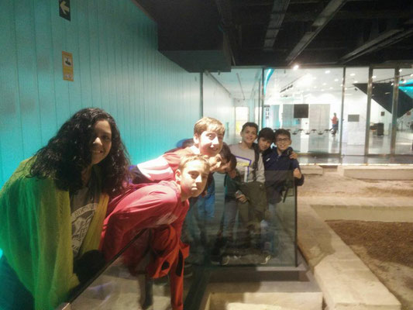
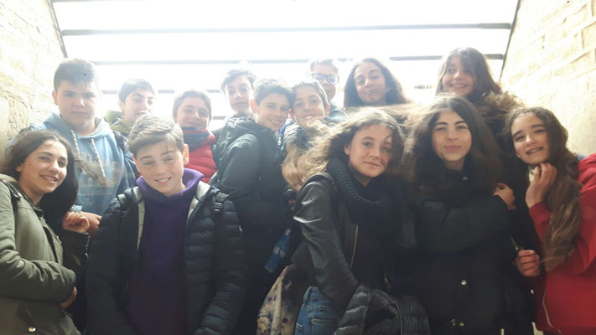
THE ANTIQUARIUM
On Tuesday we went to antiquarium, and we had
a lot of Roman things

Slide 4
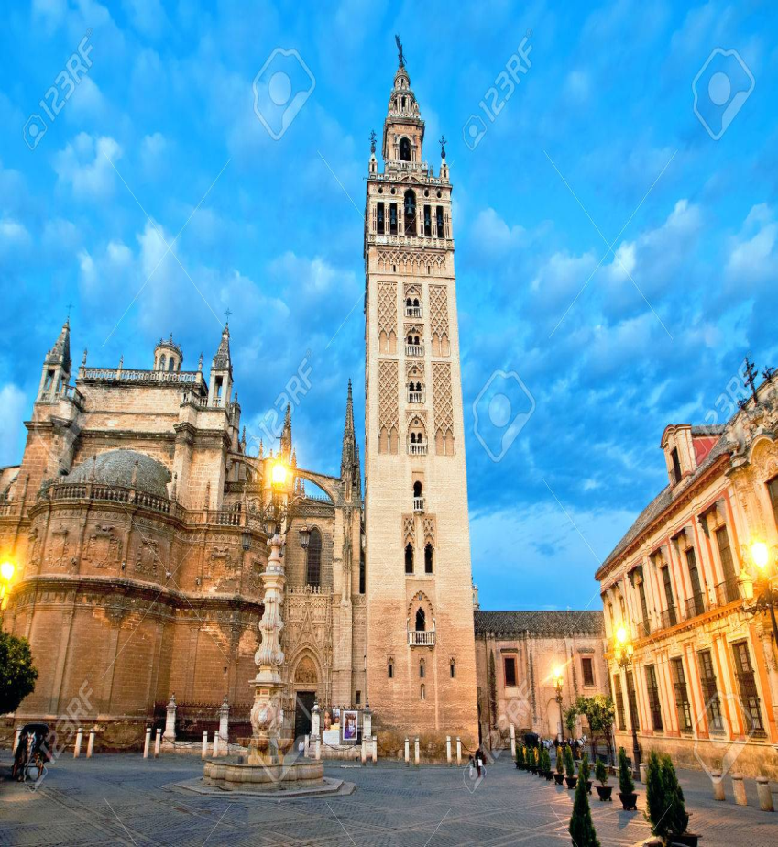
THE giralda
The Giralda is
very amazing and
it is very tall

Slide 5
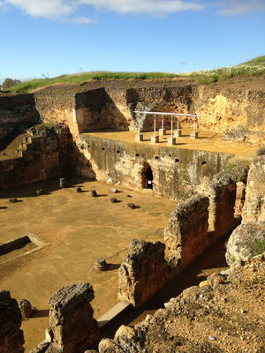
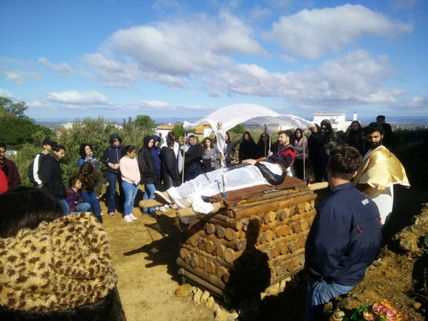
CARMONA
When we went to Carmona and my friend Daniel pretended to be dead, it was fun!

Slide 6
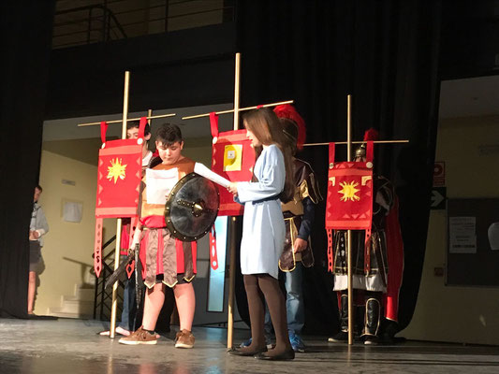
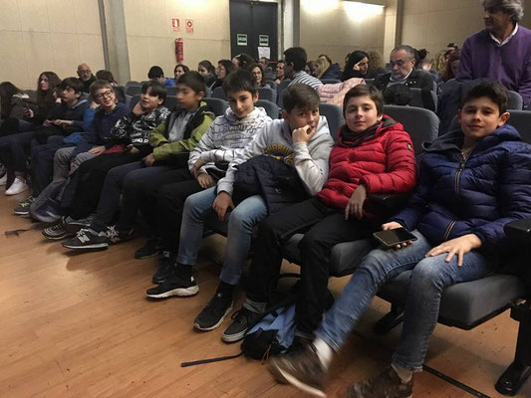
THE ThEATRE
In the theatre we see a beautiful and funny show

Slide 7
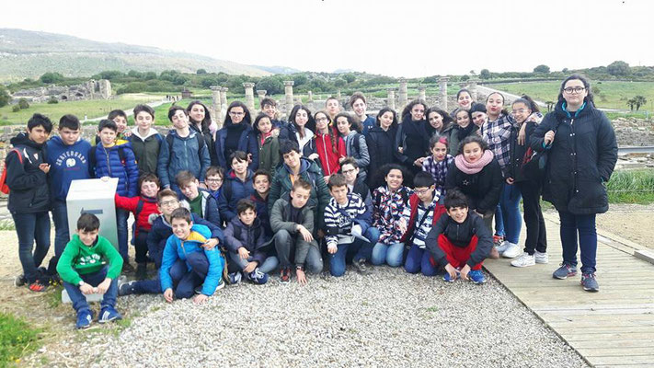
our opinion
We think that the Erasmus is a very good and funny experience.

Slide 8
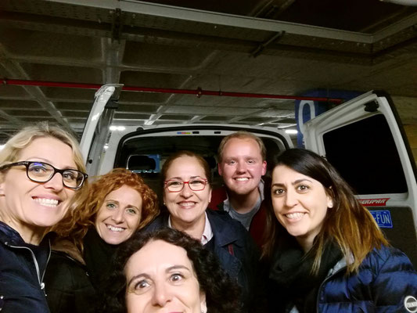
THE TEACHERS
The teachers did a very good joob,we like the teachers’ lesson about this project.

