Slide 1
Erasmus Change
An amazing adventure throught two patrimonial cities: Rome and Seville
By Francesca Brancaccio and Aylén Peñuela

Slide 2
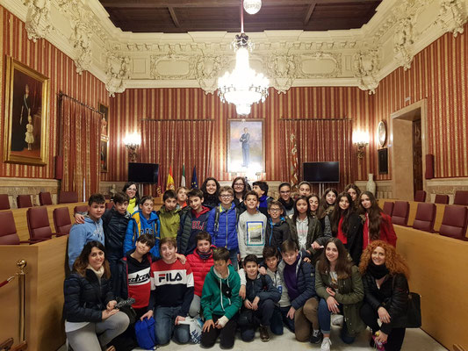
THE TOWN HALL
In the Town Hall we saw the place where the politics do the elections and make laws.

Slide 3
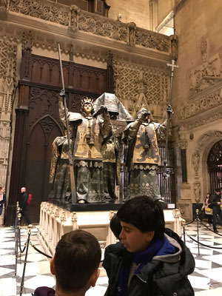
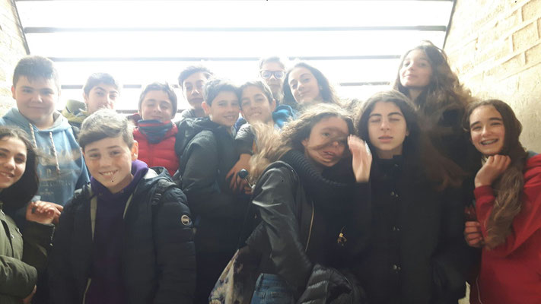
THE GIRALDA
We went to the Giralda’s upper part and we saw all Seville. Then we went to the cathedral.

Slide 4
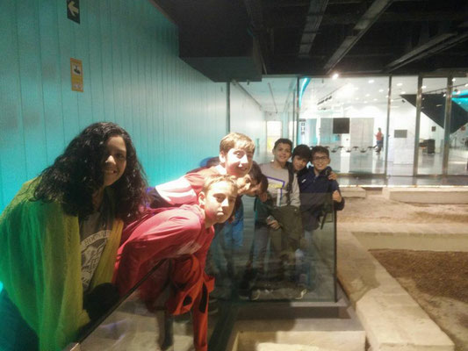
THE SETAS’ANTICUARIUM
We went to the Setas totally wet and we saw the thermas. Later, we listened the presentation of Paula.

Slide 5
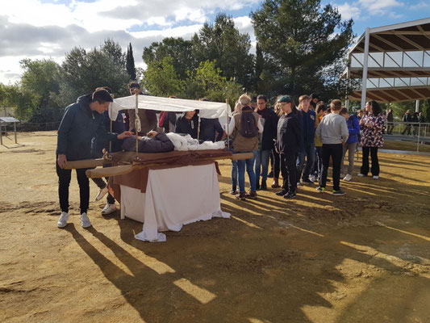
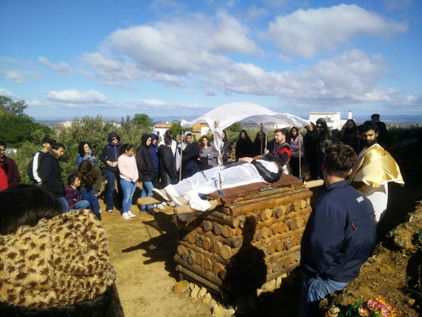
CARMONA’S NECROPOLIS
On Wednesday we went to Carmona’s necropolis and we made a typical roman funeral with two actors.
We entered into the tombs.

Slide 6
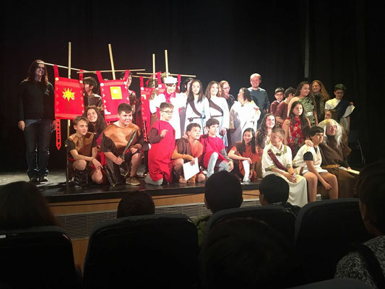
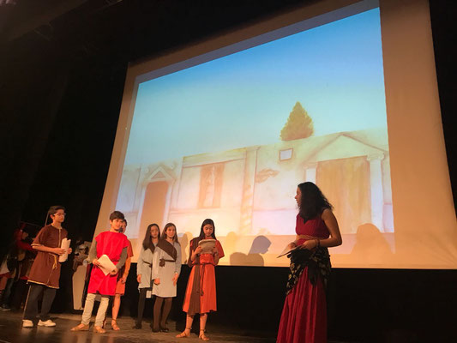
THE BRAGGART SOLDIER’S REPRESENTATION
The representation was very funny… I like it a lot!
-Francesca
We were really nervous! But, we did our best.
-Aylén

Slide 7
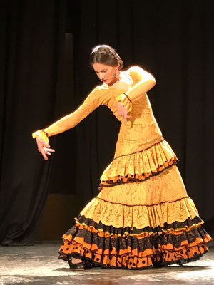
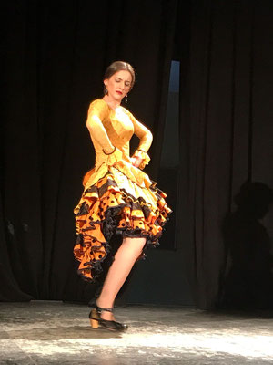
FLAMENCO’S DANCER
After the representation, we saw a flamenco’s dancer… she was very talented and we liked it a lot.

Slide 8
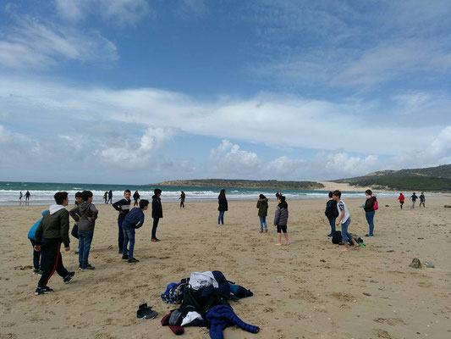
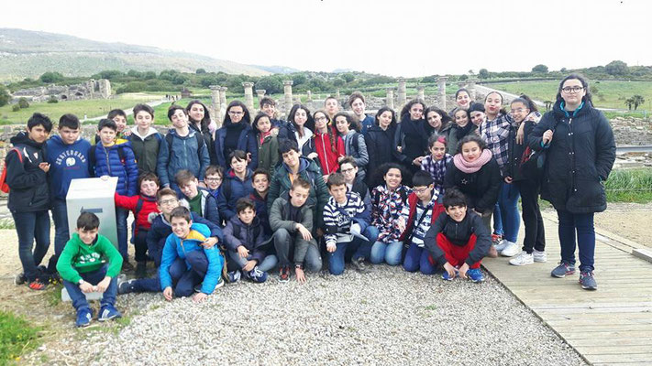
BOLONIA’S RUINS
The Thursday, we went to Cadiz and saw the museum. Then we went to the beach and we stayed there for a lot of time.

Slide 9
THE ORGANISATION
The organisation was very good and I think that we had the just activities, it was perfect!
The only problem was the rain,but it wasn’t the project’s fault.

Slide 10
THE ROLE OF THE TEACHERS
I think that my teacher (italian teacher) had to partcipate a little bit more. But the others were good.
-Francesca
I think that my teachers were totally awesome. They participate in all the activities.
-Aylén

Slide 11
EXCHANGE FAMILY
I was very good with my family… I loved it and I will like to pass more time with they. And my exchange family for me is like a real family.
-Francesca
I love it! My italian parents were too kind with me and I love my change.I feel that I was with my real family. I will like to see they soon.
-Aylén

Slide 12
OPINION
This experience allowed me to have a sister that my mum never had. I am really glad that I made this change.
-Francesca
This experience is one of the best that I ever feel! It was wonderful to have a sister and a new family,in other country. I’ve learn a lot things in this change.
-Aylén

Slide 13
