Slide 1
Erasmus Change
An Amazing Adventure through two Patrimonial Cities: Seville and Rome
By:
Margherita Magnani
Alba Pérez

Slide 2
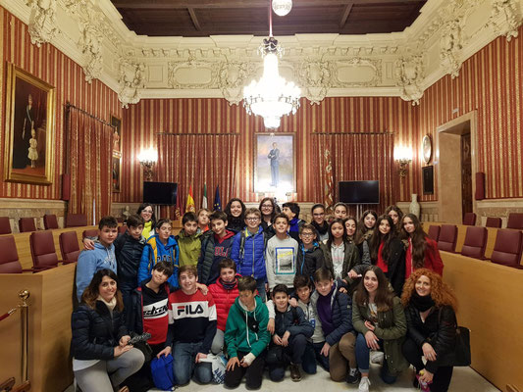
The Town Hall
The Town Hall is a place where the politics talk about the problems and laws of the city.

Slide 3
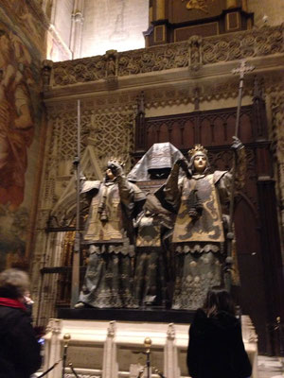
The Giralda
The Giralda is a tall monument in the centre of Seville. On the top of the Giralda we can see all the city. Later we went to de Catedral.

Slide 4
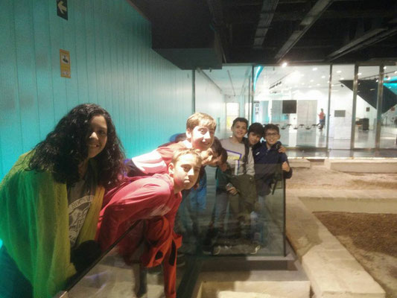
The Anticuarium
The Anticuarium is into Las Setas and there are ruins of a roman civiltation.

Slide 5
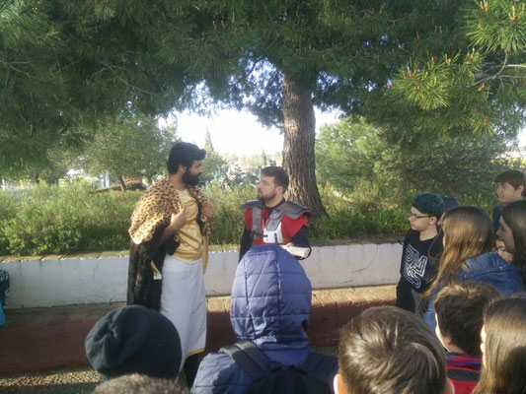
The Necropolis of Carmona
In the Necropolis of Carmona there are some ruins and some tombs. We went to the Alcazar and we played a game.

Slide 6
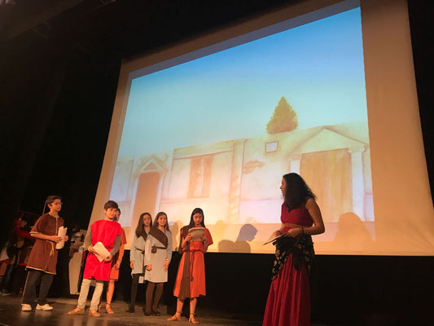
The theatre
In the evening of Wednesday, we represent a roman theatre while the italian boys and girls saw it.

Slide 7
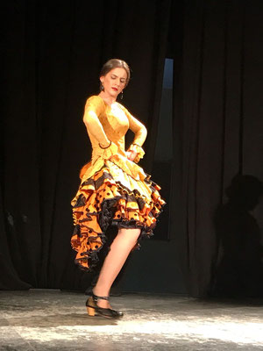
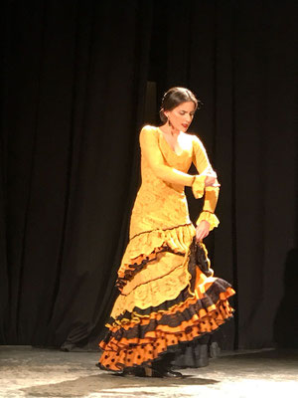
Flamenco dancer
Last to the theatre a girl danced a tipical dance of Seville called Flamenco.

Slide 8
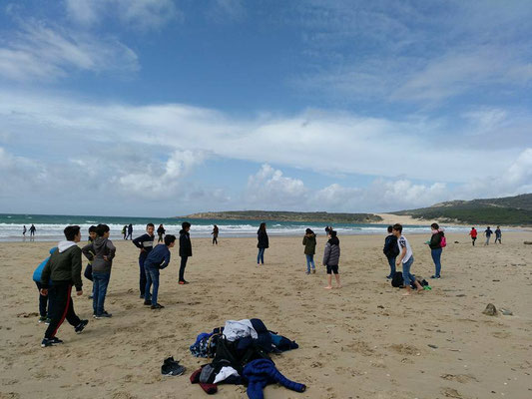
Bolonia
In Bolonia, first, we went to the museum. Second, we visit the roman ruins. Later we went down to the beach by bus.

Slide 9
The experience
We think that this experience isn’t for everyone, everyone really enjoyed it. In this two cities we made a lot of new friends and we saw a lot of beautiful places.
For us it was like having a second family, that soppurted us a lot and helped us in everything.

