Slide 1
Piazza del Campidoglio
Milena Petrucelli

Slide 2
Piazza del Campidoglio is one of Rome's most beautiful squares, designed in the sixteenth century by Michelangelo and laid out between two summits of the Capitoline Hill, the most important of Rome's fabled seven hills.
From the founding of Rome until its fall almost one thousand years later, the Capitoline Hill symbolized the epicenter of Rome's might and many of the city's most important buildings stood on this hill.

Slide 3
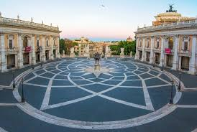
Later, during the Middle Ages, the site continued to play an important part in Rome's history. The senate of Rome assembled here and even today it still has some political significance since the city hall is located here.

Slide 4
Michelangelo's Design
When Emperor Charles V planned a visit to Rome in 1536, the muddy Capitoline Hill was in such a derelict state that pope Paul III Farnese asked Michelangelo to design a new square, the Piazza del Campidoglio (Capitoline Square). The project also included a redesign of the existing buildings surrounding the square.

Slide 5
Michelangelo came up with an original, trapezoidal design for the square with an intriguing oval shaped ground pattern.
Construction of the square started in 1546 but only the staircase at the entrance of the Palazzo Senatorio was realized when Michelangelo died in 1564. The project was finally completed in the seventeenth century according to Michelangelo's designs.

