Slide 1
THE BASILICA OF SAINTS COSMA E DAMIANO
EDOARDO GALELLA II F

Slide 2
THE STORY AND WHAT IS IT
The Basilica of Saints Cosma and Damiano
The Basilica of Saints Cosma and Damiano is a church in the Roman Forum, parts of which incorporate original Roman buildings. The circular building at the entrance of the Forum (not used today) was built in the early 4th century as a Roman temple; probably it was dedicated to Valerius Romulus, deified son of the emperor Maxentius. The main building was perhaps the library of an imperial forum.
It became a church in 527 and contains important but restored early Christian art, especially in its mosaics.
Today it is one of the ancient churches called Tituli. The current Cardinal Deacon of the Titulus Ss. Cosmae et Damiani is Beniamino Stella, made Cardinal on 22nd February 2014. The basilica, devoted to the two Greek brothers, doctors, martyrs and Saints Cosmas and Damian, is located in the Forum of Vespasian, also known as the Forum of Peace.
Next to the new entrance to the complex, there are rooms with the original marble paving of the Peace Forum, and the wall where the 150 marble slabs of the Forma Urbis Romae were hung. Through the cloister, the entrance to the church opens on the side of the single nave. The plan of the basilica followed the norms of the Counter-Reformation: a single nave, with three chapels per side, and the big apse, which now looks quite oversized because of the reduction in height of the 17th-century restoration, framed by the triumphal arch, also mutilated by that restoration.
The mosaics are masterpieces of 6th- and 7th-century art. In the middle is Christ, with Saint Peter presenting Saint Cosmas and Saint Theodorus (right), and Saint Paul presenting Saint Damian and Pope Felix IV; the latter holds a model of the Church.

Slide 3
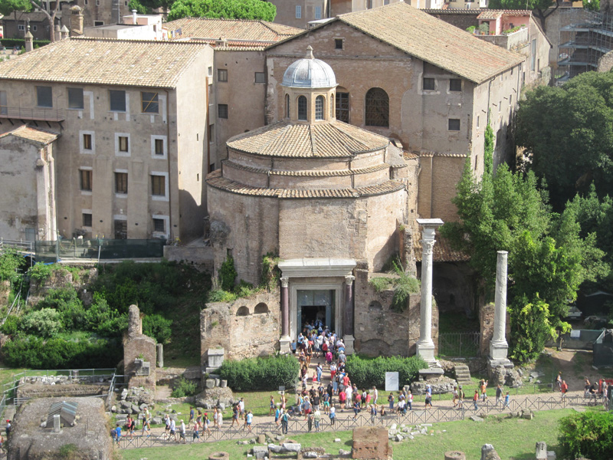

Slide 4
