Slide 1
Musei capitolini
MILENA PETRUCELLI

Slide 2
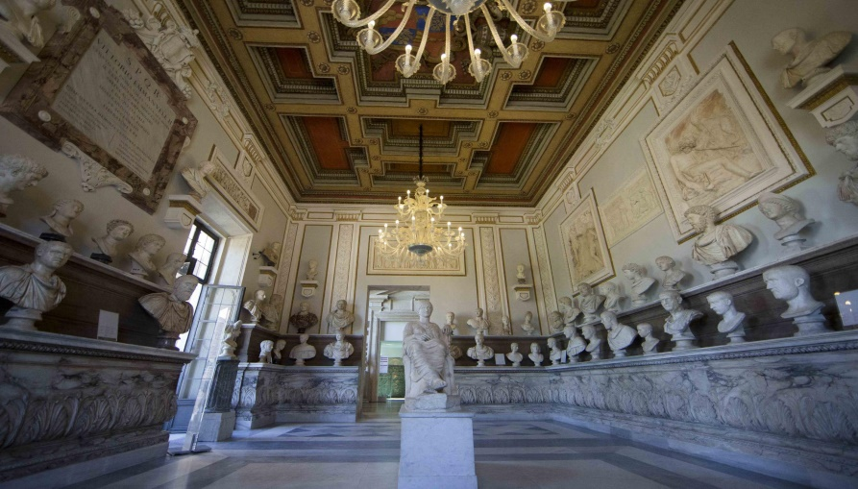
The Capitoline Museums are found in Piazza del Campidoglio. The museums are owned and administered by the Municipality of Rome. The museum were the result of the donation of a collection of valuable bronzes by Pope Sixtus IV in 1471 to the citizens of Rome, making them the oldest museums in the world.

Slide 3
The museums are made up by two imposing buildings located on the Piazza del Campidoglio: the Palazzo dei Conservatori and the Palazzo Nuovo. Both mansions are linked by the Galleria Lapidaria, a tunnel that takes you under Piazza del Campidoglio without having to leave the museums.

Slide 4
Palazzo dei conservatori
Opened to the public in 1734 under Pope Clement XII, the Palazzo dei Conservatori houses a collection including paintings, sculptures, busts of well-known people of that time and other art work by renowned artists like Caravaggio, Tiziano, Rubens and Tintoretto.
One of the main attractions found in this museum is the original sculpture of the Capitoline Wolf. The mansion also features the Ritratto di Carlo I d'Angiò de Arnolfo di Cambio (1277), the first sculpture of a living person.

Slide 5
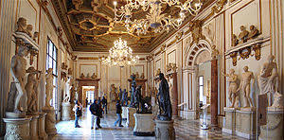
One of the most striking parts of the building is a glass-covered hall. In the centre is the equestrian statue of Marcus Aurelius, originally displayed in the Piazza del Campidoglio. In this wing, fragments of several colossal statues are preserved.

Slide 6
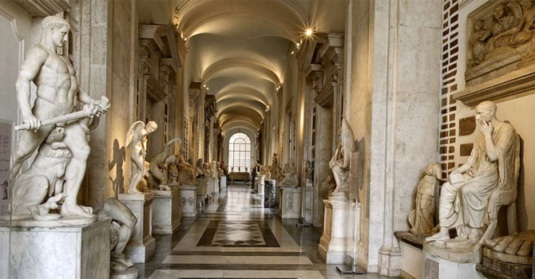
PALAZZO NUOVO
The Palazzo Nuovo is devoted primarily to the exhibition of statues, sculptures, mosaics and busts. Some of these are Roman replicas of Greek originals. Among the museum’s greatest works is the Capitoline Venus, a marble sculpture designed between 100 and 150 AD. Other famous works of art include the Discobolus and the statue of Dying Gaul.

