Slide 1
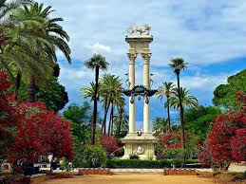
MURILLO GARDENS

Slide 2
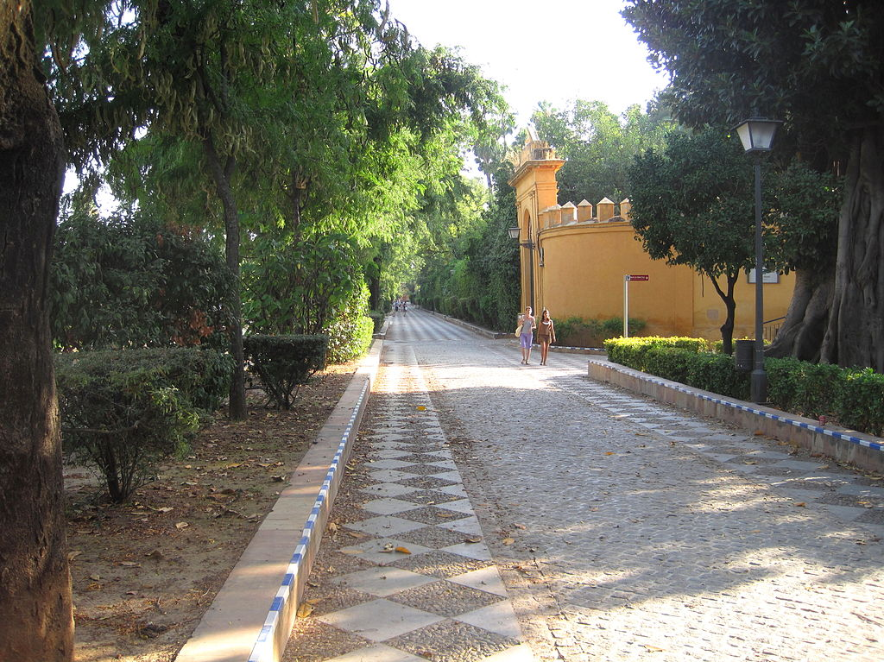
The Murillo Gardens are located next to the Paseo de Catalina de Ribera

Slide 3
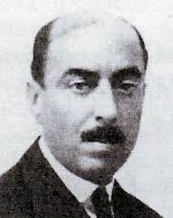
ARCHITECT
The Gardens, as we know them today, were designed in 1915 by Juan Talavera

Slide 4
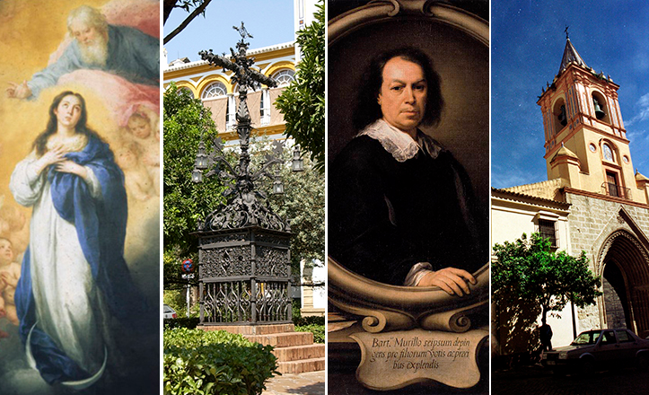
In 1918, at the request of the El Liberal newspaper editor, they were named Murillo Gardens since the painter was buried in the church there was in the nearby Plaza de Santa Cruz.

Slide 5
HISTORY
. The Murillo Gardens, previously known as the Retiro Gardens , belonged to the Reales Alcázares of Seville until in 1862.
. They were donated to the city to be integrated in the Seville Fair which was then held in the nearby Prado de San Sebastián.

Slide 6
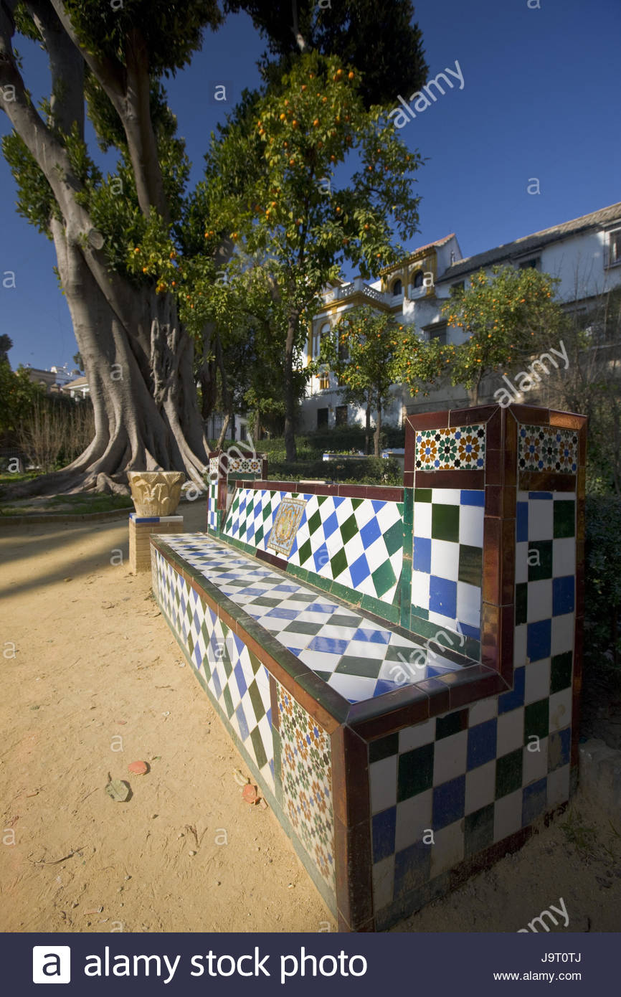
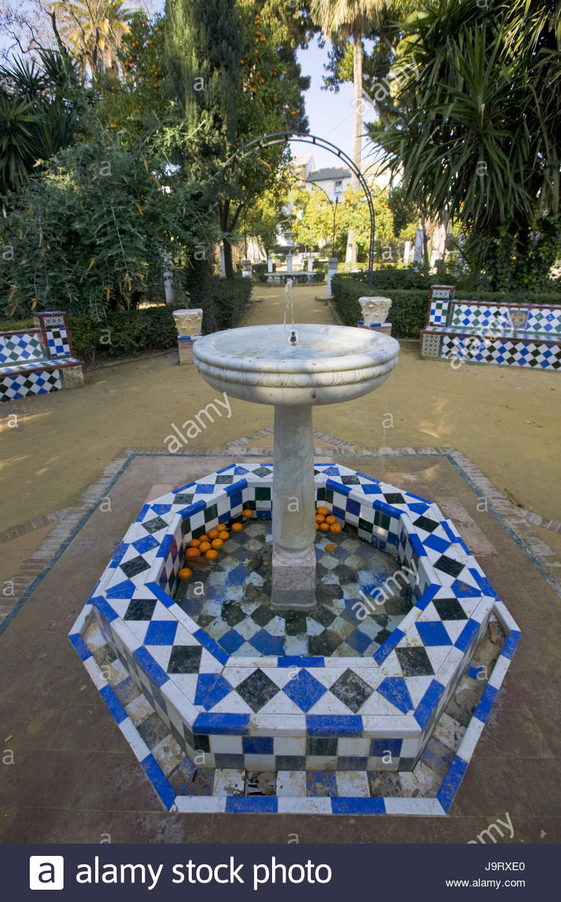
Bricks and ceramics are, together with the amazing and marvellous vegetation, the real attractions of this centrally-located Sevillian venue.

Slide 7
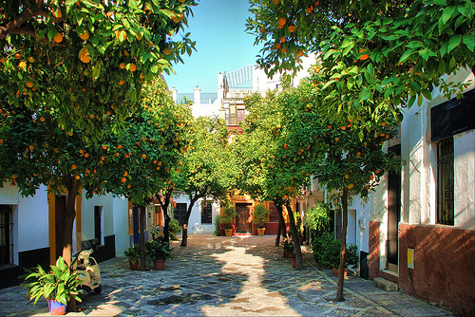
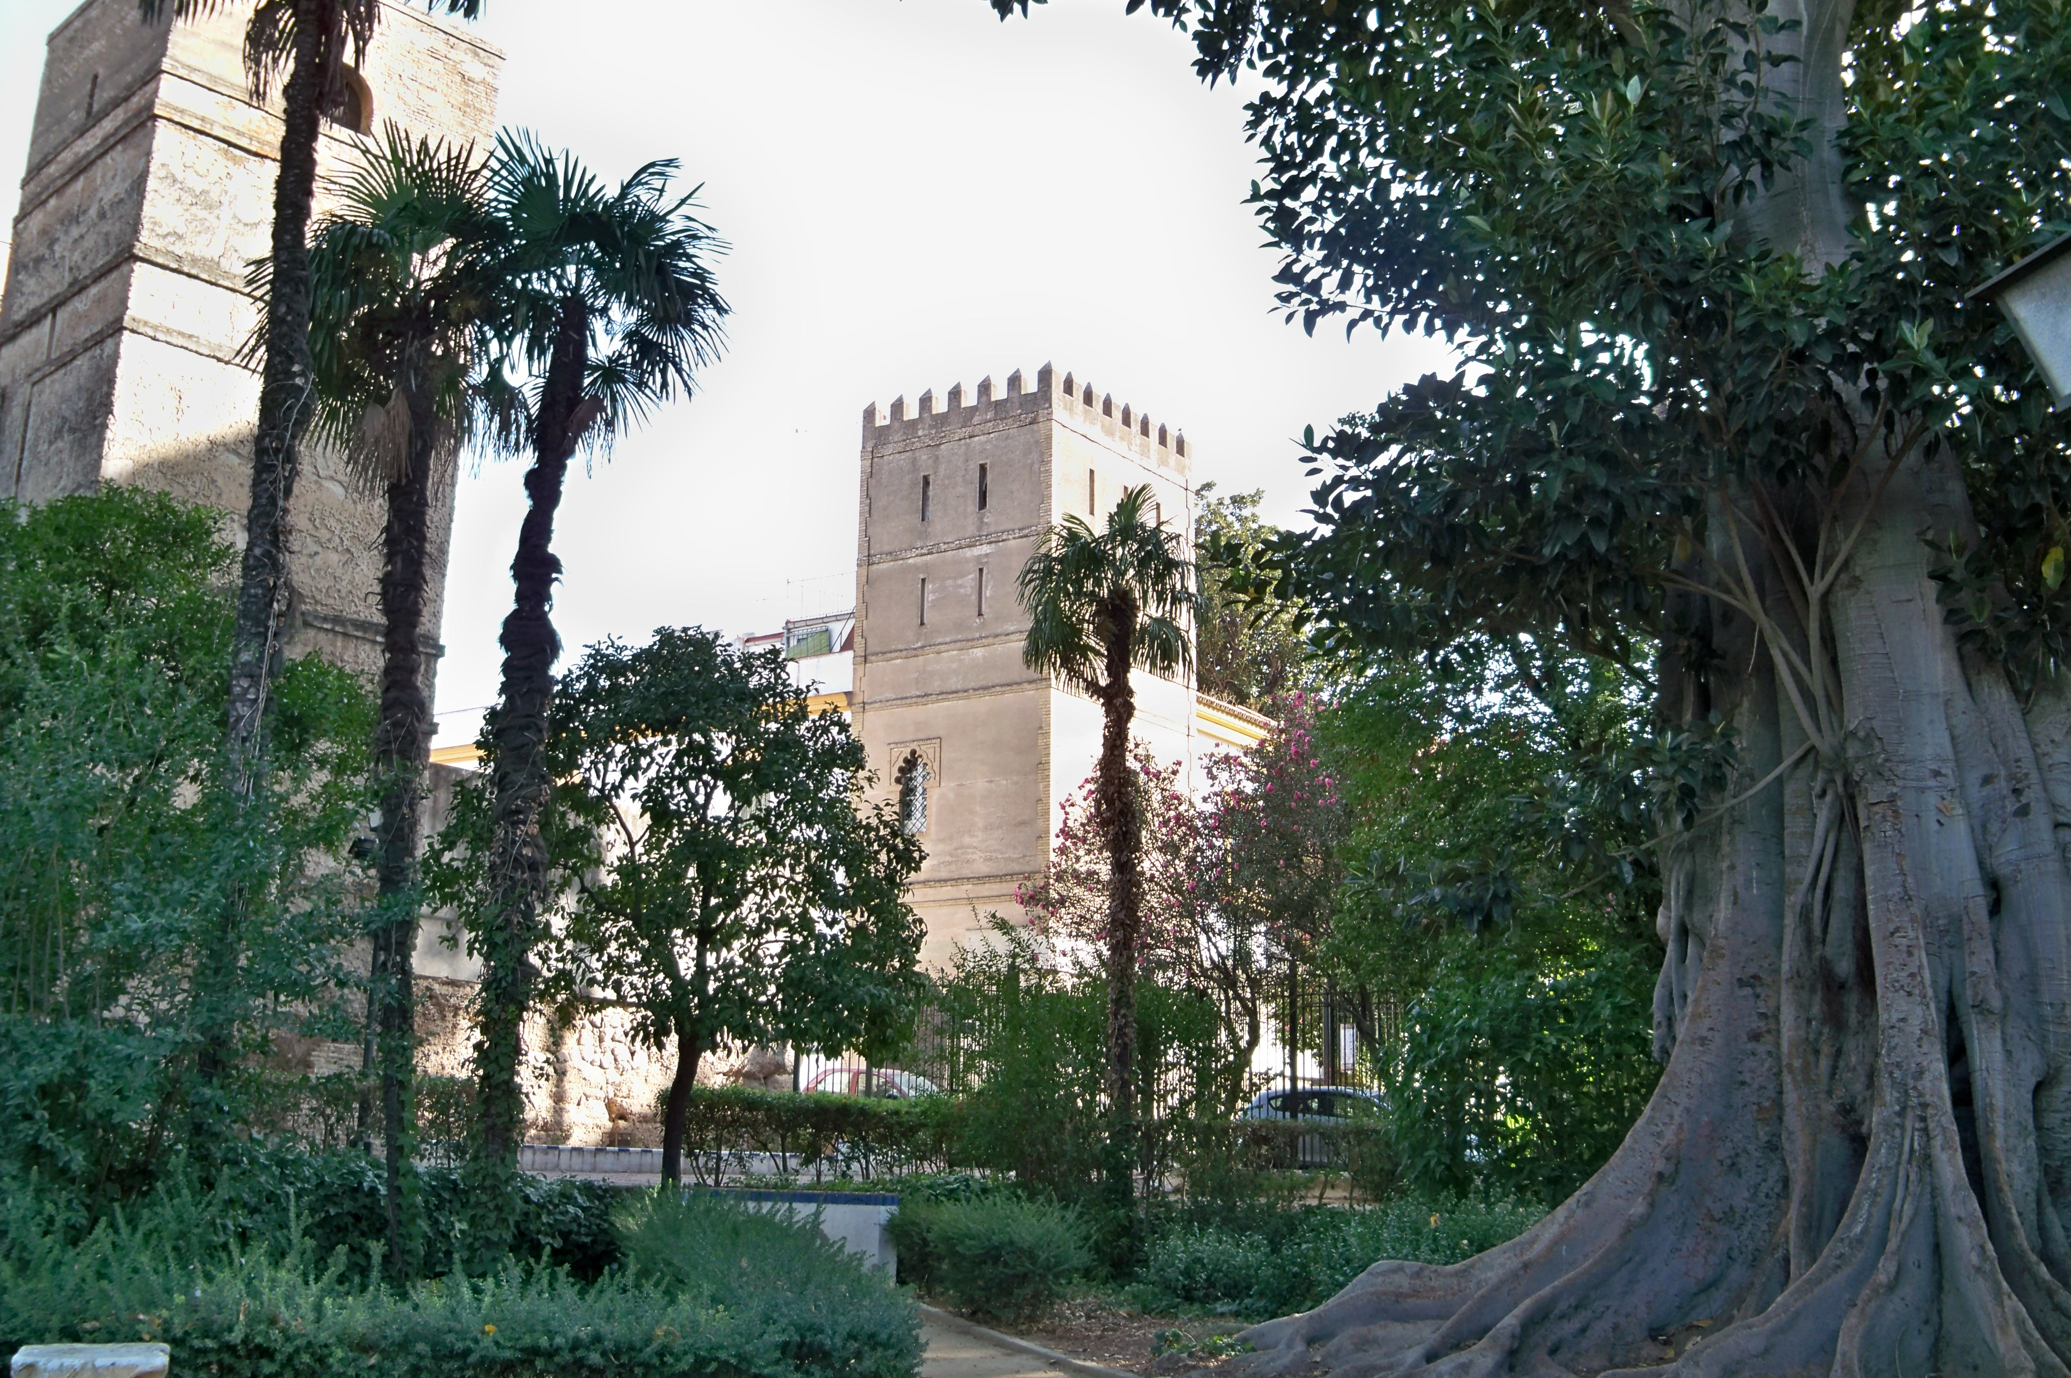
PLANTS
Magnolia and orange trees, ficus and night jasmine are some of the plant species that intermingle with arbours, fountains, ceramics and monuments.

Slide 8
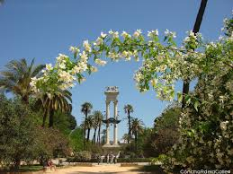
THE END
BY MANOLO MUÑIZ FERNÁNDEZ

