Slide 1
ITALY & SPAIN
An Amazing Adventure through two Patrimonial Cities: Seville and Rome

Slide 2
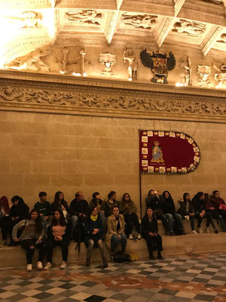
THE TOWN hall
It`s was very funny

Slide 3
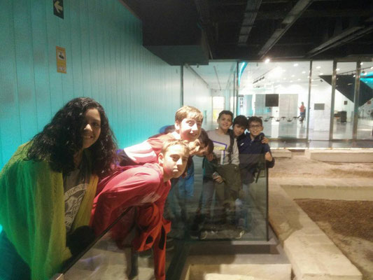
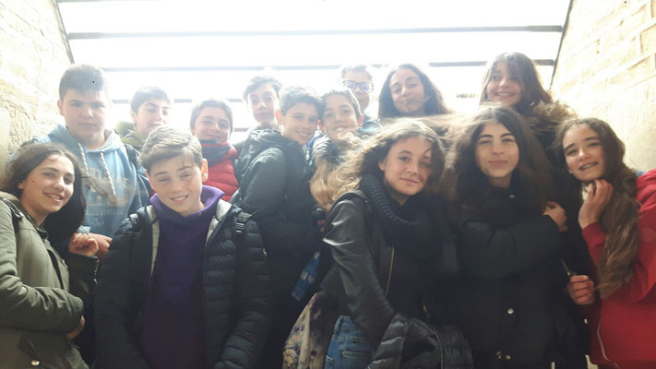
THE ANTIQUARIUM
On Tuesday we go to antiquarium, have
a lot of Roman things

Slide 4
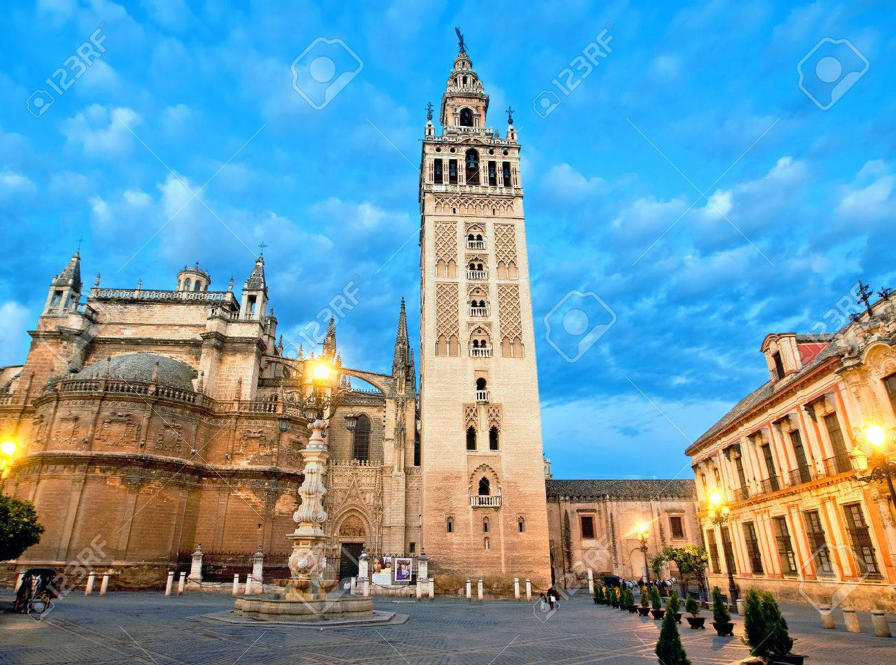
THE giralda
The Giralda is
very amazing and
it is very tall

Slide 5
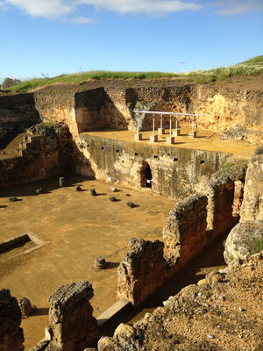
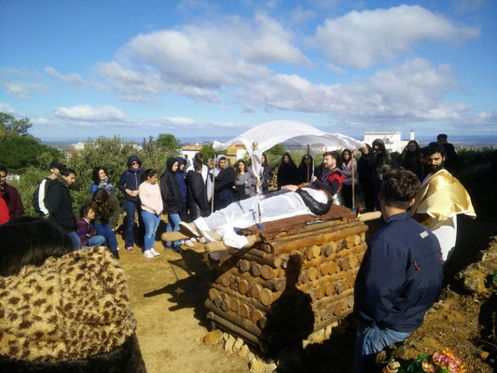
CARMONA
When we go to Carmona and my friend Daniel pretended to be dead, it was fun!

Slide 6
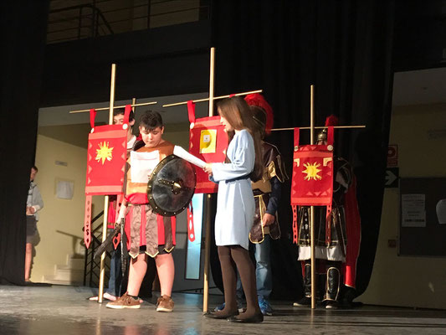
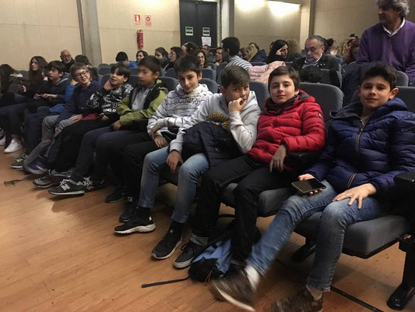
THE TEATRE
In mo

