Slide 1
Mª Luisa Park
Antonio Camacho Martín

Slide 2
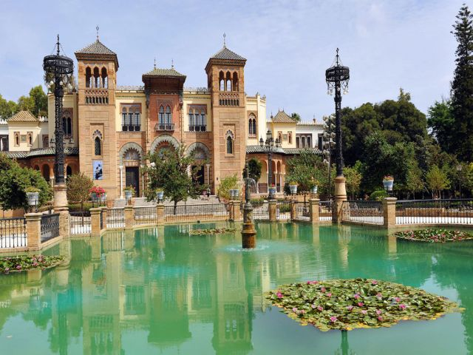
What’s Mª Luisa park?
Mª Luisa park is the first urban park in Seville and one of its green lungs thanks at its vegetable decoration

Slide 3
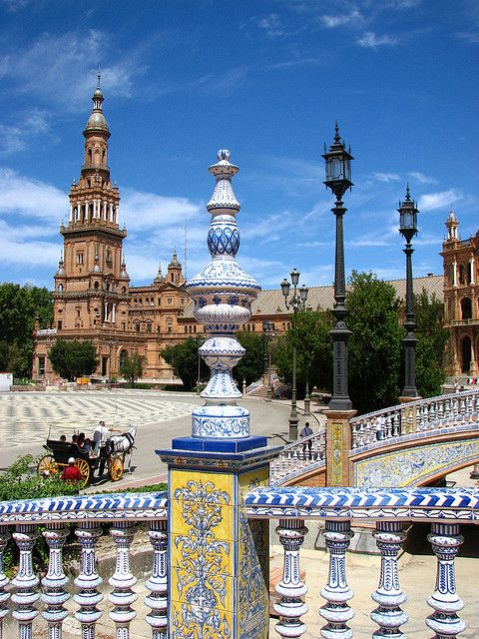
Who and when they made?
It was made for María Luisa Fernanda de Borbón and duque de Montpensier Antonio de Orleans.
They donated money to build the park on 1893; until 1910, don’t start the big contructions and it inaugurated on 1914.

Slide 4
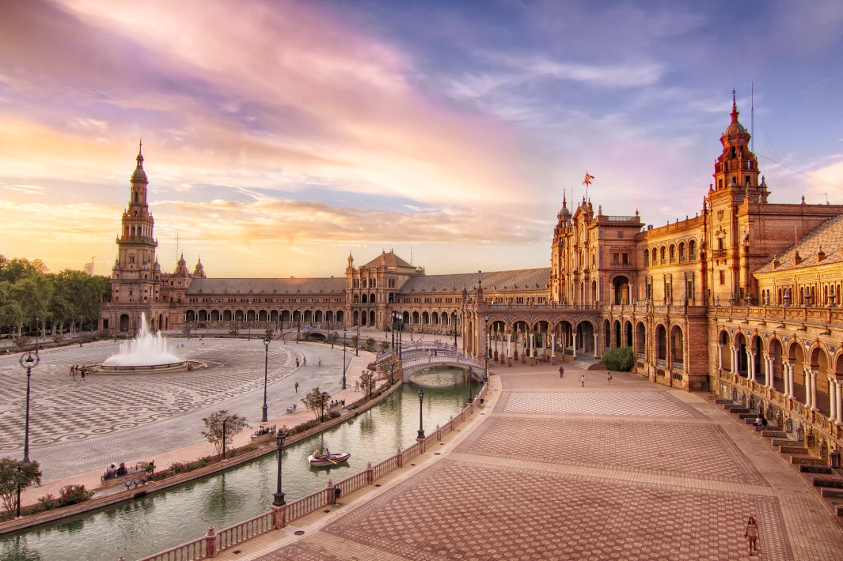
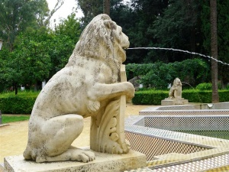
Which are the important monuments of the park?
Spanish Place
Lion sources

Slide 5
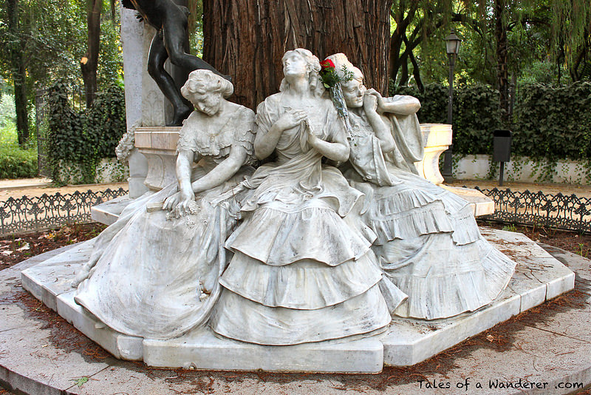
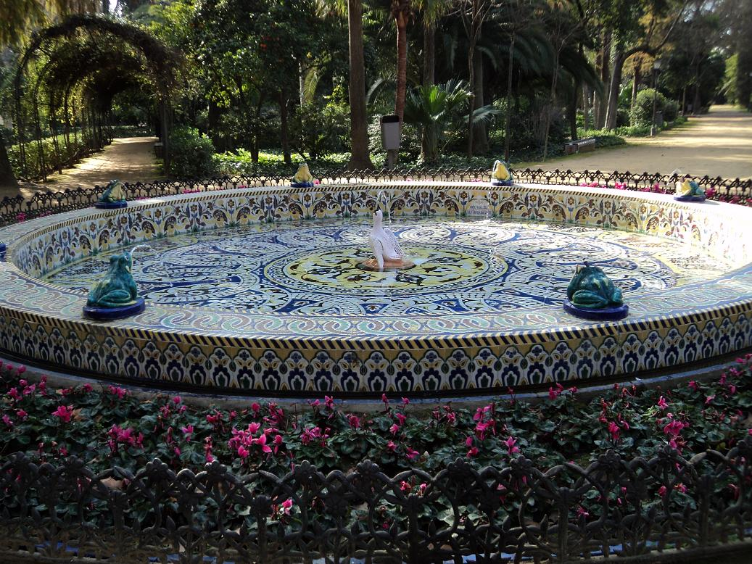
Bécquer Gazebo
Frog sources

Slide 6
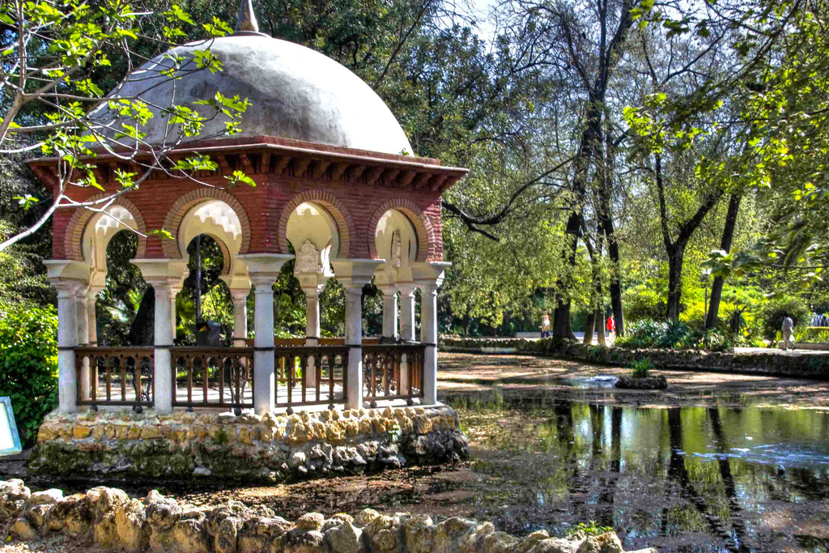
How much it measure?
The park has a extension of 34 hectares (including the grass, plants and constructions)

Slide 7
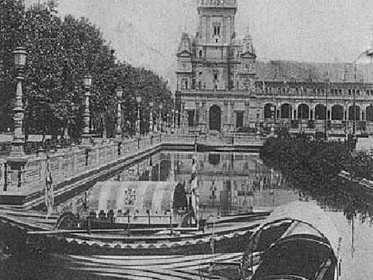
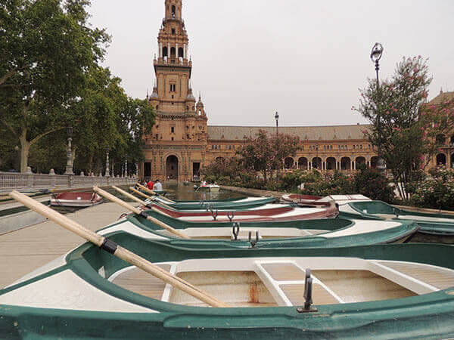
Mª LUISA PARK EVOLUTION
1971
2018
Boat zone, Spain place

