Slide 1
An Amazing Adventure Through Two Patrimonial Cities
Leonardo Milana and
Daniel López

Slide 2
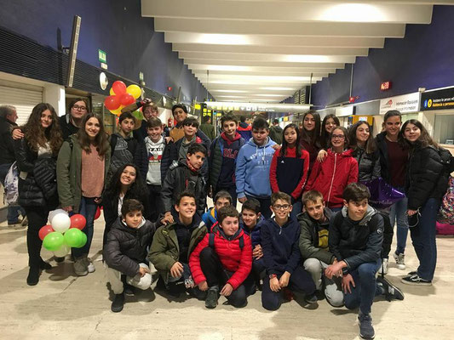
MONDAY SEVILLE

Slide 3
WRITINGS OF MONDAY
Italians arrive in Seville
They are very happy!!!!!

Slide 4
TUESDAY SEVILLE

Slide 5
WRITINGS OF TUESDAY
We go to the center and then we see the Catedral, the Giralda, the Town Hall… We see a lot of things!

Slide 6
WEDNESDAY SEVILLE
WE WENT TO CARMONA,
A LEGENDARY PLACE FOR THE PEOPLE THAT LOVE THE ROMANS AND THEIR CUSTOMS

Slide 7
WRITINGS OF WEDNESDAY
We went to Carmona, an amazing place. We see tumbs and a lot of more things
Later Spanish students rehease some scenes from a play called The Braggart Soldier and the Italians see it.
They pass a very good time!

Slide 8
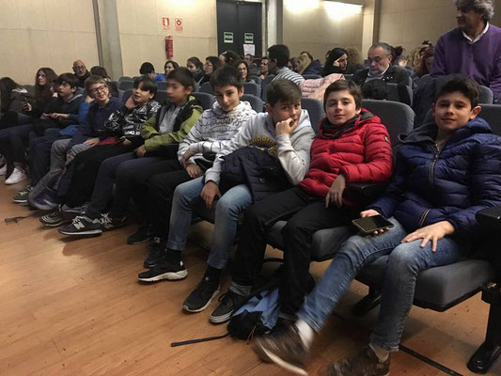
WEDNESDAY EVENING IN SEVILLE

Slide 9
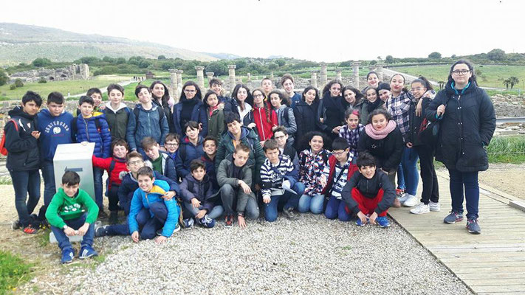
THURSDAY IN SEVILLE

Slide 10
WRITINGS ABOUT THE THURSDAY
We went to Bolonia in Cádiz.
We see a lot of ruins and the Spanish students talk about the ruins.

Slide 11
AND NOTHING MORE OF SEVILLE!!
NOTHING MORE OF SEVILLE!
MY PERSONAL OPINION:
I LOVE THIS WEEK AND THIS PROJECT... IT HAS BEEN A WORTHY EXPERIENCE.(DANIEL LOPEZ FDEZ)
MY PERSONAL OPINION: Seville is a beautiful city, and nothing more. (LEONARDO MILANA)

