Slide 1
Raphael’s Rooms
The four rooms known as the Stanze of Raphael formed part of the apartment situated on the second floor of the Pontifical Palace that was chosen by Julius II della Rovere (pontiff from 1503 to 1513) as his own residence and used also by his successors. The pictorial decoration was executed by Raphael and his school between 1508 and 1524.

Slide 2
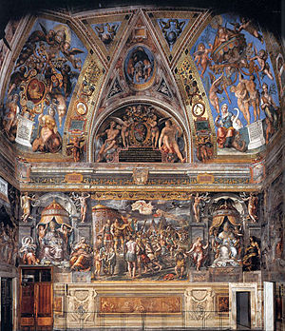
Room of Costantine
The room, that was designed to be used for receptions and official ceremonies, was decorated by the school of Raphael on the basis of drawings by the artist, who died prematurely before completion of the work (1520). It takes its name from Constantine (306-337 A.D.), the first Christian emperor to officially recognize the Christian faith, granting freedom of worship. On the walls are painted four episodes of his life which testify to the defeat of paganism and the triumph of the Christian religion: the Vision of the Cross , the Battle of Constantine against Maxentius, the Baptism of Constantine and the Donation of Rome. The decoration of the room is completed by figures of great Popes flanked by allegorical figures of Virtue. The original wooden roof which Leo X (pontiff from 1513 to 1521) had built was replaced under Gregory XIII (pontiff from 1572 to 1585) by the modern ceiling, the decoration of which was entrusted by order of the Pope to Tommaso Laureti who portrayed the Triumph of the Christian religion in the central panel. The work was completed at the end of 1585 under Pope Sixtus V (pontiff from 1585 to 1590).

Slide 3
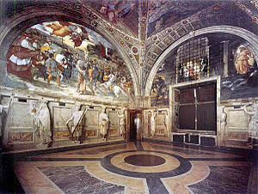
Room of Heliodorus
This room was originally used for the private audiences of the Pope and was decorated by Raphael immediately after the Segnatura. The room's programme is political and aims at documenting, in different historical moments from the Old Testament to medieval history, the miraculous protection bestowed by God on the Church. Faith had been threatened (Mass of Bolsena), in the person of its pontiff (Liberation of St Peter), in its site (Encounter of Leo the Great with Attila) and in its patrimony (Expulsion of Heliodorus from the temple). These were also chosen to express the political programme of Julius II (pontiff from 1503 to 1513), aimed at freeing Italy, at the time occupied by the French, to restore the temporal power under threat to the papacy. The four episodes of the Old Testament on the ceiling are the work of Raphael, while in the grotesques and in the arches there are still some parts that can be attributed to Luca Signorelli, Bramantino, Lorenzo Lotto and Cesare da Sesto. They date to the first decoration commissioned by Julius II at the beginning of his pontificate, that was interrupted and then replaced by the present one due to the pontiff's great admiration for the first frescoes of Raphael in the adjoining room of the Segnatura.

Slide 4
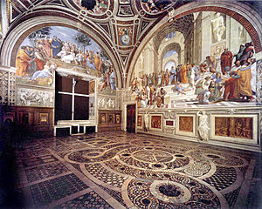
Room of the Segnatura
The Room of the Segnatura contains Raphael's most famous frescoes. Besides being the first work executed by the great artist in the Vatican they mark the beginning of the high Renaissance. The room takes its name from the highest court of the Holy See, the "Segnatura Gratiae et Iustitiae", which was presided over by the pontiff and used to meet in this room around the middle of the 16th century. Originally the room was used by Julius II (pontiff from 1503 to 1513) as a library and private office. The iconographic programme of the frescoes, which were painted between 1508 and 1511, is related to this function. It was certainly established by a theologian and meant to represent the three greatest categories of the human spirit: Truth, Good and Beauty. Supernatural Truth is illustrated in the Disputation of the Most Holy Sacrament (theology), while rational Truth is illustrated in the School of Athens (philosophy). Good is expressed in the Cardinal and Theological Virtues and the Law.
Beauty is represented in the Parnassus with Apollo and the Muses. The frescoes of the ceiling are connected with the scenes below them. The allegorical figures of Theology, Philosophy, Justice and Poetry allude in fact to the faculties of the spirit painted on the corresponding walls. Under Leo X (pontiff from 1513 to 1521) the room was used as a small study and music room, in which the pontiff also kept his collection of musical instruments. The original furnishings of the time of Julius II were removed and replaced with a new wooden wainscot, the work of Fra Giovanni da Verona. The wood covered all the walls with the exception of that of the Parnassus, where, for reasons of space, the same decoration, still visible today, was painted in fresco. The wooden wainscot was probably destroyed following the Sack of Rome in 1527 and in its place, during the pontificate of Paul III (pontiff from 1534 to 1549) a wainscot in chiaroscuro was painted by Perin del Vaga.

Slide 5
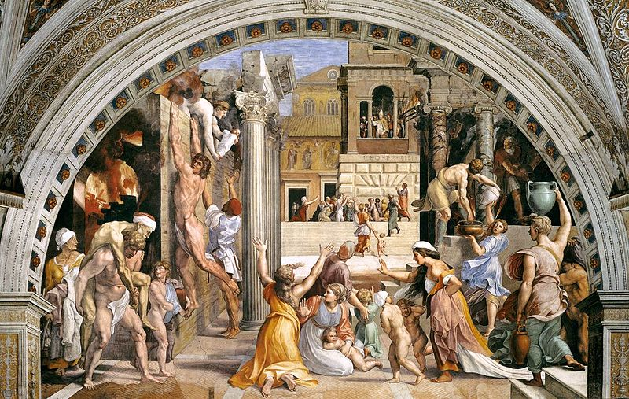
Room of the Fire in the Borgo
The room was used in the time of Julius II (pontiff from 1503 to 1513) for the meetings of the highest court of the Holy See: the Segnatura Gratiae et Iustitiae, presided over by the Pope. The paintings on the ceiling, by Pietro Vannucci, called the Perugino, commissioned by the Pope in 1508, are related to this function. At the time of Leo X (pontiff from 1513 to1521) the room was used as a dining room and the task of frescoing the walls was assigned to Raphael who entrusted a large part of the work to his school. The work was completed between 1514 and 1517. The frescoes illustrate the political aspirations of Leo X through stories taken from the lives (narrated in the Liber Pontificalis) of two previous Popes with the same name: Leo III (Crowning of Charlemagne and Justification of Leo III) and Leo IV (Fire in the Borgo and the Battle of Ostia). In all the episodes the Pope is a portrait of the reigning pontiff Leo X. Six seated figures of emperors and sovereigns who are protectors of the church are shown in the monochromes below the paintings.

