Slide 1
An Amazing Adventure Through Two Patrimonial Cities
Davinia Carrascosa De Diego.

Slide 2
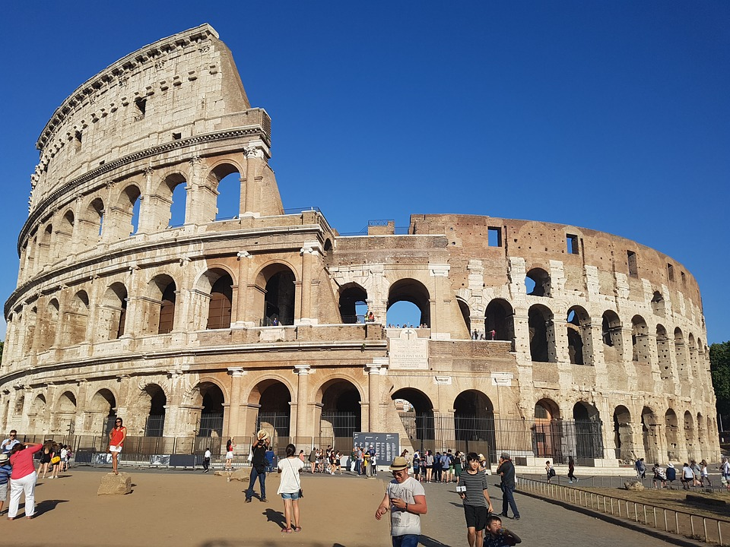
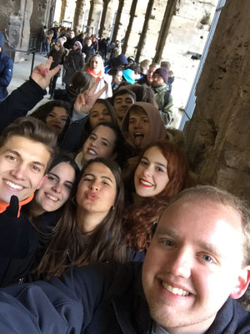
Best trips in Rome
1º Coliseum: Because it was really beautiful and we learnt a lot. There were lot of people but it was worth it because we were able to see how was the heart of the city in the past. Actually a base of the Roman society in it’s time.

Slide 3
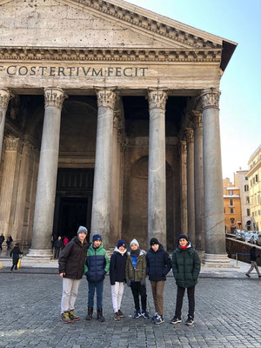
Best trips in Rome
2º The Pantheon: It was really cool because we were able to know the way of thinking in roman age in the religious way. Even though there was snow it was really cool and we were able to appreciate the monument completely. Also we learnt about the history of the pantheon itself which was really enjoyable because we saw the course of the building throw history, like the times it was destroyed, who did it...

Slide 4
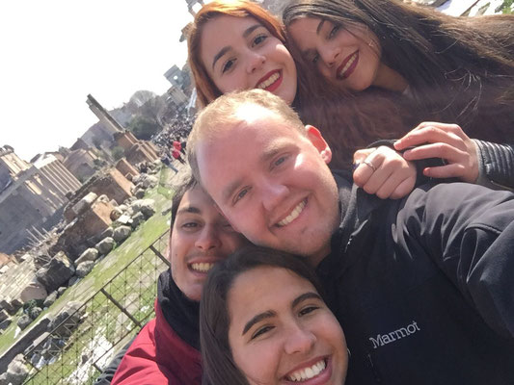
Best trips in Rome
3ºThe Forum: Though there was a lot of mud because of the snow but we could see all the forum and learn a lot about roman politics, like the way they used to work, it´s organization… So it was great fun either way. And also it was really visually beautiful because, it’s amazing how ruins can represent the history of a place and for me, that makes what could just be old rocks, something really beautiful and interensting.

Slide 5
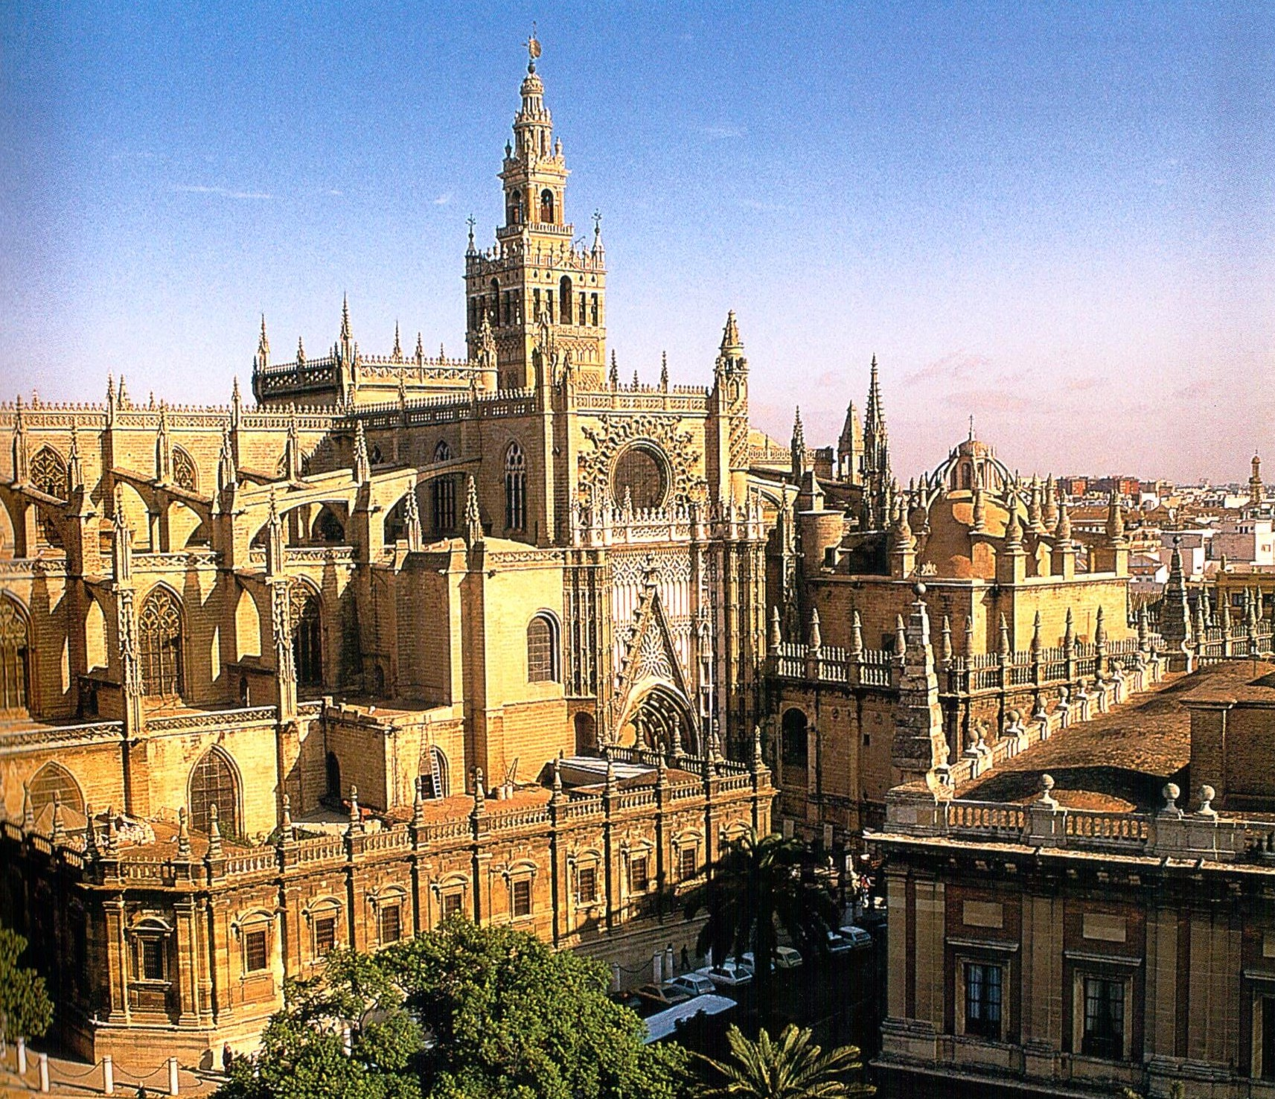
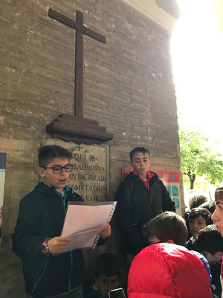
Best trips in Seville
1º Cathedral and La Giralda: I really liked the those two monuments because they were really majestic and I think they have a big meaning in the history of Seville. Furthermore above the Giralda we were able to see all the city very clearly even though it was raining and it was pretty cold outside.

Slide 6
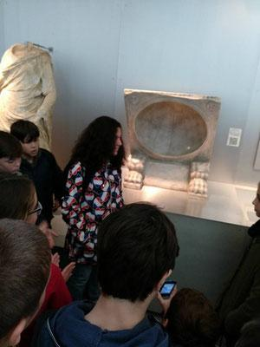
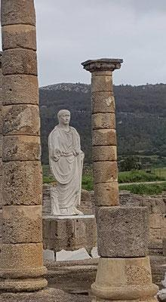
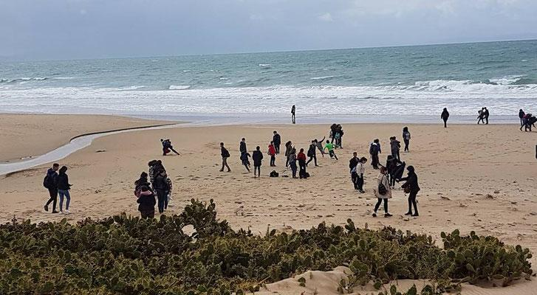
Best trips in Seville
2º Baelo Claudia: this trip showed us how great could the roman buildings be and we could learn ever more how they used to lived in those time and how advanced their society was for their era. Also we were able to see beautiful sculptures as well as enjoy the sea a little

Slide 7
Best trips in Seville
3º Carmona: Personally for me it is the best trip or at least the second because we could learn a lot and we did it playing, it was very cool because we played the role of roman soldiers attacking a castle so we learnt the way their army used to work by raiding a castle so it was an amazing experience. Also we were able to see Carmona which is a beautiful place and learn about the roman funerals.

Slide 8
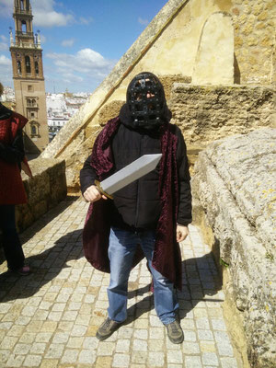
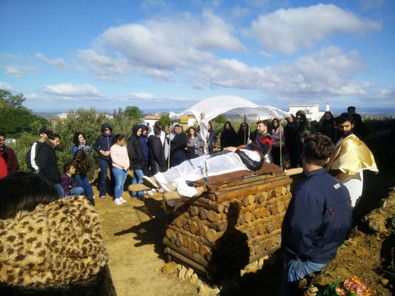

Slide 9
Opinion about the partner
In my opinion, i did have things in common with my partner and during the previous months of the trip we used to chat a lot and we really got along; but when we really met, i realized that though those things in common, crucial points of our personalities were completely opposite and that make the situation really complicated because the way we wanted to experience the project was averse.
I wanted to keep visiting the city, learn and hang out with the rest of the people in the Erasmus after the school trips and she didn’t want to, that’s why i gave her the chance to decide, if she didn’t want to be with other people she was able to stay at home so both of us were happy, so i’d like she had done the same for me, that way i could have enjoyed Rome like my classmates, she stayed at home during both mobilities so she did what she wanted, i respected that she didn’t want to do anything after the schools trips but she didn’t was empathic enough when we were in Rome to see that i wanted to be like the others and keep enjoying Rome even more.

Slide 10
Opinion about the teachers
In general, i think they did organizate things good and they were there for us. The trips were great and during them they made sure that everyone was paying attention and learning. But i also think that for example in my case the Italian teachers could have talked to my partner to solve the situation because she is their student and that would have made the experience a way greater.

Slide 11
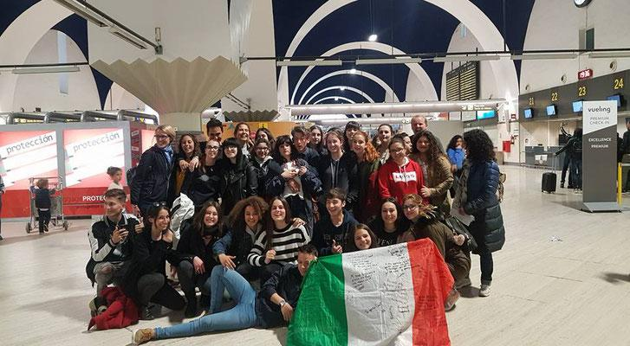
Conclusion
Though i didn’t have the bests communication with my partner and in Rome i did nothing after the school trips, i made amazing friends, with who i keep in touch and i could share a lot of nice memories and experiences with them so though the problems, i enjoyed the project a lot cause i was able to learn about an amazing city with my friends and share mine with other people who is amazing. I can’t wait to do another Erasmus project and learn about other countries and people (also i can’t wait to go to Rome again).

