Slide 1
Santa Cruz Neighborhood
MªJosé Cordero Peinado

Slide 2
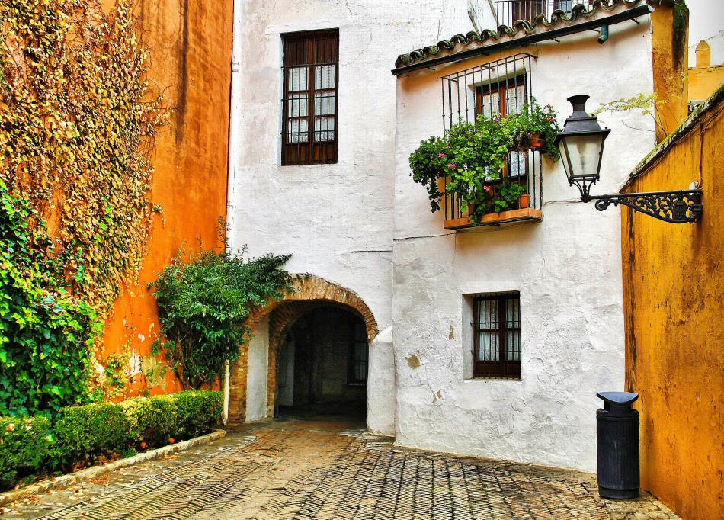
History
Its origin was the Jewish quarter, when the king Fernando III of Castilla conquered the city. He conquered Toledo first and second seville. In 1483 some Jewish people were expelled but some Jewish people and Muslims remained in the quarter. Nowadays there are many legends of the quarter,like the legend of Don Juan Tenorio.
Santa Cruz was closed, narrow and with disease outbreaks, but thanks to José Laguillo, Juan talavera Heredia and the Ibero-American,the neighborhood started its present development.

Slide 3
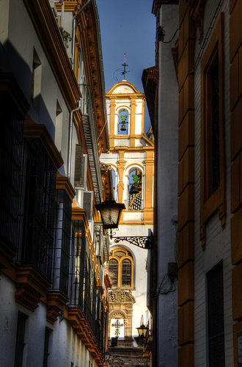
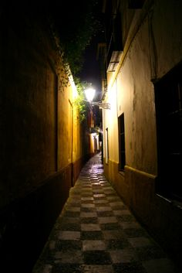
Description
It's a labyrinth formed for narrow streets and alleys to get away from the heat that ends in the squares that seem to be removed from all of the people in the center.
In this quarter there are many historical squares like the Venerables squares, its name comes from the old hospital of Venerables Sacerdotes, where the legend of Don Juan Tenorio started

Slide 4
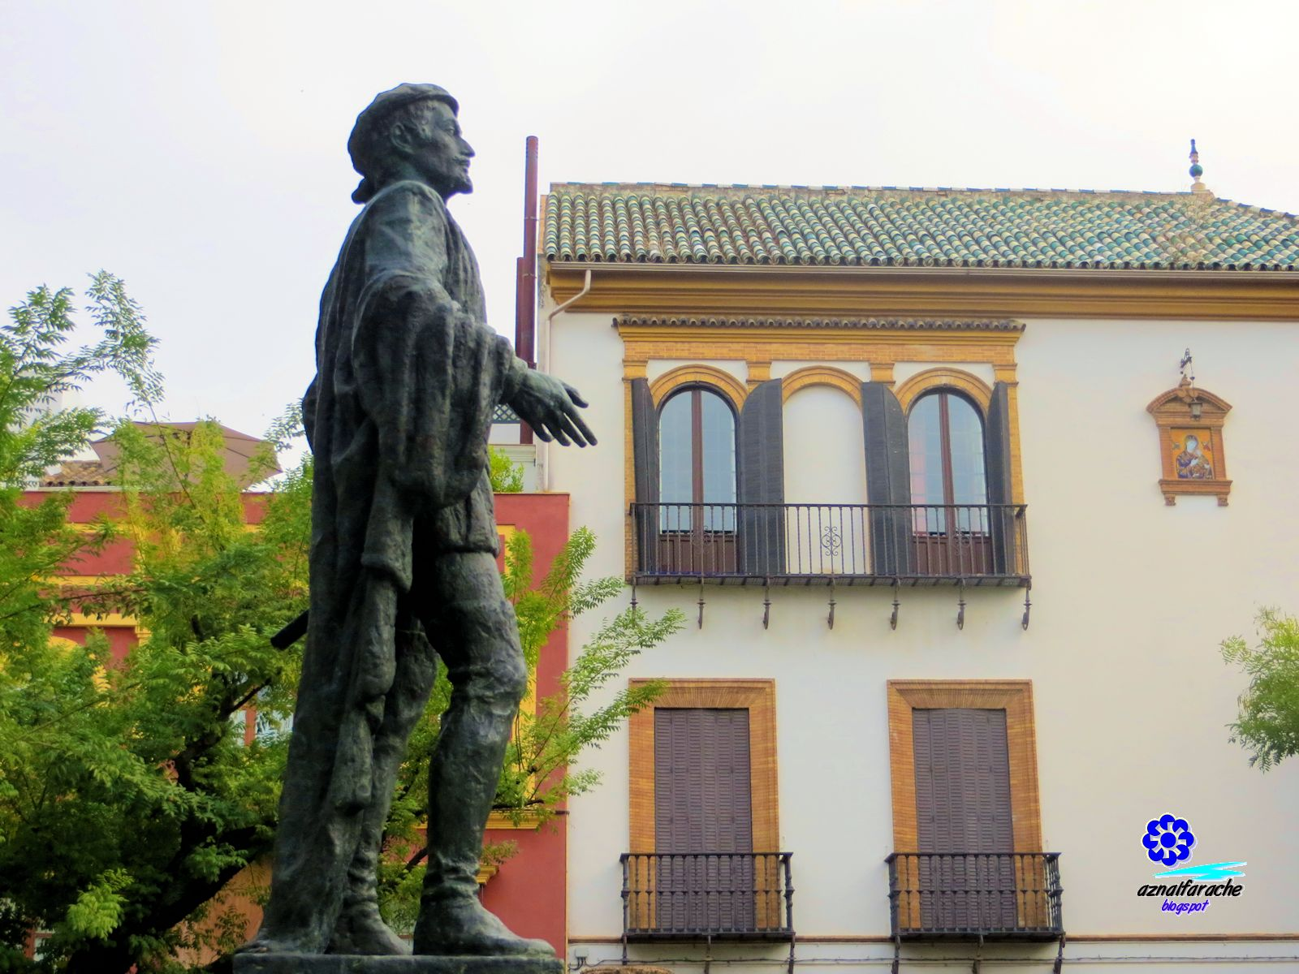
Don Juan Tenorio
Don juan was a man who flirted with woman and fought men, one day he loved that Doña Inés, he was challenged by his friend to flirt with a novice and girlfriend of his enemy. He kidnapped the novice Doña Ines and he fell in love for her unexpectedly. Ines father’s faced Don Juan. He killed the father and escaped. Doña Ines died of grief.
Don juan returned to the place of the tragedy and the spirit wanted to take to hell, but the spirit of Doña Ines saved her lover .

Slide 5
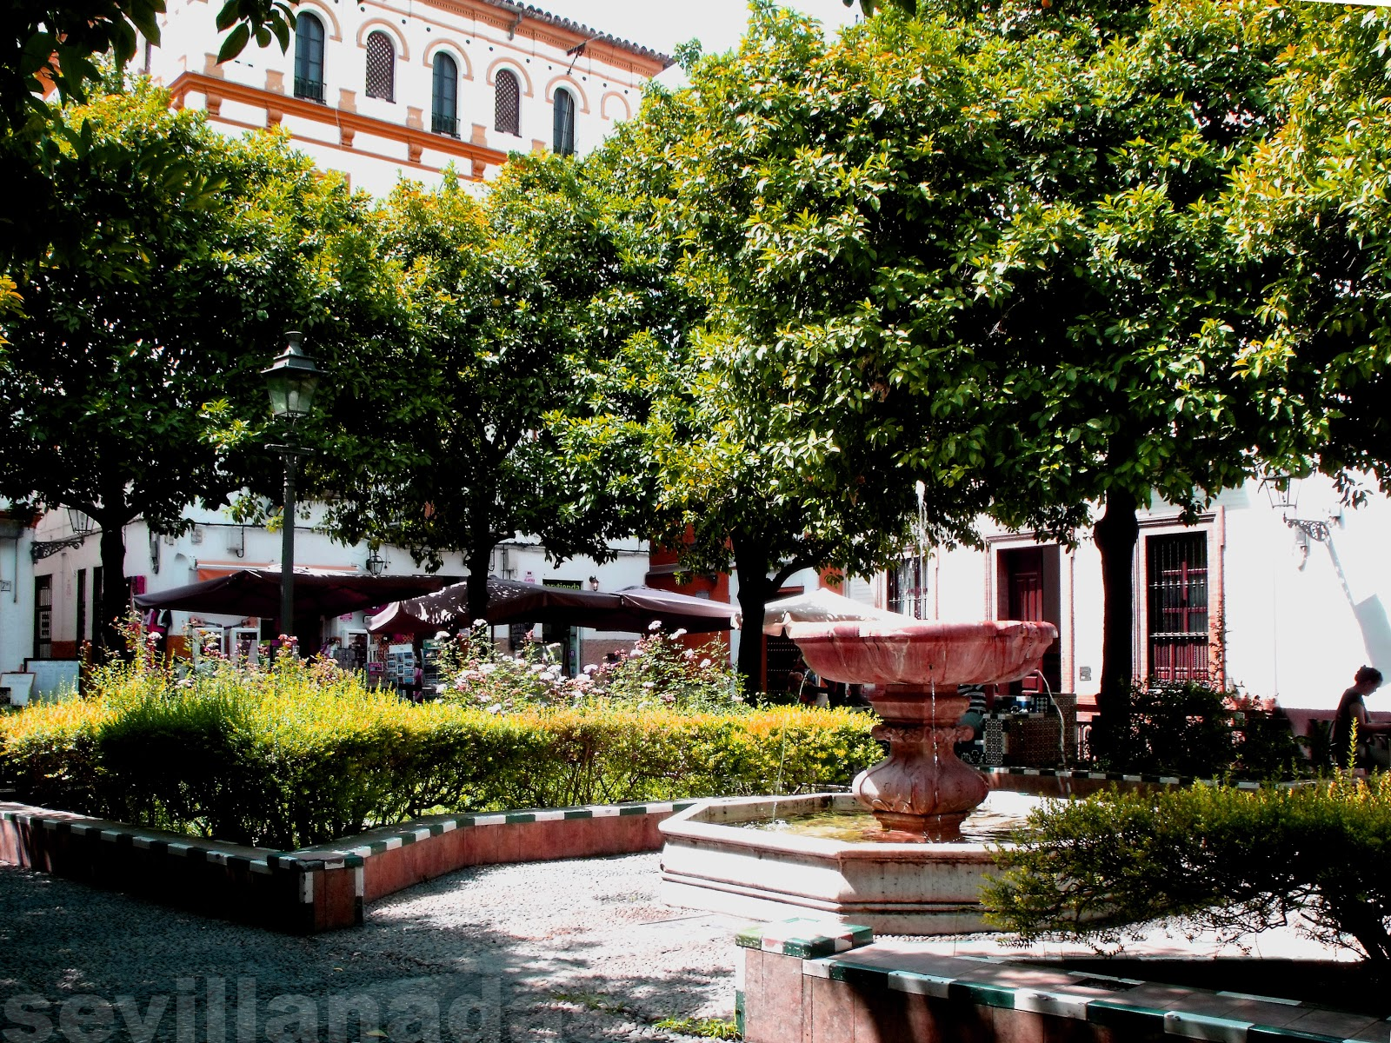
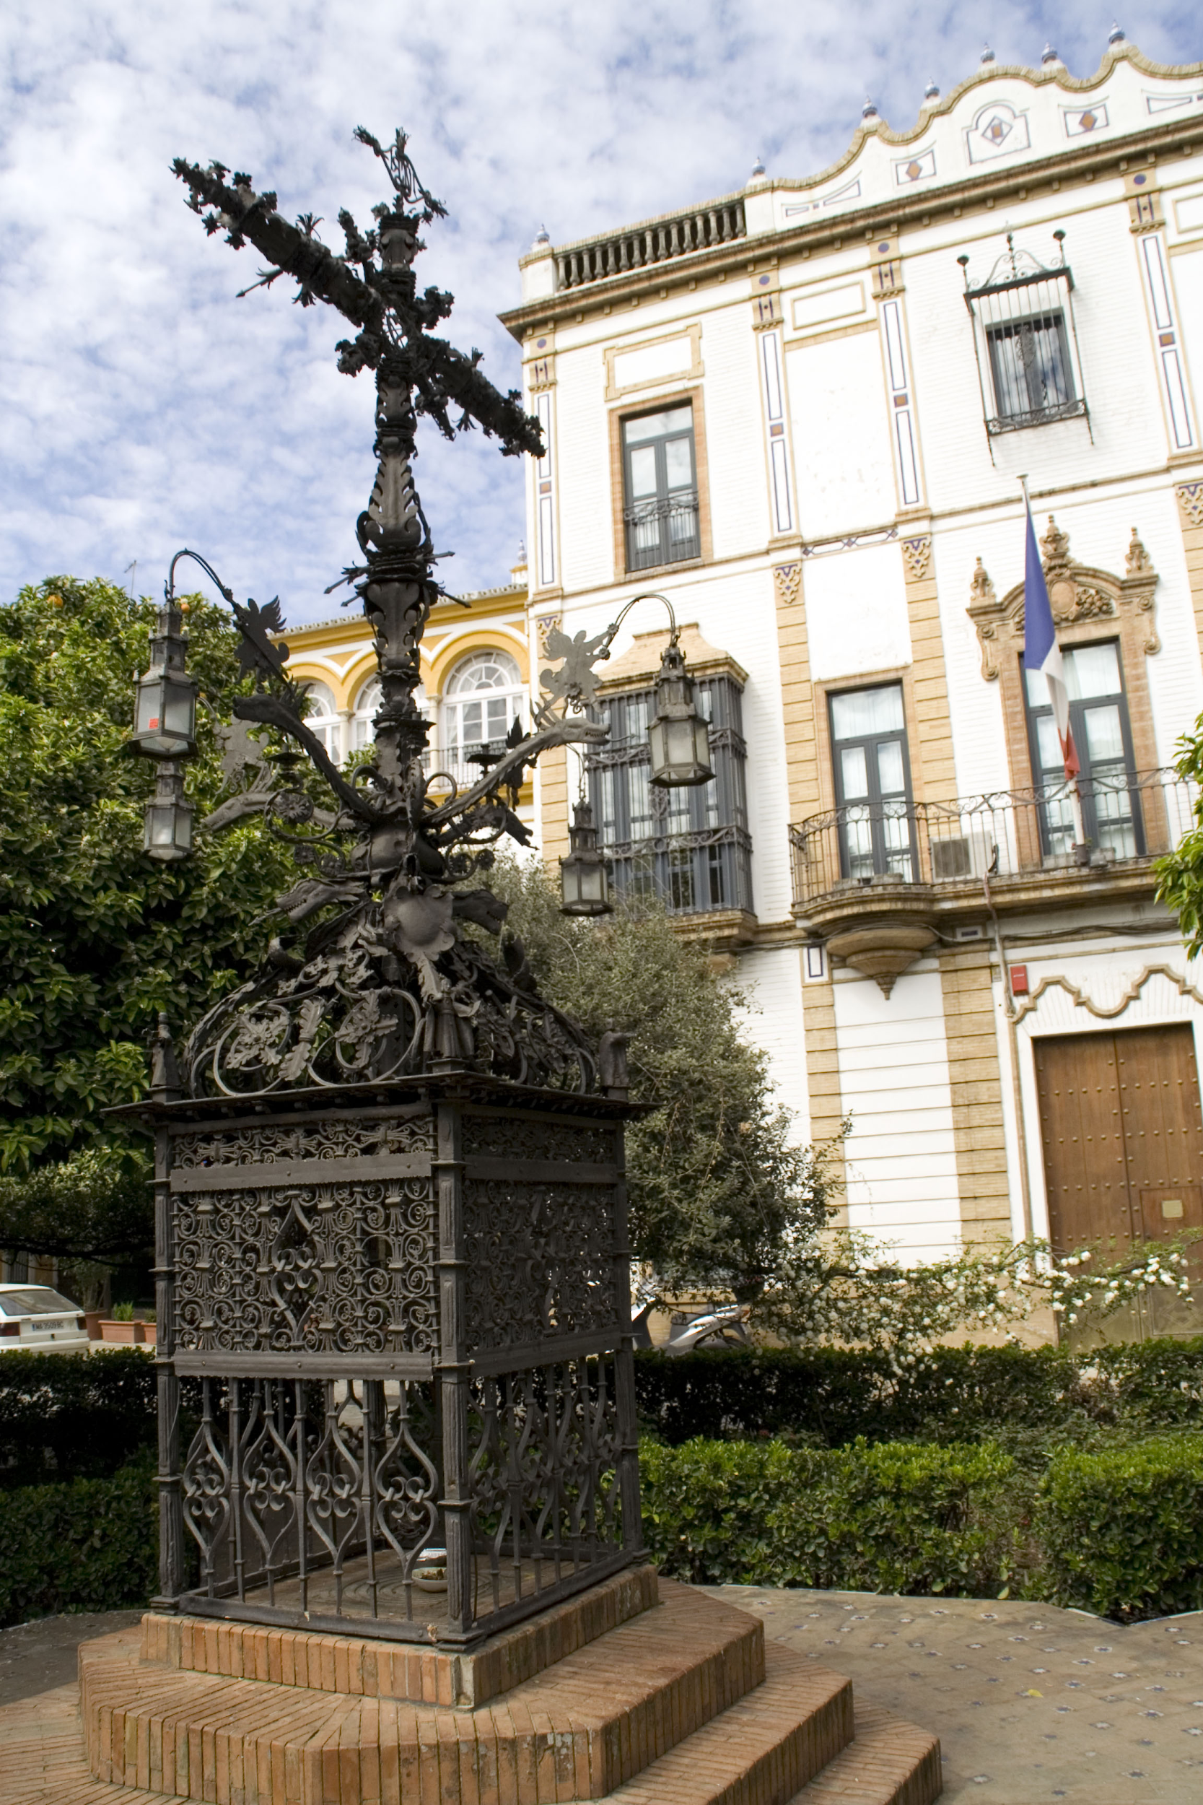
Doña elvira square isn’t very large a square, the square is included in the classic popular tour of the city. This place is where the father of Doña Elvira lived, and near here was the house of Murillo.
Plaza de santa cruz here there was a church in ruins, in the French occupation ,them they decided to demolish the church, but they did not see that under the floor of the church there were remains of Murillo.
plaza de las cruces
is a zone where the
essence of the city is,
thanks to its emblem,
this emblem are three
crosses on columns
of marble.

